Slide 1
Welcome

Slide 2

Notes:
SMC faith in development (Svenska missionsrådet in Swedish) is an umbrella organisation for churches and organisations on a Christian basis who work both in Sweden and internationally. We have faith in development, human rights and work together to end poverty and oppressive structures.

Slide 3
Our vision is for the Kingdom of God to be manifested on earth. Imagine a world free from poverty and oppressive structures, in which people can influence their own situations and where God’s creation is managed responsibly for future generations. That is what we and our member organisations work for.
Notes:
SMC Faith in Developments vision.

Slide 4
Notes:
The logos of SMCs member organisations

Slide 5
Chatham house rules
…anyone who comes to the meeting is free to use information from the discussion, but is not allowed to reveal who made any comment…
Notes:
Ask the participants what rules for the discussion that should be applied. As a compliment you can show the Chatham house rules.
From Wikipedia:
The Chatham House Rule is a system for holding debates and discussion panels on controversial topics, named after the headquarters of the UK Royal Institute of International Affairs, based in Chatham House, London, where the rule originated in June 1927.
At a meeting held under the Chatham House Rule, anyone who comes to the meeting is free to use information from the discussions, but is not allowed to reveal who made any comment. It is designed to increase openness of discussion.

Slide 6
Introduction to the tool-box​
Notes:
Introduction to the tool.
The following six slides is a clarification of the layout of the toolbox and the process you have ahead.

Slide 7
The purpose is increased
religious literacy
Notes:
The purpose is increased religious literacy, to support organisations working with a rights-based approach. These organizations may be faith-based or secuelar.
Religious literacy is needed in a world where beliefs and religious actors play a significant role in shaping values and norms in society.

Slide 8

What do we mean
by religious literacy?
Notes:
SMC’s policy on religious literacy states:
An understanding that beliefs and religious actors play a significant role in shaping society,
and our ability to relate to and work with these ideas and actors.
But first we want to introduce where we are going with this tool.

Slide 9


3 levels of religious literacy
General
Contextual
Practical
Notes:
In this toolbox we refer to three levels of religious literacy.
General religious literacy – The goal is o develop and deepened your knowledge and reflection about the role of religion in rights-based development. In this first section we also look at the role religion plays in driving and motivating our own organisation.
Contextual religious literacy – The goal is to, through increased religious literacy, strengthen your context- and actor analysis.
Practical religious literacy – The goal is to identify relevant strategies in relation to religion and religious actors.

Slide 10



Religious ideas and actors
Freedom of religion or belief (Forb)
Ourselves
Notes:
On the first general level we will investigate religious literacy from three different perspectives:
Religious ideas and actors- what is out there?
Ourselves and our identity- who are we?
Freedom of Religion or Belief (FoRB): what implication does it have on this general level?

Slide 11
Notes:
The second level is contextual.
Here we look at:
Religious ideas and actors- what is fpund in this context?
Ourselves and our identity- who are we in this context?
Freedom of Religion or Belief (FoRB) how does it effect the context, and does it set limits to the conversation and learnings we are about to have?
Note that the little symbol of the map-marker indicates the contextual level.
Already here we must flag for the necessity to already now have a specific context in mind- a real case to work with if you are going through the whole workshop.

Slide 12
How can we act in this context?
Notes:
At the third level we will look at the practical aspect of religious literacy.
We will use our insights to find strategies and plan our actions and identify what we need to learn more about.
Our analysis from the three levels come together to help us think about how we can act in this context - entry points, strategies, and learning priorities.
Note that the symbol of the hand indicates the practical level.

Slide 13
Part 1
General religious literacy
Notes:
Welcome to the first level: General religious literacy

Slide 14
Narratives change the world
Notes:
We often speak about grand narratives as a source of understanding the world. It could be the stories of the dominant ideologies like socialism, nationalism, capitalism, liberalism, individualism or even the human rights agenda. It could also be religious narratives like ”the kingdom of God”, reincarnation or the dream of the caliphate.
These are stories that have a great impact on people's lives, hopes and aspirations. Thus, we call them Grand narratives.
Discuss with the group which grand narratives that are important in their context: nationalism, socialism, capitalism, colonialism, national independence, religious narratives or other. Try to link this to events in history and context!

Slide 15
Religious literacy is the capacity for all to do a good job in a certain context.
Bilingualism is the ability to speak both the language of faith and the language of universal human rights in the same context, at the same time.
Notes:
What is religious literacy, and what do we mean by bilingualism?
Sometimes there has been some confusion around the definition of religious literacy. Particularly within faith-based organisations with multi faith staff, the concept of religious literacy has been wrongfully understood as an attempt to force a religious understanding on staff. Therefor we separate the two concepts of religious literacy and bilingualism.
Religious literacy is a professional skill needed for everybody working in a religious context- which is everywhere. If you come from a secular background, you might need practical training to gain the capacity to see religious actors or religious ideas at work in your context. Religious literacy is not about seeing only to pros of religion but to be able to understand religion for better or worse.
Bilingualism –here refers to the ability to speak both a language of faith, or theology, and a language of human rights or development. This is a capacity for people of faith in the faith-based organisations working in the field of development with a faith-based identity.

Slide 16
Language of development
Back donor
Implem-entation
Donor
Language of faith
Notes:
Bilingualism
Actors that have capacity to utilize both relevant religious language and theological awareness AND human rights language and theory, often have a higher capacity to choose among several available strategies and to navigate the context in an agile way.
But sometimes this capacity is lost.
Back donors are usually secular government agencies and use a secular language of development. This language seems to “follow the money”, creating a ”development room” where a secular language is spoken even if donors and partner organisations are faith-based. Research has shown that the secular language of back donor seems to permeate the language of cooperation. Project proposals, evaluations and reports are written in the language of secular development agencies.
Many practitioners have an experience of leaving their own language of faith outside the “development room” in an attempt to “be professional”.
If the ability to speak the language of faith is lost, one dimension in cooperation is lost. Many faith-based donor organisations are so used to tone down their faith-based identity, in communication with government bodies, that their identity is altered and the bilingualism is lost.
To regain the language of faith demands determination.

Slide 17
Notes:
The world is religious:
However, religious belonging is not a guarantee for religious literacy. Also, general contextual religious literacy is not necessarily a guarantee for ”religious fluency” in several religions. Religious fluency is like with any language – you are most fluent in your own mother tongue. If you are a Christian, you will most probably be more fluent in how Christianity potentially relates to human rights rather than in how Islam potentially relates to human rights. Important to be humble and curious!

Slide 18
Exercise
To look at religion from
an outside perspective?
Notes:
To be professional is to be religiously literate- but also to be able to try to see your own faith from the outside.
Discuss if it is a problem to talk about religion from an outside perspective.
Why are we sometimes embarrassed? What reasons are there to avoid religion as a topic of conversation?
Is it problematic for a devout believer to distance themselves from faith and try to look at it as a phenomena?
Do I carry prejudice against other’s capacity to look at their faith from the outside?
How can we have a professional attitude towards religion- even our own faith?

Slide 19
Exercise
In what situations do you relate to religious actors or ideas during a regular work week?
Notes:
In what situations and in relation to what kinds of questions do you relate to religious actors or ideas during a regular work week?
Discuss in groups!

Slide 20
An organised collection of beliefs, cultural systems and world views that relate humanity to an order of existence. Many religions have narratives, symbols, and sacred histories that are intended to explain the meaning of life and/or explain the origin of life or the universe. From their beliefs about the cosmos and human nature, people derive morality ethics, religious laws or a preferred lifestyle.
(Wikipedia)
Notes:
What is religion?
So, what is religion? That's an incredibly complicated question, and the answer will depend on whether you are asking from a theological, sociological, philosophical, cultural or legal perspective. Here is one definition
If possible, give the text as an handout and read out loud.

Slide 21
What is religion?
Spirituality
Ethics
Theology
Identity
Notes:
What is religion? Another way to look at different aspects of religion.
Spiritual- the personal level between a group or an individual, and a deity or spiritual realm
Theology – the public or shared part of spirituality or the narrative that helps us construct how we see the world- also making it possible to look at religion from the outside.
Ethics- the results of the above in values and actions
Identity- the shared collective values. Bordering politics.

Slide 22
4
Notes:
4 principles on the following four slides
What is religion?
Four principles that can help us understand religion as a societal phenomena.
These four principles seek to address some of the most common misunderstandings about religion.
(Adapted from The Harvard University Religious Literacy Project website.)

Slide 23
A difference between confessional theology and the study of religion
Notes:
A difference between confessional theology and the study of religion

Slide 24
2. Religions are internally diverse
Notes:
2. Religions are internally diverse

Slide 25
3. Religions evolve and change
Notes:
3. Religions evolve and change

Slide 26
4. Religious influences are embedded in cultures
Notes:
4. Religious influences are embedded in cultures

Slide 27
A difference between confessional theology and the study of religion
2. Religions are internally diverse
3. Religions evolve and change
4. Religious influences are embedded in cultures
Notes:
What is religion? Discuss if you agree on these statements or they need further discussion. Are they helpful in the process of developing religious literacy?

Slide 28
SMC’s view of religious literacy
Notes:
Religious literacy
General religious literacy
Contextual religious literacy
Human rights literacy in relation to FoRB.
Practical religious literacy
For SMC…
General religious literacy: the general understanding and acceptance that religion is an important factor in all social development which needs to be brought into the equation without either exaggerating or diminishing its importance as a factor. It is also about having religious knowledge. What are the basic tenants of relevant religions or the basic traits of non-religious world views?
Contextual religious literacy: bringing your religious literacy into the context where you are positioned? What are the basic religious/faith tenants of the religious groups where you are situated? What are the different nuances in religious practice? Who are the religious groups around you and what are their internal and external relations to other societal actors? What religious or non-religious ideas are important for people in general and how do they influence their behaviour and their relations with each other? Are there power dynamics that come into play? How does religion and other social phenomena such as e.g. culture, tradition, politics or ethnicity interact in what is happening in the context? What forces are instrumentalized by whom and for what purposes?
A contextual religious literacy will demand analysis of the context; it’s actors and of your own organization and it’s religious or non-religious identity in relation to all of this.
FoRB and human rights literacy: having a correct basic understanding of what rights FoRB gives to individuals and religious organisations (FoRB is often a very misunderstood universal human right) and whether the context you are situated in actually allows for freedom of thought, religion and conscience? I.e. to what extent can religious, non-religious actors and individuals actually operate freely? Are there agents in the context that abuse FoRB and the language of FoRB to promote their own agendas? How does the status for FoRB in the context affect other human rights – government restrictions and social conflict?
Practical religious literacy: the ability to practically apply general and contextual religious literacy in the context where you are working.
- Practical know how on e.g. human rights based interreligious dialogue and cooperation
Development and application of suitable strategies: Depending on your organisational identity, contextual analysis and your goals you might come to different conclusions as to what is the best strategy moving ahead. Taking such strategic decisions intentionally and developing the right method and practice as a result. We will come back to those strategies later. Key message here: without religious and FoRB/HR literacy it is more difficult to make informed and intentional choices and monitor their impact.

Slide 29
"Why do we need religious literacy?"
"What are the arguments?"
Notes:
So now, let us dig deeper into general religious literacy
So, what does the world look like and why do we need religious literacy?
What are the arguments?
The world is religious! Religion is an important factor in all social development which needs to be brought into the equation without either exacerbating or diminishing its importance as an actor. Religion affects humans, groups, societies, communities and our relationship to the rest of nature – in all countries.

Slide 30
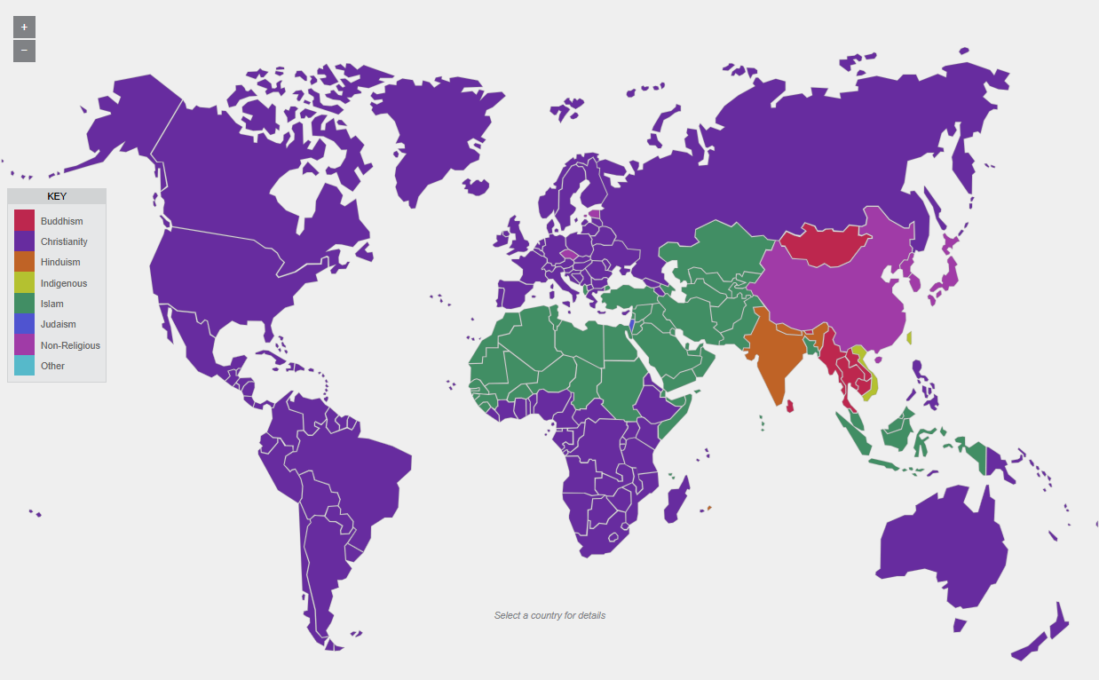
Notes:
The world is religious
The Conventional Picture. But it does not really say a lot…..
Interactive map with religious affiliation http://d3tt741pwxqwm0.cloudfront.net/WGBH/sj14/sj14-int-religmap/index.html
Data från Pew 2010

Slide 31
2025
85%
Notes:
The world is religious
Percent of the world’s population that define themselves as adhering to a religion.
This is maybe obvious in many countries, but not in Sweden.
When saying that the world is religious it is important to consider who is making the definitions.
To what extent does self-announced religious affiliation actually have impact on people’s everyday lives in different contexts?
What does it mean to consider one-self as Christian in Sweden compared to China?
Does it matter if it is the state or another external actor that defines one’s religious identity or if it is the individual?
Does everyone have the right and the real possibility to state what religion or world view they adhere to?
Keep these questions in mind as we proceed.
Source: ”The Changing Global Religious Landscape” PEW Research Center, 2017

Slide 32
2025
2060
85%
87%
Notes:
The number of persons affiliated with a religion is expected to increase. Mostly because populations in countries with strong religiosity have greater population growth. (Pew Research Centre)

Slide 33
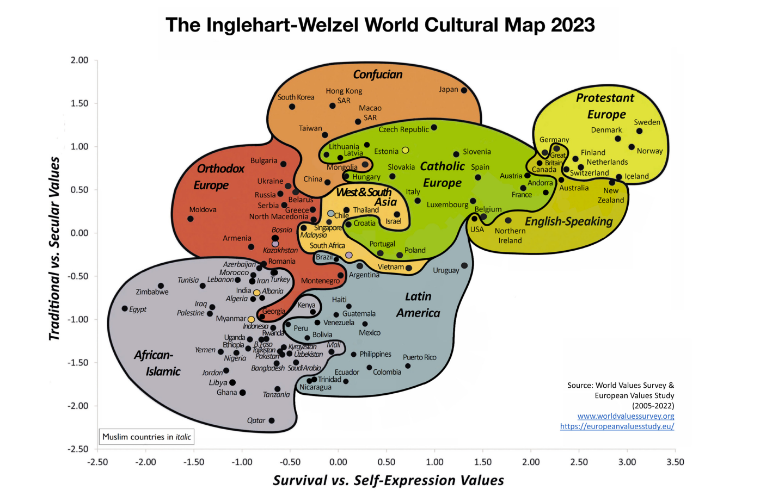
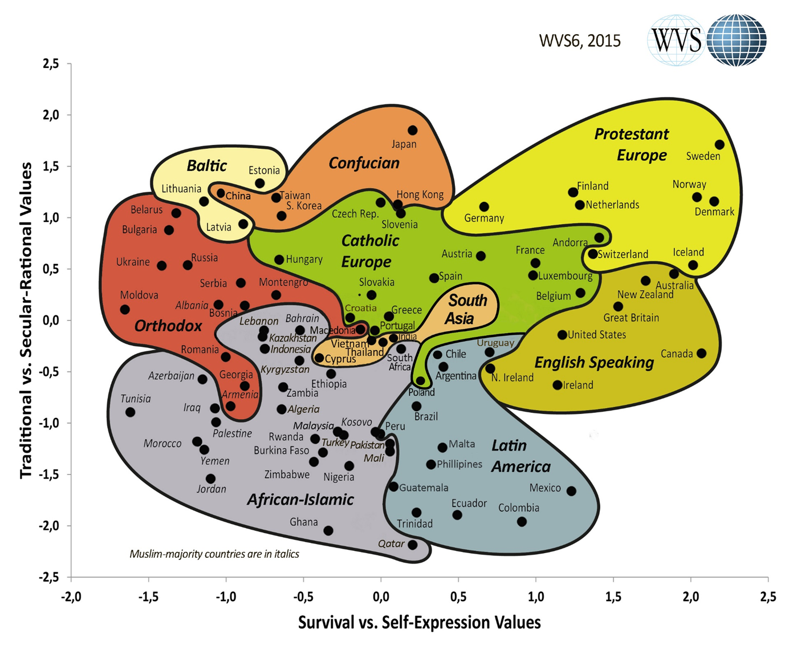
Values matter
Notes:
Why is religious literacy important?
Values matter.
Global development and the human rights agenda is based on values. Swedish development cooperation is, just like any other county’s, based on values. What are the grand narrative behind these values?
People's values are shaped by the narratives trough which they interpret the world. Religion provides the “grand narratives” for many people around the world.
The cultural map as presented by the World Values Survey would probably illustrates this variation between the values that are at work in different parts of the world. Note that Sweden is places in the upper right corner, as the most secularized and least traditional country in the world. What can we learn from this map as we discuss the importance of religion from a Swedish perspective.
It is a large probability that an average Swedish person does not see the importance of religion and therefor lacks in religious literacy.
However, the reality is much more complex which was shown in a recent study by a Swedish scholar (David Thurfjell, The godless people). Two things are worth mentioning:
The Swedish secularisation process might be slightly exaggerated, as this is told in a context influenced by the anti-religious and political circles, where we can trace a “religious illiteracy”.
There is an ambiguity in secular post-Christian Swedes’ way of speaking about religion and themselves; there is a discrepancy in what post-Christian Swedes actually believe and the idea they have about themselves.
In conclusion: even though secularization has gone far in Sweden, the image of Swedish society as a “de-christianed” and secularized country is being greatly exaggerated.

Slide 34
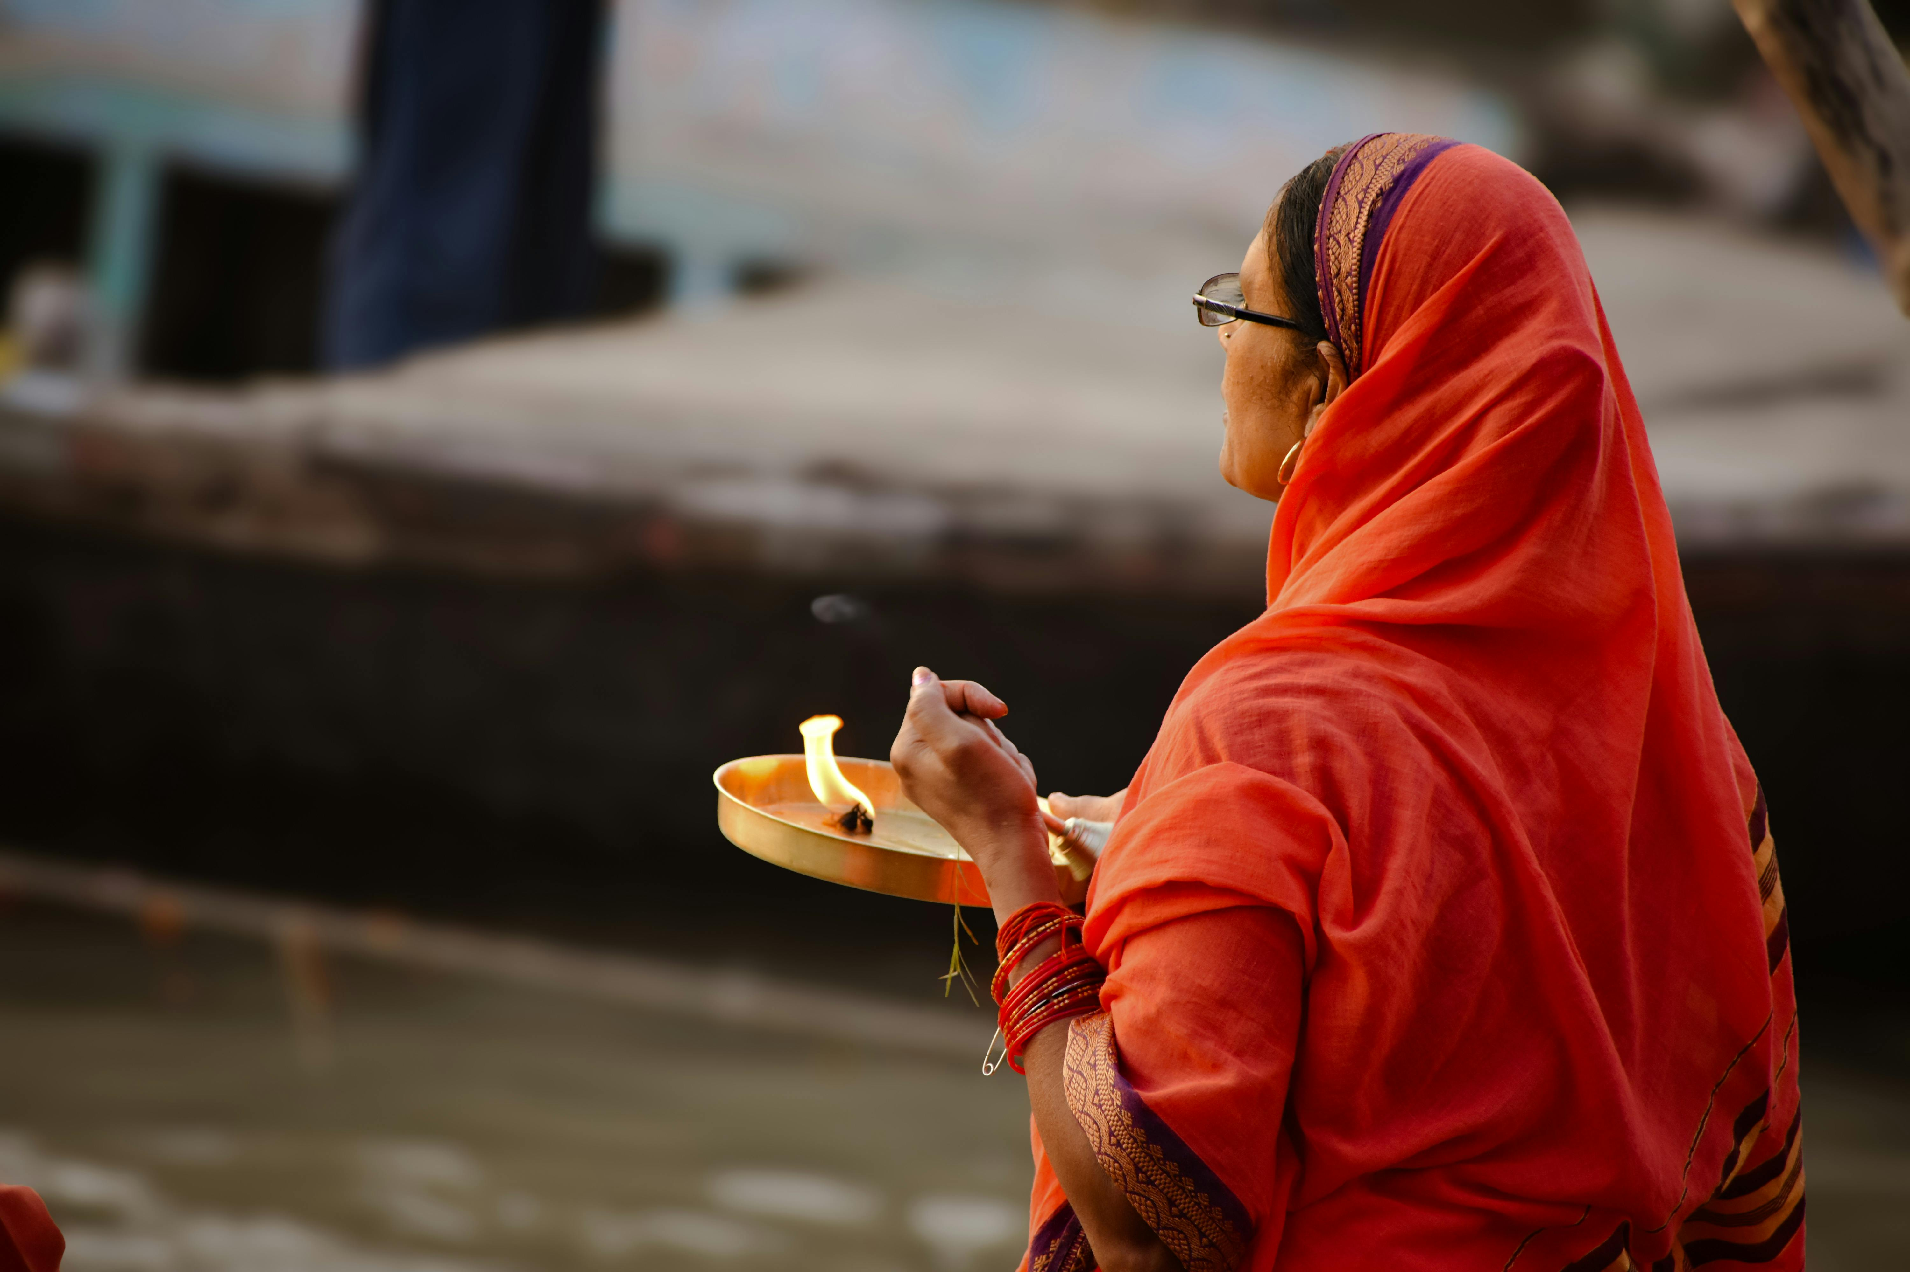
The world is complex
…and religion and identity are complex
Notes:
Remember that people more often than we think have Multiple identities
In reality, individuals might identify themselves as having many different worldviews or religions. In Sweden there is recent research showing that Swedes increasingly construct their religious identities from a number of different religious and non-religious sources – not always being coherent with each other.
People are not always as intellectually reflected in their faith as essentialist religious definitions would have it Religion is a complex phenomena in itself – one definition of religion will not suffice.

Slide 35
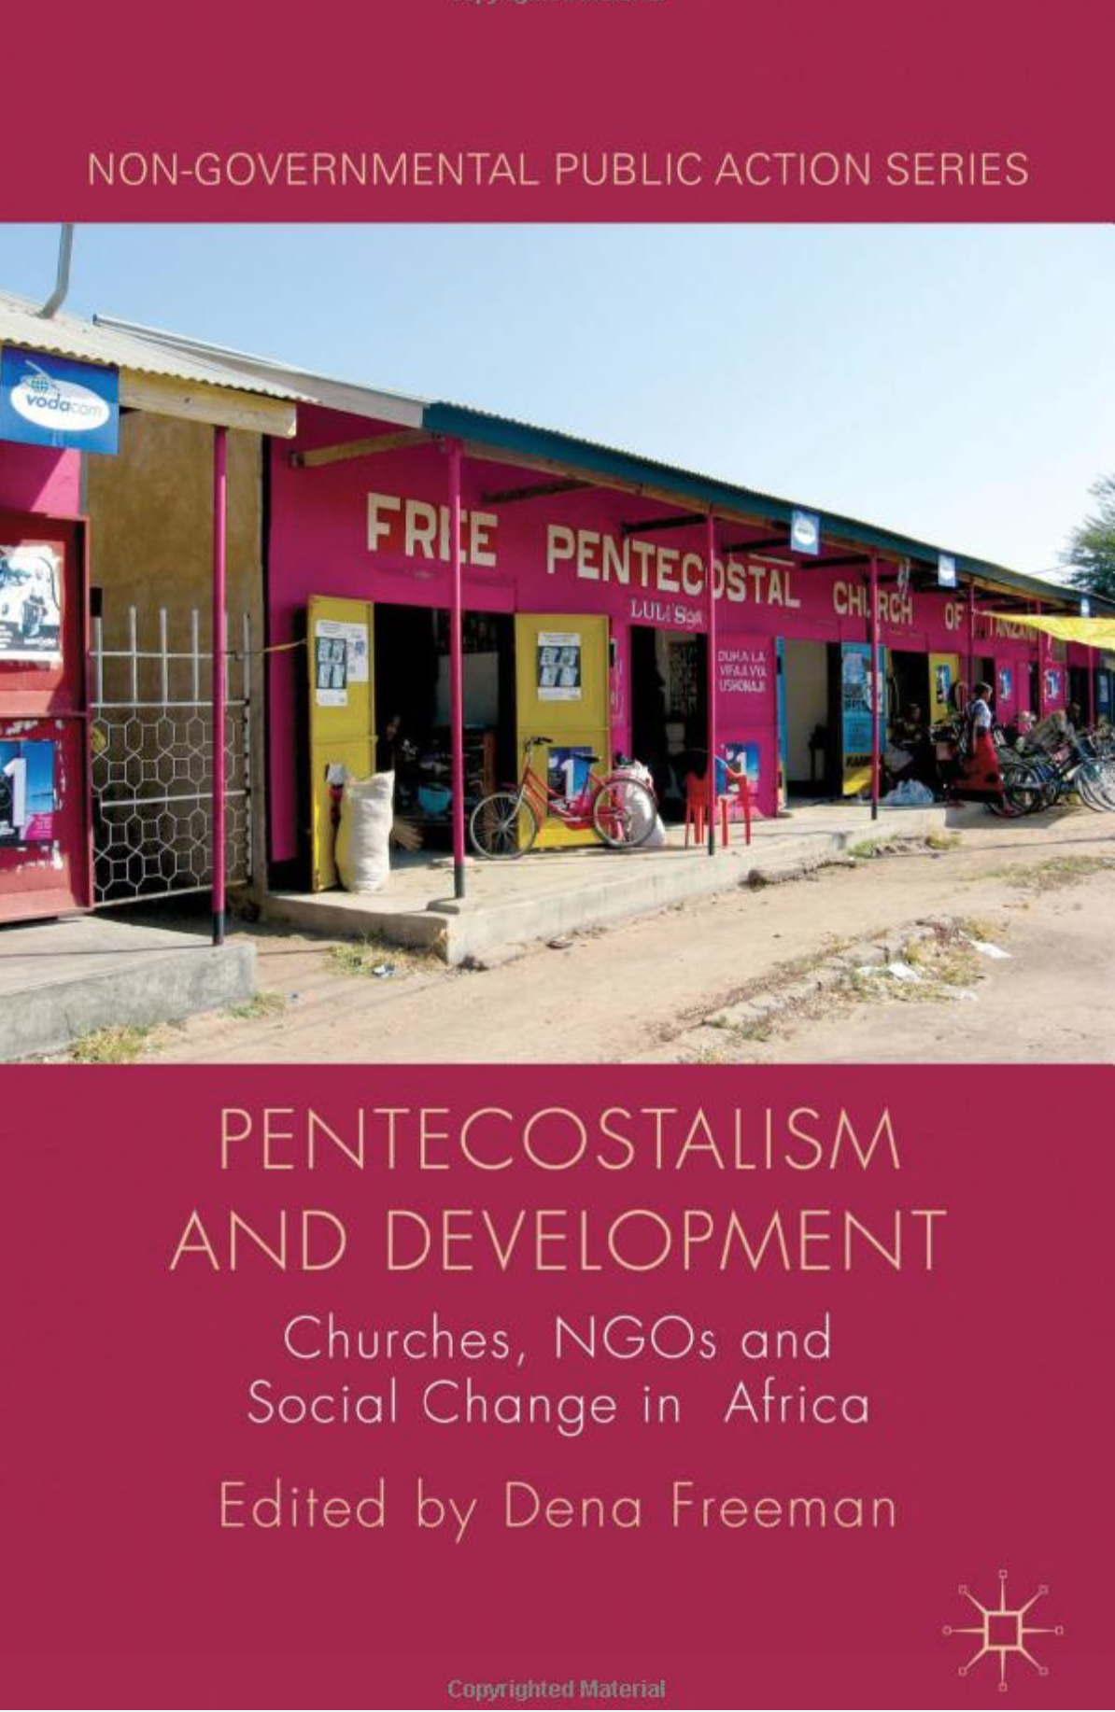
Religion motivates
Notes:
Religion motivates people (and societies) to change. It strengthens resilience and is a strong contributor to a sense of purpose.
Three examples:
Truth and reconciliation commissions that are often led by religious leaders.
Religious actors are often in the forefront of conservationist ambition as they offer a language of sanctity concerning the environment.
“Pentecostal churches are often rather more effective change agents than are development NGOs…they are exceptionally effective at bringing about personal transformation and empowerment, they provide the moral legitimacy for a set of behaviour changes that would otherwise clash with local values, and they radically reconstruct families and communities to support these new values and new behaviours. Without these types of social change…it is difficult for economic change and development to take place” (Freeman p.3).

Slide 36
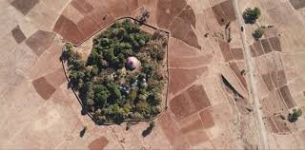
Faith can provide a narrative and ethos that has an impact beyond science or policies
Notes:
Religion motivates people (and societies) to change. It strengthens resilience and is a strong contributor to a sense of purpose.
Three examples:
Truth and reconciliation commissions that are often led by religious leaders.
Religious actors are often in the forefront of conservationist ambition as they offer a language of sanctity concerning the environment.
“Pentecostal churches are often rather more effective change agents than are development NGOs…they are exceptionally effective at bringing about personal transformation and empowerment, they provide the moral legitimacy for a set of behaviour changes that would otherwise clash with local values, and they radically reconstruct families and communities to support these new values and new behaviours. Without these types of social change…it is difficult for economic change and development to take place” (Freeman p.3).

Slide 37
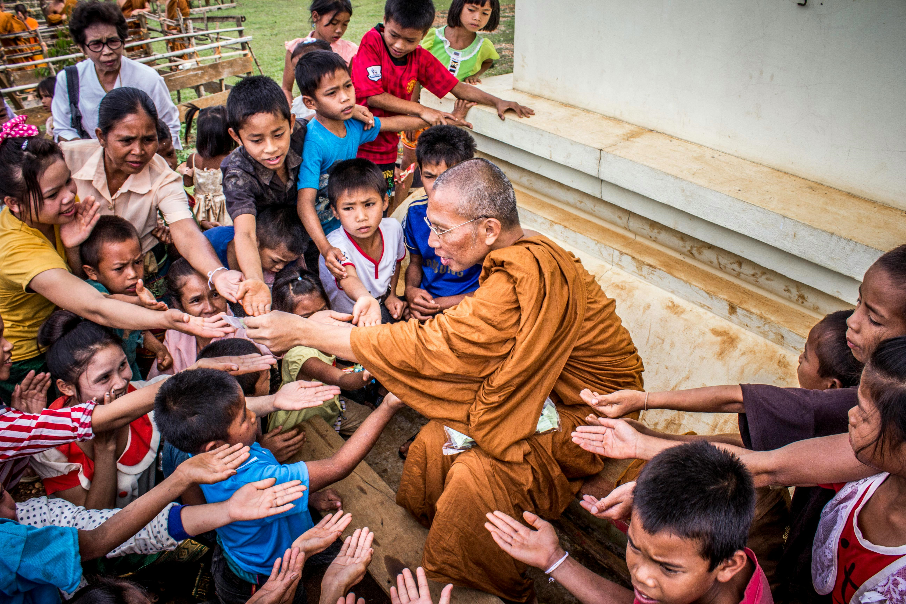
Faith-based
Actors have...
Notes:
Faith-based actors have legitimacy, networks, reach, efficiency, long term presence
Religious actors have legitimacy, networks, reach, efficiency and long- term presence.
E.g. health and educational institutions on a religious basis – ranging from health centers in Uganda to qualified madrasas in Pakistan
First responders within humanitarian work (e.g. the earthquake in Nepal – see picture)
Can be strong advocacy actors through contacts at the grassroots level and access to political decision makers ands strong international networks.
Buddhist monks from Kopan monastery after the earthquake in Nepal 2015

Slide 38
Change from top to bottom
Structural issues
Individual issues
Change from bottom to top
Notes:
Why do religious actors act the way they do? Religious literacy helps us to understand some of the underlying ideas that form the action of faith-based organisations.
A part of religious literacy is to understand how theology and social action are interlinked. Different faith groups chose totally different approaches to societal change. This is often based in their theology. In the Christian tradition this goes back to the different approaches to the government that different church-traditions have taken over history.
The slide refers to two axels where a top-bottom or bottom-top approach to societal change is taken, and where the focus on change is either on the personal or the collective/societal. Different religious groups could be placed differently in this graph.

Slide 39
Religion and gender
Who have access to power trough religious organisations?
Who are the followers and believers?
Do you have examples of conflict between FoRB and gender justice?
Notes:
Some questions:
Who have access to power trough religious organisations?
Who are the followers and believers?
Do you have examples of conflict between FoRB and gender justice?
These questions are not easily answered. The question about religion and gender-relations is extremely complex. Religion has a great impact on power structures concerning gender. It was also in tackeling issues of gender equality and sexual and reproductive health and rights, that the development actors first identified the need to involve religious actors in their work.
You will come back to issues about gender and religious actors when you start looking into contextual religious literacy.

Slide 40
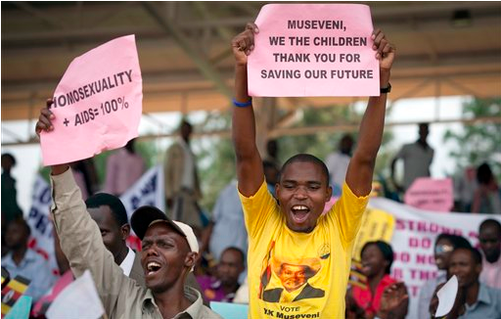
For better,
for worse...
Notes:
Sometimes we say: There is religion. There is bad religion. And here is very bad religion.
There are numerous examples of religious actors having a negative impact on development or human rights. It takes some religious literacy to understand the complex relation between politics and religion. The picture from Uganda shows where the government, supported by religious actors, have pushed for stricter anti-LGBTI legislation. Religious literacy is needed to understand how religious groups often have a complex political agenda, different from a traditional right-left agenda. Some religious actors are very radical on social justice but conservative on women's rights etc.
You may also find different opinions within the same religious body.
The role of religion in conflicts is often debated. There are examples of religious actors promoting a conflict, but there are also many examples of conflicts emerging from socio-economic or political causes, but for many reasons taking on a religious façade.

Slide 41
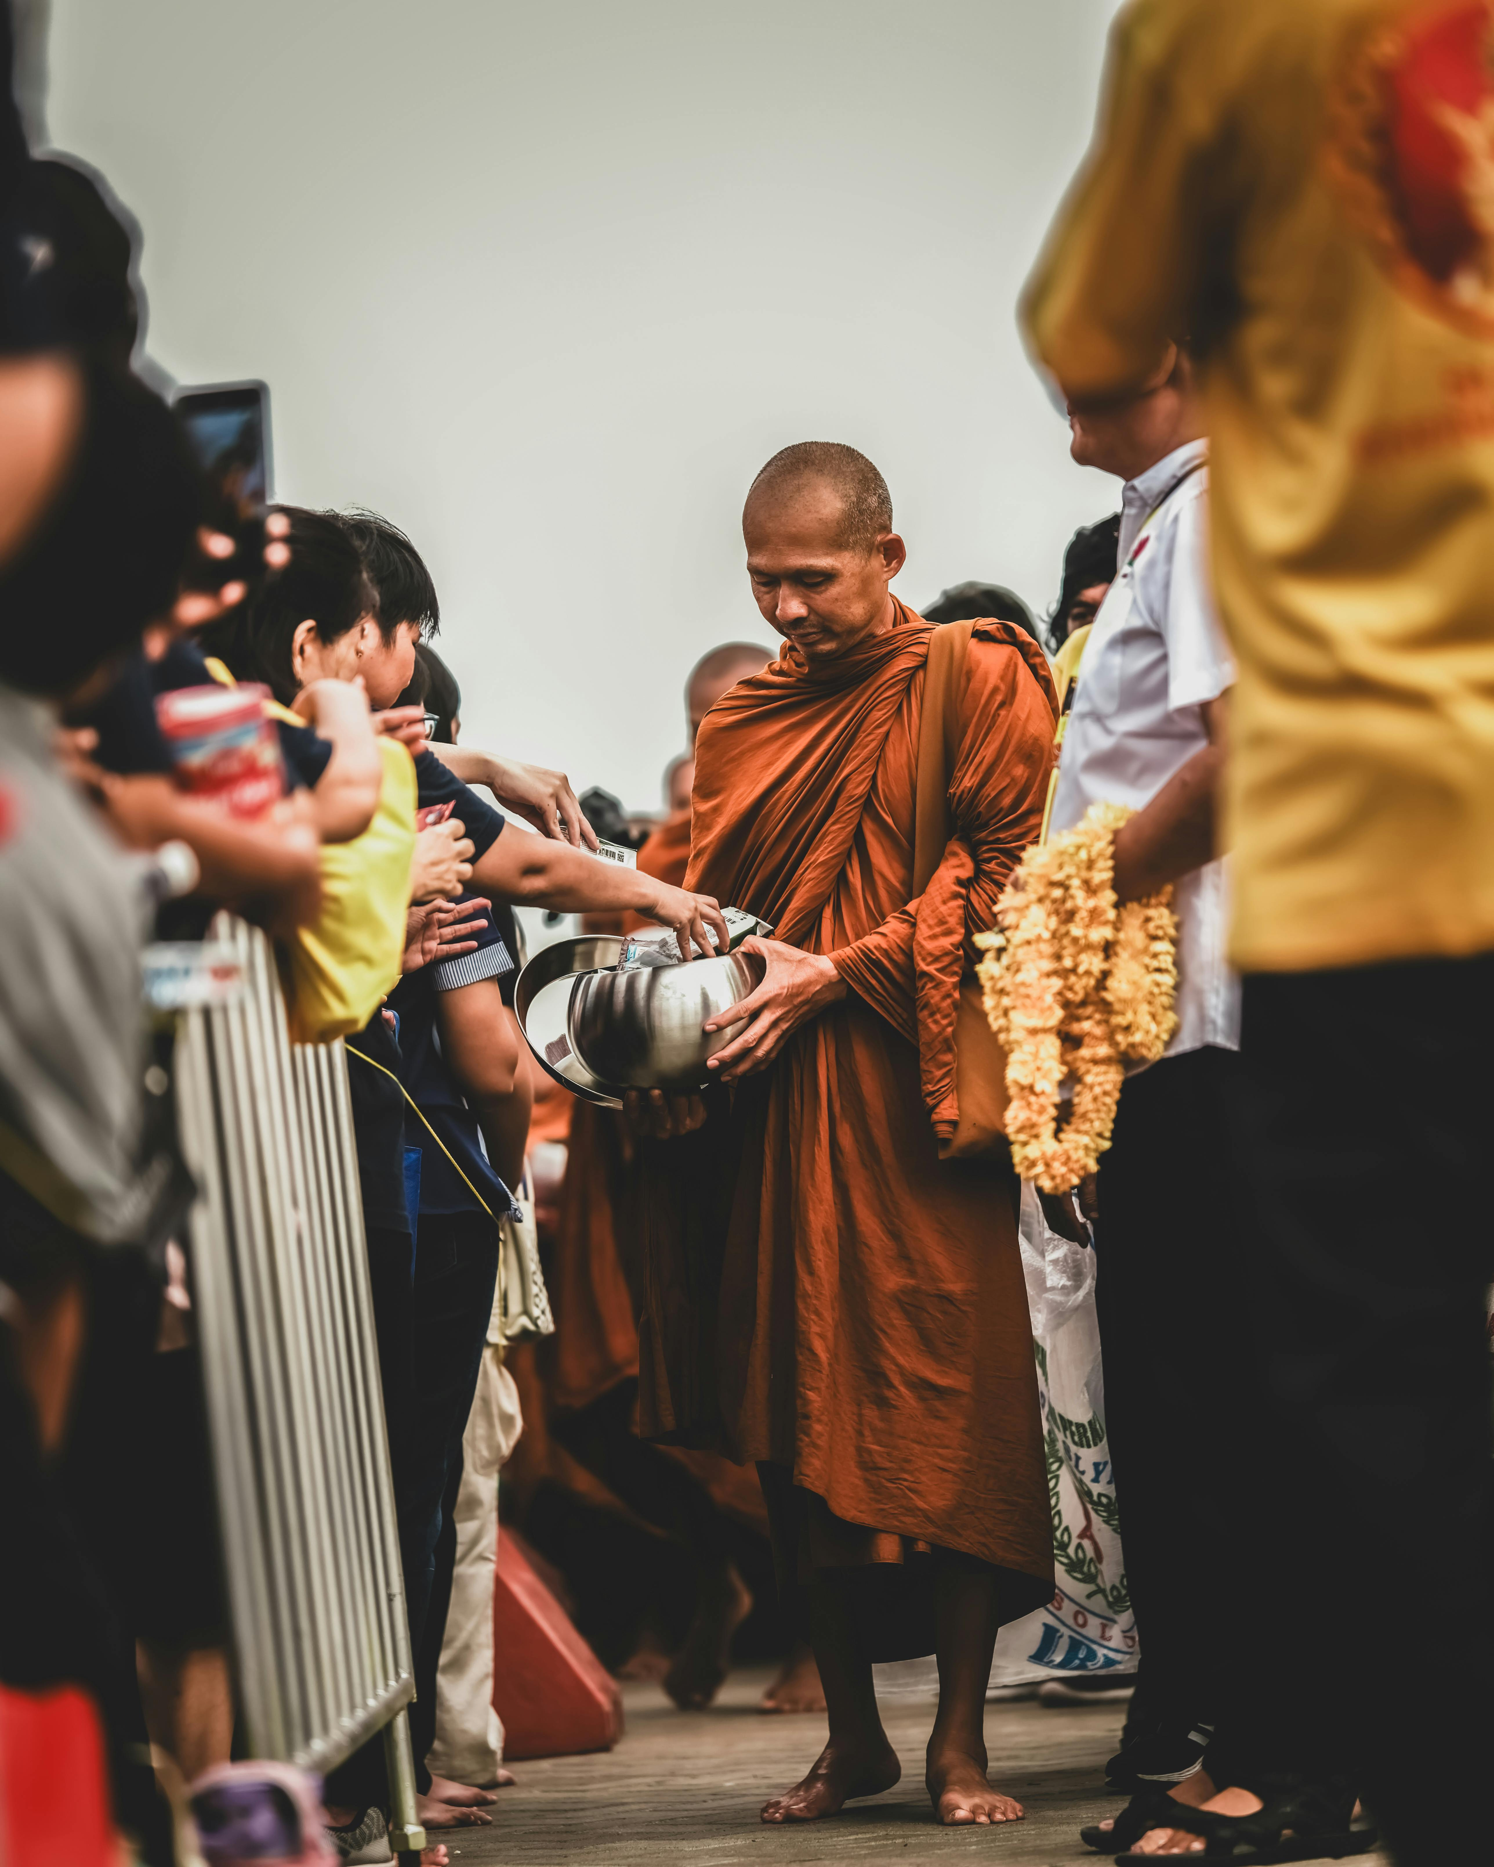
Instrumentalisation
Who owns the agenda?
Notes:
Is there a risk in instrumentalizing religious actors for an agenda formulated by a back donor? One example is when faith-based actors have been rather keen to underline their own “added value” in development work, for example their reach and access to grassroots communities. Back-donors have seen religious actors as “easy”, effective and cheap instruments for a certain agenda. This means that these back-donors have not totally understood the complex nature of faith-based actors.
Can you think of examples of this in your own context?
Can you think of examples where an actor, on the receiving end of a project, have adapted to the language and value-driven agenda of the back-donor in order to obtain funds?
Instrumentalization must be problematized. Religious actors cannot be seen as just messengers or instruments for a development agenda. Religious actors have their own agenda, in their own right.

Slide 42
It is time to take a look at ourselves and our identity
Notes:
Now it is time to start looking at who we are ourselves on this general level of religious literacy!

Slide 43
Secular or Faith-Based?
Notes:
What about us? Are we religious?
So, we have established a case for the world being religious, and that engaging with religion is important for social change.
Now we move onto the second part of general religious literacy.
Again this ‘traditional distinction’ might not be very helpful, as our reality is often far more complex.

Slide 44
Sider and Unruh’s FBO typology
1. Faith-permeated organisations
2. Faith-centred organisations
3. Faith-background organisations
4. Faith-secular partnerships
5. Secular organisations
Notes:
Organisational Typologies
Ronald J. Sider & Heidi Rolland Unruh, “Typology of religious characteristics of social service and educational organizations and programs”, Non-profit and voluntary sector quarterly 33, no. 1 (2004): 109-134.
1. Faith-permeated organisations, the connection with religious faith is evident at all levels of mission, staffing, governance and support.
2. Faith-centred organisations were founded for a religious purpose, remain strongly connected with the religious community through funding sources and affiliation, and require most staff to share the organisation’s faith commitments.
3. Faith-background organisations tend to look and act secular, although they may have a historical tie to a faith tradition.
4. Faith-secular partnerships present a special case in which a secular (or faith-background) entity joins with one or more congregations or other explicitly religious organisations.
5. Secular organisations have no reference to religion in their mission or founding history.

Slide 45
Typologies within the SMC network
Church/denomination
Social/diaconal branch of Church
FBO based on one person’s vison
Christian foundation but HR in praxis
Christian values expressed through HR
Notes:
Typologies found within the SMC-family.
It is a little bit different than the typology mentioned above.

Slide 46
IDEA model
Declared identity:
WE SAY
Experienced identity:
WE FEEL
Attributed identity:
THEY SAY
Notes:
IDEA
Identify
Declared
Experienced
Attributed
One helpful way of thinking about organizational identity is to break it into three parts:
What we officially say about the organization in policies, websites, constitutional documents, strategic plans etc.
What we experience working in the organisation - how is it in reality!
What others say about the organization? Who do they perceive that we are? (rightly or wrongly … “facts are facts, but perceptions are reality!”)
What different answers will we get if we ask about whether we are religious or secular, or about what drives and motivates our organisation?

Slide 47
IDEA model
Who are we in reality?
Declared identity:
WE SAY
Experienced identity:
WE FEEL
Who do we
say we are?
How do we want to be perceived?
Attributed identity:
THEY SAY
Who are we in the eyes of others?
Notes:
Here with the questions!

Slide 48
Common enemy
Faith
Unmet Rights
Motivations?
Ideology
Common Interest
Security
Solidarity
Political mandate
Concern about vulnerable groups
Notes:
What drives our organisation? Let the participants respond to the suggested words! Should there be other words on the list?
There are many different factors which can motivate people within organisations. Faith is one possible motivator. We are probably motivated by more than one factor.
What about your organisation?
This is what we will explore through the model.

Slide 49
Discuss in organisation groups
Who do we say we are?
How do we want to be perceived?
Declared identity:
WE SAY
Experienced identity:
WE FEEL
Who are we in reality?
Declared
What do we express in our formal documents and our outward communication?
What typology would we use to describe us based on our formal documents and outward communication?
Experienced
How do we experience ourselves?
What typology would you use to describe the organisation?
Notes:
Exercise
Internal perspective:
Collect responses to each of the different parts of the IDEA model on separate large sheets of paper (A3 or bigger)

Slide 50
Discuss in organisational groups
Who are we in the eyes of others?
Attributed identity:
THEY SAY
Attributed
How do others perceive us? How have they described our organisation? Do they perceive us as religious?
Which FBO type would they assign to us?
Notes:
Exercise part 2 What drives our organization?
External perspective:
- continue on another sheet of paper

Slide 51
Putting it together
Declared identity:
WE SAY
Experienced identity:
WE FEEL
Attributed identity:
THEY SAY
Notes:
How close do the 3 sheets correlate with each other?
When we look at the three rings, how well do they fit together and in what way do they differ?
What does this reveal to us about and our religious identity?
How well do we understand our religious identity? Is this something we need to work on further?

Slide 52
Is it the staff?
Is it in your policy?
Is it the Board?
Who is the guardian of your identity?
Is it the Secretary General?
Is it the members?
Notes:
This is a different viewpoint than the IDEA-exercise. Discuss in groups, who is the owner, guardian or keeper of your identity? How is it in reality? How would you like it to be?

Slide 53


Exercise
Notes:
Organizational anecdotes…
Let's go back to the importance of stories! What narratives does your organisation carry to describe your identity? Share stories that you love to share to describe your organisation! As you identify these stories: who shares them normally? Who is the owner and the carrier of your identity? These stories might say more about your organisational identity than any policy or mission-statement.

Slide 54
Exercise
Discuss: Multi faith staff
Describe the situation in your own organisation
How do you make use of this asset?
What is the relationship between multifaith staff and organisational values?
Notes:
Many organisations have staff from different religious backgrounds. Are staff with different religious backgrounds or no religious beliefs, seen as an asset in religious literacy? How are their experiences used?
This is maybe a sensitive issue in your organisation?
Does this relate to FoRB issues?

Slide 55
What is FoRB?
Notes:
Now we move onto the third part of general religious literacy - the importance of freedom of religion and belief. FoRB or lack of FoRB sets the limits to how free we are to talk about religion and development. Limitations in FoRB might affect the whole outcome of the discussion. As a facilitator you must of course be aware of such limitations in your group and context.
https://www.forb-learning.org

Slide 56
Why is FoRB important?
Notes:
We need freedom to talk about religion and values…

Slide 57
Religious Actors, FoRB and Social Change
Notes:
The extent to which FoRB is realised or not in a specific context, effects the ways in which religious actors cooperate or do not cooperate with formal or informal power-holders. The following four slides give four different examples of the complex relations between religious actors and the rulings powers in a society.

Slide 58
Religious Actors are not always what they seem to be...
In line with power/majority
Notes:
Sometimes religious actors enforce the existing power structures. They might be a part of the state structure. They might be identified with the majority of the population. There could be many reasons for the support of religious actors to the power structures at hand.

Slide 59
Religious Actors are not always what they seem to be...
In line with power/majority
In open opposition to the rulers
Notes:
Sometimes religious actors are in open opposition to the government or other power structures.
Sometimes this is a very complex matter where parts of a denomination supports the ruling powers and other parts of the same denomination is in opposition.

Slide 60
Religious Actors are not always what they seem to be...
In line with power/majority
In open opposition to the rulers
Development or Human rights on the surface, religious under the radar
Notes:
When FoRB is very limited, organisations might have a developmental or humanitarian agenda on the surface but a religious agenda in the hidden. This is very complex as a humanitarian work could be an expression of faith and have its own value in the eyes of the religious actor. Many religious organisations have a social wing, giving them freedom to operate in areas where evangelisation/preaching could not be possible. But is it really a hidden agenda or is it an integrated part of the belief system?

Slide 61
Religious Actors are not always what they seem to be...
In line with power/majority
In open opposition to the rulers
Development or Human rights on the surface, religious under the radar
Religious on the surface, HR under the radar
Notes:
In context where the political freedom is very limited, religious organisations might be a safe haven for HR-work or even more subversive actions. THERE AREEXAMPLES OF EDUCATIONALhaving a religious/theological identity during the military rule of Burma/Myanmar but more secretly training human rights defenders. Another example is western Christian organisations having missionaries in apartheid South Africa, in reality working with political issues.

Slide 62
Exercise
Discuss in table groups
Can we freely talk about norms and religion in our project areas?
What legal frameworks exist to protect FoRB in the country?
Is there culture of freedom in relation to religion and belief in the country?
Give both positive and negative examples if possible
Notes:
Ask the group to share their stories. If the context is very restrictive and they represent a persecuted minority, formulate this as positive stories. Most likely the bad stories will come indirectly.

Slide 63
Summary: General religious literacy
Notes:
General religious literacy is a combination of
- understanding the role of religion in the world,
- an understanding of who we are - what motivates us - regarding a religious perspective
- and recognition that religion and values lie beneath our behaviours and structures. We need freedom to talk about religion and values, in order to change society.

Slide 64
Part 2
Contextual religious literacy
Notes:
Contextual religious literacy

Slide 65
3 levels of religious literacy
General
Contextual
Practical
Notes:
General religious literacy - Develop knowledge and reflection about religions role in rights-based development and what drives our own organisation.
Contextual religious literacy - Strengthen context and actor analysis through increased religious literacy.
Practical religious literacy - Identify relevant strategies in relation to religion and religious actors.

Slide 66
Maybe you havealready answered these three questions?
Notes:
The next slides post three questions. To what extent have you already integrated these perspectives into your existing analysis?
Decide which situation/context you are focusing on. Choose one relevant and practical case!
This is very important for the rest of the training. The context or the examples chosen here will be important as cases used in later discussions.

Slide 67
1. What religious actors and ideas are at work in our context?
Notes:
Think of your specific chosen context. We are going to identify the actors that are present in you your chosen context.

Slide 68
2. How well do we understand these religious actors?
Notes:
We are going to use a series of methods to learn more about these actors and, by increased religious literacy, understand what we need to learn to improve cooperation. Increaewd religious literacy will help us to chose strategies for working with actors we encounter.

Slide 69
3. Does the context allow us to ask questions about religion and belief?
Notes:
We need to consider FoRB as it has impact on the limitaions and possibilities for understanding our context.

Slide 70
Religious actors
Identify religious actors
Build a general picture of who they are
Start to understand what drives them
Consider how they relate to our project goals
Notes:
These bullet points is what the next section will guide us through concerning religious actors.

Slide 71
Our awareness and understanding
Understand how well we understand religious actors in our context
Identify areas we need to understand further
Consider how religious actors in this context perceive us
Notes:
These bullet points is what the next section will guide us through concerning our own awareness and understanding.

Slide 72
FoRB context
Understand the FoRB context of our work
Understand to what extent can we freely talk about religion and values
Consider how this might enable/limit our work
Notes:
These bullet points is what the next section will guide us through concerning FoRB.

Slide 73
Us and them
Notes:
Humans are quick to form groups. That is a survival skill we have. But immediately we form a WE, we also form a THEM. And when we articulate a THEM there is always a danger of generalizations and prejudice.
Prejudice is formed when the hero from our group is compared to the villain of the other.
Discuss how this deeply human trait effects the context you are in! Do you have examples of this prejudice and stigmatization?
Bring the awareness of our tendency to sort people in US and THEM as you start to analyse who is an actor in your context!

Slide 74



An iterative process
"How well do we understand these religious actors?"
What religious actors and ideas are at work in our context?
Back-out?
Does the context allow us to ask further questions about religion and belief?
Move forward?
Notes:
Process check:
Probably better to think about this as an iterative process where we first gather what we know, and evaluate our knowledge. Do we need to research further or can we move forward? What questions do we need to take into our work. Maybe you will discover that you need to back out - that the context is too dangerous to engage with these questions, or that you simply do not have the ability to engage with the religious actors as needed … we think in most cases you can persevere, though this may mean working more sensitively to the issues, or partnering with others who can help.
One tip as you work through this section is to create a “to-do list” to gather all the questions and things you will need to follow up on.

Slide 75
Exercise
Step 1: Actor Mapping
Identify actors in project/program area that relate to the issue in focus (i.e. the local system).
Identify any religious actors in this context.
Choose 3-4 religious actors that are the most meaningful to focus on (e.g. due to their influence or your relationship with them). Note that you might decide to change these later after further analysis
Notes:
Now you understand why the context you chose for your workshop must be well defined.

Slide 76
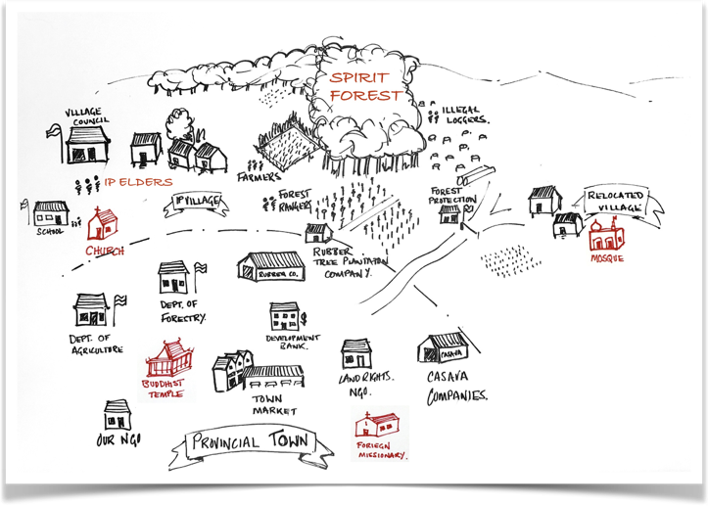



Exercise
Notes:
In this exercise, be very concrete and practical. If possible, draw a map of the area you are working in – even if it is an oversimplified map.
Use big sheets of paper and present the drawings/mappings from each group.

Slide 77
Exercise
Step 2: Actor Analysis
For each chosen religious actor, think about:
How does this religious actor relate to other actors in the context? Where do they have influence? Are there any conflicts with other actors?
Who are the religious leaders?
Is what they want clear? (change, status quo, political power, wealth?)
What is it that influences and constrains this actor? Consider: Theology, Norms, Religious artefacts and practices, Internal power relations and hierarchy
Notes:
Exercise
Support resource “every day political analysis”: http://www.dlprog.org/publications/everyday-political-analysis.php

Slide 78
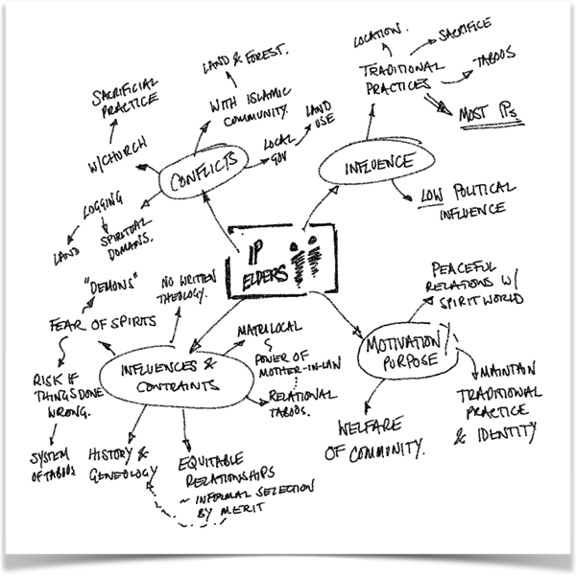
Exercise
Notes:
Example of quick actor analysis.
Draw a mind-map of the relations between the different actors involved.

Slide 79
Exercise
Step 3: Force field analysis
In relation to the project/program goal how does each actor present opportunities or hindrances?
Are there other issues that we need to consider?
What areas do we need to understand more deeply?
Notes:
Exercise
This is a variation on force field analysis - see article: http://pubs.iied.org/pdfs/6334IIED.pdf and online resource: https://www.mindtools.com/pages/article/newTED_06.htm
Do the forces even out, or do we see this actor mostly supporting or resisting the project goals?

Slide 80
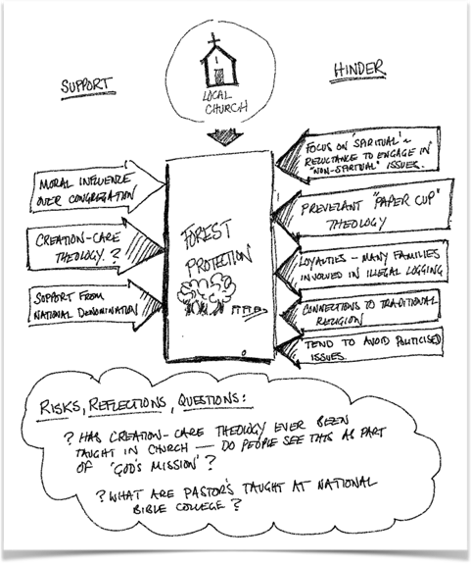

Exercise
Notes:
Example of a quick force field analysis.

Slide 81
Who are we in the eyes of others?
Attributed identity:
THEY SAY
Based on our knowledge of the local actors we want to work with, what do we know about their view of us? How do they perceive us as religious?
Which FBO type would they assign to us?
Notes:
Before we evaluate our religious literacy, lets go back to the identity model - for the religious actors you have chosen, how do they specifically perceive us? What challenges might this create?

Slide 82
For each religious actor
Actor: | We know nothing! | We know a little | We have a good awareness | How can we increase our understanding? What possibilities are there?
About the religion in general
Organisation
Theology
Practice
About the actor
Organisation and power structures
Theology and religious language
Religious practice
Influence on culture and society
About the actors relationships
Influence on target groups
Networks/Relationships
Conflicts with other actors
their perspective of us
Notes:
Self-assessment
Print this as a handout!
Based on the actor analysis you have just done for each chosen religious actor; how would you assess the depth of your knowledge about this actor?
What do you need to know more about?
The depth of your understanding of different religious actors will affect what engagement strategies are available to you.

Slide 83
Notes:
Process check.
So where are we now?
We have looked at contextual religious literacy
We have looked religious actors, the FoRB context and ourselves in this context.
We will never know everything, and this is not the purpose. It is about knowing enough to move forward and to help identify our limits and knowledge gaps.
So now we need to start bringing this together.

Slide 84
How could you weave these tools and ways of thinking into your existing stakeholder/ actor analyses?
Notes:
Reflection:
Before we do this, let's just have a reflection about this process:
We have used a set of tools in isolation from a normal project design process. But ideally these would be included as part of your project design processes - how could you integrate them in the future?

Slide 85
4. FoRB-space
Religious identity of actors
Relationship to project goals
3. Our religious identity
Notes:
How can we engage?
Bring together four aspects! Have these aspects in mind as you start to discuss how to approach religious actors.

Slide 86
Limits to FoRB?
Relationships?
Are there theological arguments?
Shared goals?
Shared practice?
Could religious language help?
Access to Networks?
Notes:
How can we engage?
What should we think about as we approach religious actors?

Slide 87
Map out actors in relationship to us and the project goals
Shared practice
Good Knowledge
Basic awareness
Inadequate
 | ? | ⊝ | ⊙ | ⊕
Shared practice
Good Knowledge
Basic awareness
Inadequate
 | ? | ⊝ | ⊙ | ⊕
passive
passive
Our relationship to their religious identity
active
passive
passive
active
active
passive
active
active
active
Relationship to project goals
Notes:
Print as a handout!
To start to get us thinking, try doing a quick mapping of each of the actors in relation to us and the project goals
Project goals might need to be divided up to better reflect how different actors relate to these.
Note that the “for” and “against” are divided into two - it might be helpful to think in terms of passive “for” and “against” versus active “for” and “against”
Actors might need to be given more detail…

Slide 88
Map out
Opportunities
Barriers/weaknesses
Risks
Questions
Notes:
How can we engage? Barriers and risks.
As you discuss the religious actor's relationship to the project goals, and you as an organisation, what are the opportunities, barriers, risks and further questions that you identify.
The groups can write the findings on a big sheet of paper!
Some questions to get you thinking…
What are our unique opportunities to engage with this actor?
Does their theology relate to our project goals in ways which we could appeal to? How?
Would this actor provide access to new networks?
Do we have shared religious practices that strengthens our relationship?
What barriers might we face?
Might this religious actor actively resist working with us? Why?
Does their theology conflict with any of our project goals? Or with us as an organization? How?
If the FoRB context does not allow us to speak freely, how will we work with this?
What risks do we face in referring to religion or cooperating with this actor?
Who might we risk excluding?
What conflicts could be escalated?
What questions must we find answers to?

Slide 89
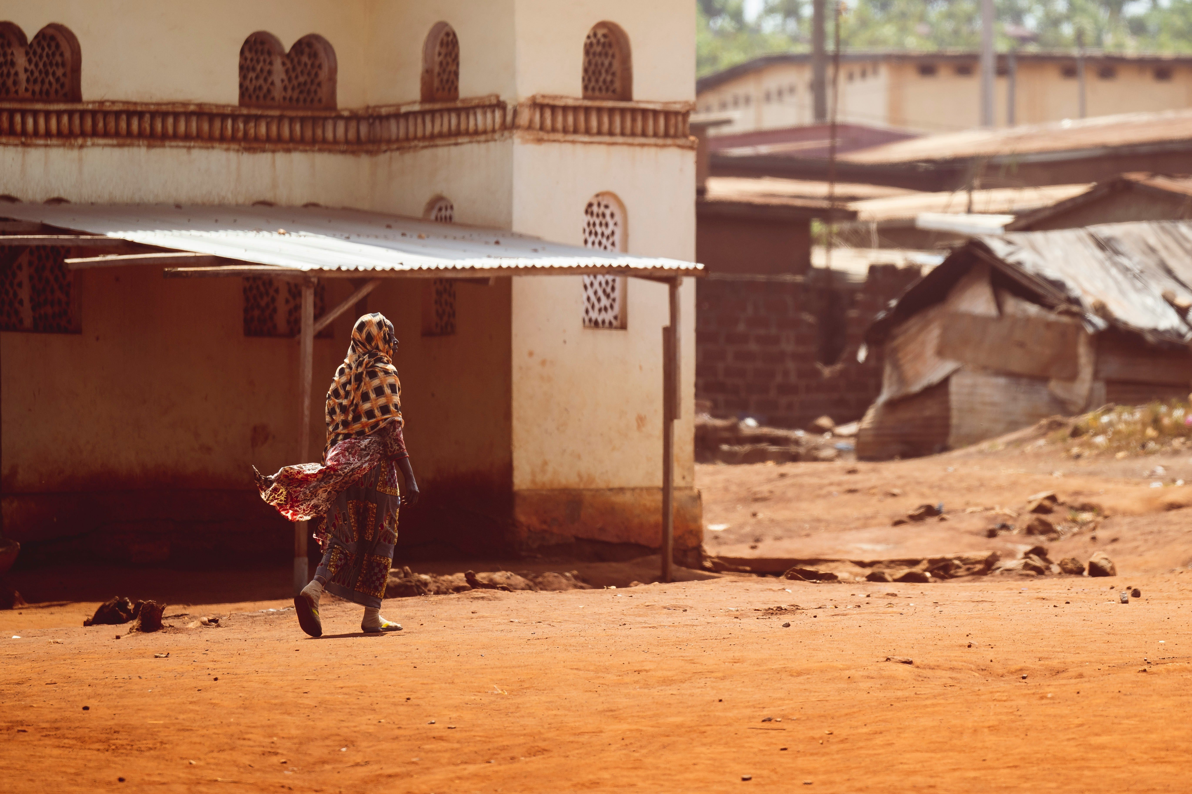
What “religious capital” do we have with this actor? How might our religious literacy or shared religious practice support our engagement with this actor?
Notes:
Some questions to get you thinking…
What are our unique opportunities to engage with this actor?
Does their theology relate to our project goals in ways which we could appeal to? How?
Do we have the ability to use a shared religious language to communicate about the project goal? What religious terms could we use?
Would this actor provide access to new networks? How would we be able work with them?
Do we have shared religious practices that strengthens our relationship?

Slide 90
Part 3
Practical religious literacy
Notes:
Practical religious literacy

Slide 91
3 levels of religious literacy
General
Contextual
Practical
Notes:
General religious literacy - Develop knowledge and reflection about religions role in rights-based development and what drives our own organisation.
Contextual religious literacy - Strengthen context and actor analysis through increased religious literacy.
Practical religious literacy - Identify relevant strategies in relation to religion and religious actors.

Slide 92
Notes:
Process check.
You have now looked at the general level of religious actors and ideas, your own identity and FoRB.
You have also looked at the same issues in your specific context.
You are now about to start looking at the practical implementations of these parts of the process.
Are there still unsolved issues or discussions that needs to be taken further in earlier stages of the process?

Slide 93






Practical religious literacy strategies
Avoid
Adapt
Navigate
Challenge
Tone down
Cooperate
Notes:
Print the following six slides and put them on the billboard or on the tables. They are useful for the following discussions
Practical religious literacy is about being intentional in how we engage with religious actors, based on a good understanding of who they are, and who we are.
SMC has identified six different strategies.
The first five strategies were identified in SMCs study on gender and religion. They do not represent ideal strategies, but rather real-life choices that different organisations have employed. Each come with pros and cons. The sixth strategy is one we have recognised in the development of this tool (and hope you can help us develop further!)
We will return to these later as we think about strategies.

Slide 94
Avoid
Notes:
AVOID
Programs can be designed without paying attention to religious leaders, but perhaps they are missing an opportunity to involve important actors or for advocacy.
Sometimes your contextual analysis and your goal might reveal that the best strategy is to avoid religious leaders/faith-based partners and work entirely from a secular/human rights-based approach. This might mean that you avoid conflicts with religious leaders/actors – but can also include the risk that you miss key actors for change and do not harness the potential for social reform religion can harbor. Also, there is a risk that this is a naive approach.
Example in learning study – from a secular partner organizations in Bangladesh
The example is from a secular partner organization in Bangladesh deciding to avoid cooperation with religious actors because superstition was so strong effecting the outcome of the project:
“Religious superstition was used in a broad negative sense meaning religion as something negative holding people back from development, conserving existing attitudes especially related to gender issues and women rights. It this sense, religion is certainly not something seen as being a help when working for changes and development, rather it is a conservative force that help keeping existing power relations at status quo. The view is that this kind of religious superstition is linked to old traditions and is nurtured by local imams but also by ordinary people and family members, including women.”

Slide 95
Adapt
Notes:
ADAPT
Work within the frameworks provided by religious actors, interpretations and practice.
An easier and quicker way of obtaining results within certain limits without challenging religious norms.
No opposition from the religious establishment.
2. Adapt to religion: work within the frameworks provided by religious actors, interpretations and practice – might help you to reach certain quick results through widespread networks but contains the risk that religious norms are never challenged or changed. Risks undermining long term and sustainable change.
Example in learning study – SEAL project on SRHR in Kenya utilizing norms acceptable to religious context
The project manoeuvres successfully within the boundaries of Kenyan educational policy and religious boundaries, while at the same time advocating for policy change at national level. Through a holistic approach SRH issues of secondary school students are addressed in cooperation with school staff and parents.
[…]
Training material developed and used by SEAL do align well with the Kenyan educational policy frames, and thus somehow also align with a religiously influenced and conservative line on sexuality.

Slide 96
Navigate
Notes:
NAVIGATE
Use pragmatic compromise as strategy so that potential conflicts are defused (or avoided). This could mean that certain principles must be sacrificed or that an organisation will choose not to challenge certain issues so that other important goals can be reached instead.
3. Navigate within the religion: use pragmatic compromise as strategy, choose your battles wisely as to what you challenge and what you leave be- even if you might need to sacrifice some principles along the way-
Example in learning study – avoidance of e.g. LGBTI rights/SRHR/abortion focus on conscientious objection in relation to the military rather than in relation to abortion in a Catholic context-
In the advocacy work Justapaz also has to navigate in the religious climate of the Colombian society at large, which is influenced by conservative values stemming from the Catholic Church. One example of this is that Justapaz (in network with other civil society organizations) is working for a new law of conscientious objection. In the law proposal conscientious objection to military service has been put together with conscientious objection to abortion, which can seem to be both strange and problematic. The logic, however, is that in a catholic context that is critical to abortion it is important to position oneself in relation to the forces that struggles for the right of health workers to declare themselves conscientious objectors to abortion. In short the issue is a matter of strategy.

Slide 97
Challenge
Notes:
CHALLENGE
If challenging religion, an organization needs to be prepared for resistance.
The potential for lasting change to norms and structures maintained by religion in society.
4. Challenge the religion/ utilize religion to challenge: Potential for long term change of norms and structures but includes the risk of being challenged and even severely so. Important to consider what internal change factors there are within the religious setting and how those can be utilized.
Example in learning study – EHAIA project in Kenya on HIV and gender.
The Bible is used by EHAIA in a deliberative manner to create discussion about important issues regarding HIV and gender. In Muthua, the text about the Samaritan woman who touches Jesus’ clothes leads to an interesting discussion about power. In the workshop in Malawi the text about Vashti is ”turned upside down” and looked at from Vashti’s own perspective as a woman, which leads to an interesting discussion about gender roles. Sometimes the Bible opens the door to discuss sensitive issues that are strictly taboo, such as sexual violence. An example of that is the Tamar campaign that was launched by EHAIA in 2005. ”Across Africa, EHAIA introduced the story of Tamar (2 Samuel 13:1-22), who was raped by her half-brother, to religious leaders and community members. Bringing attention to the fact that the Bible includes this account immediately legitimized discussions among workshop participants” […]

Slide 98
Tone down
Notes:
TONE DOWN
Avoid religiously associated tensions in the context through downplaying the role of religion
There is a risk that an organization will be afraid to take on important issues for fear of conflict.
Enables active change processes to take place without fueling conflicts or increasing religious tensions.
5. Downplay the role of religion: avoid religiously associated tensions in the context through downplaying the role of religion. E.g. be clear with own religious identity but work interreligious/inclusively or talk more about human rights/citizenship rights than about religious identities.
Example in learning study TMLT in India – chooses not to evangelize but emphasizes its social mission. Example from FoRB work in Egypt.
TLMTI has a very clear religious identity. Being known as a Christian actor is an asset, as the Christian organisations have a good reputation. The Christian staff pray together, and the organisation has churches and conducts services. The majority of the staff are Christians and several persons from the staff expressed that the faith gives strength to the organisation. The mission statement and the core values also have a clear focus on Jesus and on Christianity. Religion thus seems to be a motivating factor and a driving force, at an individual and an organisational level. However, TLMTI made it clear that they do not evangelize, and in Chhattisgarh the volunteers and the staff stressed that TLMTI is known to people primarily as a social organization […] The norm of a multicultural, multi religious and peaceful society is very strong. There is an expressed need and also a will within the organisation to ”tread gently” and to be respectful.

Slide 99
Cooperate
Notes:
COOPERATE
Sees the religious actor as a support in the change process. Religious actors can give access to larger networks, and if we share a common goal leaders may be supportive of cooperation and lead to more transformative change. However, this is done at the risk of excluding others, and may need to be carefully balanced with “challenge” strategies.
6. Cooperate with religion - This is similar to challenge but sees the religious actor as a support in the change process, which could enhance our project. Religious actors can give access to larger networks, and if we share a common goals leaders may be supportive of cooperation. Need to think about how we use theological language.

Slide 100
Discuss in your group
What do you see are the pros and cons of these different strategies in your context?
What specific tools or approaches have you used in order to implement any of these strategies?
What tools or approaches have you seen others use?
Notes:
Expose the printed sheets, or the ppt-presentation with the symbols of the various strategies to remind the participants!

Slide 101
Applying the strategies
How would you describe your current project? What strategy are you currently employing?
Which strategies do you think best fit your project based on the what you have been learning so far? (the same as above, or a different strategy?)
If there is a difference? What changes would you need to make to implement this strategy? If they are the same, how could you be more intentional in implementing this strategy? How could you strengthen it?

Slide 102
An iterative process
"How well do we understand these religious actors?"
What religious actors and ideas are at work in our context?
Back-out?
Does the context allow us to ask further questions about religion and belief?
Move forward?
Notes:
It is probably better to think about this as an iterative process where we first gather what we know, and evaluate our knowledge - do we need to research further or can we move forward? What questions do we need to take into our work. Maybe you will discover that you need to back out - that the context is too dangerous to engage with these questions, or that you simply do not have the ability to engage with the religious actors as needed … we think in most cases you can persevere, though this may mean working more sensitively to the issues, or partnering with others who can help.
One tip as you work through this section is to create a “to-do list” to gather all the questions and things you will need to follow up on.

Slide 103
What more should we learn?
Notes:
During the course of this tool, we have identified, at several points, issues which we need to learn more about. How are we going to do this?
The image of a lighthouse is a helpful model to help think about what is needed for us to learn from our work and the changes we are seeing.
Further down on this note-page you foins some links to useful resources.
The lantern sheds light onto topics of interest for the organisation/program (learning priorities).
The tower elevates the light, the taller the tower, the greater the field of vision—as do the processes and activities for effective and efficient learning (learning plan).
The foundation is a solid environment of trust and openness that grounds the work of the lighthouse (learning culture).
What priorities do you have to learn about through your work in relation to religious literacy and religious actors? e.g. what helps to engage them? How is their behaviour changing? What issues are sensitive?
How will you find answers to these questions? It helps to be intentional, and have a plan with methods, roles, budgets and times - to help make sure that learning is planned and prioritised!
A learning culture is of course foundational… how does leadership view learning? Is there time and resources given to learning? Is there openness to experiment and learn?
There are many resources for increased religious literacy and FoRB.
http;//www.forb-learning.org
https://fabo.org/course/Religion_and_ Development

Slide 104
What is the next step?
Where do we go from here?
Notes:
Make a plan for the next month. What do you need to do immediately after the workshop?
What changes needs to e done in six month?
What will be done in a year from now?

