Slide 1
m%dfoaYSh iudc mßj¾;l mdGud,dj

Slide 2
2 jeks ieish
is;Sfï" yDoh idlaIsfha" wd.u weoySfï iy úYajdi oeÍfï ksoyi y÷kajdoSu

Slide 3
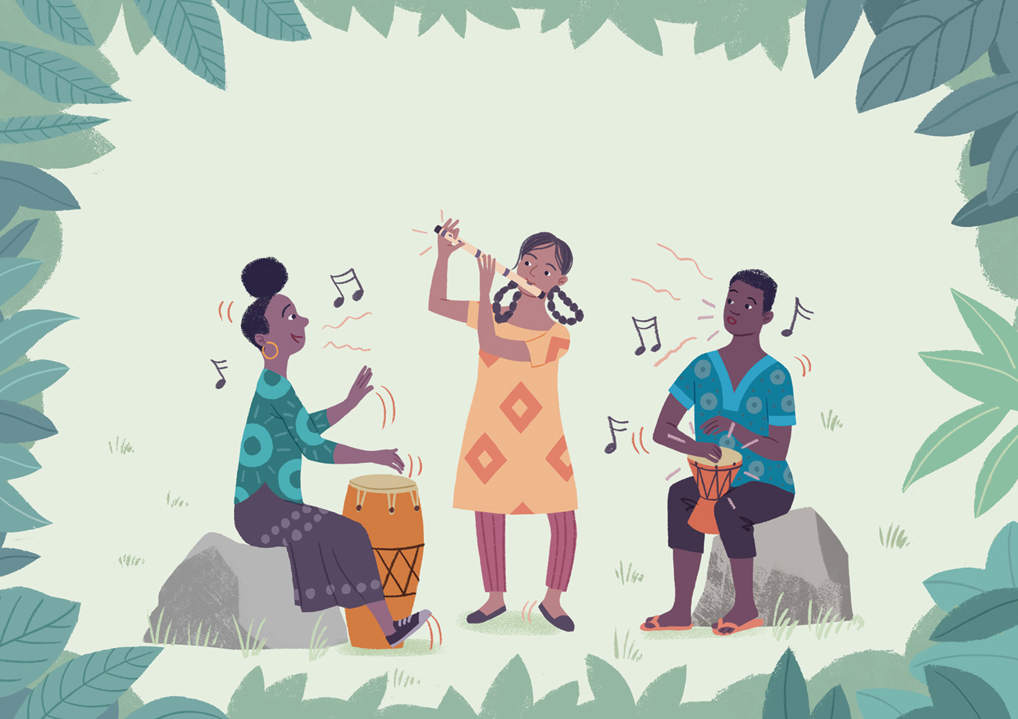
k<dfõ iy fnrfha .S;
Illustrated by Toby Newsome
Notes:
wxl 3 isg 23 olajd jk ia,hsâ u.ska ztlu;a tl ldf,lZ wNHdih i|yd Ndú;d lrk ,o l;dj ksrEmKh flfrhs'
k<dfõ iy fnrfha .S;
le;ßka lEIa iy isâfi,a-udß úka;¾ m%d.a úisks'
Ñ;% fgdì ksõiï úisks'

Slide 4
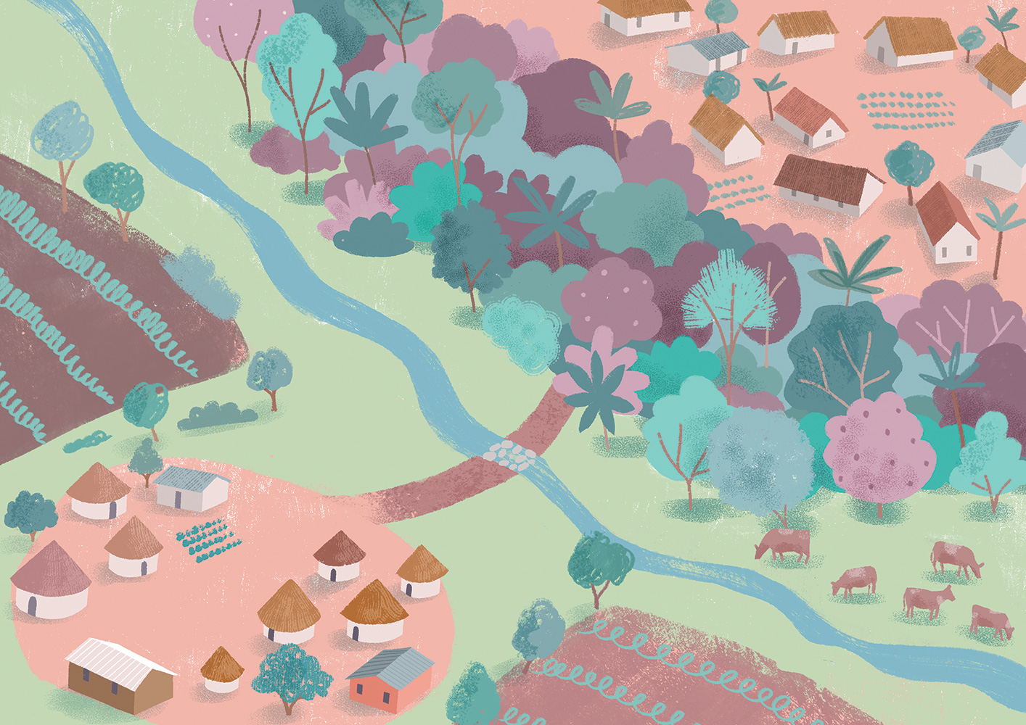
Notes:
tlu;a tl ldf,l .ïudk folla ;snqKd'

Slide 5
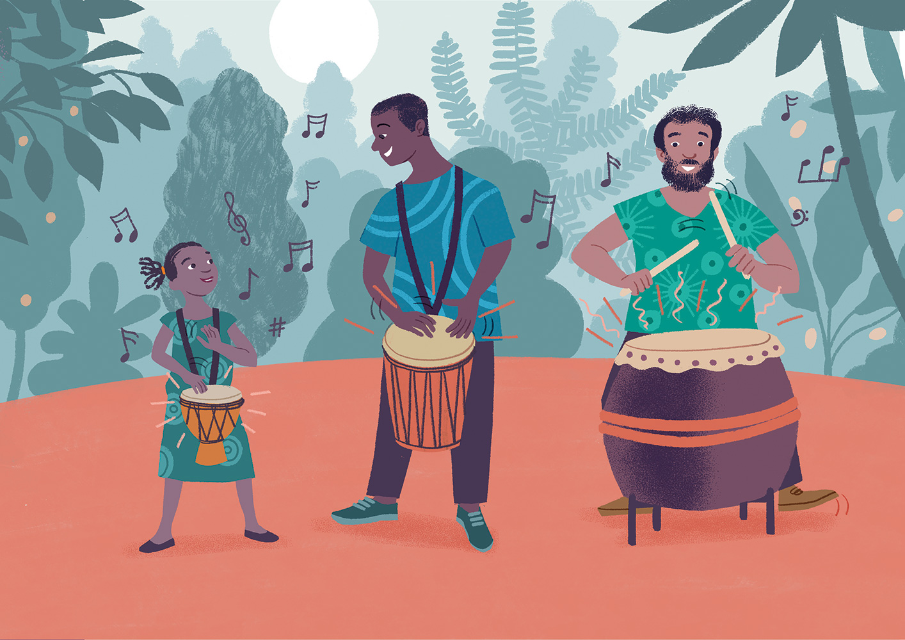
Notes:
jkdka;rfha ;snqKq .fï jeishka fnr jdokh yd kegqï i|yd m%isoaOhs' <ufhl=g fl<ska jdä úh yels jQ fudfydf;a isgu Tjqkag fnrhla ,nd fokjd' ksy`vj weoyef,k j¾Idjla fuka y`v kef.k b;d l=vd fnr iy fofofkl= úiska Tijdf.k hd hq;= ;rï úYd, .s.=reï y`v iys; fnr o ;snqKd' fnr jdokh Tjqkaf.a Ôú;h iu. - tkï ieureï" fYdalùï iy ta w;r jQ iEu fohl § u - tlg .uka l< fohla' jkdka;rfha isák wd;auhka iu. iu.sfhka ;ukaf.a Ôú;h mj;ajd f.k hdug fnr jdokh WmldÍ jk nj tu jeishka úYajdi l<d'

Slide 6
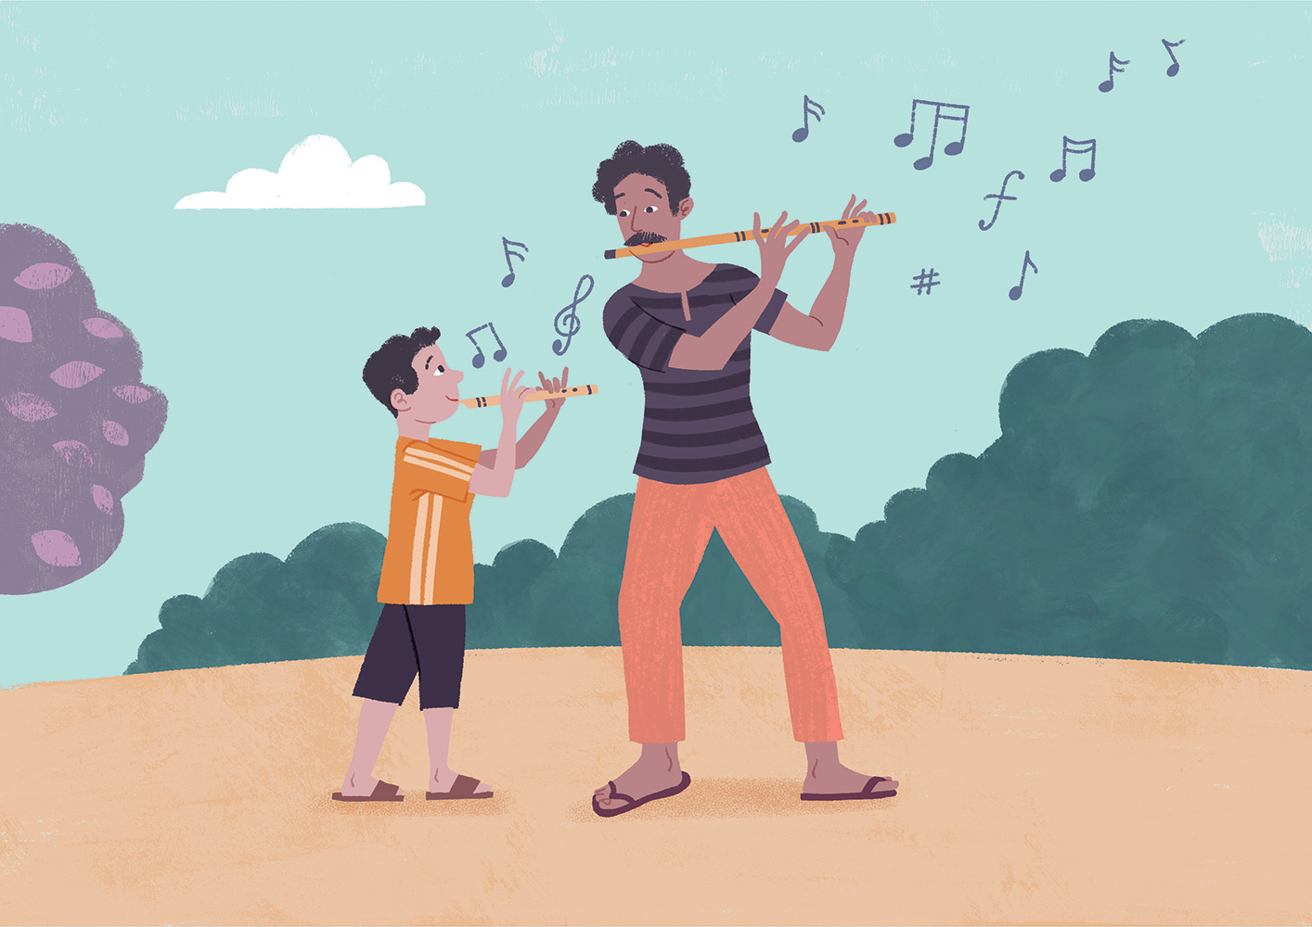
Notes:
my< ñáhdjf;a msysá .fï jeishka ljodj;a fnr jdolhskaj f;areï wrf.k ;snqfKa keye' Tjqka fnr jdokh wd.ka;=l fohla f,i i,lñka tu ir, zfnry`vZ foi ne¨fj wj{d iy.;j isky fjñkqhs' ñáhdjf;a msysá fï .ïudkfha msßñ <ufhl= Wm; ,enQ úg" Tyqf.a mshd ,Sfhka fyda wiaÓ j,ska k<djla leghï l< w;r" tu msßñ <uhd ;u Ôú;h wjika jk ;=reu tu k<dj ;u f., jgd me<¢ kQ,l t,a,df.k isákjd' Tjqkaf.a idïm%odhsl ;d," olaI f,i jdokh lrkakg bf.k .ekSug jir .Kkdjla .; jk w;r" ÈjH f,dalfha isák foúhkaf.a is; ji`.hg m;a ù f.dúìï j,g jeiai iy ysre t<sh ,nd fok ;rug b;d ñysß f,i k<dj jdokh lrúh yels olaI;djhla ;snQ msßñkag by<u f.!rjh ysñjqKd'

Slide 7
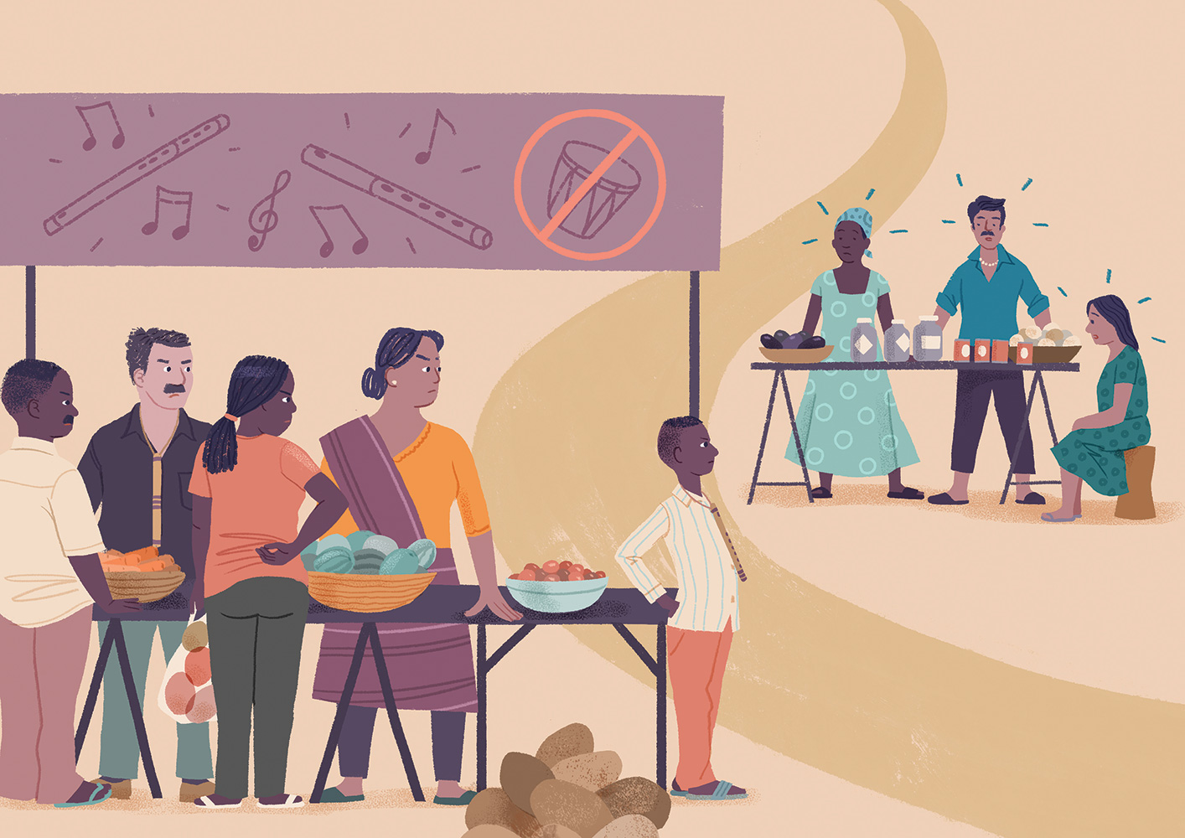
Notes:
fnr .ïudkfha .ïjeishka ;u NdKav úlsŒu i|yd k<d .ïudkfha i;sfmd<g .sh;a" tu .ï fofla jeishka tlg tl;= jqfka keye' fj<| fmd< ;=< fnr jdokh ;ykï lr, ;snqfK' k<d .ïudkfha fndfyda fj<|ie,a ysñhka fnr jdolhskag nvq úlsŒu m%;slafIam l<d' ta jf.au fnr jdolhskag k<d .ïudkfha jeishka .ek ukdmhla ;snqfK;a keye'

Slide 8
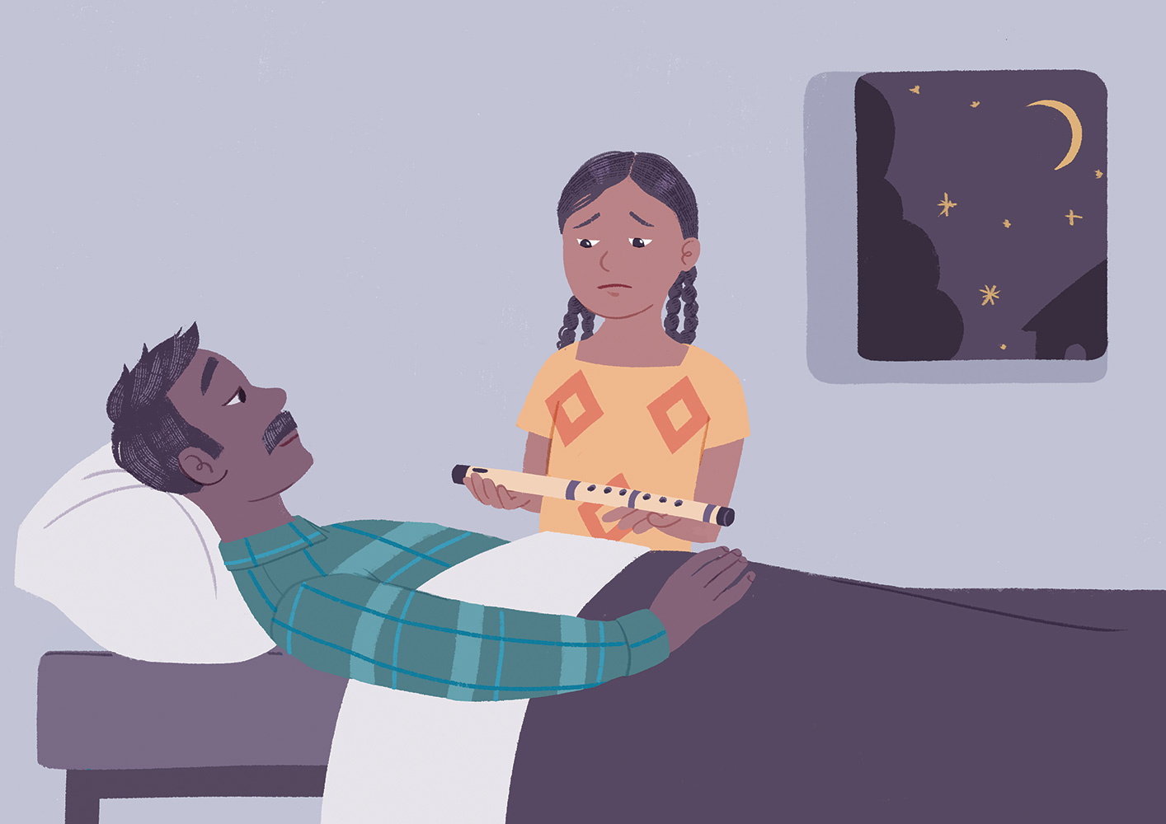
Notes:
mjqf,a tlu orejd jQ ishdkd kï l=vd .eyeKq <ufhla k<d .ïudkfha Ôj;a jQKd' wehf.a úuis,su;a nj iy lreKdjka;lu ksid ish¨ fokdu wehg wdorh l<d' wehg jhi wjqreÿ 10 § wehf.a mshd wikSm jqKd' tl ojila Tyq wehj Tyq <`.g le|jd" —‍uf.a wdorŒh ÿfõ" uu jeä l,la Ôj;a fjk tlla keye' uf.a k<dj wrf.k th me<|.kak" túg wms ieuúgu tlg b£ú˜‍' fuh wid ishdkd úlaIsma; jqKd¦ .eyeKq <uhska k<dj me<| isàu tA .fï isß;la jqfKa keye' kuq;a jeä l,a fkdf.dia weh ;udf.ka u fufyu weyqjd" —‍ug jdokh lsÍug bv fokak fyd| ke;af; wehs@˜‍ wef.a mshd ñh .sh Èkfha rd;%sfha § ishdkd mshdf.a k<dj f.k wehf.a fn,a, jgd me<| .;a;d'

Slide 9
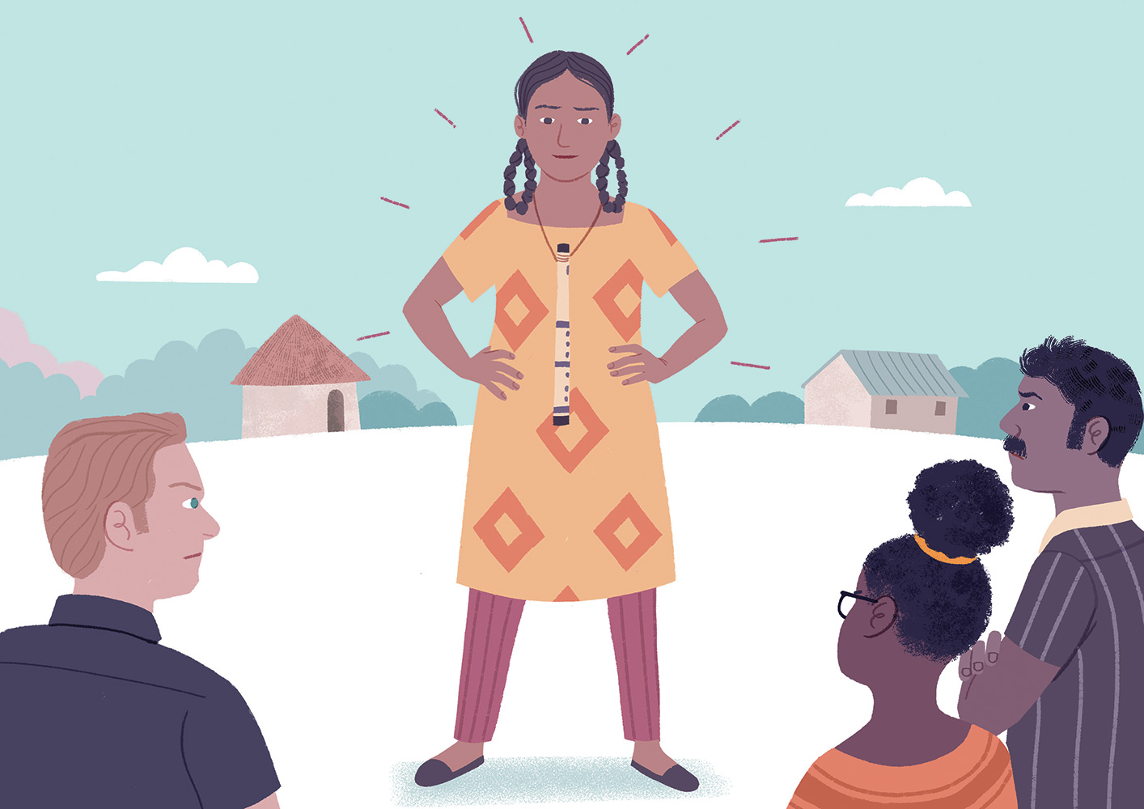
Notes:
ishdkd l%ufhka jefv;au weh ;u ujg fj<| fmdf<a § úlsŒu i|yd t<j¿ j.d lsÍug Woõ l<d' weh läir yd ldre‚l jqj;a" weh k<dj me<| isá ksid wehf.a .fï wh fndfyda úg wehg kskaod l<d' iuyr úg Tjqka th .,jd ±ñh hq;= hehs wehg ta;a;= .ekaùug W;aidy l<;a weh th m%;slafIam l<d' ishdkdg wjia:djla ,enqKq iEu úgu weh jkdka;rhg f.dia mshdf.a k<dj jdokh l<d'

Slide 10
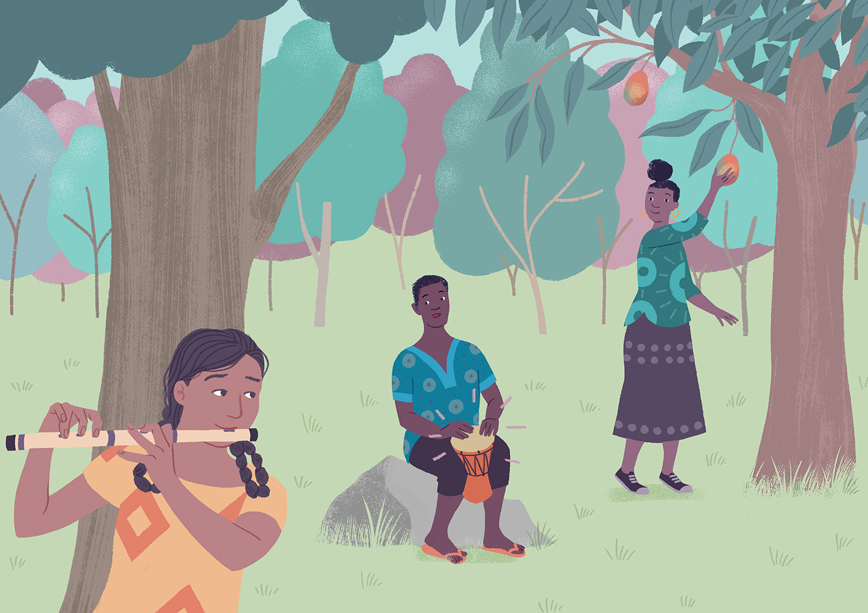
Notes:
tjeks tla ojil ishdkdg ishqï fnr jdokhla weiqKd' l=;=y,fhka hq;=j weh fnr y`v Tiafia jkdka;rh yryd .uka lr t<suyka ia:dkhlg meñKshd' t;k isá ;reKfhla fnrhla jdokh lrñka .dhkhl fh§ isáh§ Tyqf.a ifydaoßh .ilska m<;=re fk<ñka isáhd' ishdkd Tjqkaj fj<| fmdf<a§ y÷kd f.k ;snqKd - Tjqka Tfkda iy whsßia lshk ifydaor ifydaoßhka fofokdhs'
.ia msgqmi ieÕù isá ishdkd wehf.a k<dj jdokh lrkak mgka .;a;d' k<dfõ .S;h iy fnrfha ßoauh ,iaik ix.S;hla ujñka tlsfkl iu. uqiqjqKd'
.S;h wjika jQ úg ishdkd m%fõYfuka t<suyk fj; mshuka l<d' k<dj iys; .eyeKq <ufhl= oelmq Tfkda iy whsßia mqÿuhg m;a jQ kuq;aa" Tjqkag fukau wehg;a k<d .ïudkfha § k<dj jdokh lsÍug bv fkdfok nj jgyd .;a Tjqka f.a uqyqKg iskdjla ke.=Kd' whsßia Bg miafi ishdkd g m<;=re álla ÿkakd' fï ;=ka fokd ijia jk ;=reu l;dny lrñka ix.S;h jdokh l<d'

Slide 11
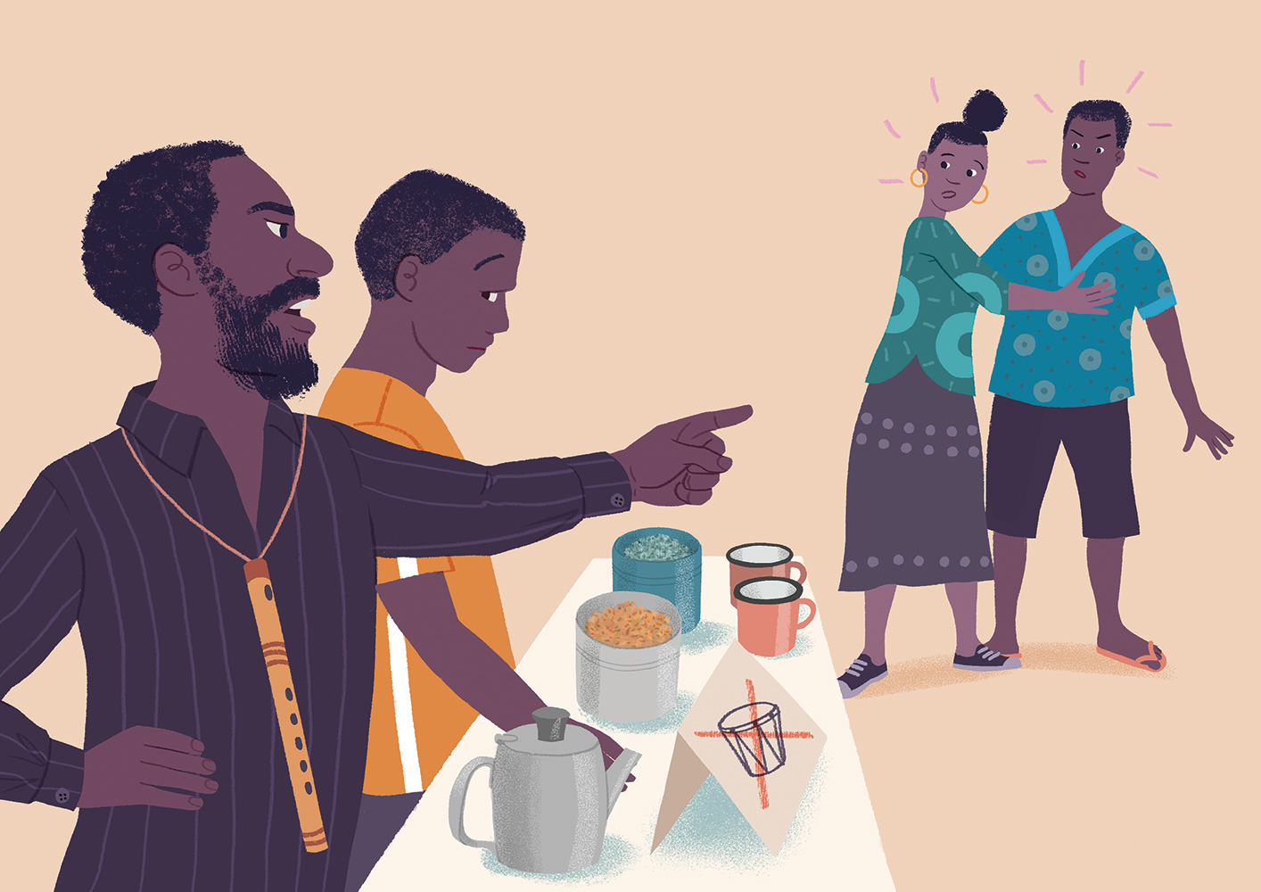
Notes:
B<Õ fj<|fmd< Èkfha§ ishdkd wehf.a w¨;a hd¿fjd f;a lvh bÈßmsg bkajd ±lald' f;a lvfha whs;sldrhd Tjqkag lE.eiqjd" —hkjd hkak" crd ‍fnrldrfhdæ˜‍ Tfkda fldamhg m;a jQ kuq;a whsßia Tyqj t;kska wylg weof.k .shd' Tfkda fjkqfjka f;a yoñka isá lvh whs;slref.a mq;d ,eÊcdfjka n,d isáhd'

Slide 12
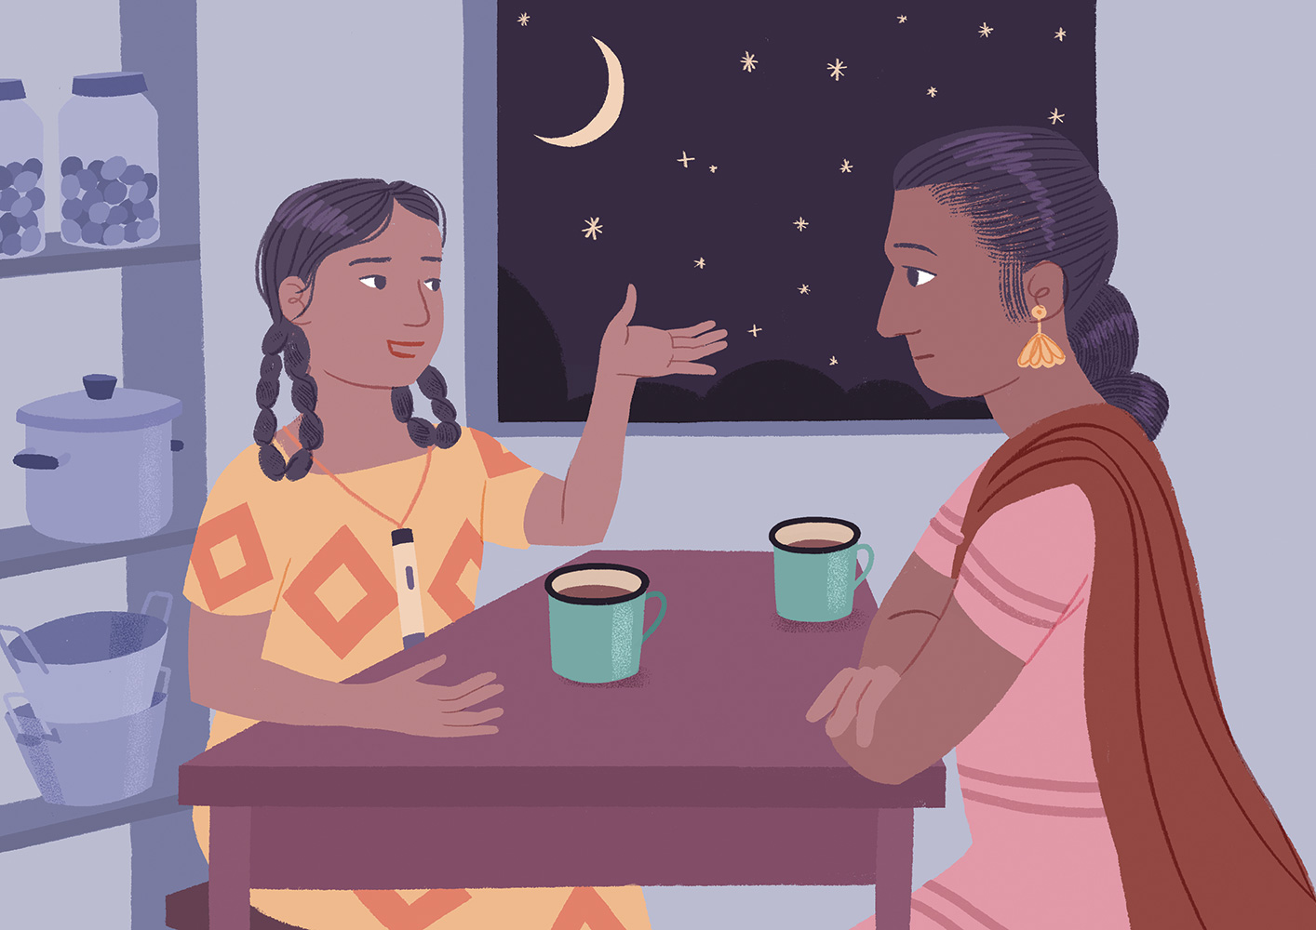
Notes:
ishdkd óg fmr lsis ojil zfnr jdolhskag ;ykïZ lsh,d .y,d ;snqKq mqjre .ek ys;,d ;snqfKa keye' weh iy wehf.a uj lsis úfgl;a fnr jdolhskaf.a lvj,ska lsisjla ñ, § f.k ke;s nj f;areï .;a úg wehf.a yoj;g nrla oekqKd'
tÈk rd;%sfha ishdkd wehf.a wïud iu. l;d lrñka bkak úg Tjqka ljodj;a fnr jdolhskaf.a lvj,g hkafk ke;af;a wehs lsh,d weyqjd' —‍Thd okak foag iSud fj,d bkak tl jvd fyd|hs˜‍ hkqfjka wehf.a uj ms<s;=re ÿka kuq;a" iEu flfkl=u u iEu ;ekl§ u idorfhka ms<s.kafka ke;af;a wehs oehs f;areï .; fkdyels jQ ishdkd ta ms<sn| È.ska È.g u wehf.ka úuiqjd' Tfkda iy whsßia Tjqkaf.a lvfha úl=Kk rij;a m<;=re .ek weh wdYdfjka l:d l<d' wka;sfï§" ishdkd f.a uj B<Õ ojfia§ Tjqkaf.a m<;=re lvfhka m<;=re lsysmhla wrf.k n,kak tlÕ jqKd'

Slide 13
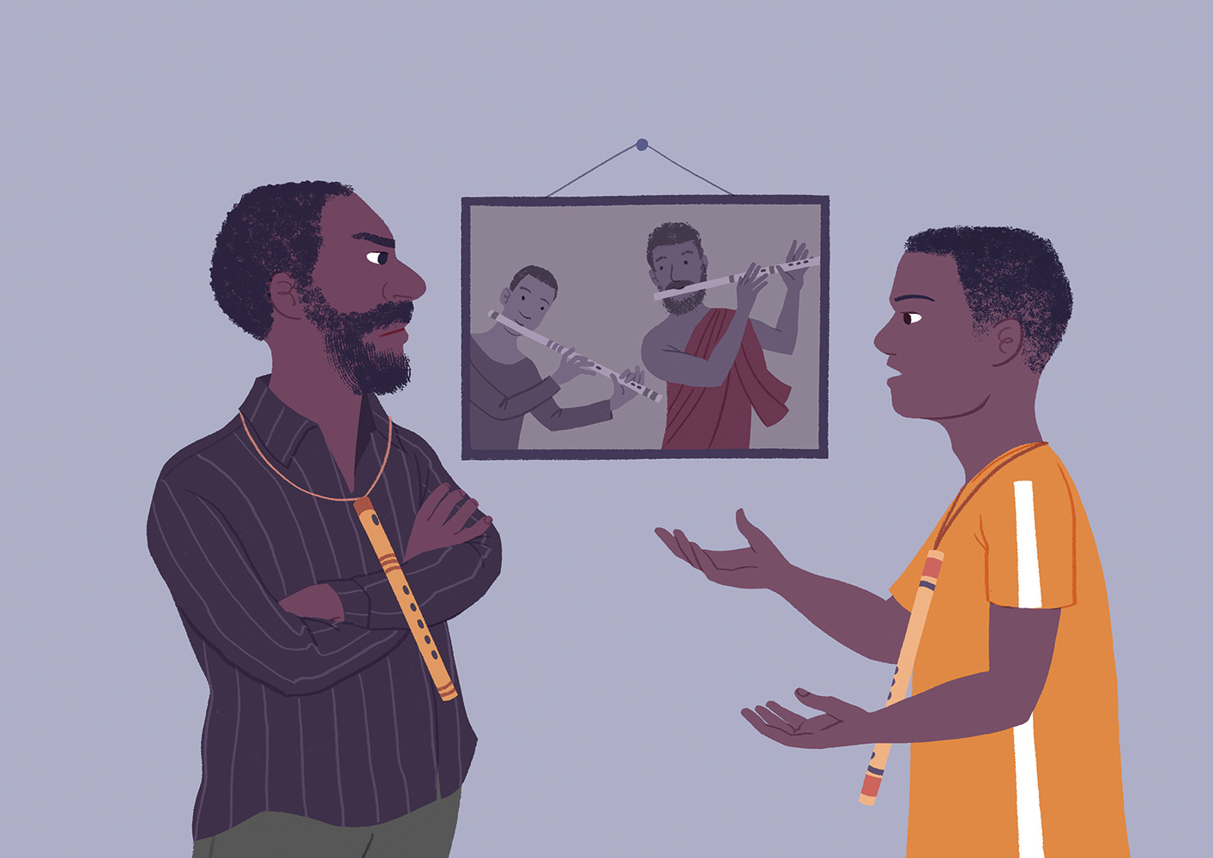
Notes:
fï w;r" f;a lvh whs;slref.a ksjfia § Tyqf.a mq;a fn%daka ;u mshd fnr jdolhskag i,lmq wdldrh .ek m%Yak l< úg l,n,hla we;s jqKd' f;a lvfha ysñlre .fï jvd;a f.!rjhg m;a jQ k<d jdolfhl= jQ w;r Tyq wdvïnr mqoa.,fhla o jqKd' Tyqf.a mshd iy iShd;a olaI ix.S;{hka jQ kuq;a Tyqf.a mq;d .ek ;snQ oeä n,dfmdfrd;a;=j iqka jqKd' fn%daka fld;rï W;aidy l<;a Tyqg b;du uQ,sl ;d,hla j;a jdokh lr .kak neß jqKd' jir .Kkdjla ;siafia n,y;aldrfhka mqyqKq lrkq ,nñka l=ßre f,i úfõpkh lrkq ,eîfuka miqj fn%dakag k<dj ms<sn| ;snQ ish¨‍ ridiajdohka ke;s ù f.dia ;snqKd' fnrj, ÿria: ßoauhg is; we§ .sh Tyq fjk;a Ôú;hla .ek isysk ueõjd'

Slide 14
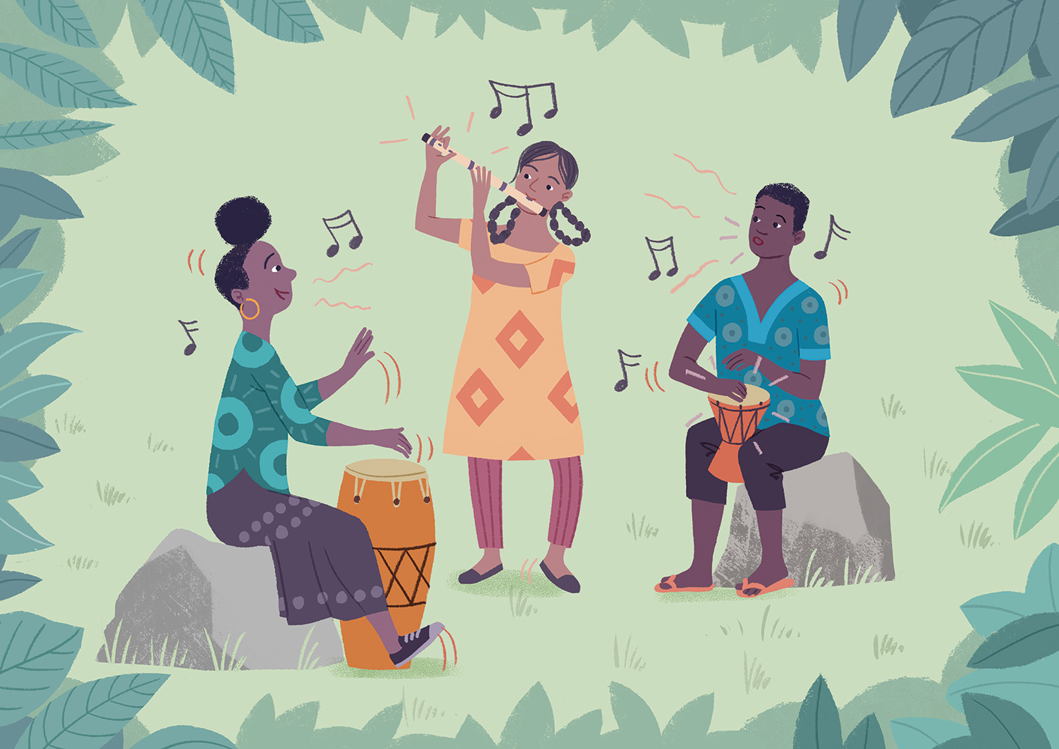
Notes:
ld,h f.ù h;au ishdkd" whsßia iy Tfkda ;sfokd ks;ru le,Efõ§ yuqù tlg tlaj jdokh lsÍug mqreÿ jqKd' Tjqka o isysk ueõfõ iEu flfkl=ju idorfhka ms<s.kakd" újD;j fnr iy k<d jdokh l< yels" fj<|fmd< ;=<§ Tjqkag tlg tlaj Tjqkaf.a iqkaor ix.S;h jdokh l< yels ld,hla .ek hs'

Slide 15
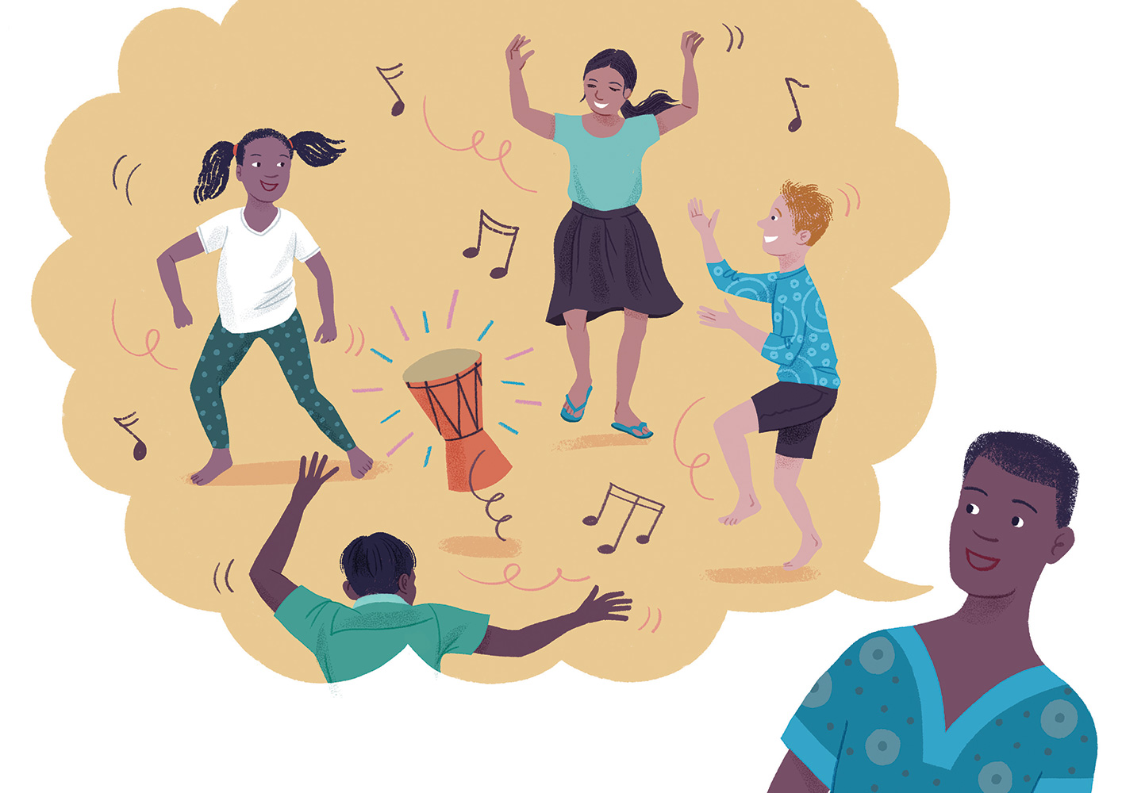
Notes:
iEu i;shlu Tfkda iy whsßia t<j¿ lfâÈ ishdkd iy wef.a uj ne,Sug hk w;r" ishdkd f.a uj Tjqkaf.ka m<;=re yd weg j¾. ñ,§ .kakjd' Èkla ;u bk máh u; ;ndf.k isá fnrh foi ishdkd f.a uj l=;=y,fhka n,d isák nj Tfkda ÿgqjd' —‍fïl yskdfjk fnrh˜‍" Tfkda lsõjd' —tafl Yíoh lshkafk i;=g' uu tal jdokh lrk úg <uhs kgkjd" yskdfjkjd˜‍' th ishdkd f.a ujf.a is;a weo.;a;d'
wfkla fnr jdolhska o t;ekg tla/ia ùug mgka .;a w;r" ishdkd iy wehf.a uj Tjqkaf.a fnr .ek o úuiqjd' tod ishdkd f.a ujg wehf.a t<j¿ ál b;d blau‚ka úl=Kd .kak mq¿jka jqKd' fj<| fmdf<a Tjqkaf.a fldgig meñfKk fnr jdolhskaj ms<s.ekSu .ek wi,ajeis lv ysñhka l,n,hg m;a jQ kuq;a" ishdkd f.a uj ;¾l lf<a iEu flfkl=gu tlsfkldf.ka ñ,§ .; yels kï Tjqka ish,a,kagu jvd fyd| wdodhï ,efnkq we;s njhs'

Slide 16
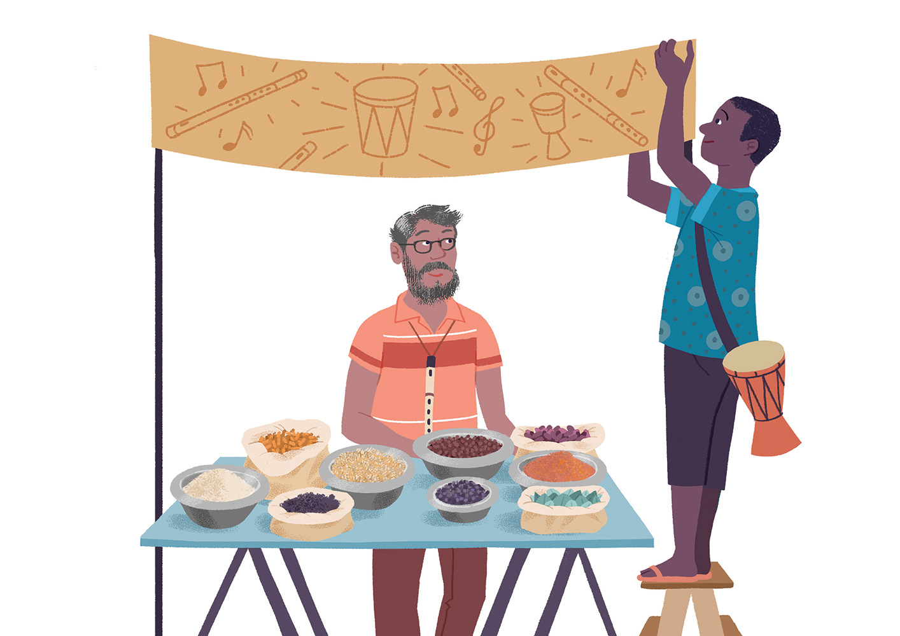
Notes:
Tjqkaf.a l=áh wi, u uy¿‍ ñksfila l=¿nvq úl=Kñka isáh;a Tyqg fyd| fj<|dula ;snqfK keye' fj<|du jeä ÈhqKq lsÍu i|yd ˜‍yefudau idorfhka ms<s.ksuq˜‍ hkqfjka mqjrejla iú lsÍug fhdackd l< Tfkda" uy,a,d i|yd fnrhl iy k<djl rEmhla iys; w,xldr mqjrejla mska;dre l<d'
uy¿‍ ñksidf.a fj<|du jeä jQ w;r" bka miqj l%ufhka wfkl=;a fj<|ie,a ysñhkag;a th ta;a;= .shd' fnr jdolhskag fukau k<d jdolhskag whs;s lv j,;a —yefudau idorfhka ms<s.ksuq˜‍ hk mqjre fmfkkakg mgka .;a;d' fj<|fmd< ÈhqKq jqKd'

Slide 17
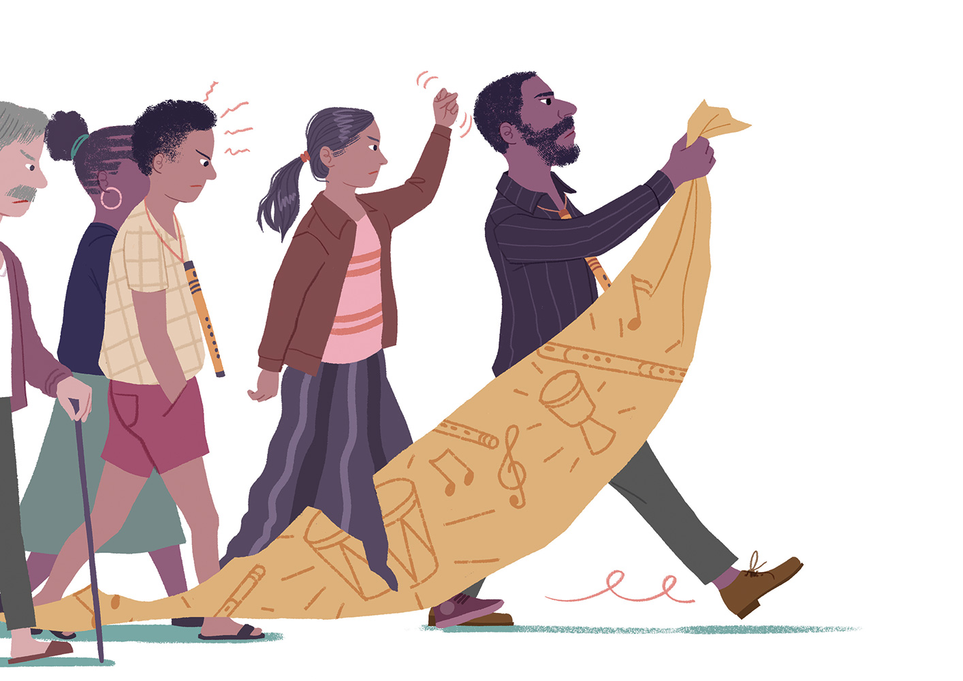
Notes:
kuq;a ish,a, fyd¢ka isÿ jqfKa keye' fnr jdolhska ;udf.a fj<|ie,g we;=¿ ùu .ek fn%daka f.a mshd ìhg m;a jqKd' th tf;la mej;s merKs l%uj,g ;¾ckhla f,i ÿgq Tyq" ta iudk woyia ;snQ ;j;a wh tl;= lr f.k tu mqjre lvd oud fnr jdolhskag ysßyer l<d' fj<|fmd< ;=< l,n,ldÍ ;;ajh j¾Okh jQ neúka fj<|fmd< iNdj;a thska lkiai,a,g m;ajqKd'

Slide 18
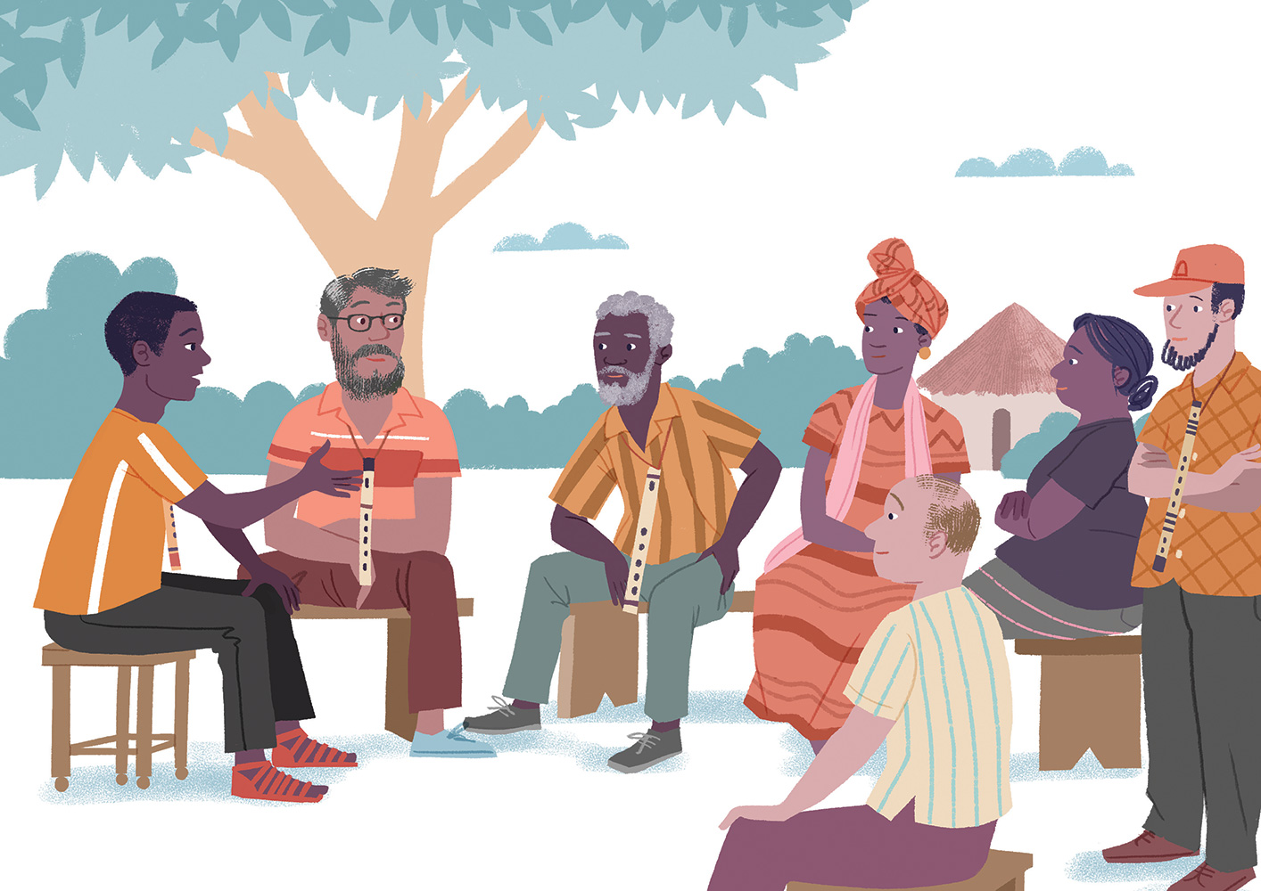
Notes:
fn%daka ;u mshdf.a l+fgdamdhkag iydh §u m%;slafIam l<d' ta fjkqjg Tyq iy uy¿ l=¿nvq fjf<kaod fj<|fmd< iNdj iu. l;d lr" fj<|fmdf<a isák ish¨ fokd i|yd m%ix.hla meje;aùug Tjqkaj fmd<Ujd .;a;d' iuyr úg fn%daka f.a mshd iy wfkla wh ;ukaf.a l:dj,g iy .S;j,g ijka §ug fnr jdolhska leu;s jkafka kï Tjqkaj ms<s.ekSug mqreÿ jkq we;ehs Tyq is;=jd'

Slide 19
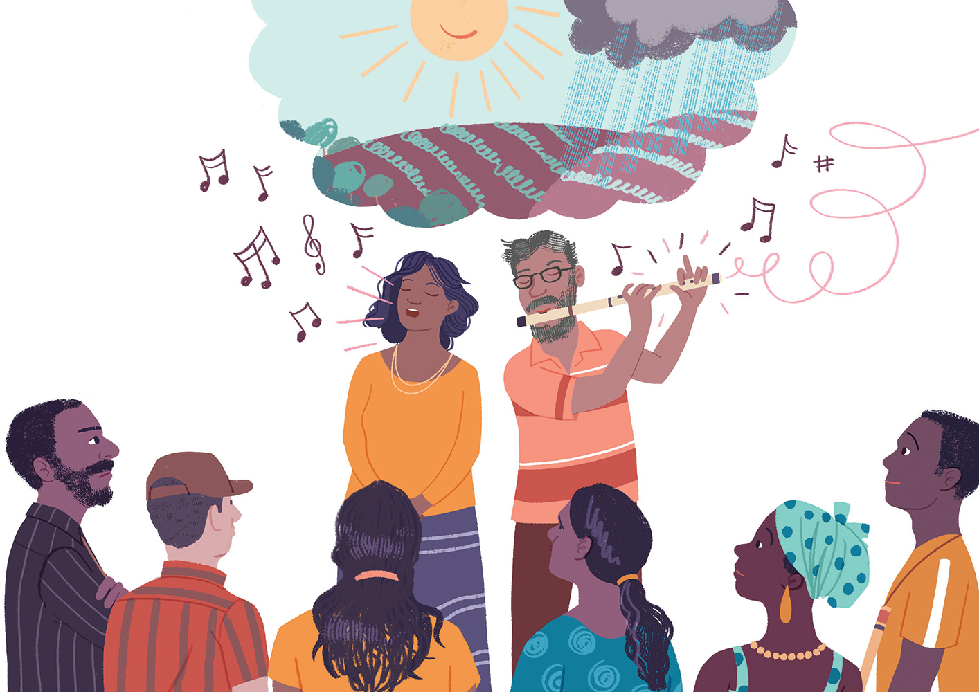
Notes:
m%ix.h ms<sn| mqj; ieu;eku me;sr .sh w;r ñksiqka ÿr isg thg meñ‚hd' fj<|ie,a ysñfhda tÈk fjkodg jvd fndfyda foa úl=Kd .;a;d'
wka;sfï§ m%ix.h wdrïN lrk fj,dj wdjd' uy¿ l=¿nvq fjf<kaod ;u ,S k<dj f.k ,iaik ;d,hla jdokh lroa§ Tyqf.a Èh‚h fyd| wiajekakla ,nd §u fjkqfjka foúhkag lD;{;djh m< lrk .S;hla .dhkd l<d' ;udf.a ;reK ld,fha § jir .Kkdjla ÿIalr;d ú£fuka miqj fuu .S;h ;udg t;rï u m%fhdackj;a jQfha ukaoehs Tyq meyeÈ,s l<d' msßi w;r isá iuyr fnr jdolhskaf.a iskyj yd m%Kduh olajk nj ÿgq fn%daka f.a mshd mqÿuhg m;a jqKd'

Slide 20
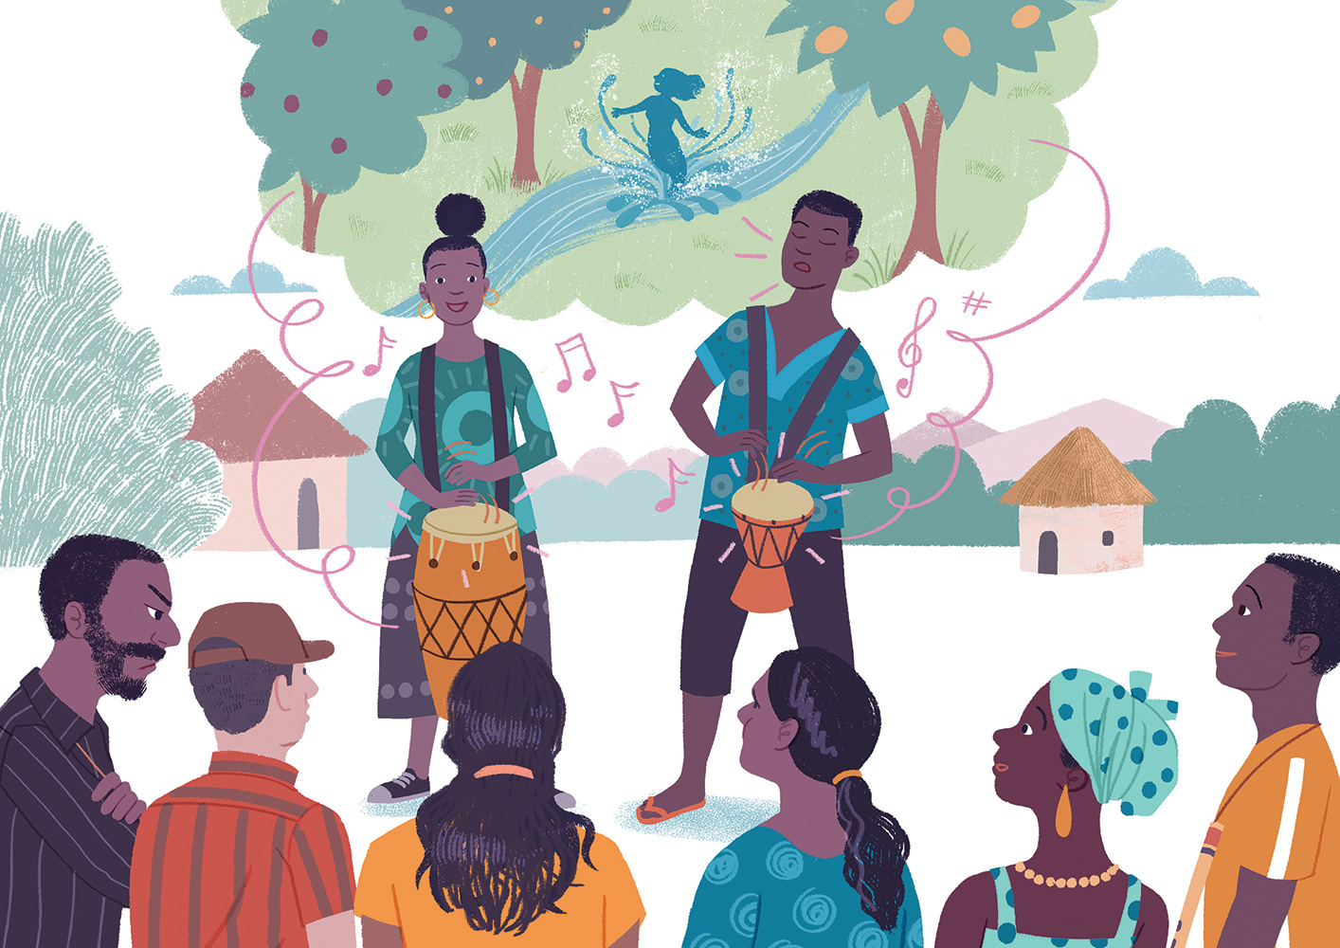
Notes:
uy¿ fjf<kaod Tfkdag iy whsßiag fõÈldjg wdrdOkd l<d' Tjqka ;u fnrj, l;kaor mjid" jkdka;rfha fod<mdf¾ r`. fok wd;auhg f.!rjhla jYfhka w,xldr ;d, ks¾udKh lr" Tjqkaf.a m<;=re .ia wdrlaIdldÍj ;nd .ekSu fjkqfjka l=Kdgq wd;auhg ia;+;s lsÍug .s.=ï fok .S; .dhkd l<d' m<uq j;djg k<d .fï .eñhka fnr jdolhska fnr jdokfhka woyia lf<a l=ulao hkak f;areï .kak mgka .;a;d' fn%daka f.a mshd ta foi rjd ne¨jd'

Slide 21
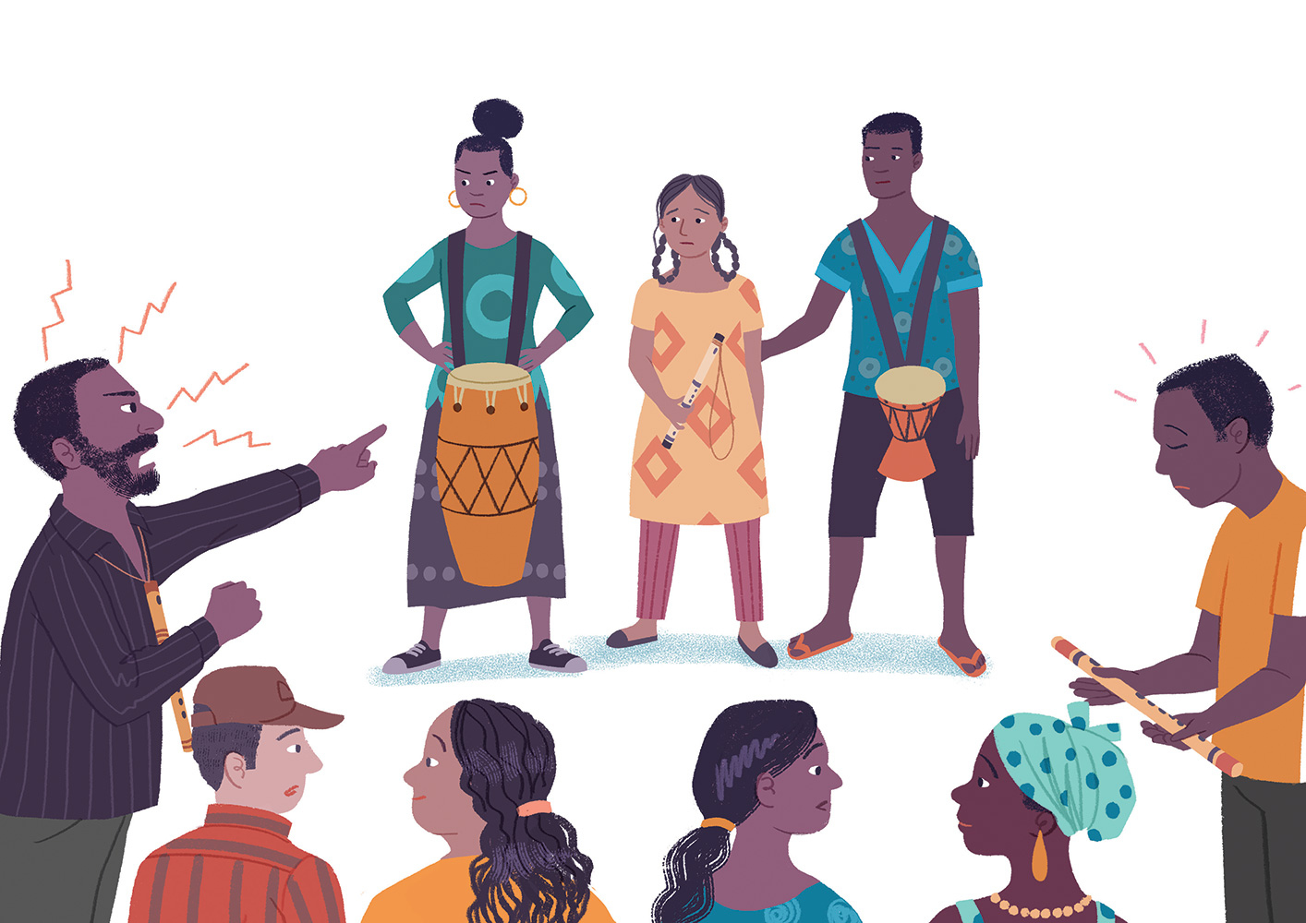
Notes:
wjidkfha ishdkd fõÈldjg meñK Tfkda iy whsßia iu. tla jqKd' weh ;u mshd isysm;a lr" Tyqf.a k<dj f;d,a u; ;nd Tjqka ;sfokd tlaj jdokh lsÍug mgka .;a;d' úu;sfhka hq;= ksy`v;djla me;sr .shd' ñka fmr lsis Èfkl k<dj iy fnrh tljr weiS ;snqfKa keye'
ishdkd f.a k<dfjka ks¾udKh jQ ysre yd jeis foúhka i|yd lD; .=K ±laùfï ;d, jd;h yryd mdù f.dia fod< mdr r`. fok ;d,hg jdokh jQ Tfkda f.a fnrfha ßoauh iu. uqiq jqKd'
.S;h wjika ùu;a iu. msßi tlsfkldf.a uqyqKq foi ne¨jd' iuyre fo.sähdfjka fuka w;amqä .ioa§ ;j;a iuyre bj; n,d .;a;d' fn%daka f.a mshd ishdkd foi n,d ;ryska mqmqrñka ˜fødayshdæ˜‍ lshñka lE .eiqjd'
;u mshd foi n,d isá fn%daka f.a uqyqK fYdalfhka nr jqKd' ;u ysi i,ñka Tyq Tyqf.a f., jgd t,a,d ;snQ k<dj f.k ;u mshdf.a fj<| l=áh u; ;nd ioyg u .fuka msgj .shd'

Slide 22
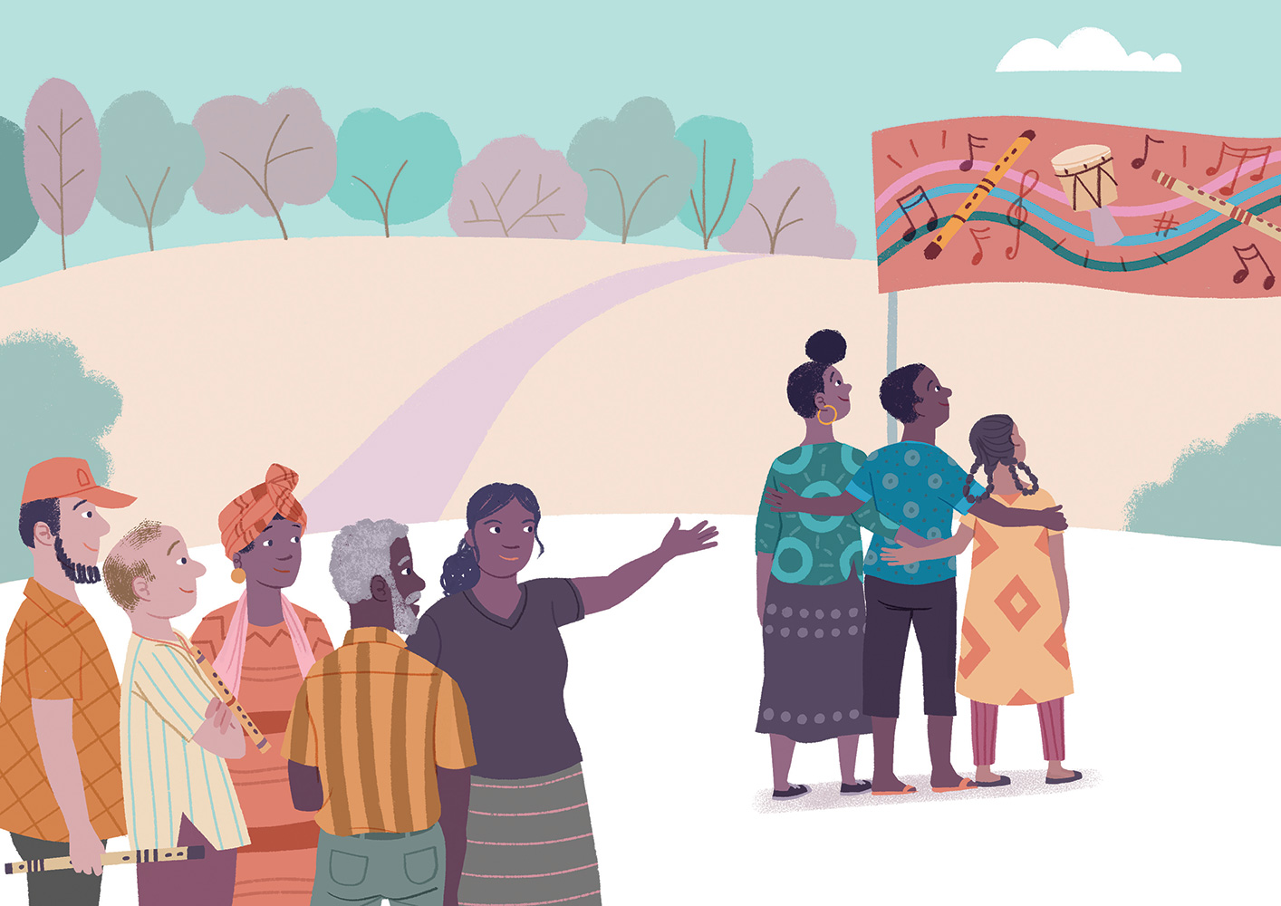
Notes:
m%ix.fhka miq .ï foflys u úYd, l;dnyla we;s jqKd' fj<| fmdf<a iEu lvhl u iEu flfkl=gu fiajd ,nd Èh hq;=o@ .eyeKq <uhskag k<dj jdokh lsÍug bv Èh hq;= o@ k<dj iy fnrh ljod fyda tlg jdokh l< hq;=o@ udi .Kkdjlg miqj;a .ïjeishkag ;ju;a ta .ek tlÕ fjkak neßjqKd'
fnr jdolhskaf.a w;aoelSïj,g weyqïlka §" ish¨‍ fokdf.a wjxlNdjh ÿgq fj<|fmd< iNdj fufia ;Skaÿ l<d( —fj<|fmd< ;=< § ish¨u‍ ñksiqkag fyd¢ka i,lkq ,eìh hq;=hæ˜ fnr jdokh i|yd mkjd ;snQ ;yku bj;a lr" b;sßj ;snQ zfnr jdolhskag ;ykïZ hk mqjre o bj;a l<d' kuq;a WmlrK jdokh lsÍu iïnkaOfhka iNdj me;a;la .ekSu m%;slafIam l<d' ta fjkqjg" —tla tla mqoa.,hdf.a wjxl úYajdihg .re lrk w;r Tjqkag th wkq.ukh lsÍug ksoyi we;˜ hkqfjka m%ldY l<d'

Slide 23
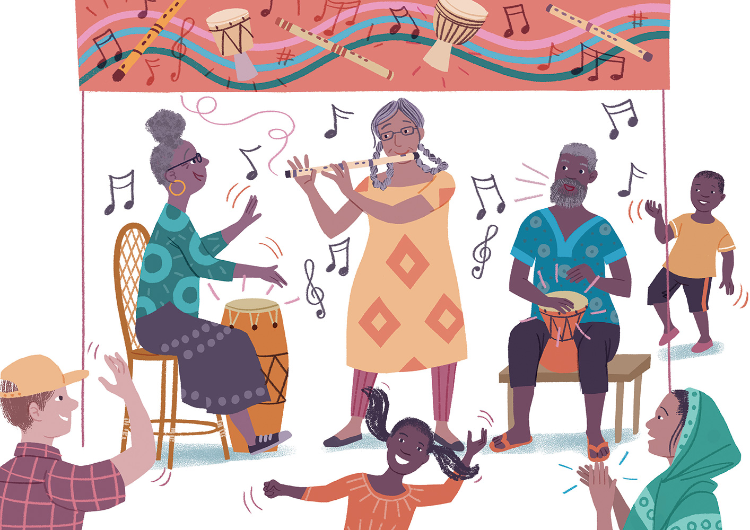
Notes:
fj<|fmdf<a iEu fj<| l=áhl§ u ;ukaj ms<s.kq ,nk nj fnr jdolhskag ye`.S hdug jir .Kkdjla .; jQ kuq;a" iEu i;shl u ishdkd" Tfkda iy whsßia tlaj Tjqkaf.a ysifla iqÿ ù we`.s<s oro`vq jk f;la u k<dfõ iy fnrfha .S; jdokh lrñka isákq olakg ,enqKd'

Slide 24
is;kak" úYajdi lrkak" wh;ajkak" m%.=K lrkak" m%Yak lrkak" mßj¾;kh lrkak" m%;slafIam lrkak'
Notes:
Tn ztlu;a tl ldf,lZ keu;s l=vd lKavdhï idlÉPdj y÷kajd fok úg fuu ia,hsvh m%o¾Ykh l< hq;= hs' ia,hsvfha we;s iEu jpkhla u hï wdldrhlska l;kaorhg iïnkaOù we;s nj u;l ;nd .kak'

Slide 25
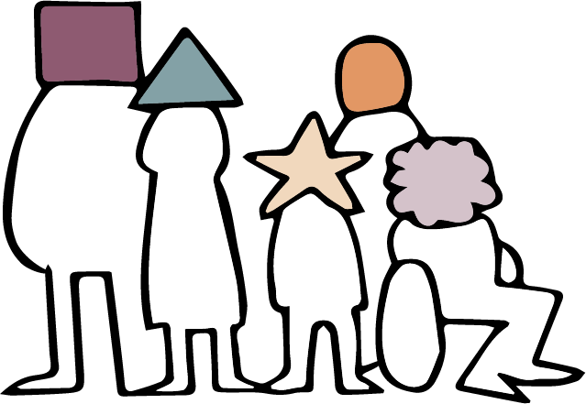
wd.u weoySfï fyda úYajdi oeÍfï ksoyi( wdrlaId lrkafka ljqrekajo" ke;fyd;a l=ula o@
Notes:
wxl 25 isg 46 olajd jk ia,hsv u.ska 2 jeks ieisfha bosßm;a lsÍu ksrEmKh lr ;sfí'
bÈßm;a lsÍu( is;Sfï" yDoh idlaIsfha" wd.u weoySfï iy úYajdi oeÍfï ksoyi
ye¢kaùu b;ska" wd.u weoySfï fyda úYajdi ±Ífï ksoyi u.ska wdrlaId lrkafka ljqreka o" ke;fyd;a l=ula o@
;¾ldkql+, ms<s;=r kï wd.ï iy úYajdi hehs Tng isf;kakg mq¿jka' kuq;a we;a; jYfhkau" wd.u weoySfï fyda úYajdi ±Ífï ksoyi u.ska ta ;=< we;s wd.ñl fyda fjk;a úYajdi wdrlaId lrkafka keye' th foúhka jykafiaj fyda mQckSh foa wdrlaId lrkafka keye' wfkla iEu udkj ysñlula u.ska fukau fuu.ska o wdrlaId lrkafka ñksiqkajhs'
fuu whs;shg lshk iïmQ¾K ku" is;Sfï" yDoh idlaIsfha" wd.u weoySfï fyda úYajdi ±Ífï ksoyig we;s whs;sh hs' fuu whs;sh u.ska mqoa.,hd ljqrekao" Tjqka úYajdi lrkafka l=ulao" Tjqka ljr wd.ulg wh;ao hkak fkdi,ld iEu ñksfil=f.au whs;sjdislï wdrlaId lrkjd'

Slide 26
udkj wjYHa;d iy udkj ysñlï
Notes:
wd.u weoySfï fyda úYajdi ±Ífï ksoyi mokï ù we;af;a ish¨‍ u ñksiqkag my; i|yka uQ,sl wjYH;d we; hk woyi u;hs(
is;Sug;a" hym;a yd i;H foa l=ula oehs ;ukag u ;SrKh lsÍug;a bv fokq ,eîug¦
fmdÿ úYajdi" ms<sfj;a iy wkkH;d iys; lKavdhïj,g wh;a ùug¦ iy
woyia yd ms<sfj;a m%Yak lsÍug" iy ;uqka úYajdi lrk foa .ek ;ukaf.a uki fjkia lr .ekSug iy ;ukaf.a yDoh idlaIshg úreoaO foa lsÍu m%;slafIam lsÍug'
is;Sug" úYajdi lsÍug" wh;a ùug" m%.=K lsÍug" m%Yak lsÍug" uki fjkia lr .ekSug iy m%;slafIam lsÍug'

Slide 27
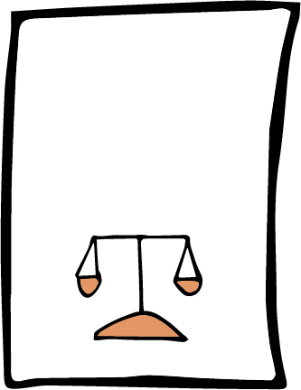
isú,a yd foaYmd,k whs;sjdislï ms<sn| cd;Hka;r iïuq;sh
ICCPR
Notes:
wmg ;sfnk whs;sjdislï fudkjdo@
b;ska" wmg we;s whs;sjdislï fudkjdo@ wms ±ka cd;Hka;r iïuq;sj, i|ykaù ;sfnk foa foi n,uq(
isú,a yd foaYmd,k whs;sjdislï ms<sn| cd;Hka;r iïuq;sfha (ICCPR) 18 jeks j.ka;sh u.ska wd.u weoySfï fyda úYajdi ±Ífï ksoyi wdrlaId lr ;sfnkjd'
fuh kS;sfhka ne£ isáh hq;= jk .súiqula jk w;r" rgj,a 173 la fuu cd;Hka;r kS;s wkq.ukh lsÍug fmdfrdkaÿù isákjd' ^iyNd.Sjkakkaf.a rg o fuu iïuq;sh ms<sf.k ;sfí oehs Tjqkag mjikak'&

Slide 28
iEu mqoa.,fhl=g u is;Sfï" yDoh idlaIsfha yd wd.u weoySfï ksoyi ;sìh hq;=h'
18 jeks j.ka;sh
Notes:
tys 18 jeks j.ka;sfha m<uq jeks jdlHfha fufia i|yka fjkjd(
—is;Sfï" yDoh idlaIsfha iy wd.u weoySfï ksoyi iEu mqoa.,fhl=gu ;sìh hq;=h'˜

Slide 29
is;kak
Notes:
;uka .eyeKq <ufhla jqk;a ;ukag k<dj me<£ug bv Èh hq;= hehs is;+" l;kaorfha isák ishdkd g jf.a u iEu flfkl=gu ;uka úiska u is;kakg whs;shla ;sfhkjd'

Slide 30
m%;slafIam lrkak
Notes:
;ukaf. mshdf.a l%shd jerÈ hehs úYajdi l< ksid mshdg Woõ lsÍu m%;slafIam l< fn%dakag jf.a wmf.a yDo idlaIshg weyqïlka §ug wmg;a whs;shla ;sfhkjd'

Slide 31
úYajdi lrkak" whs;s fjkak
Notes:
úYajdi ±Íug yd wh;a ùug" tkï wd.ñl fyda wd.ñl fkdjk úYajdi ±Íug iy wd.u fyda úYajdih mokï lr .;a wkkH;djhla we;s lr .ekSug wmg whs;shla ;sfnkjd' k<dfõ iy fnrfha l;dfõ .ïjeishka fuka wmf.ka fndfyda fofkla o wjxl úYajdi orkjd' wmf.a úYajdi iy wm tu úYajdi fnod.kakd mqoa., m%cdj wmg úYd, jYfhka jeo.;a fjkjd'

Slide 32
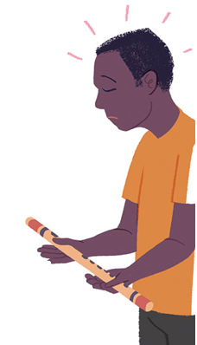
mßj¾;kh lrkak
Notes:
kuq;a wm Ôj;a jkafka l=uk iudchl jqk;a" wmf.a úYajdi fl;rï i;H iy ksjerÈ jqk;a" ;ukaf.a k<dj .,jd oud ;u m%cdj yer .sh fn%daka jf.a l=uk fya;=jla ksid fyda ;ukaf.a úYajdi fyda ;ukaf.a m%cdj flfrys úYajdih ke;s jqKq wh bkak mq¿jka'

Slide 33
isú,a yd foaYmd,k whs;sjdislï ms<sn| cd;Hka;r iïuq;sfha 18 jeks j.ka;sh(
;uka f;dard.kakd wd.ula weoySug fyda úYajdihla oeÍug we;s ksoyi fuu whs;shg we;=<;a úh hq;=h'
udkj ysñlï ms<sn| úYaj m%ldYkfha 18 jeks j.ka;sh(
;ukaf.a wd.u fyda úYajdih oeÍug fyda fjkia lsÍug we;s ksoyi fuu whs;shg we;=<;a úh hq;=h'
Notes:
cd;Hka;r udkj ysñlï kS;sfha §" Tfí wd.u weoySfï fyda úYajdi ±Ífï whs;sh iu. u Tfí wd.u fyda úYajdi yer hdug iy fjkia lsÍug we;s whs;sh;a wdrlaId fjkjd'

Slide 34
wNHka;r ksoyi
Notes:
is;Sug" úYajdi lsÍug" m%Yak lsÍug iy wmf.a úYajdi fjkia lsÍug we;s fuu whs;sjdislï fndfyda úg wNHka;r ksoyi f,i y÷kajkjd' tajd wmf.a ukfia iy wmf.a wd;aufha isÿfjñka mj;sk foaj,a ms<sn|j jk w;r" th wmf.a wkkH;djhg" ta lshkafk wms ljqrekao hkak ms<sn| wm ;=< we;s yeÕSug wod< fjkjd'
fï fya;=j ksid tajd mru whs;sjdislï fjkjd' cd;Hka;r kS;sh hgf;a lsis úfgl;a fuu whs;sjdislï iSud lsÍug lsisÿ mqoa.,fhl=g fyda rchlg wjir keye'
kuq;a we;a; jYfhkau" wd.u iy úYajdi lshkafk wfma ukfia yd wd;aufha isÿjk fohg jvd fndfyda fihska jeä fohlaæ wms lrk foa ms<sn|j;a - jpk iy l%shdjka ;=<ska wmf.a úYajdi m%ldY lrk wdldrh;a thg we;=<;a fjkjd'

Slide 35
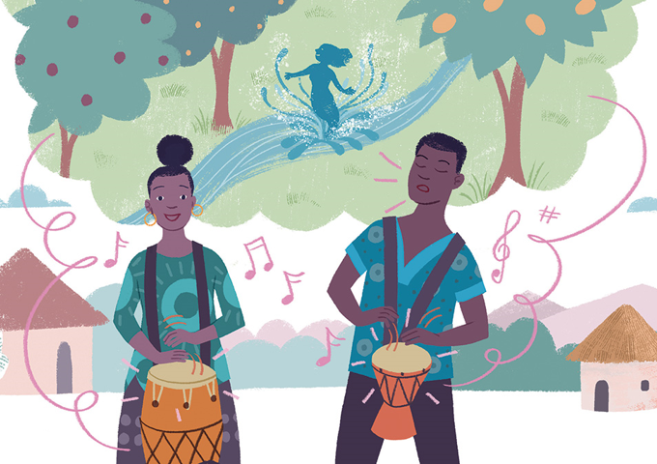
m%.=K lrkak
Notes:
wms wymq l;kaorfha" .ïjeishkaf.a Ôú; k<d me<£fï isg tÈfkod Ôú;fha fnr jdokh olajd jQ Tjqkaf.a úYajdi yd wh;aùu m%ldY flfrk ms<sfj;a j,ska msÍ ;snqKd' wd.u weoySfï fyda úYajdi ±Ífï ksoyi yryd fuu whs;sjdislï o wdrlaId lrkjd' wms kej; iïuq;sh foi n,uq(

Slide 36
mqoa.,slj fyda wfkla wh iu. m%cdj ;=<" iy m%isoaêfha fyda fm!oa.,slj jkaokd lsÍfïoS" weoySfïoS" ms<smeoSfïoS iy b.ekaùfïoS ;u wd.u fyda úYajdih m%ldY lsÍug we;s ksoyi ''' fuu whs;shg we;=<;a úh hq;= h'
18 jeks j.ka;sh
Notes:
18 jeks j.ka;sfha fufia i|yka fjkjd(
mqoa.,slj fyda m%cdj ;=< fjk;a wh iu. iy m%isoaêfha fyda fm!oa.,slj" jkaokd lsÍfï§" ms<sme§fï§" m%.=K lsÍfïoS iy b.ekaùfï§ ;u wd.u fyda úYajdih m%ldY lsÍug we;s ksoyi ''' fuu whs;shg we;=<;a jkafkah'
wmsg mqoa.,slj hdÉ{d lsÍug iy iduqysl jkaokd lsÍï iy iïm%odhka iys;j m%cdjl fldgila f,i wmf.a wd.u weoySug fyda úYajdi m%ldY lsÍug whs;shla ;sfnkjd' tu m%cdjg;a whs;sjdislï ;sfnkjd - tajd ;u m%cdfõ idudðlhkaj md,kh lsÍfï whs;sjdislï fkdfjhs" tajd rdcHh iïnkaOfhka mj;sk whs;sjdislï' WodyrKhla úÈhg" wd.ñl yd úYajdi m%cdjkag wjYH kï nexl= .sKqï mj;ajd .ekSug" ñksiqka fiajfha fhoùug iy f.dvke.s,s whs;s lr .ekSug yels jk mßÈ Tjqkag kS;suh wkkH;djhla ,nd .; yels njg rdcHhka iy;sl úh hq;=hs'
mqoa.,hskag iy lKavdhïj,g wd.ula weoySug fyda úYajdihla ±Íug úúO l%u ;sfnkjd' wdrlaId lrk ,o l%shdldrlï ms<sn| WodyrK tlai;a cd;Skaf.a úfYaI{hska ´kE ;rï ,nd § ;sfnkjd' WodyrKhla f,i" wmsg my; i|yka l%shdldrlï isÿlrkakg whs;sjdislï ;sfnkjd(

Slide 37
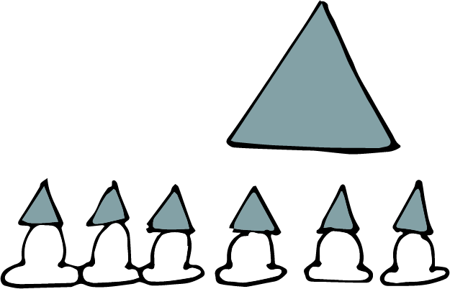
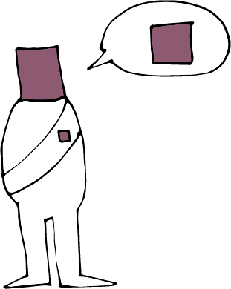
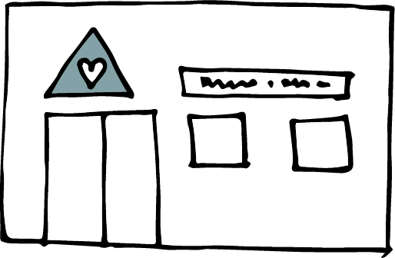
Notes:
jkaokd lsÍu i|yd tla/ia ùug" W;aij ieuÍug iy wd.ñl ms<sfj;a lrk Èkj, j;dj;a lsÍug'
wd.ñl we÷ï we£ug iy úfYaI wdydr fõ,a .ekSug'
mQckSh ia:dk iy iqidk N+ñ ;sîug iy wd.ñl ixfla; m%o¾Ykh lsÍug'
iudcfha ld¾hNdrhla bgq lsÍug¦ WodyrKhla f,i" mqKHdh;k msysgqùug" iy
wd.u fyda úYajdi .ek l:d lsÍug iy b.ekaùug" iy kdhlhska mqyqKq lsÍug fyda m;a lsÍug'
fuu wjia:dfjys§" Tn fufia is;kjd úh yelsh( —úYsIaGhs - fï wdldrfha whs;sjdislï ;uhs uf.a m%cdjg;a wjYHæ˜' ke;skï Tn lkiai,a,g m;afjkjd úh yelshæ

Slide 38
Notes:
iafõÉPdjdoh yd iudkd;au;djh - wka whg ydkshla fkdlrkakæ
m%j¾Okh lsÍu i|yd ;u wd.u fyda úYajdi Ndú;d lrk" wka whg fjkia fldg i,lk fyda ;u lKavdhu ;=< isák wka whj hgm;a lrk iy md,kh lrk mqoa.,hska .ek l=ula lsj yelso@
wd.u weoySfï fyda úYajdi ±Ífï ksoyi hkafkka woyia lrkafka" wfkla mqoa.,hskag l=uk n,mEula we;s jqj;a" Tjqkag tfia lsÍug ksoyi we;s njo@
jdikdjg th tfia fkdfõæ

Slide 39
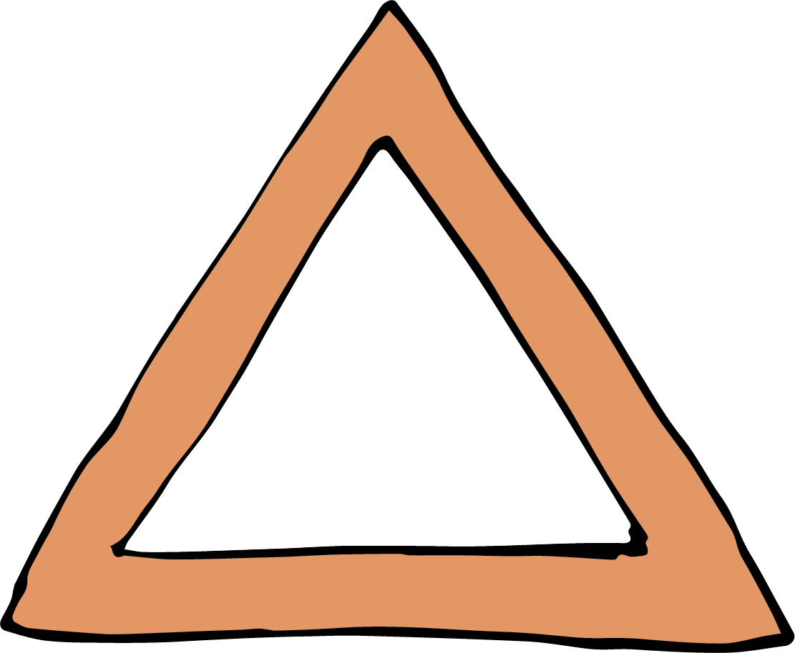
udkj j.lSï
Notes:
udkj ysñlï iïuq;Ska wmf.a whs;sjdislï fudkjdo hkak fukau wmf.a whs;sjdislï i|yd we;s iSudjka fudkjdo hkak;a wmg lshd fokjd' fjk;a wdldrhlska lshkjd kï - wmf.a whs;sjdislï l%shd;aul lsÍfï§ wm i;= j.lSï fudkjdo hkak lshd fokjd'
lsisfjla ;ukaf.a whs;sjdislï iy ksoyi wka whg ydkshla jk whqßka Ndú;d fkdl< hq;=hs lshd wmg fuu j.lSï idrdxY.; l< yelshs' udkj ysñlï iïuq;Skag wkqj fuh iEu mqoa.,fhl=f.a u iodpdrd;aul hq;=lula'
iEu flfkl=f.a u whs;sjdislïj,g .re lsÍug;a" iEu flfkl=u ydksj,ska wdrlaId lsÍug;a rchg kS;suh j.lSula ;sfnkjd'
±ka wms ydksùfuka wm wdrlaId úh hq;= wdldrh jvd;a meyeos,s lr.ksuq'

Slide 40
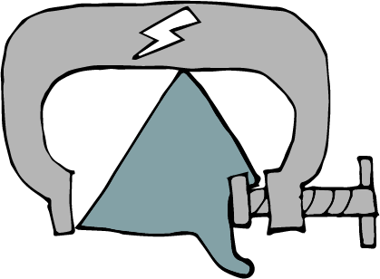
n,y;aldrh i|yd wjir ke;'
18 jeks j.ka;sh
Notes:
m<uqj( n,y;aldrhla fkd;sìh hq;=hsæ
wd.u weoySu fyda úYajdi ±Íu hk ldrKdj,§ n,y;aldrhg wjir keye' úYajdi lsÍu yd wh;aùu iafõÉPdfjka isÿ úh hq;=hs' hful=g úYajdi lsÍug fyda úYajdi fkdlsÍug" ms<sfj;a bgq lsÍug fyda fkdlsÍug" wd.ulg wh;a ùug fyda wh;a fkdùug n,lsÍu i|yd n,OdÍkag" úYajdi woyk m%cdjkag iy mjq,aj,g ;¾ckh lsÍï" ìh .ekaùï fyda m%pKav;ajh fhdod .ekSug wjir keye'

Slide 41
fjkiafldg ie,lSu i|yd wjir ke;'
2 jeks j.ka;sh
Notes:
fojkqj( fjkiafldg ie,lSu fkdl< hq;=hæ
iïuq;sfha 2 jeks j.ka;sh u.ska" wd.u" cd;sh" ia;%S mqreI iudcNdjh fyda NdIdj hkdoS lreKla u;" ljr fyda wdldrhlg fjkiafldg ie,lSu ;ykï lr ;sfnkjd' udkj ysñlï .súiqï w;aika lr we;s rdcHhka" iEu flfkl=gu tl yd iudkj ie,lSug;a" wm bf.k .;a l;kaorfha fj<|fmd< iNdj úiska isÿ lrk ,o mßÈ" iudcfha fjkiafldg ie,lSu wjika lsÍu i|yd l%shdYS,Sj lghq;= lsÍug;a tlÕ ù ;sfnkjd'

Slide 42
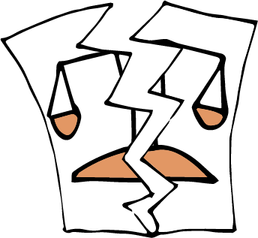
lsisfjla hï whs;shla fjk;a udkj ysñlï úkdY lsÍu i|yd Ndú;d fkdl< hq;=h'
5 jeks j.ka;sh
Notes:
f;jkqj( whs;sjdislï úkdY fkdl< hq;=hæ
5 jeks j.ka;sfha i|yka jkafka tla udkj ysñlula fjk;a udkj ysñlï úkdY jk whqßka l%shd;aul lsÍfï whs;sh ,efnkakla f,i w¾: oelaùug lsisÿ rchlg" lKavdhulg fyda mqoa.,fhl=g wjir ke;s njhs'
20 jeks j.ka;sh u.ska fjkia fldg ie,lSug" tÈßjdÈlï j,g fyda m%pKav;ajhg fmd<Ujd .ekSu yryd wd.ñl ffjrh me;sÍu fjkqfjka fmkS isàu ;ykï lrhs'
hï wd.ula u.ska ;ukaf.ka b,a,d isákafka l=ulao hkak ms<sn|j rchla fyda mqoa.,fhla l=ula is;=j;a" wd.u weoySfï fyda úYajdi ±Ífï ksoyi u.ska ;ukag fjk;a ck;djkaf.a whs;sjdislï md.d oeóug whs;shla ,nd fokafka hehs lsisfjl=g ;¾l l< fkdyelshs' tneúka" fnr jdolhskag ysßyer lsÍu ksjerÈ foh hehs fn%daka f.a mshd is;=j o" Tyqg tfia lsÍug whs;shla ke;'
m%pKav;ajh idOdrKSlrKh lrkakg fyda Wis.ekaùug wd.u fhdod.kakd wjia:d fyda ñksiqkag ydks lrk wd.ñl j;ams<sfj;a ms<sn| WodyrK ´kE ;rï Tfí is;g kef.kjd we;s nj ug úYajdihs' ñksiqka iduldój ;u wd.u weoySu fyda úYajdi ±Íu widOdrK f,i j<lajk ,o wjia:d .eko Tfí is;g kef.kjd we;s'

Slide 43
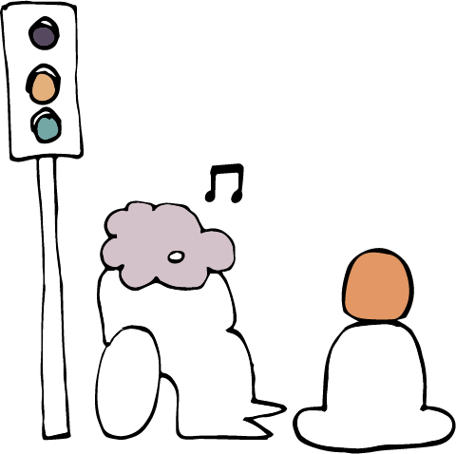
iSudlsÍï ke;æ
iSudlsÍï@
Notes:
wd.u weoySfï fyda úYajdi ±Ífï ksoyig we;s iSud
tfyukï" fï kS;s fudkjdo@
rchkag wd.ï weoySfï fyda úYajdi ±Ífï ksoyi iSud lrkakg wjir ,efnk wjia:d fudkjdo@ wms fï kS;s ms<sn| blaukska úuid n,uq'
m<uqfjka u" is;Sug yd úYajdi lsÍug we;s whs;sh ^wNHka;r ksoyi& lsis úfgl;a iSud l< fkdyelshs'
fojkqj" wd.u weoySfï fyda úYajdi ±Ífï ksoyi iSud lrkq ,eìh yelshs - kuq;a tfia l< yelafla my; i|yka kS;s y;r wkq.ukh lrk úg muKhs(

Slide 44
iSudlsÍï(
1. kS;sfhys ,sÅ;j ;sìh hq;=h’
2. iudkqmd;sl úh hq;=h’
3. fjkia fldg i,lk wdldrfha fkdúh hq;=h’
4. uyck fi!LHh" uyck iduh" uyck wdrlaIdj" uyck iodpdrh fyda fjk;a mqoa.,hskaf.a whs;sjdislï iy ksoyi wdrlaId lsÍu i|yd wjYH úh hq;= fõ'
Notes:
1' iSudj úia;r flfrk kS;shla ;sìh hq;=hs' fjk;a jpk j,ska lsjfyd;a" fmd,sishg Tjqka leu;s leu;s foa l< fkdyelshs'
2' mkjk iSudj" tu.ska úi£ug W;aidy lrk .eg¨‍jg iudkqmd;sl úh hq;=hs' WodyrKhla f,i" hï úYajdihla woyk m%cdjlf.a YíojdyskS moaO;sh b;d f>daIdldÍ kï" tys y`v wvq lrk f,ig fyda ovhlg hg;a jk f,i tu weoys,s m%cdjg ksfhda. lrkq ,eìh yelshs' Tjqka tla/iaùu iïmQ¾Kfhkau ;ykï lsÍu iudkqmd;sl fkdfjhs'
3' ish¨u iSud lsÍï fjkiafldg ie,lSfuka f;dr úh hq;=hs - tajd iEu flfkl=gu wod< úh hq;=hs'
4' tu iSud lsÍï my; i|yka foaj,ska tlla wdrlaId lsÍu i|yd wjYH úh hq;=hs( uyck wdrlaIdj" uyck iduh" uyck fi!LHh" uyck iodpdrh fyda mqoa.,hskaf.a fjk;a whs;Ska iy ksoyi'
zwjYHZ hk jpkh we;a;g u jeo.;a' iSud lsÍï mekùu iqÿiqhs lshd rch fyda ck.ykfhka nyq;rhla úiska is;Su muKla m%udKj;a jkafka keye¦ iSudj mekùu wjYH úh hq;=hs' fjk;a jpk j,ska lsjfyd;a" wod< whs;sjdislï iSud fkdlr tu ms<sfj;a yryd ks¾udKh jQ .eg¿j úi£fï fjk;a l%uhla fkd;sìh hq;=hs' whs;sjdislï iSud lsÍu hkq wjidk úi÷uls' tfia jqj;a" iuyr úg th wjYH fõ'

Slide 45
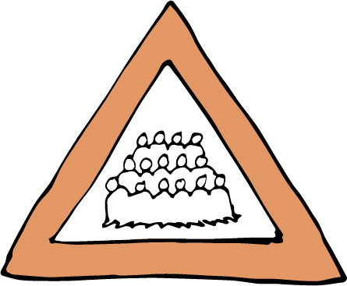
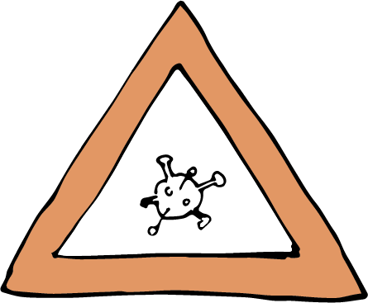
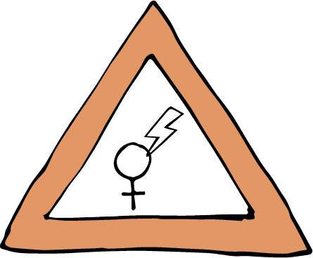
kS;Hdkql+, iSudlsÍï
Notes:
WodyrKhla .ksuq – ´kEjg jvd ñksiqka ixLHdjla mQckSh ia:dkhlg tla/ia ùu wk;=reodhl úh yelsh' tneúka" uyck wdrlaIdj u; mQckSh ia:dkhg we;=,aùug wjir Èh yels mqoa.,hska ixLHdj iSud lsÍug n,OdÍkag wjYH úh yelshs'
fldfrdakd ffjria jix.;h ;=<§ jkaokd lsÍu i|yd tla/iaùï iïnkaO uyck fi!LH iSud lsÍï b;d iq,N ù ;sfnkjd – iuyr úg fï iSudjka wjYH" iudkqmd;sl yd fjkia fldg fkdi,lk tajd fõ' iuyr úg tajd w;sYhska fjkia fldg i,lk yd wiudkqmd;sl iajNdjfhka hqla;hs'
ldka;djkaf.a ,sx.fþokh ;ykï lsÍu wka whf.a" tkï fï wjia:dfõ§ .eyeKq <uhskaf.a whs;sjdislï iy ksoyi wdrlaId lrk iSud lsÍulg WodyrKhla' fuh ixialD;sl fyda wd.ñl ms<sfj;la f,i i,lkq ,enqj;a" th .eyeKq <uhskaf.a fi!LHhg wk;=reodhl jk w;r" wd.u weoySfï fyda úYajdi ±Ífï ksoyig wod<j th idOdrŒlrKh l< fkdyelshs'

Slide 46
iSudlsÍï(
1. kS;sfhys ,sÅ;j ;sìh hq;=h’
2. iudkqmd;sl úh hq;=h’
3. fjkia fldg i,lk wdldrfha fkdúh hq;=h’
4. uyck fi!LHh" uyck iduh" uyck wdrlaIdj" uyck iodpdrh fyda fjk;a mqoa.,hskaf.a whs;sjdislï iy ksoyi wdrlaId lsÍu i|yd wjYH úh hq;= fõ'
Notes:
fuu kS;s we;a; jYfhka u jeo.;a' tu kS;s ke;s kï rchhkag ;uka wleu;s ´kEu lKavdhula fyda ms<sfj;la iSud lsÍug yelshs' iSud lsÍï lshkafka wjidk úi÷ula ñi rdcH md,kh i|yd jk fuj,ula fkdfjhs' ó<Õ ieisfha§ wms f,dalh mqrd isÿjk úúO wdldrfha wd.u weoySfï fyda úYajdi ±Ífï ksoyi W,a,x>kh ùï ms<sn|j jvd;a .eUqßka úuid n,uq'

Slide 47
igyk( fuysoS wd.u weoySfï fyda úYajdi oeÍfï ksoyi iïnkaOfhka Tfí rfÜ kS;sh u.ska kshu lr we;s foa ms<sn| ia,hsv tlla fyda lsysmhla fuhg tla lsÍug Tng wjYH úh yel'
Notes:
igyk( fuys§ wd.u weoySfï fyda úYajdi ±Ífï ksoyi iïnkaOfhka Tfí rfÜ kS;sfhka kshu lr we;s foa ms<sn| ia,hsv tlla fyda lsysmhla tla lsÍug Tng wjYH úh yelsh'

Slide 48
PdhdrEmh( Robbi Akbari Kamaruddin / Alamy Stock Photo
Notes:
wxl 48 isg 60 olajd jk ia,hsv zwmf.a oji ;=< wd.u weoySfï fyda úYajdi ±Ífï ksoyiZ keu;s wNHdihg iïnkaO fõ' lÓlhd i|yd jk igykaj, we;s mdGh lshjñka fyda ta yd iudk fohla mjiñka tajd Ndú;d lrkak'
Tfí Ôú;fha idudkH Èkhla .ek is;kak'
^hdÉ{d lsÍug fmr uqia,sï mqoa.,fhla w;mh fidaod msßisÿ fjhs" bkaÿkSishdj&

Slide 49
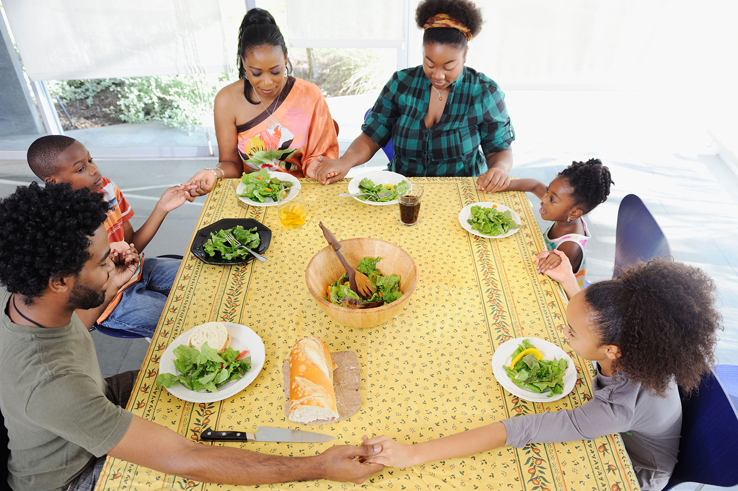
PdhdrEmh( Tetra Images, LLC / Alamy Stock Photo
Notes:
Tfí woyia" úYajdi" m%Yak wdosh m%ldY lrkafka l=uk wjia:dj,oSo iy flfiao'''
^l%sia;shdks mjq,la lEug fmr zia;=;shZ m%ldY lrhs" weußld tlai;a ckmoh&

Slide 50
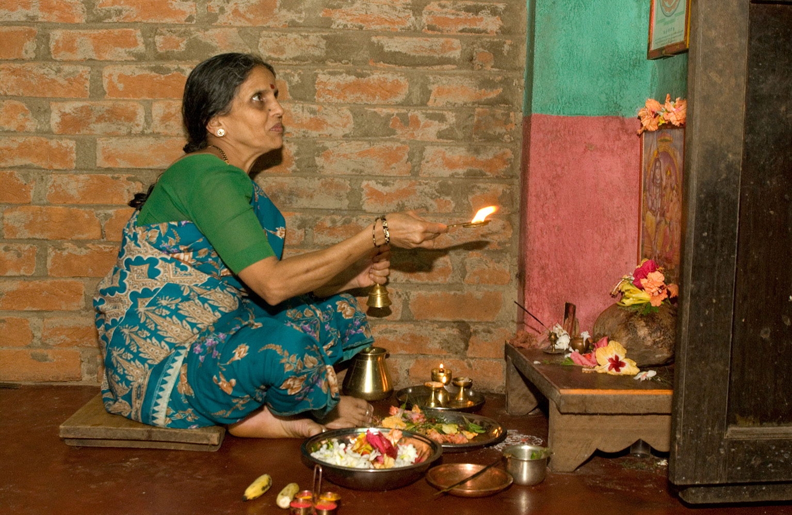
PdhdrEmh( Simon Rawles / Alamy Stock Photo
Notes:
''' tfuka u wd.ñl fyda wd.ñl fkdjk wh;aùu iy wkkH;dj ms<sn| Tfí yeÕSu m%ldY lrkafka l=uk wjia:dj,o iy flfiao@
^yskaÿ ldka;djla ish ksjfia l=áh ;=< hdÉ{d lrhs" bkaÈhdj&

Slide 51
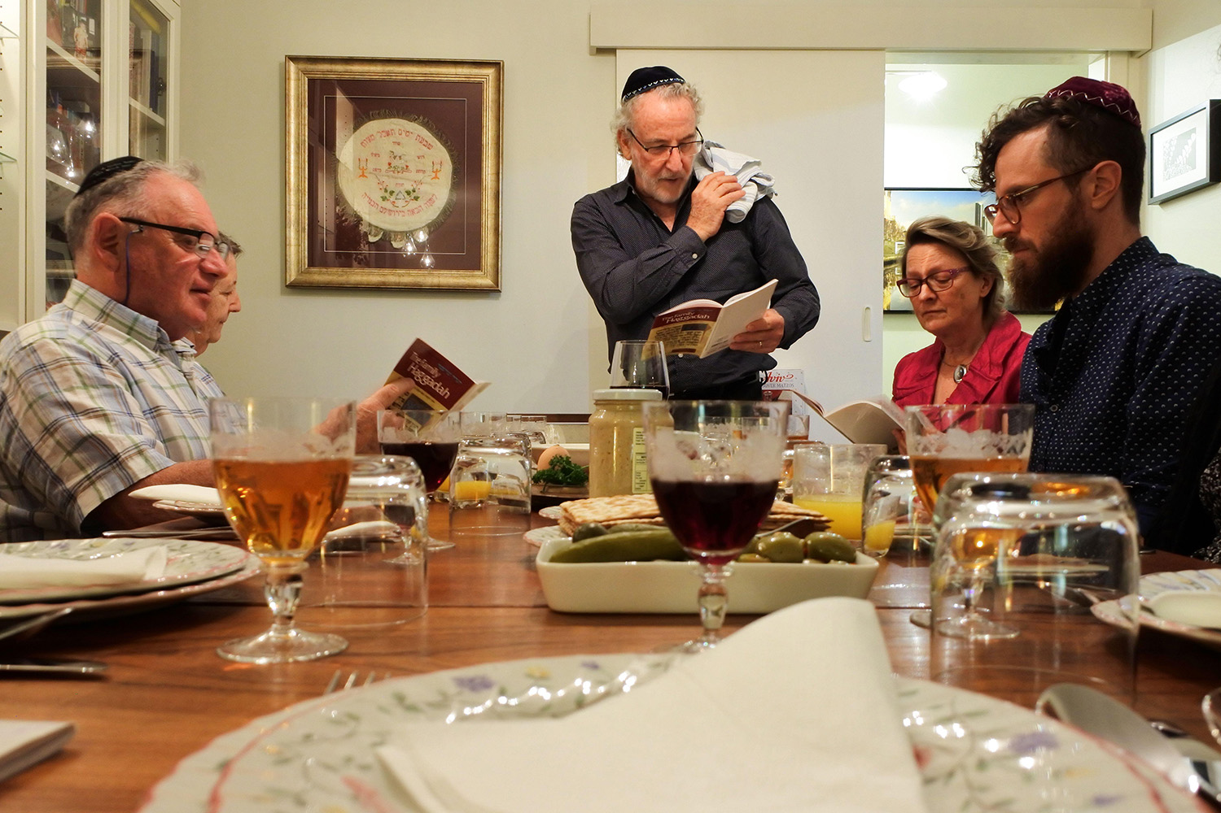
PdhdrEmh( Rafael Ben Ari / Alamy Stock Photo
Notes:
th Tn lEug .kakd foa ;=< ;sìh yelsh '''
^hqfoõ mjqf,a mdial= fNdackh" ´iafÜ%,shdj&

Slide 52
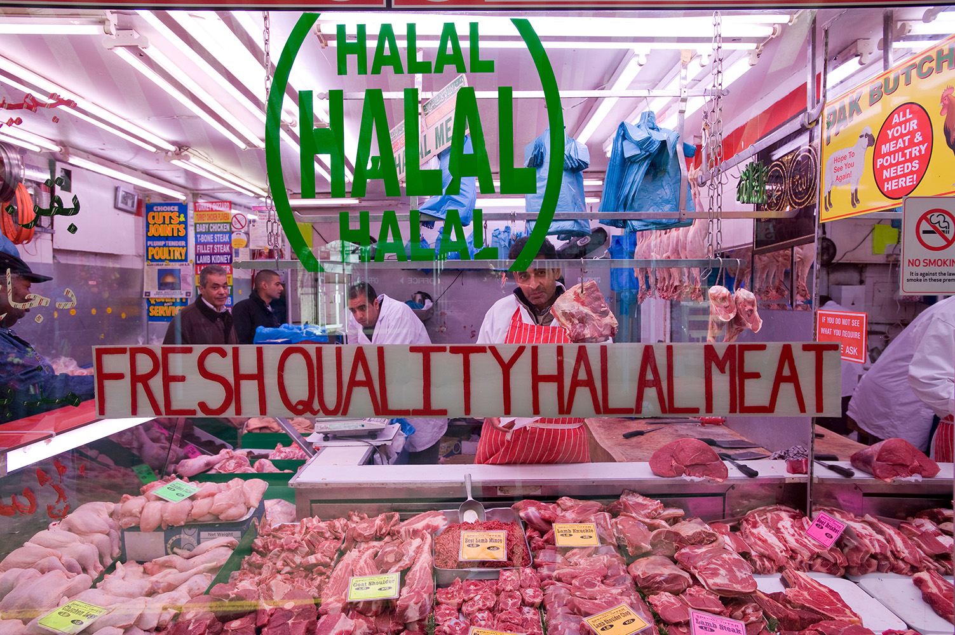
PdhdrEmh( Gregory Wrona / Alamy Stock Photo
Notes:
''' ke;skï lEug fkd.kakd foa ;=< ;sìh yelsh'
^y,d,a uia fjf<kaoka" ,kavka&

Slide 53
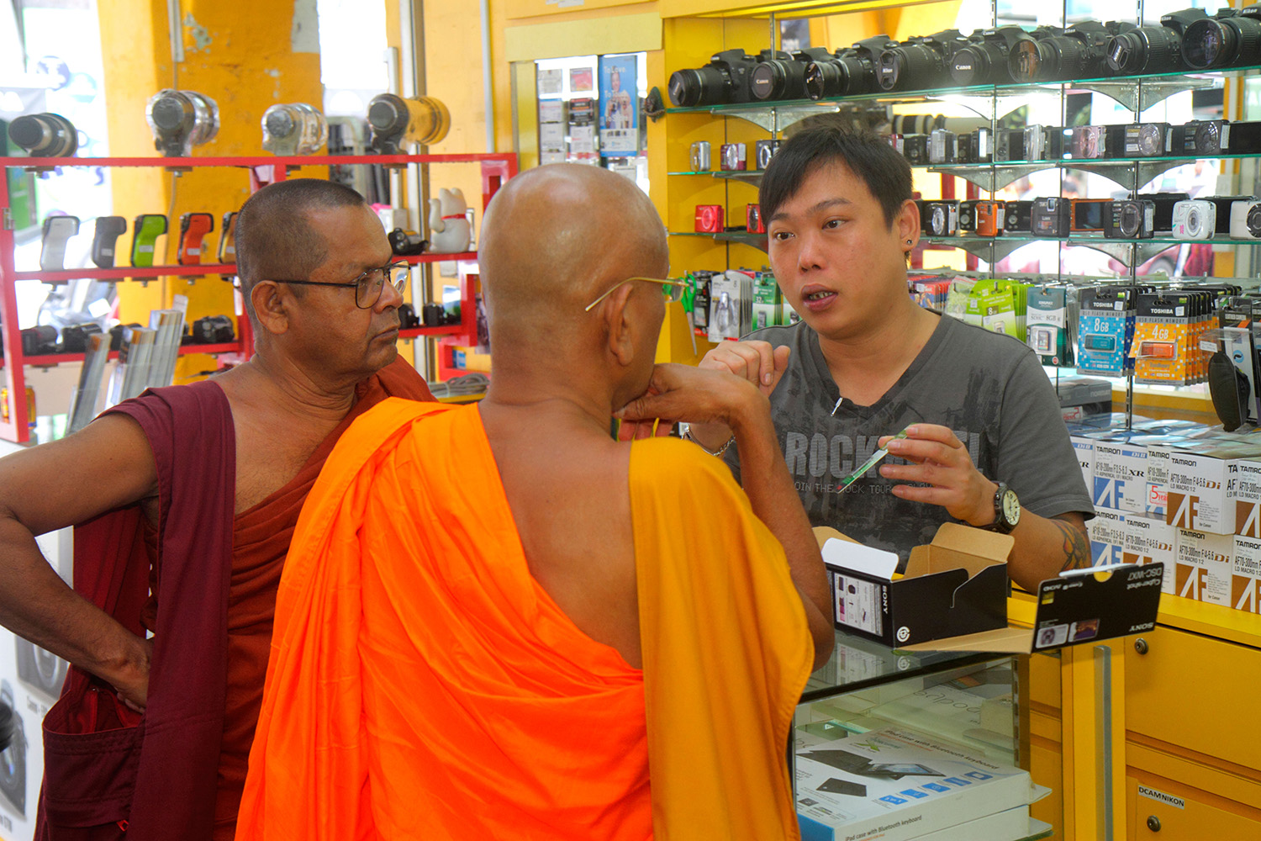
PdhdrEmh( Jeffrey Isaaz Greenberg / Alamy Stock Photo
Notes:
Tn w¢k m<¢k foa ;=< '''" tfyu ke;akï w|skafka m<|skafka ke;s foa ;=< ;sìh yelsh'
^fn!oaO NslaIQka jykafia idmamqjlska NdKav .ksñka" isx.mamQrej&

Slide 54
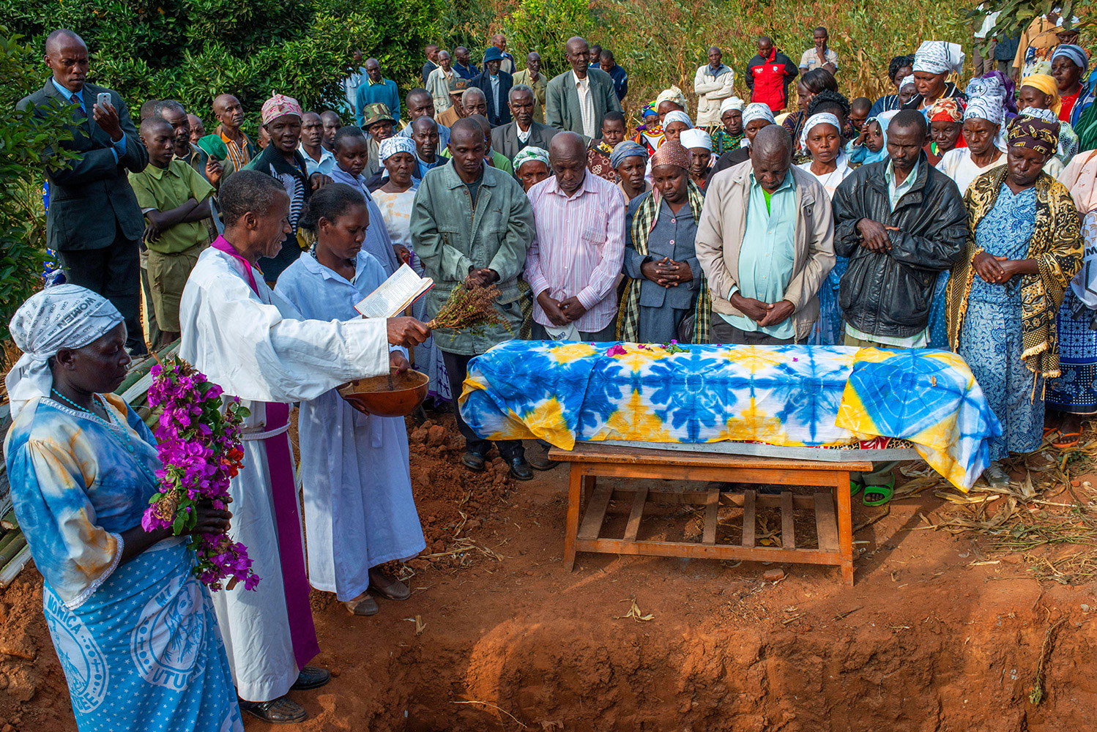
PdhdrEmh( Sergi Reboredo / Alamy Stock Photo
Notes:
hdÉ{d fyda pdß;% ;=< ;sìh yelsh'''
^COVID iy taâia frda.hg f.dÿre jQjl=f.a wjux.,H lghq;=" flkahdj&

Slide 55
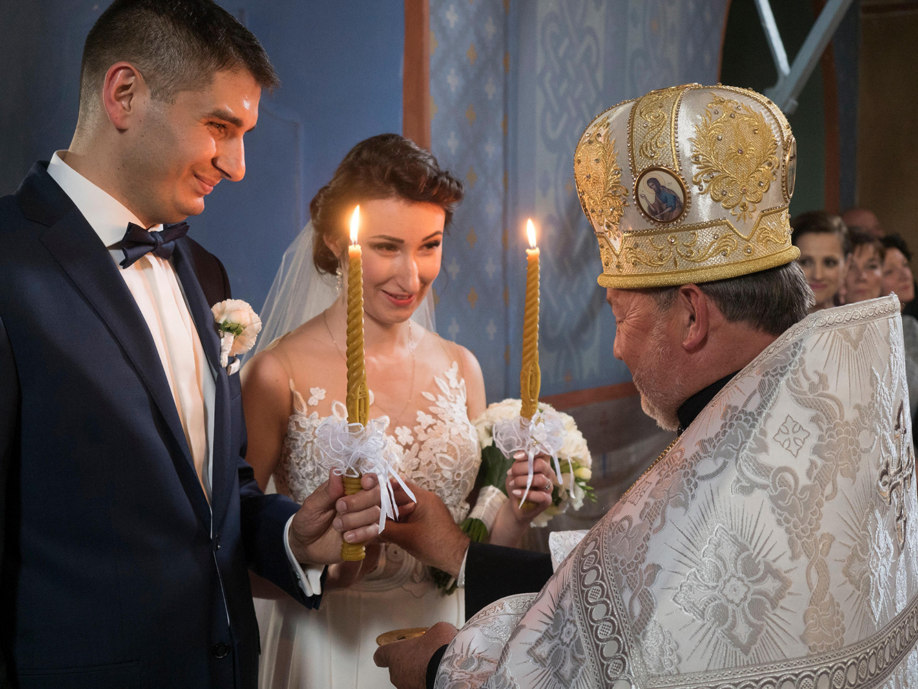
PdhdrEmh( Agefotostock / Alamy Stock Photo
Notes:
''' tfia ke; fyd;a Ôú;fha m%Odk wjia:d ieuÍï ;=< ;sìh yelsh'
^´f;dfvdlaia l%sia;shdks újdy W;aijhla" fmda,ka;h&

Slide 56
PdhdrEmh( Dieddin Alsoub / Alamy Stock Photo
Notes:
Tn lshjk foa ;=< ;sìh yelsh'
^uqia,sï mjq,la fmd;a idlÉPd lrñka&

Slide 57
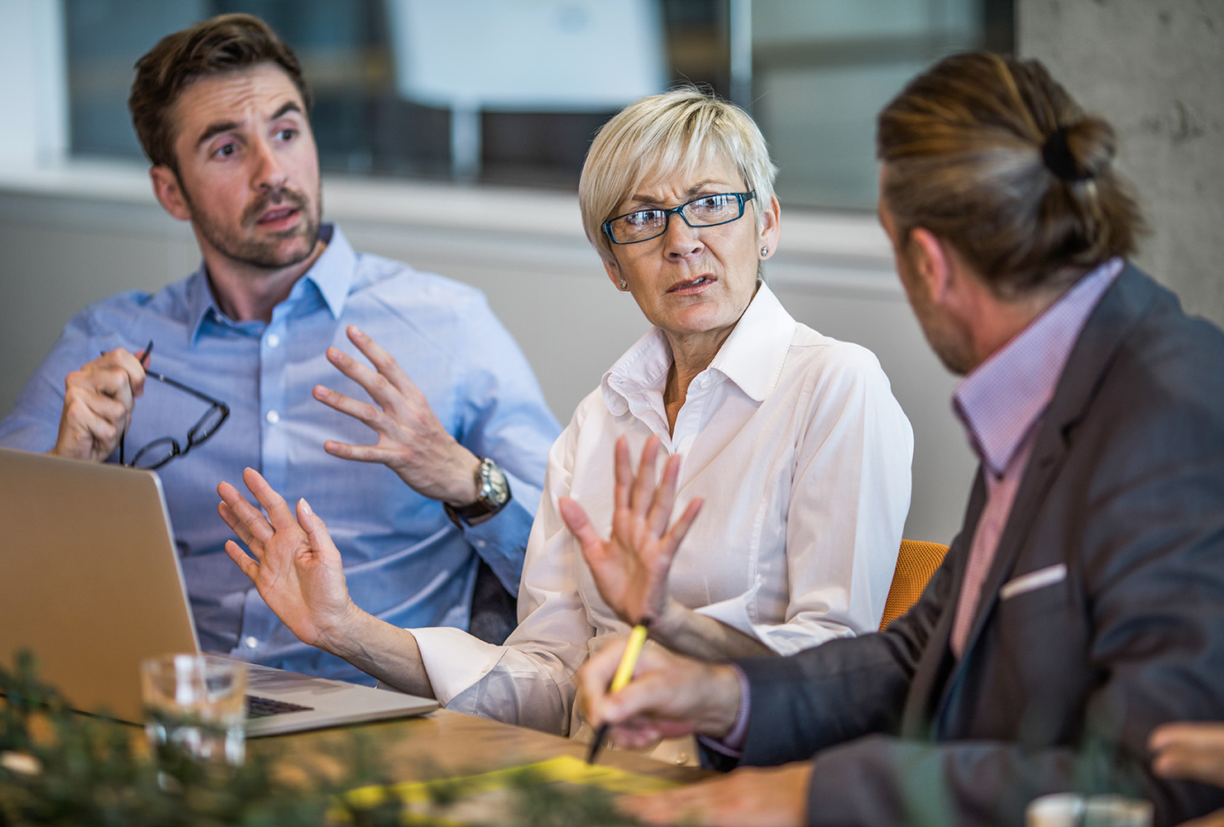
PdhdrEmh( Skynesher/Istock
Notes:
Tfí mjqf,a wh" ñ;=rka fyda i.hka iu. Tn isÿ lrk ixjdo ;=< ;sìh yelsh'
^i.hka ;¾l lrñka&

Slide 58
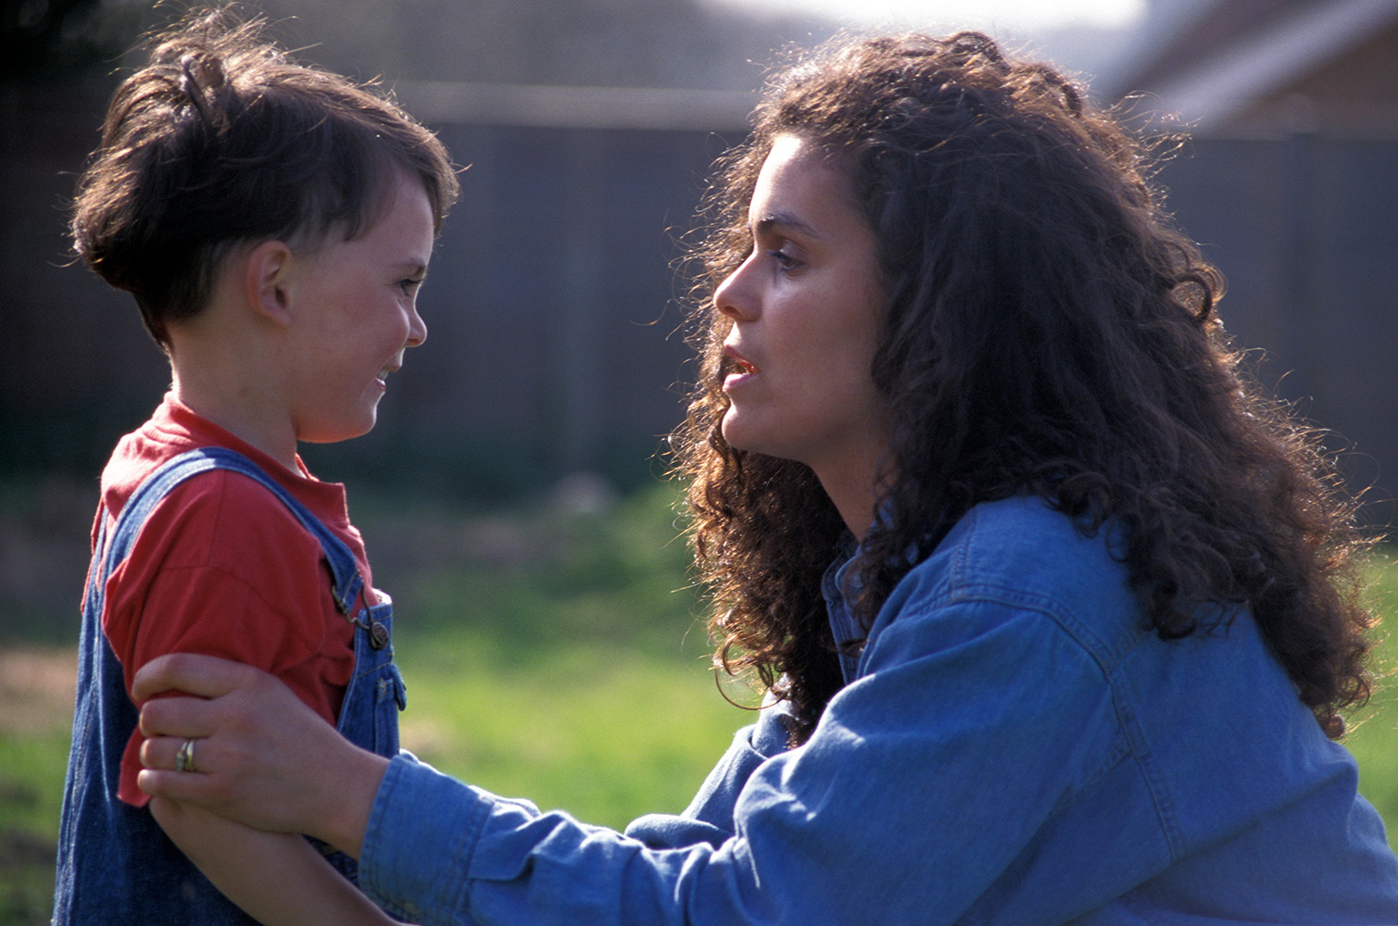
PdhdrEmh( Angela Hampton Picture Library / Alamy Stock Photo
Notes:
Tn Tfí orejka we;s oeä lrk wdldrh ;=< ;sìh yelsh'
^wïud orejdg ;rjgq lrñka&

Slide 59
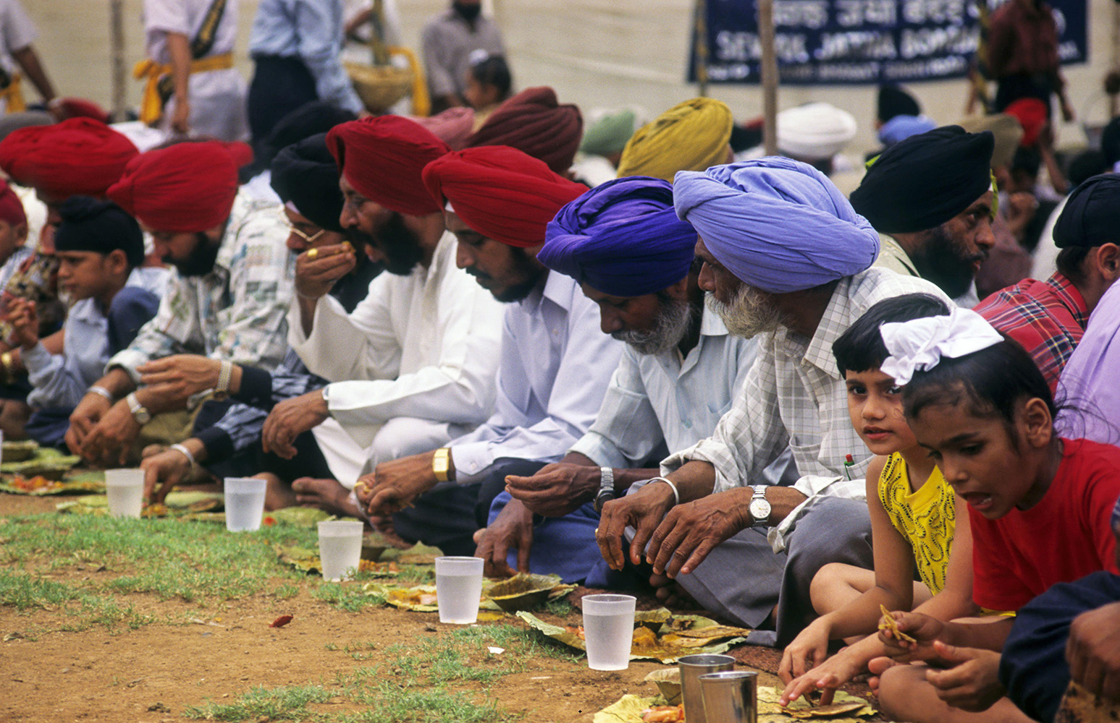
PdhdrEmh( Dinodia Photos / Alamy Stock Photo
Notes:
Tn m%cdjg fiajh lrk wdldrh ;=< ;sìh yel '''
^iSla m%cd uq¿;ekaf.h" bkaÈhdj&

Slide 60
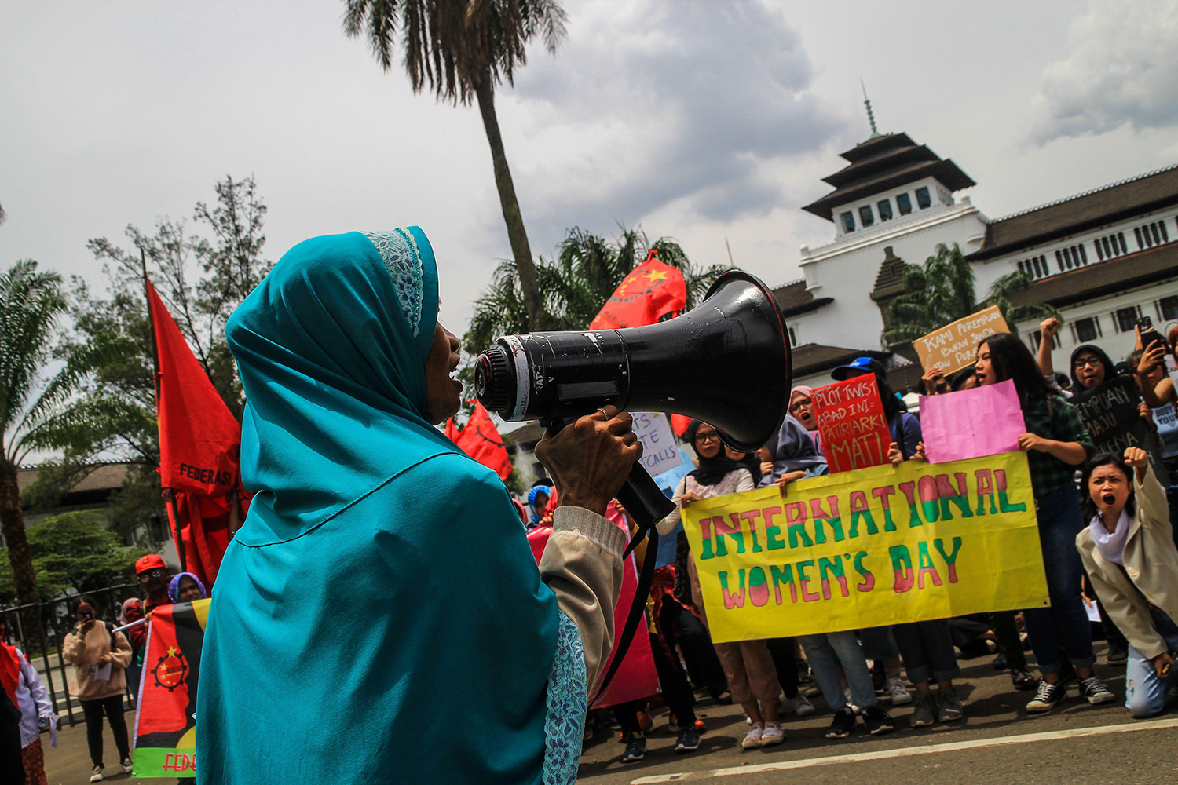
PdhdrEmh( SOPA Images Limited / Alamy Stock Photo
Notes:
ke; fyd;a" iudcfha Tng wod< jk .eg¿ i|yd iïnkaOùu ;=< ;sìh yel'
^ldka;d whs;sjdislï fjkqfjka úfrdaOh oelaùu" bkaÿkSishdj&

Slide 61
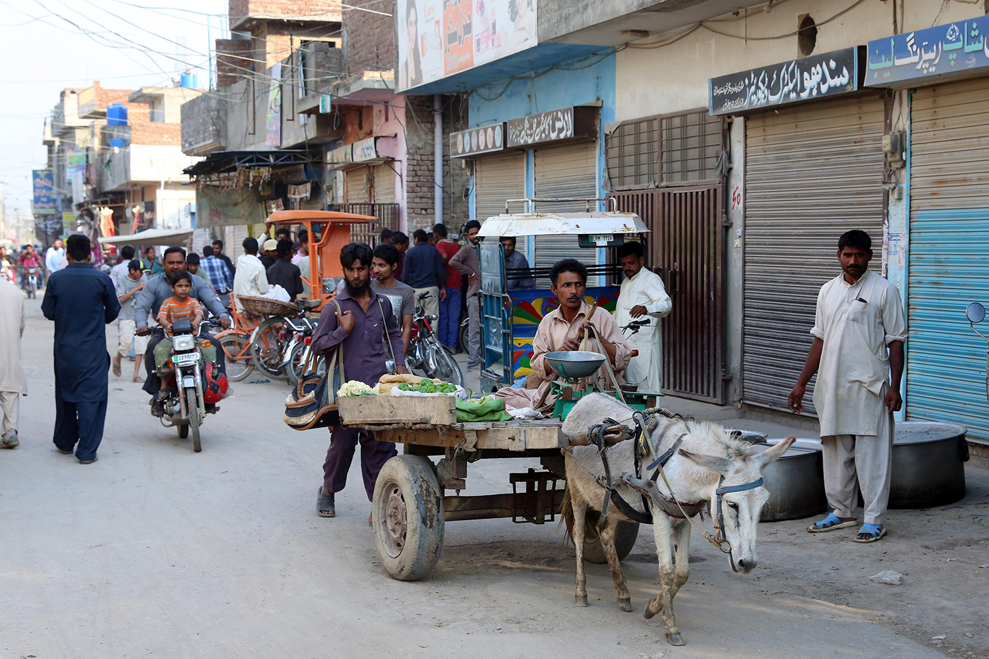
PdhdrEmh(Friedrich Stark / Alamy Stock Photo
Notes:
wxl 61 isg 63 olajd jk ia,hsv j,ska ieisfha wjidk woyia oelaùï i|yd fhdod .kq ,nk mSg¾f.a l:dj ksrEmKh lrhs'
mSg¾ f.a l;dj" mdlsia;dkh
mSg¾ lshkafka mdlsia;dkfha ,dfyda¾ k.rhg wh;a" m%Odk jYfhka u uqia,sï ck;dj cSj;a jk fldaÜ ,dlamd;a m%foaYfha cSj;a jQ l%sia;shdks m%cdjla i|yd fjkila we;s lsÍug Wmldr l< ;reKfhla' iEu WoEiklu mSg¾ ;ukaf. oji wdrïN lrkafka m%dfoaYSh l%sia;shdks rEmjdyskS kd,sldjl foaj.e;sjrfhla bÈßm;a lrk foaj fufyhla keröfuka wk;=rejhs' —ug Y=oaOjQ ,shú,s lshùug fyda nhsn,a wOHhk lKavdhïj,g iyNd.S ùug jeh lrkak lrï ld,hla keye' kuq;a fï foaj fufyh keröu uf.a oji wdrïN lrkak lÈu l%uhla˜" Tyq mjihs'

Slide 62
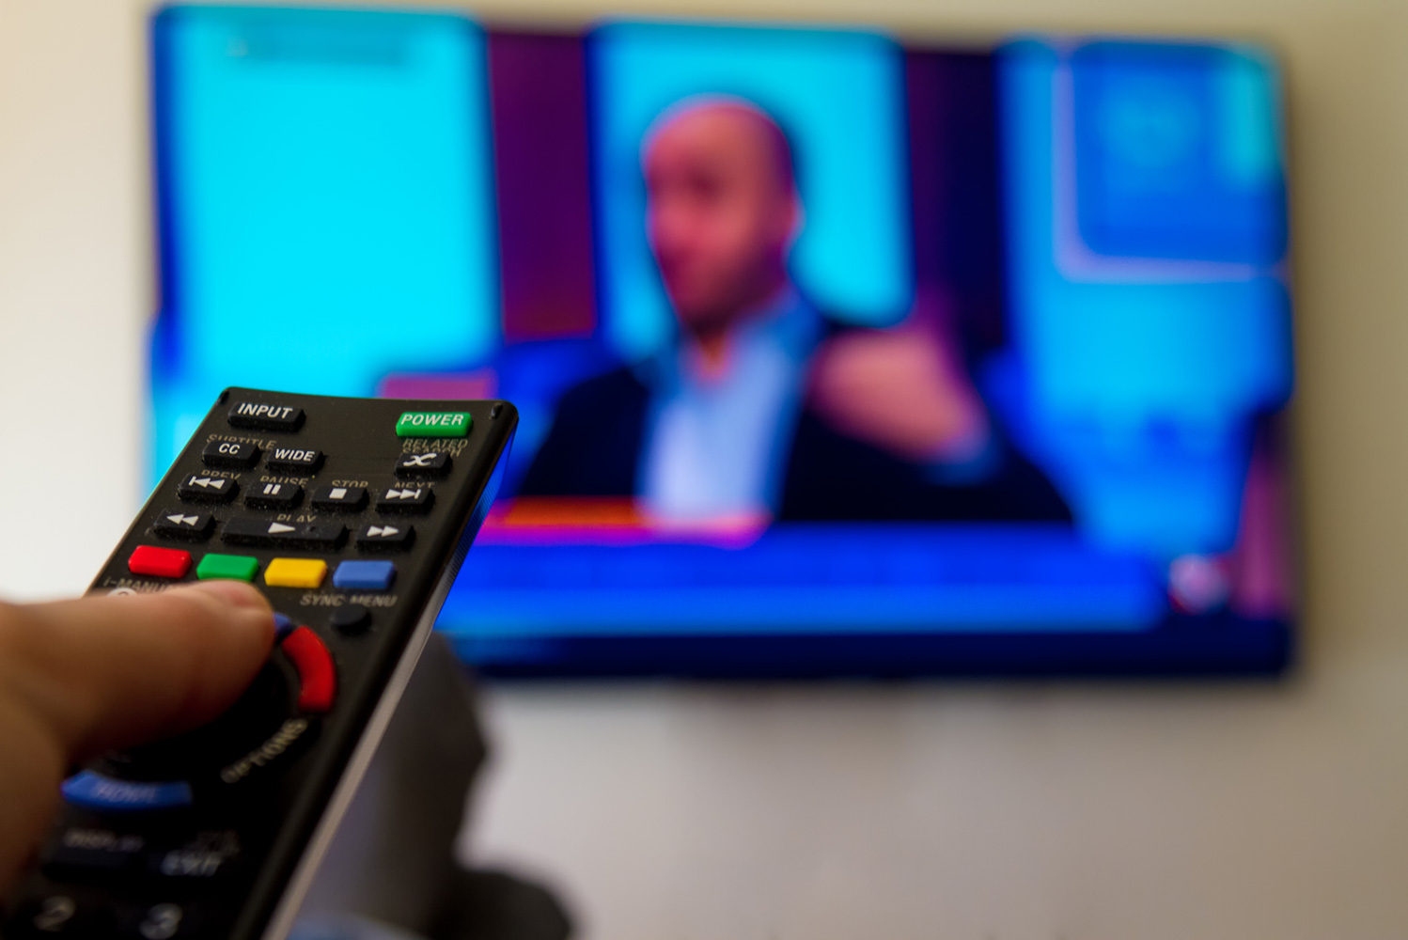
PdhdrEmh(Simon Mayer
Notes:
tla WoEikl l%sia;shdks rEmjdyskS kd,sldj úldYh jqfka keye' uq,§ mSg¾ ys;=fõ l=ula fyda ;dlaI‚l .eg¿‍jla we;s lsh,d' i;shlg miqj;a tu kd,sldj úldYh fkdù ;sfnk úg" mSg¾ iy tu m%foaYfha isá" ks;sm;d tu jevigyk kerUQ fma%laIlhska msßila tu rEmjdyskS foaj fufyh bÈßm;a l< foaj.e;sjrhd yuq jQjd' foaj.e;sjrhd Tjqkag lshd isáfha kd,sldj wfkl=;a m%foaYj, fyd¢ka úldYh jk njhs'
ta ms<sn|j fidhd neÆ úg Tjqkag ±k.kakg ,enqfKa tu m%foaYfha uqia,sï m,a,shl mQcljrfhla flan,a ;dla‍IK Ys,amsfhla iu. tlaù tu m%foaYhg rEmjdyskS kd<sldj lmd yer ;snQ njhs' thg fya;=j tu m%foaYfha ujq,újrhd th bjekac,sl l%sia;shdks kd,sldjla f,i ie,lSuhs'
—wms fldÉpr mqÿu jqKdo lsh,d Thd,g ys;d.kak mq¿jka' wms wfma uqia,sï wi,ajeishka iu. b;d <Õska wdY%h lrkjd' wmg tA wh iu. lsisu .eg¿jla keye'˜ mSg¾ lsõjd'

Slide 63
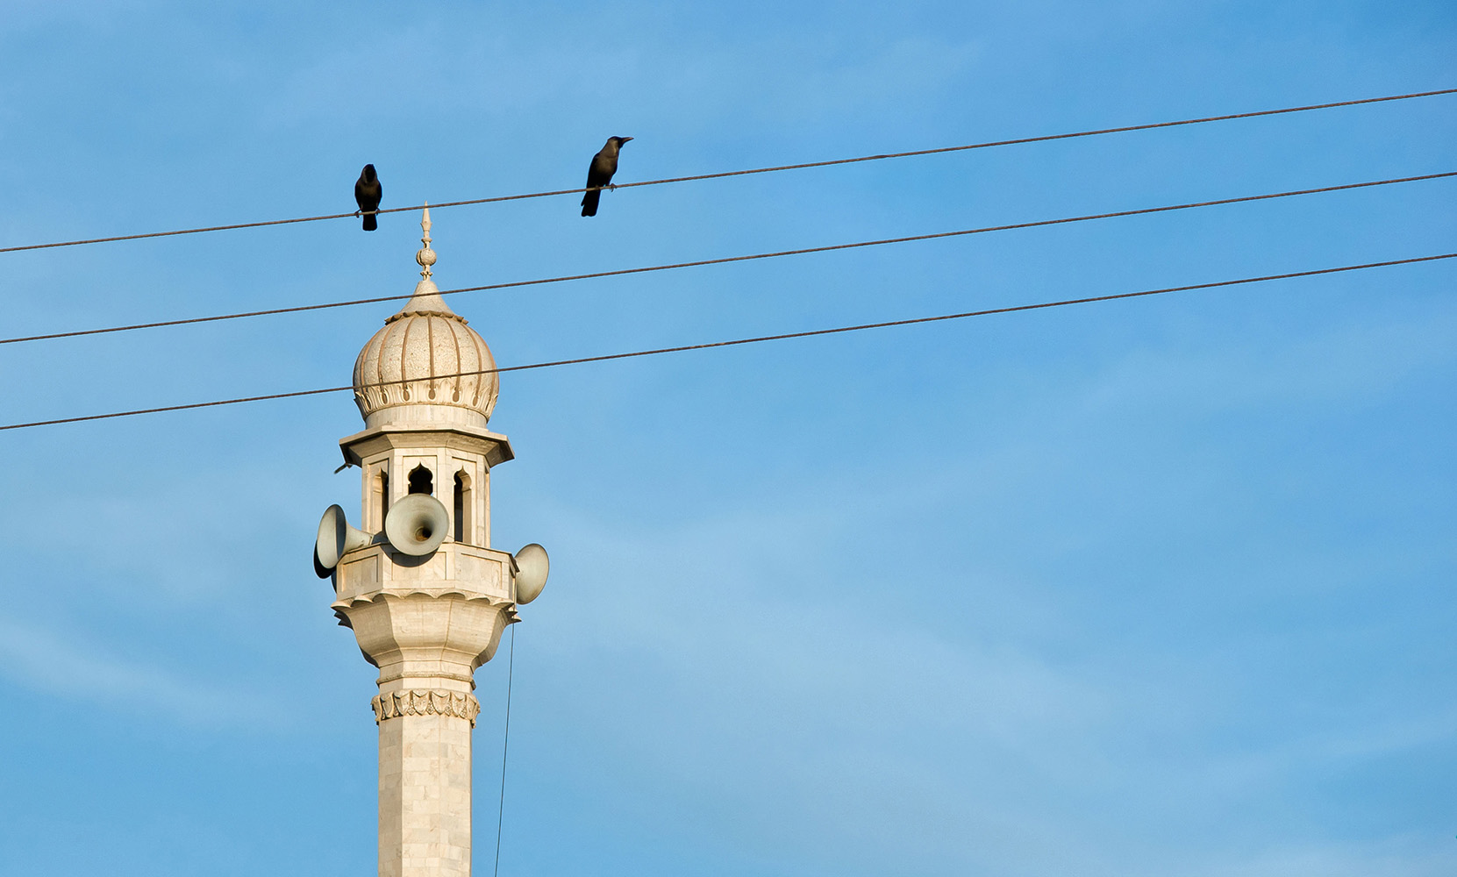
PdhdrEmh( Agencja Fotograficzna Caro / Alamy Stock Photo
Notes:
fuh b;d ixfõ§ ;;ajhla lsh, tu lKavdhu ±k.;a;d' tksid Tjqka Wmfoia yd f;dr;=re ,nd .ekSu i|yd cd;sl ls%ia;shdks ixúOdkhla iïnkaO lr .;a;d' tu Wmfoia wkq.ukh lrñka Tjqka uq,ska u flan,a ;dla‍IK Ys,amshdj yuqjqKd' tu kd,sldfõ úldYkh kej; iïnkaO lsÍug Tyqf.a úreoaO;ajhla ;snqfK keye" kuq;a Tyqg uqia,sï mQcljrhdg tfrysj hkak neye lsh, Tyq lsõj' ta ujq,újrhd iu. fï .ek idlÉPd l< hq;=hs lsh,d lKavdhu ;SrKh l<d'
lKavdhfï ksfhdað;fhla meh ;=klg jeä ld,hla ;siafia kd,sldj úldYh lsÍug bv fok f,ig Tyqg ta;a;= .ekaùug W;aidy l<;a th id¾:l jqfka keye' B<Õ ojfia tu ksfhdað;hd kej;;a th W;aidy lrñka mdlsia;dk wdKavql%u jHjia:dfjka iEu mqrjeisfhl=gu ,nd § we;s udkj ysñlï" wd.u weoySfï fyda úYajdi ±Ífï ksoyi" iy whs;sjdislï ms<sn|j ujq,újrhdg meyeÈ,s l<d' ojfia §¾> ld,hla mqrd fuf,i fya;= ±laùfuka wk;=rej" tu kd,sldj úldYh lsÍug bv§ug ujq,újrhd tlÕ jqKd' kuq;a" uqia,sï jeishkaf.a hd{d isÿ lrk fõ,djkays§ hdÉ{d lrk wi,ajeishkag ndOd fkdjk mßÈ rEmjdysKsfha Yíoh wvq lrk f,i ujq,újrhd l%sia;shdks krUkakkaf.ka b,a,d isáhd'
—wms yqÕla i;=gq jqKdæ˜ hkqfjka mSg¾ mjikjd" —fïl kslïu rEmjdyskS úldYkhla ú;rhs lsh,d flfkl=g ysf;kakg mq¿jks" tA;a" ls;=kqjka úosyg tAl wfma Ôú;fha b;d jeo.;a fldgila˜'

Slide 64
b;d fyd|hs" idorfhka kej; ms<s.kakjdæ
ó<Õ ieish( wmf.a úúO wkkH;d

