Slide 1
cs;@u; kl;l khw;wKz;lhf;Feu;fSf;fhd gapw;rp newp

Slide 2
mku;T 2:
rpe;jid Rje;jpuk;> kdrhl;rp> kjk; kw;Wk; ek;gpf;iff;fhd Rje;jpuj;;ij mwpKfg;gLj;jy;

Slide 3
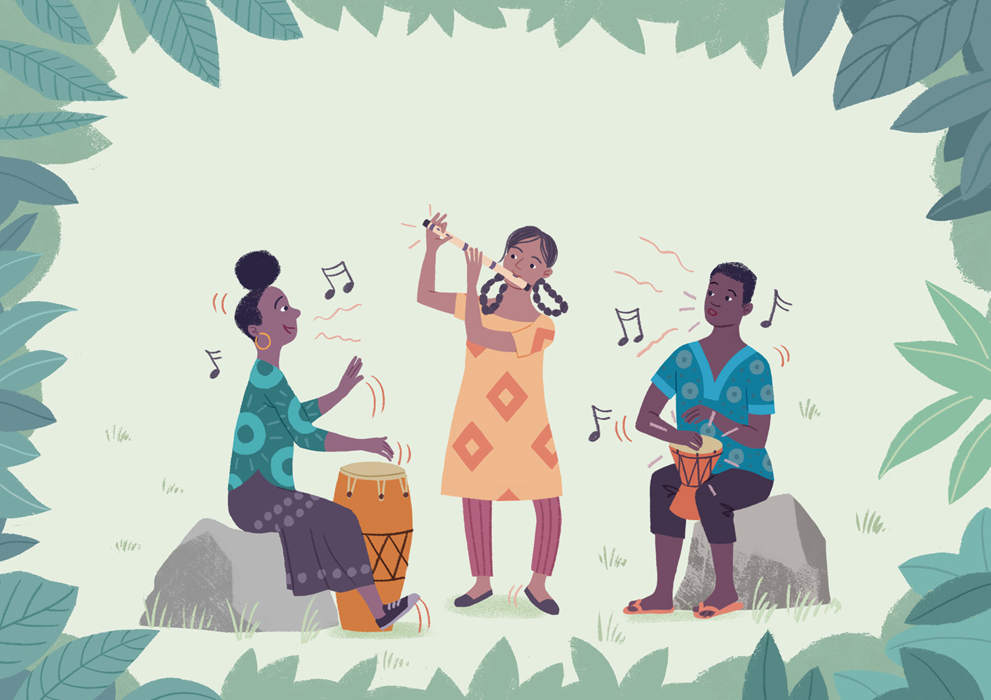
Gy;yhq;Foy; kw;Wk; jhsthj;jpaj;jpd; ghly;fs;
Illustrated by Toby Newsome
Notes:
3 - 23 tiuahd ];iyLfs; “Kd;ndhU fhyj;jpy;” vd;w
Gy;yhq;Foy; kw;Wk; jhsthj;jpaj;jpd; ghly;fs;
Katherine Cash kw;Wk; Sidsel-Marie Winther Prag MfpNahupd; Mf;fk;
Toby Newsome. ,d; tpsf;fk;

Slide 4
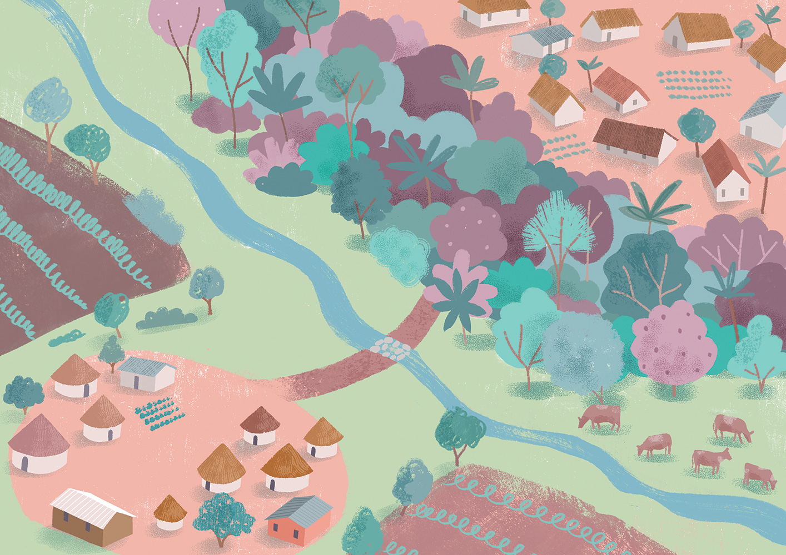
Notes:
Kd;ndhU fhyj;jpy;> ,uz;L fpuhkq;fs; ,Ue;jd.

Slide 5
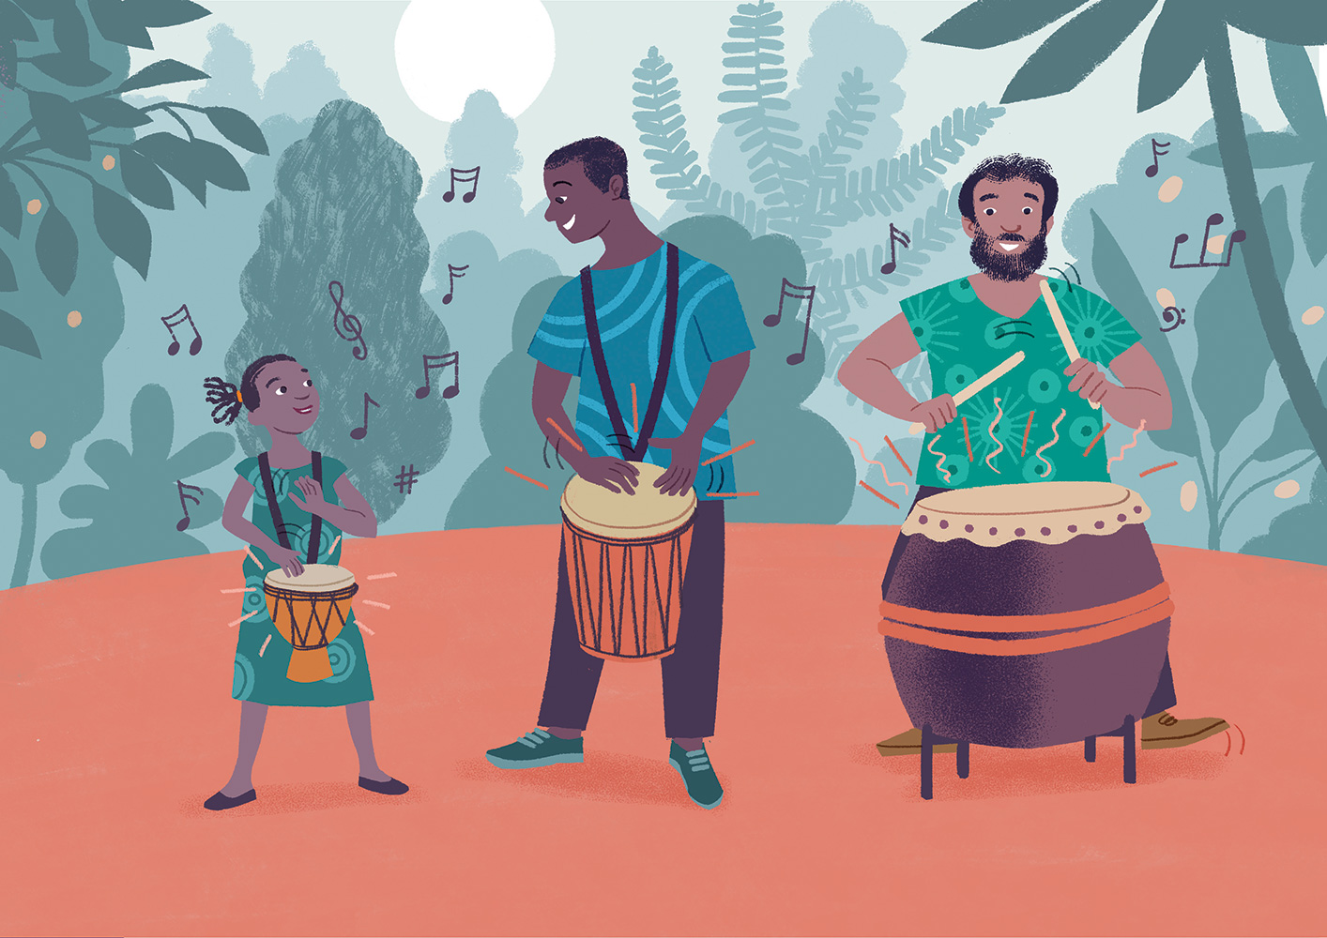
Notes:
fhl;bYs;s fpuhkj;jpy; trpj;j kf;fs; Nks thj;jpak; kw;Wk; eldj;jpw;F Ngu; Nghdtu;fsha; ,Ue;jhu;fs;. xU gps;is Neuhf epkpu;e;J mku Muk;gpf;fpd;w mj;jUzj;jpNyNa> mtu;fSf;F NkskÊ toq;fg;gl;lJ. mikjpahd kioapid Nghy rj;jnkOg;Gfpd;w rpwpa NksqÊfSk; ,Ue;jd> ,uz;L Ngu; J}f;fpr; nry;yf; $ba ,b Nghd;w rj;jnkOg;Gfpd;w Nksq;fSk; ,Ue;jd. NkskÊ ,irj;jy; tho;f;ifAld; ,ize;jpUe;jJ- nfhz;lhl;lq;fs;> Jau; epfo;Tfs; kw;Wk; mtw;Wf;fpilapyhd midj;jpYk; NkskÊ ,irj;jy; ,ize;jpUe;jJ- mj;Jld; fhl;bd; nka;g;nghUSld; Nru;e;J> Nks ,irNa mtu;fsJ tho;f;ifapid xw;Wikahf itj;jpUg;gjhf kf;fs; ek;gpdhu;fs;.

Slide 6
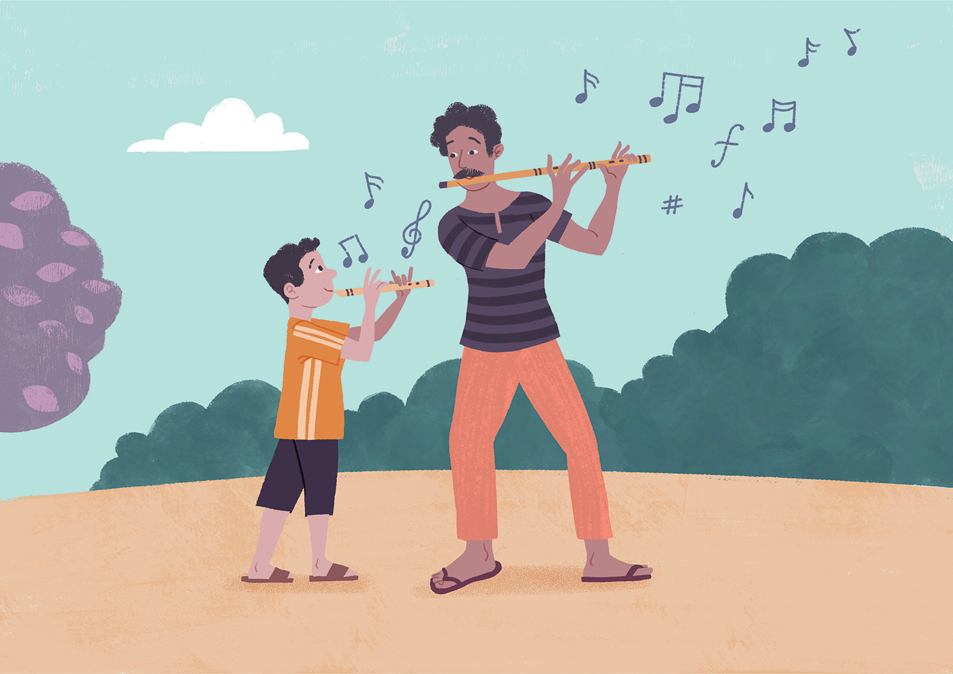
Notes:
mjd;fPopUe;j gs;sj;jhf;fpypUe;j fpuhkj;jpy; trpj;j kf;fs; NkskÊ thrpg;gtu;fis Gupe;J nfhs;stpy;iy. mtu;fs; Nks ,irapid tpUk;gj;jfhj ,iur;ryhf ghu;j;jJld; mt; ,bKof;fk; Nghd;w rj;jj;jpidg; ghu;j;J ,opthf rpupj;jhu;fs;. ,f;fpuhkj;jpy; xU Mz; gps;is gpwf;fpd;wNghJ> mg;gps;isapd; je;ij kuj;jz;Lfspdhy; my;yJ vYk;Gfspdhy; Gy;yhq;Fonyhd;wpid nra;thu;. mjid mg;gps;is jd; tho;ehs; KbT tiuapy; fapwpdhy; fl;b fOj;jpy; njhq;fg; Nghl;Lf; nfhs;s Ntz;Lk;. mtu;fSila ghuk;gupa ,irapy; Nju;r;rp ngWtjw;F gy tUlq;fs; vLj;jd vd;gJld; nrhu;f;fj;jpYs;s flTs; trPfupf;fg;gl;L tay;ntspfSf;F kio kw;Wk; #upa ntspr;rj;ijj; jUkstpw;F Gy;yhq;Foiy ,dpikahf ,irf;ff;$ba Mz;fspd; jpwikfSf;F nfsutkspf;fg;gl;lJ.

Slide 7
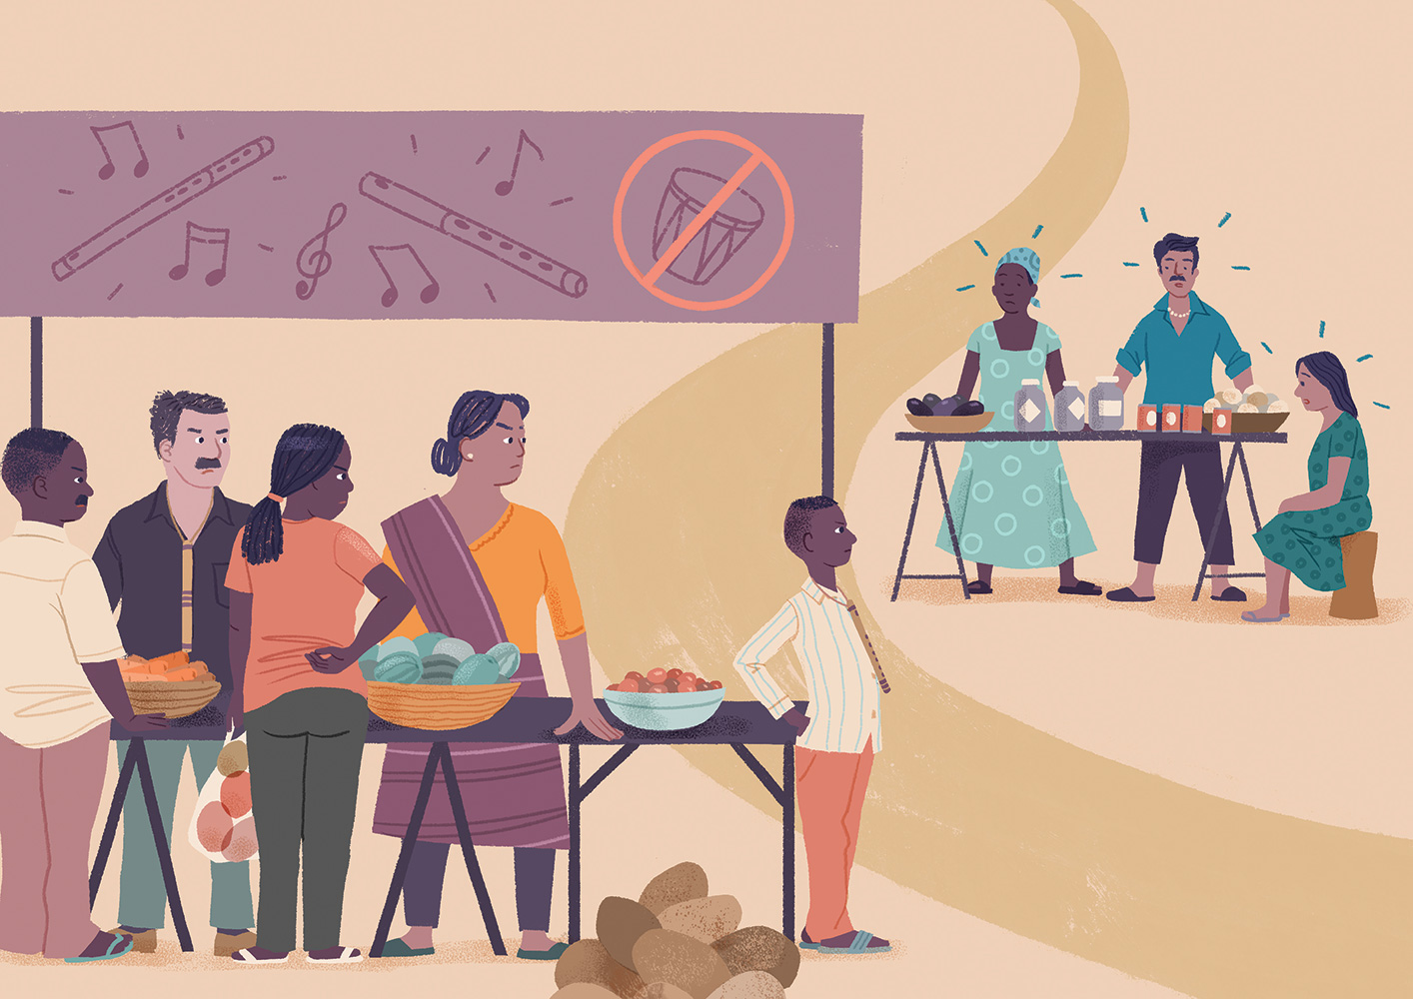
Notes:
Nks fpuhkj;jpYs;s fpuhkj;jtu;fs; jq;fSila tzpfg; nghUl;fis tpw;gjw;fhf Gy;yhq;Foy; fpuhkj;jpYs;s thuhe;j re;ijf;F nrd;wNghJk;> ,U fpuhkj;jpYs;s kf;fSk; xd;whff; fyf;ftpy;iy. re;ij ,lj;jpy; Nkskpirj;jy; jil nra;ag;gl;bUe;jJ. Gy;yhq;Foy; fpuhkj;jpd; fil cupikahsu;fs; gyu; NkskÊ ,irg;gtu;fSf;F tpw;gid nra;a kWj;jdu; vd;gJld;; NkskÊ ,irg;gtu;fs; Gy;yhq;Foy; fpuhkj;jtu;fis ntWj;jdu;.

Slide 8
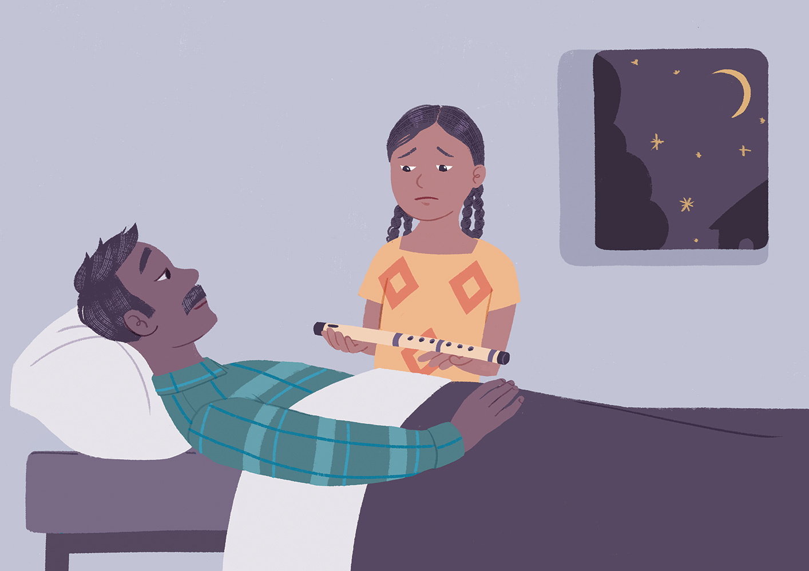
Notes:
Gy;yhq;Foy; fpuhkj;jpy; tPl;bw;F xNu gps;isahd> Ziana vd;w ngaupidf; nfhz;l xU ,sk; ngz; gps;is ,Ue;jhs;. mtSila Mu;tk; kw;Wk; ,uf;f Fzk; fhuzkhf midtUk; mtis Nerpj;jdu;. mtSf;F 10 tajhf ,Uf;Fk;NghJ> mtsJ je;ij RftPdKw;whu;. xU ehs;> mtu; mtisj; jdf;fUfpy; mioj;J> “vd;Dila md;Gf;Fupa kfNs> ehd; ePz;l ehs; tho khl;Nld;. vd;Dila Gy;yhq;Foiy vLj;J mij eP mzpe;Jnfhs;> mg;NghJ ehkpUtUk; vg;NghJk; xd;whf ,Uf;fyhk;” vd $wpdhu;. Ziana rq;flkile;jhs;; tof;fqÊfspd; gb ngz;fs; Gy;yhq;Foy; mzptjpy;iy> Mdhy; clNdNa mts; “ehd; Vd; thrpg;gjw;F mDkjpf;fg;glf;$lhJ?” vdj; jd;idj; jhNdf; Nfl;Lf; nfhz;lhs;. mdÊW ,uT mtsJ je;ij ,we;jhuÊ Ziana Gy;yhq;Foiy vLj;J mjidj; jd; fOj;ijr; Rw;wp khl;bf;nfhz;lhs;.

Slide 9
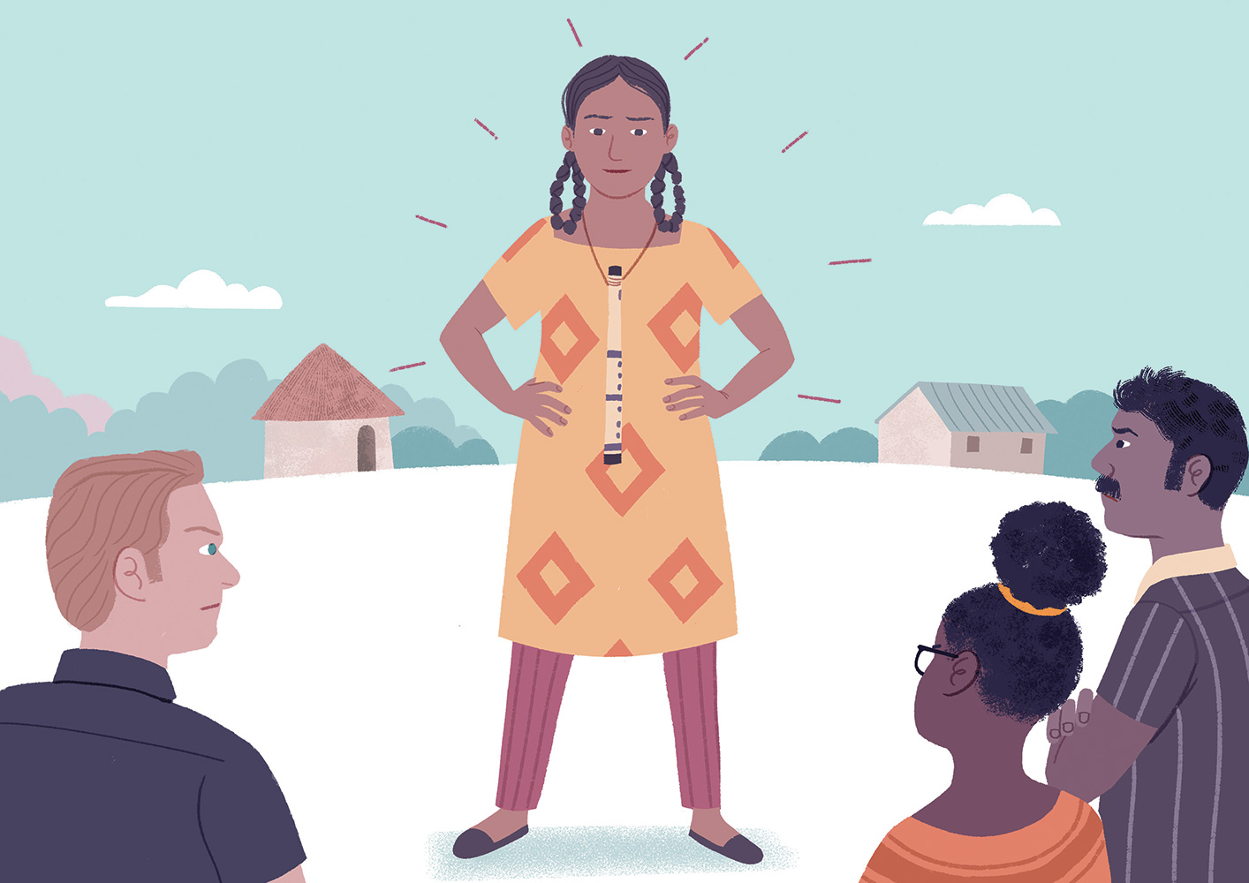
Notes:
Ziana tsu;e;jJk;> mts;; fha;fwpfis tsu;g;gjw;Fk; mtw;iw mtu;fspd; re;ijf; filapy; tpw;gjw;Fk; jd; jha;f;F cjtp nra;Ak; nghUl;L fLikahf cioj;jhs;. mts; Gj;jprhypahfTk; ,uf;fk;kpf;ftshfTk; ,Ue;jNghjpYk;> mts; Gy;yhq;Foy; mzpe;jpUe;jikapdhy; ngUk;ghYk; mtsJ fpuhkj;jpYs;s kf;fs; mtis fpz;ly; nra;jdu;. rpyNeuq;fspy;> mjidf; fol;Ltjw;F mtis ,zq;f itf;f Kaw;rpj;jdu;> Mdhy; mts; kWj;Jtpl;lhs;. Ziana ,w;F tha;g;G fpilf;Fk;Nghnjy;yhk;> mts; fhl;bw;F nrd;W jd; je;ijapd; Gy;yhq;Foiy thrpj;jhs;.

Slide 10
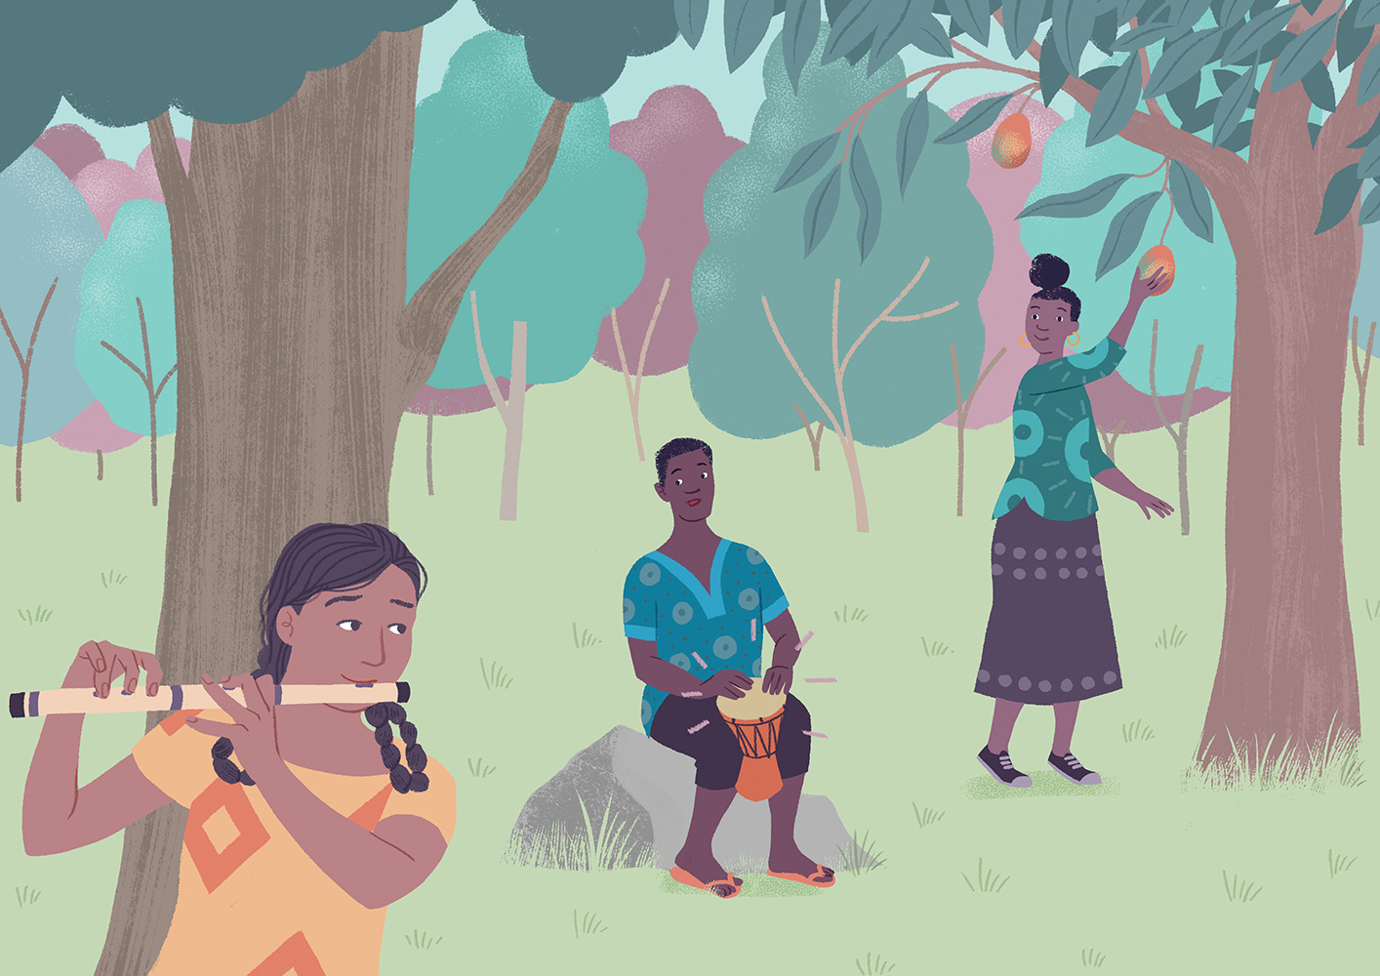
Notes:
mJNghd;w xU ehspy;> Ziana ,w;F kq;fyhd; Nks Xir Nfl;lJ. Mu;tk;kpFjpahy;> mts;; Nks Xirapidj; njhlu;e;J fhl;bD}lhf jpwe;jntspf;F nrd;whs;> mq;Nf xU ,isQd; jtpy; ,irj;J ghbf; nfhz;bUf;f> mtdJ jq;if kunkhd;wpypUe;J goq;fisg; gwpj;Jf; nfhz;bUe;jhs;. Ziana re;ijapypUe;J mtu;fis milahsk; fz;bUe;jhs;- mtu;fs; Ono kw;Wk; Iris vd miof;fg;gLfpd;w rNfhjuu;fs;. kuq;fSf;F gpd;dhy; xspe;J nfhz;L> Ziana Gy;yhq;Foy; ,irf;fj; njhlq;fpdhs;. Gy;yhq;Foypd; ,ir kw;Wk; NksjÊjpdÊ jhskÊ; vd;gd xd;Wlndhd;W ,ize;J mofhd rq;fPjkhf cUntLj;jJ.
ghly; Kbe;jJk; Ziana ftdkhf jpwe;jntspf;Fs; mbnaLj;J itj;jhs;. Ono kw;Wk; Iris Mfpa ,UtUk; Gy;yhq;FoYld; xU ngz; gps;isiaf; fz;lJk; mjpu;r;rpaile;jdu;> Mdhy; mtu;fisg; NghyNt mtSk; jdJ thj;jpaj;ij Gy;yhq;Foy; fpuhkj;jpy; ,irg;gjw;F mDkjpf;fg;gltpy;iy vd czu;e;J rpupj;jdu;. Iris, Ziana ,w;F rpy goq;fisf; nfhLj;jhs;. %tUk; khiy Neuk; tUk;tiuapy; fijj;Jf; nfhz;Lk; ,ir kPl;bf;nfhz;Lk; ,Ue;jdu;.

Slide 11
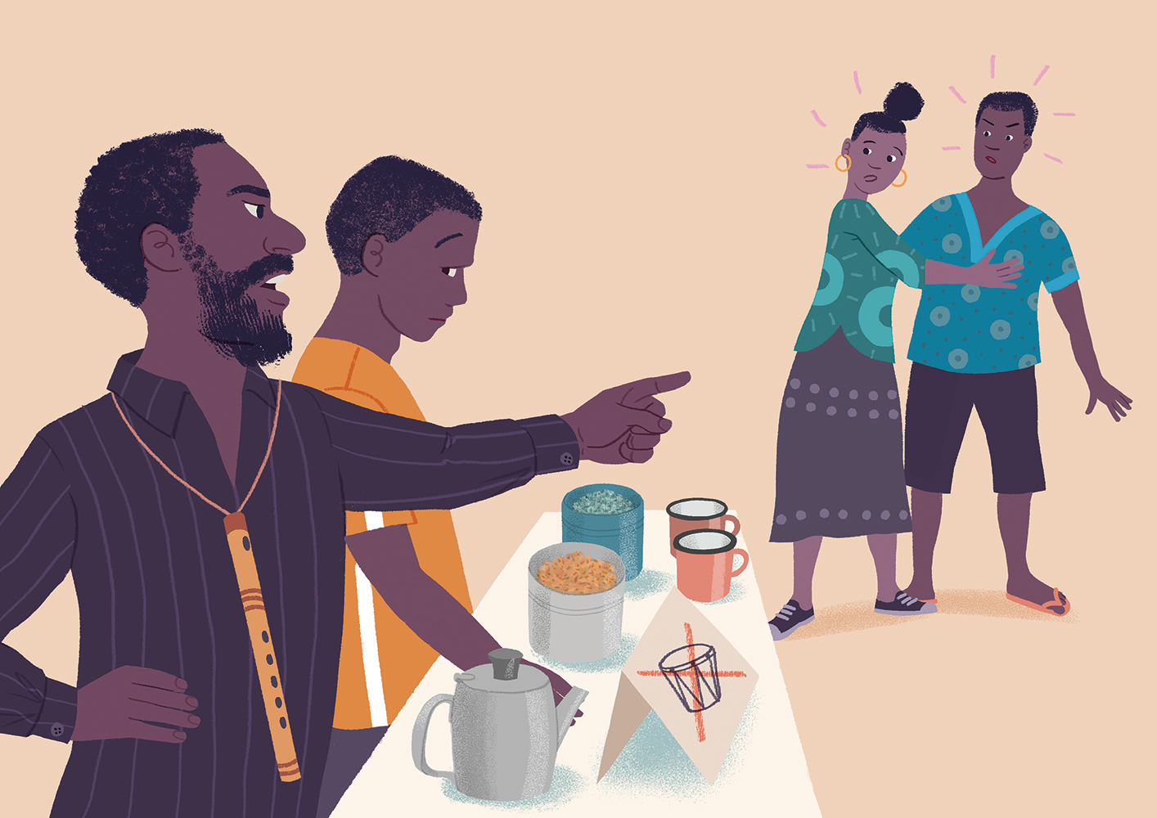
Notes:
mLj;j re;ij ehsd;W> Ziana jd;Dila Gjpa ez;gu;fis NjePu;f;filf;F Kd;ghff; fz;lhs;. fil cupikahsu; mtu;fis Vrpf; nfhz;L ,Ue;jhu;> “mg;ghy; nry;Yq;fs; NkskÊ ,irf;Fk; mOf;FfNs!.” Ono Nfhgkhf ,Ue;jhd;> Mdhy; Iris mtid ,Oj;Jf; nfhz;L te;Jtpl;lhs;. Ono ,w;fhf NjePu; fyf;fpa fil cupikahsupd; kfd; ntl;fpj; jiyFdpe;jtdhff; fhzg;gl;lhd;.

Slide 12
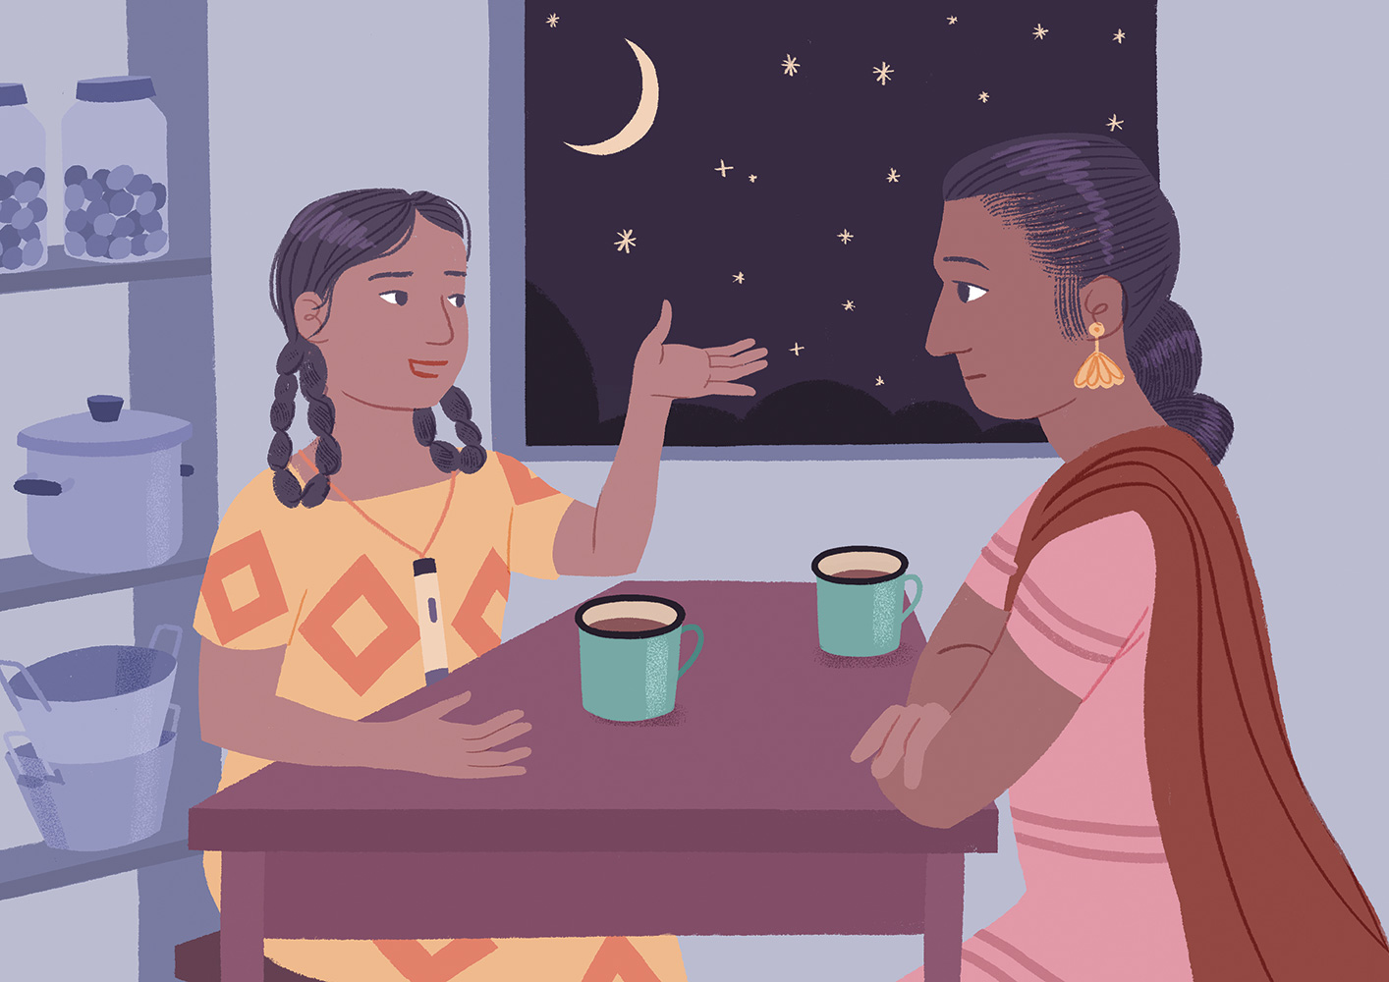
Notes:
,jw;F Kd; Ziana “NkskÊ ,irg;gtu;fs; mDkjpf;fg;gl khl;lhu;fs;” vd;w milahsq;fs; Fwpj;J vg;NghJNk rpe;jpj;jjpy;iy. mtNsh mtsJ jhNah ,Jtiuapy;; NkskÊ ,irg;gtu;fspd; filfspypUe;J vJTNk thq;ftpy;iy vd;gjid czu;e;J kdjpw;F ghukhf czu;e;jhs;.
md;W ,uT Ziana jd; jhAld; Ngrp> Vd; mtu;fs; NkskÊ ,irg;gtu;fspd; filfSf;F nrd;wjpy;iy vdf; Nfl;lhs;. “cdf;F njupe;jjid kl;Lk; itj;J nfhz;L NgrhjpUg;gJ ey;yJ” vd jha; gjpyspj;jhs;. Mdhy;> Ziana ,dhy; Gupe;J nfhs;s Kbatpy;iy> Vd; midtUk; vy;yh ,lq;fspYk; tuNtw;fg;glf;$lhJ vdf; Nfl;Lf; nfhz;Nl ,Ue;jhs;. Ono kw;Wk; Iris Mfpatu;fs; mtu;fs; filapy; tpw;fpd;w Ritkpf;f goq;fis epidj;J mts; ehT+wpdhs;. ,Wjpahf> Ziana ,d; jhahu; mLj;j re;ij ehsd;W mtu;fspd; goq;fs; rpytw;iw thq;Ftjw;F cld;gl;lhs;.

Slide 13
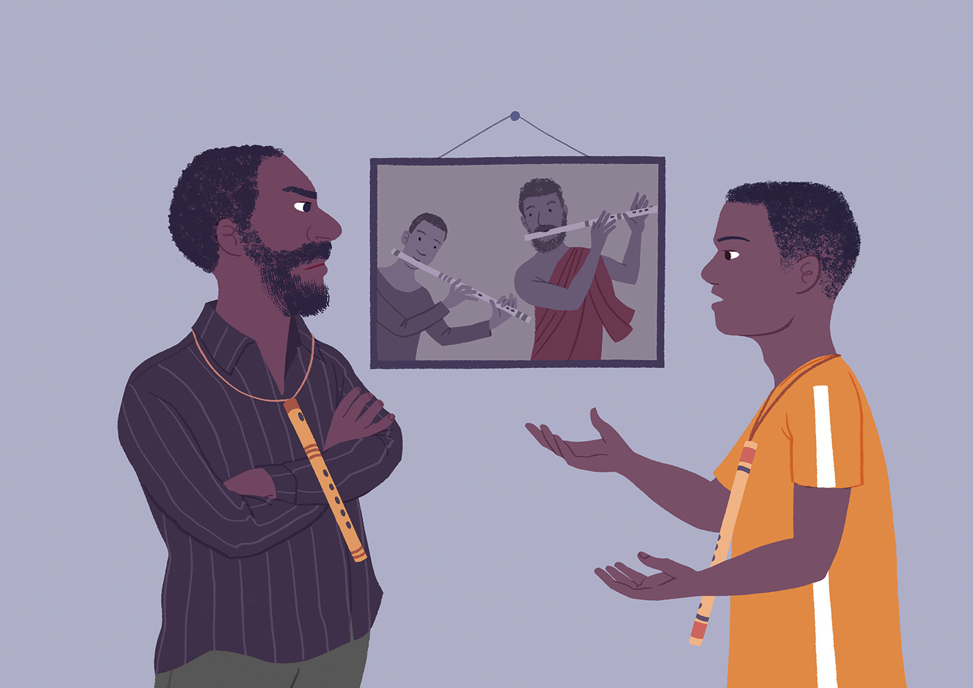
Notes:
mNjNtis> NjePu;f;fil cupikahsupd; tPl;by;> cupikahsupd; kfdhd Brone jd; je;ij NkskÊ thrpg;gtu;fis elj;jpatpjk; njhlu;ghff; Nfs;tp Nfl;likapdhy; jfuhnuhd;W Vw;gl;bUe;jJ. fil cupikahsu; mf;fpuhkj;jpypUe;j kpf nfsutkhd Gy;yhq;Foy; ,irg;gtu;fspy; xUtuhf ,Ue;jJld; ngUikf;Fupa eguhfTk; ,Ue;jhu;. mtuJ je;ij kw;Wk; ghl;ld; jpwikkpf;f rq;fPjthd;fshf ,Ue;jhu;fs;> Mdhy; mtuJ kfd; ngUj;j Vkhw;wkhfNt ,Ue;jhd;. vt;tsT fLikahf Kaw;rpj;jNghJk;> mtdhy; mbg;gil nky;ypirapy;$l Nju;r;rp ngw Kbatpy;iy. gy tUlq;fshf gyte;jkhd gapw;rp kw;Wk; Ntjidkpf;f tpku;rdq;fis mDgtpj;j gpd;du;;> mtDf;F Gy;yhq;Foy; kPjpUe;j kjpg;G ,y;yhky; NghdJ. mtDf;F J}uj;jpypUe;J tUfpd;w NksjÊjpdÊ jhskÊ; gpbj;J NghdJ> mtd; NtnwhU tho;f;ifapidg; gw;wp fdT fz;lhd;.

Slide 14
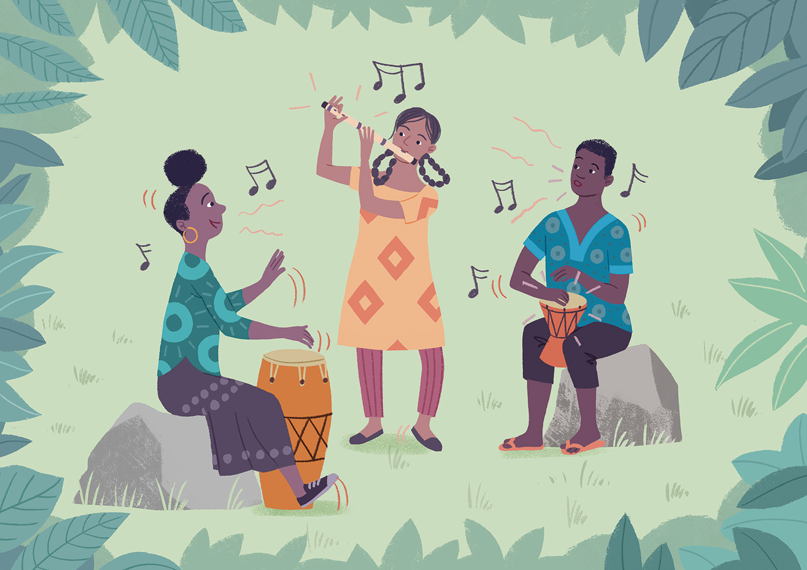
Notes:
fhyk; nry;y nry;y> Ziana, Iris kw;Wk; Ono MfpNahu; fhLfspy; re;jpj;J xd;whf tpisahbdu;. mtu;fSk; midtUk; tuNtw;fg;glf;$ba> NkskÊ; kw;Wk; Gy;yhq;Foy;fs; ntspg;gilahf thrpf;fg;glf;$ba kw;Wk; re;ijapy; mtu;fsJ mofhd rq;fPjj;jpid thrpj;J fhl;lf;$ba xU fhyj;jpidf; Fwpj;J fdT fz;lhu;fs;.

Slide 15
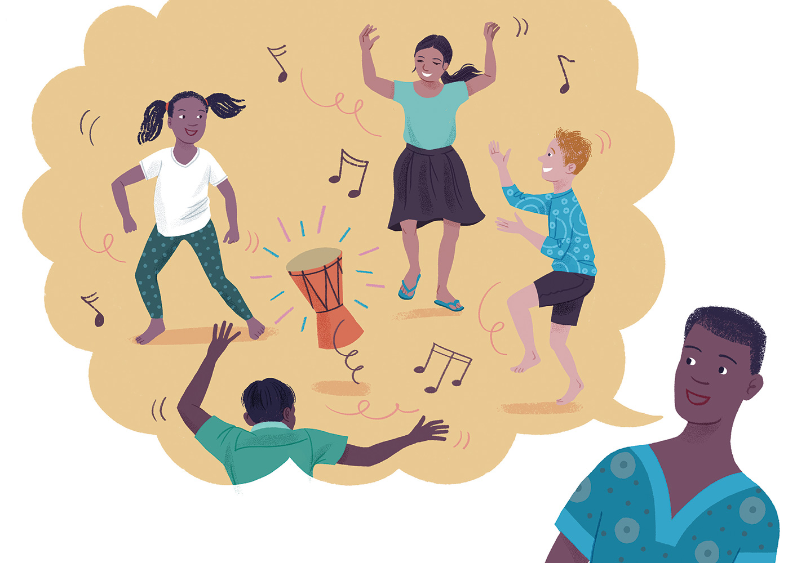
Notes:
xt;nthU thuKk;> Ono kw;Wk; Iris MfpNahu;, Ziana kw;Wk; mtsJ jhahiu re;jpg;gjw;fhf fha;fwp filf;F te;jdu;> mj;Jld; Ziana ,d; jhahu; mtu;fsplkpUe;J goq;fs; kw;Wk; fliyfis thq;fpdhu;. xU ehs;> Ziana ,d; jhahu; jdJ ,ilg;gl;bapy; fl;lg;gl;bUf;Fk; jtpiy Mu;tj;Jld; ghu;g;gjid Ono ftdpj;jhd;. “,J rpupf;fpd;w NkskhFk;” Ono $wpdhd;. “,jd; rj;jk; re;Njhrj;ijf; Fwpf;Fk; vd;gJld; ehd; ,jid thrpf;fpd;wNghJ rpWtu;fs; eldkhLthu;fs;” vd;Wk; $wpdhd;. Ziana ,d; jhahu; Mu;tkile;jhs;.
Vida NkskÊ thrpg;gtu;fs; Rw;wpYk; Nruj; njhlq;fpdu;. Ziana kw;Wk; mtsJ jhahu; mtu;fSila NksqÊfs; gw;wpAk; Nfl;ldu;. md;W> Ziana ,d; jhahu; fha;fwpfis tpiuthf tpw;W Kbj;Jtpl;lhu;. may; filf;fhuu;fs; NkskÊ thrpg;gtu;fis mtu;fspd; re;ijg;gFjpf;F tuNtw;wikf;fhf mtSld; rq;flg;gl;ldu;> Mdhy; xt;nthUtUk; Vida xt;nthUtuplKk; nghUl;fis thq;fKbAkhdhy; midtUk; nghUshjhuuPjpahf ed;ik milthu;fs; vd mts; epahak; $wpdhs;.

Slide 16
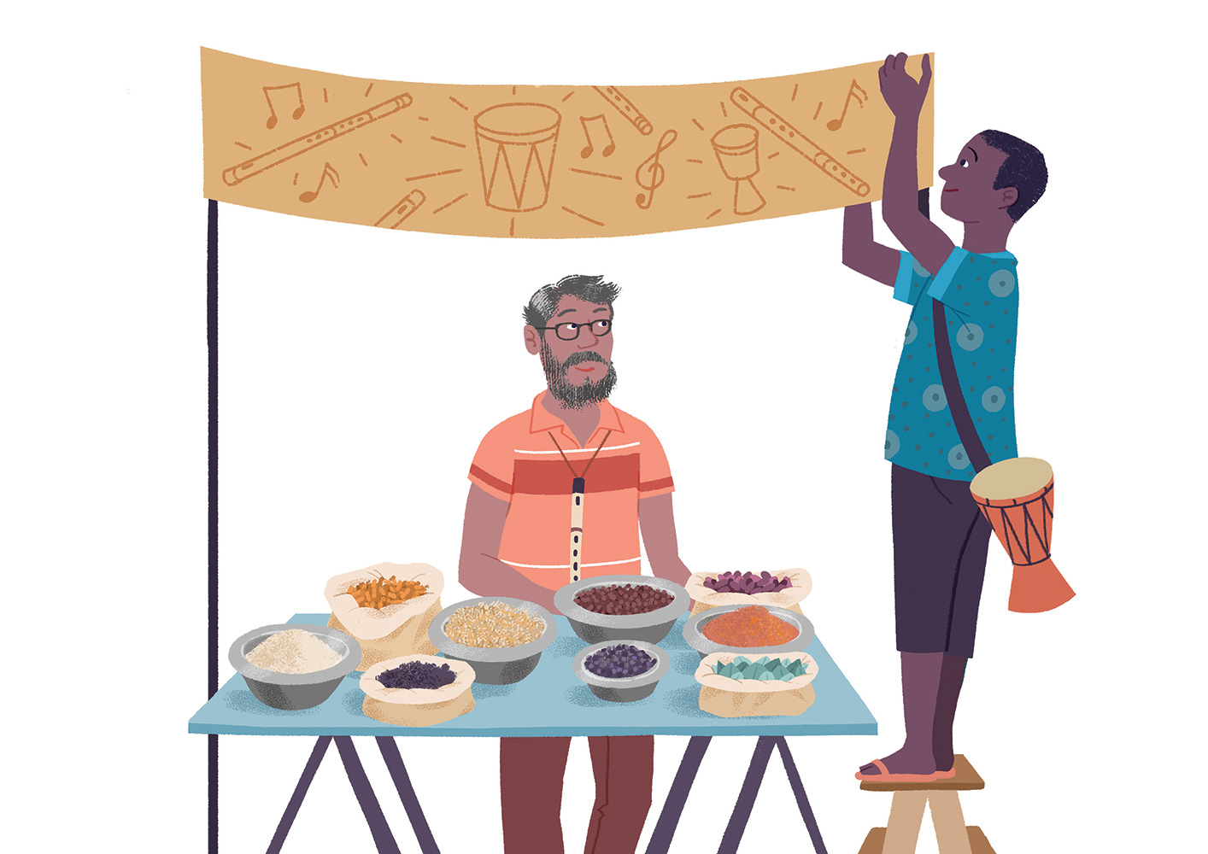
Notes:
mtu;fspd; filf;F gf;fj;jpy;> xU tNahjpgu; krhyh J}s; tiffis tpw;W te;jhu;> Mdhy; tpahghuk; ke;jkhf ,Ue;jJ. tpahghuj;ijg; ngUf;Ftjw;fhf “midtiuAk; tuNtw;fpNwhk;” vd xU gjhif itf;FkhW Ono MNyhrid $wpdhd;. mj;Jld;> NkskÊ; kw;Wk; Gy;yhq;Foypd; glq;fisf; nfhz;L mofpa glnkhd;wpidAk;; tiueÊJ nfhLj;jhd;.
tNahjpgUila tpw;gid mjpfupj;jJld; Vida fil cupikahsu;fSk; nkJnkJthf ,jw;F ,zq;fpf; nfhz;ldu;. “midtiuAk; tuNtw;fpNwhk;” vd;w milahsk; NkskÊ thrpg;gtu;fs; kw;Wk; Gy;yhq;Foy; ,irg;gtu;fspd; filfspy; xNukhjpupahf Njhd;w Muk;gpj;jJ.

Slide 17
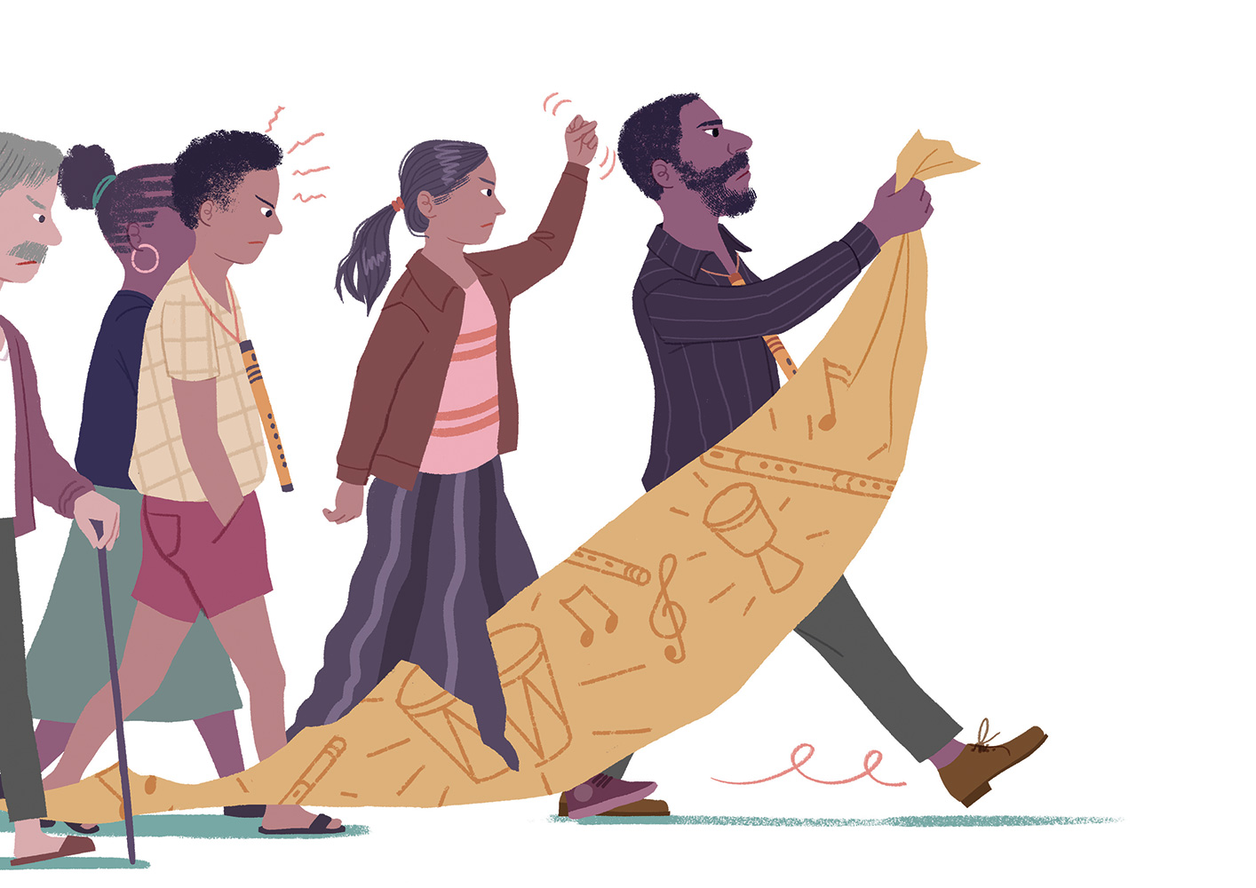
Notes:
Mdhy;> midj;Jk; ed;whf elf;ftpy;iy. Brone ,d; je;ij NkskÊ thrpg;gtu;fs; mtuJ re;ijg; gFjpf;F tUtjdhy; mjpu;r;rpaile;jhu;. mtu;fs; tUtjidg; ghuk;gupa KiwfSf;fhd mr;RWj;jyhf mtu; ghu;j;jhu;. me;j milahsq;fisf; fpopj;njwpe;J NkskÊ thrpg;gtu;fis Jd;GWj;Jtjw;fhf mtiug; Nghd;Nw rpe;jpj;jtu;fis xd;W jpul;bdhu;. re;ijg; gFjpapy; Fog;gk; Vw;gl;lJld; re;ij rig ,J Fwpj;J ftiyaile;jJ.

Slide 18
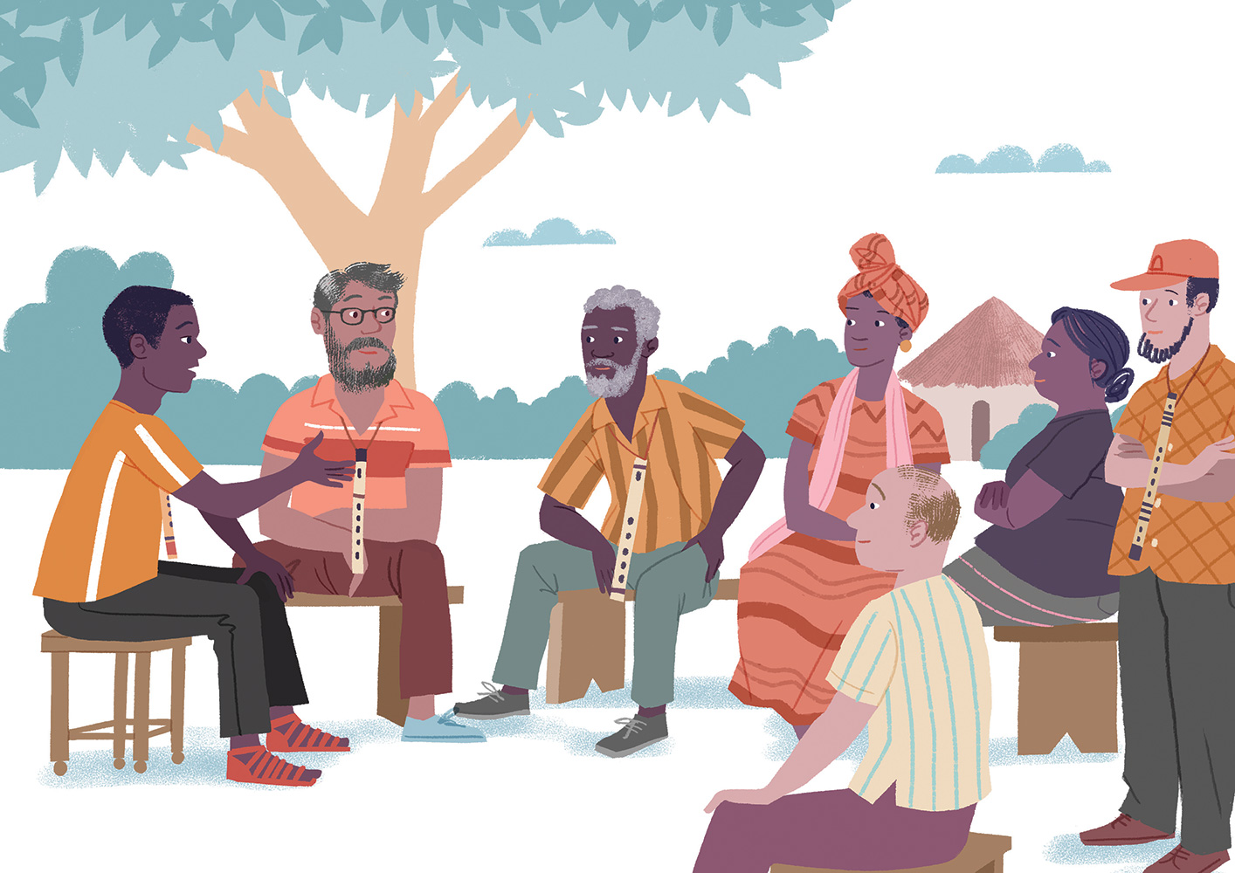
Notes:
Brone jd;Dila je;ijapd; jpl;lj;jpy; gq;nfLf;f kWj;jhd;. gjpyhf> mtDk; krhyh J}s; tpw;w mt;tNahjpgUk; re;ij rigaplk; Ngrp re;ijg;gFjpapy; midtUf;Fkhd xU ,ir epfo;r;rpapid jiyikjhq;fp elj;Jtjw;F rigapid ,zq;f itj;jhu;fs;. xUNtis> Brone ,d; je;ij kw;Wk; VidNahu;> NkskÊ thrpg;gtu;fspd; fijfis kw;Wk; mtu;fsJ ghly;fisf; Nfl;lhy; mtu;fis Vw;Wf; nfhs;sf;$Lk;.

Slide 19
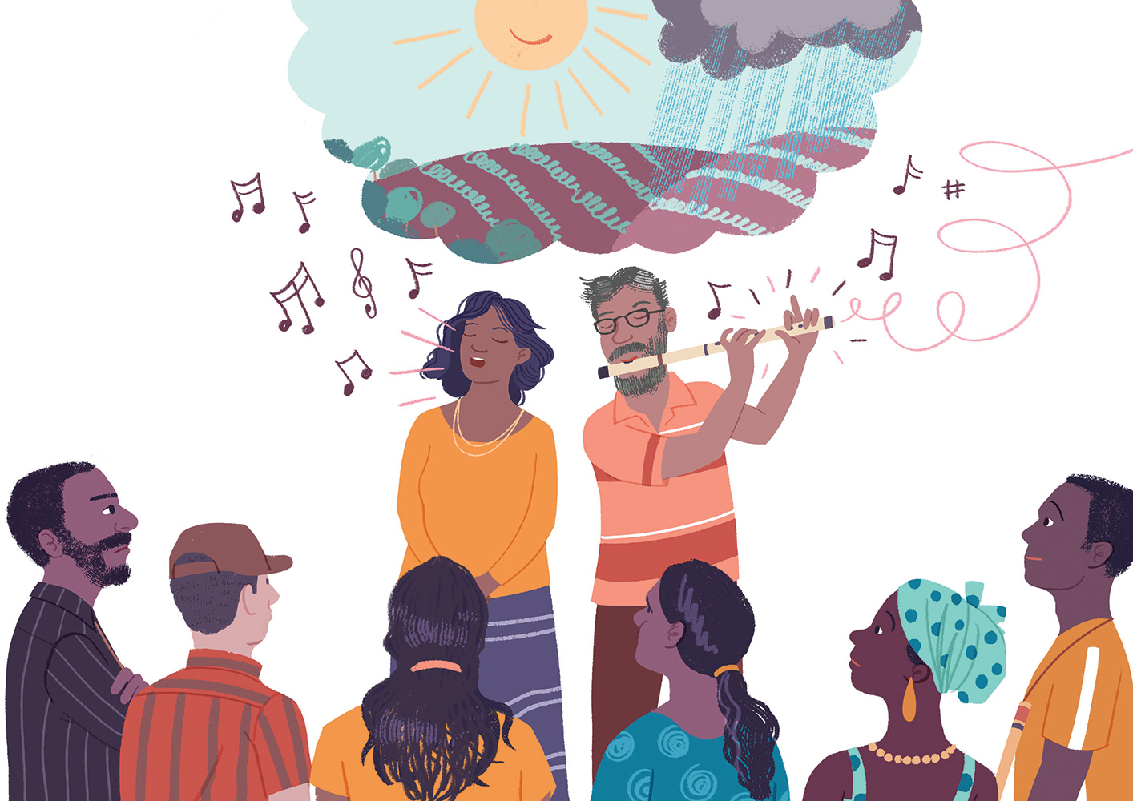
Notes:
,ir epfo;r;rp gw;wpa nra;jp gutpaJld; kf;fs; ntF njhiytpypUe;njy;yhk; te;jdu;. fil cupikahsu;fs; tof;fkhd ehis tpl mjpfkhf tpw;gid nra;jdu;.
,Wjpahf> ,ir epfo;r;rpf;fhd Neuk; te;jJ. tajhd krhyh J}s; tpahghupapd; kfs; ey;y mWtilf;fhf nrhu;f;fj;jpYs;s flTs;fSf;F ed;wp njuptpj;J ghlnyhd;wpid ghba mNjNtis> tpahghup jd;Dila kug;gyifapyhyhd Gy;yhq;Foypy; mofhd ehjnkhd;wpid kPl;bdhu;. mtUila ,s tajpy; mtu; gy tUlq;fshf f~;lg;gl;ljdhy; mtUf;F ,e;j ghly;kPJ mjpf <u;g;G ,Ug;gjhf mtu; tpsf;fpdhu;. $l;lj;jpYs;s rpy NkskÊ thrpg;gtu;fspd; Gd;difapidAk; jiyairg;gpidAk; ftdpj;jikapdhy; Brone ,d; je;ij KfQ; Ropj;jhu;.

Slide 20
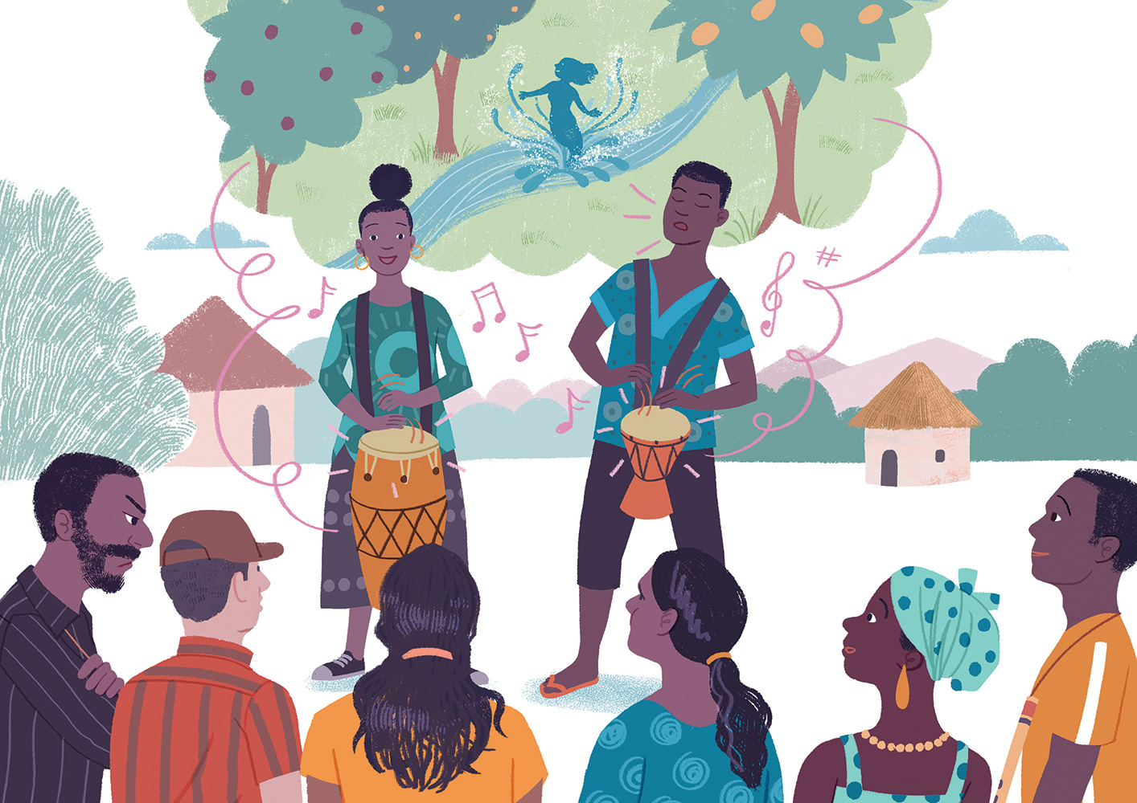
Notes:
tNahjpgu; Ono kw;Wk; Iris ,id Nkilf;F mioj;jhu;. mtu;fs; mtu;fSila NkskÊ gw;wpa fijfisf; $wpdhu;fs; vd;gJld; fhl;L ePNuhl;lj;jpw;F kjpg;gspg;gjw;fhd fspahl;l nky;ypirfisAk;> mtu;fSila fdp kuq;fis ghJfhg;ghf itj;jpUg;gjw;fhf GaYf;F ed;wp $Wtjw;fhd ,bNghd;w ghly;fisAk; ,irj;jdu;. Kjw;jlitahf> NksqÊfs; NkskÊ; thrpg;gtu;fSf;F vt;tsT Kf;fpakhdJ vd;gjid Gy;yhq;Foy; fpuhkj;jtu;fs; czu Muk;gpj;jhu;fs;. Brone ,d; je;ij gaq;fukhf rpdkile;jhu;.

Slide 21
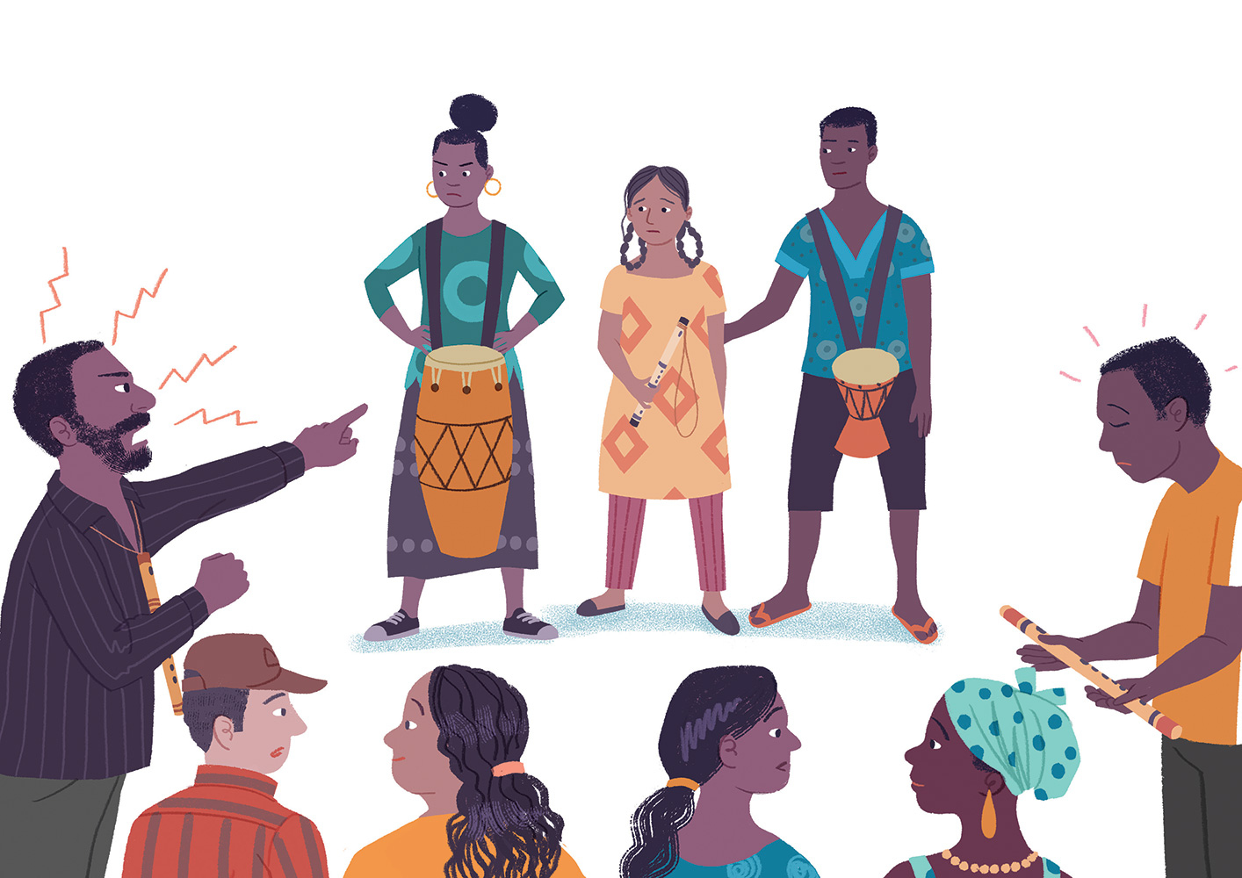
Notes:
,Wjpahf> Ziana Nkilapy; Ono kw;Wk; Iris cld; ,ize;J nfhz;lhs;. mts; jdJ je;ijia epidj;J nfhz;lhs;> mtUila Gy;yhq;Foiy mtsJ cjLfspy; itj;J> %tUk; xd;whf thrpf;f Muk;gpj;jdu;. mjpu;r;rpahd mikjpnahd;W epytpaJ. ,jw;F Kd;du;> Gy;yhq;Foy; kw;Wk; NkskÊ; xd;whf ,irf;fg;gl;Nlh my;yJ xU ngz; gps;is Gy;yhq;Foy; thrpj;Njh ahUk; Nfl;ljpy;iy.
Ono ,d; NksjÊjpypUe;J te;j eldkhLtjw;fhd jhsqÊfsÊ thid mile;j mNjNeuk;> #upad; kw;Wk; kiof;fhf ed;wp$wp ,irj;j Ziana ,d; Gy;yhq;FoypypUe;J te;j nky;ypirAk; thdpy; kpje;jJ.
ghly; Kbe;jJ> $l;lk; xUtiu xUtu; ghu;j;Jf; nfhz;lJ. rpyu; jaf;fj;Jld; if jl;ba mNjNtis> VidNahu; NtW vq;Nfh ghu;j;jdu;. Brone ,d; je;ij Ziana ,idg; ghu;j;J ntbj;jhu;. “JNuhfp” vdf; fj;jp tpl;L mtu; nfhe;jspj;jhu;.
Brone jd; je;ijiag; ghu;j;jjhy; mtdJ Kfk; ftiyaile;jJ. mtd; jd; jiyia FYf;fptpl;L> mtDila fOj;jpypUe;j Gy;yhq;Foiy vLj;J mtdJ je;ijapd; filapy; Nghl;Ltpl;L mf;fpuhkj;ij tpl;L epue;jukhf Ngha;tpl;lhd;.

Slide 22
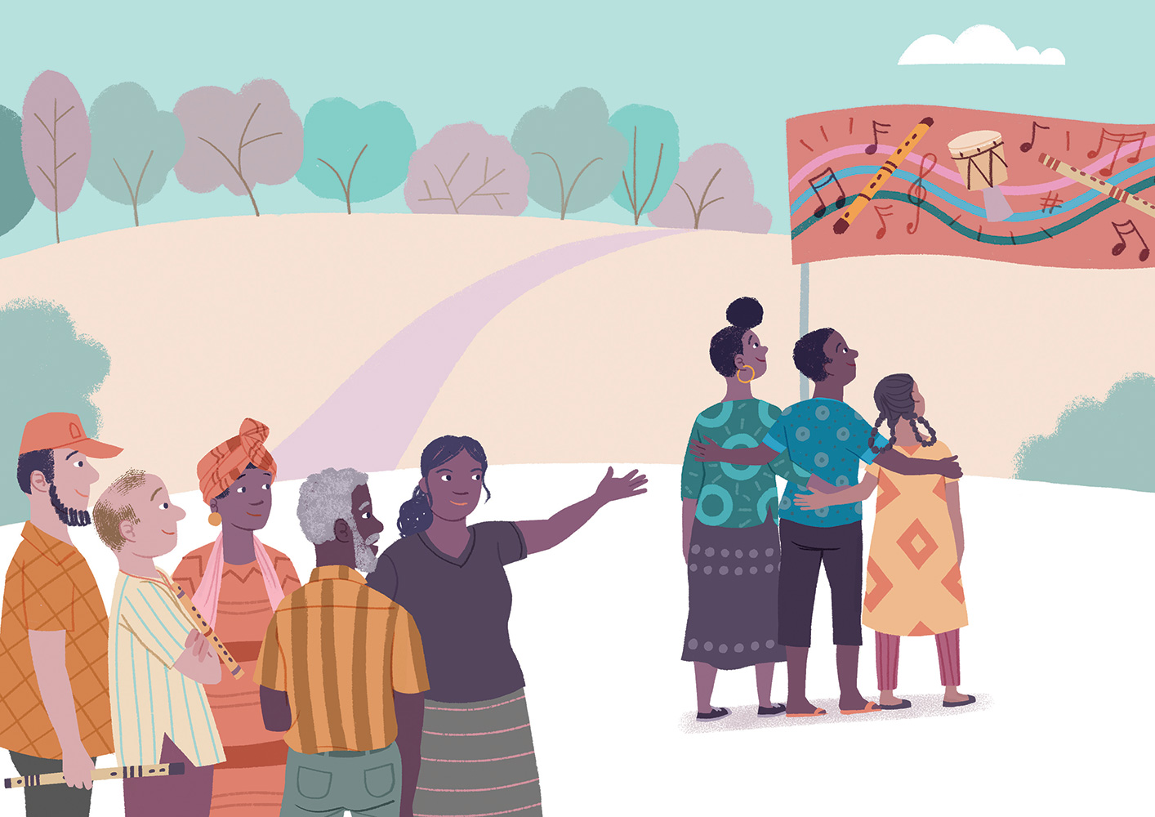
Notes:
,irepfo;r;rpf;F gpd;du; ,U fpuhkq;fspYk; gy fye;Jiuahly;fs; ,lk;ngw;wd. midtUf;Fk; midj;J re;ijf; filfspYk; nghUl;fs; tpw;gid nra;ag;gl Ntz;Lkh? Gy;yhq;Foy; ,irg;gjw;F ngz; gps;isfSf;F mDkjpaspf;f Ntz;Lkh? Gy;yhq;Foy; kw;Wk; NkskÊ xd;whf ,irf;fg;gl Ntz;Lkh? gy khjq;fSf;F gpd;dUk;> fpuhkj;jtu;fshy; cld;gl Kbatpy;iy.
NkskÊ thrpg;gtu;fspd; mDgtq;fisf; Nfl;l kw;Wk; midj;J egu;fspdJk; Neu;ikapidg; ghu;j;j re;ij rig Miz gpwg;gpj;jJ. “midj;J egu;fSk; re;ijg; gFjpapy; rpwg;ghf elj;jg;gLthu;fs;!” NkskÊ thrpg;gjw;F fhzg;gl;l jil ePf;fg;gl;lJld; vQ;rpapUe;j “NkskÊ; thrpg;gtu;fSf;F mDkjpapy;iy” vd;w milahsq;fs; ePf;fg;gl;ld. Mdhy;> rq;fPj thj;jpaq;fis ,irg;gJ njhlu;ghf KbntLf;f rig kWj;jJ. gjpyhf> xt;nthU egupdJk; cs;shu;e;j ek;gpf;iff;F kjpg;gspf;fg;gl Ntz;Lnkd;gJld; mtu;fs; mjidg; gpd;gw;Wtjw;fhd Rje;jpuj;jpidf; nfhz;bUg;ghu;fs;.

Slide 23
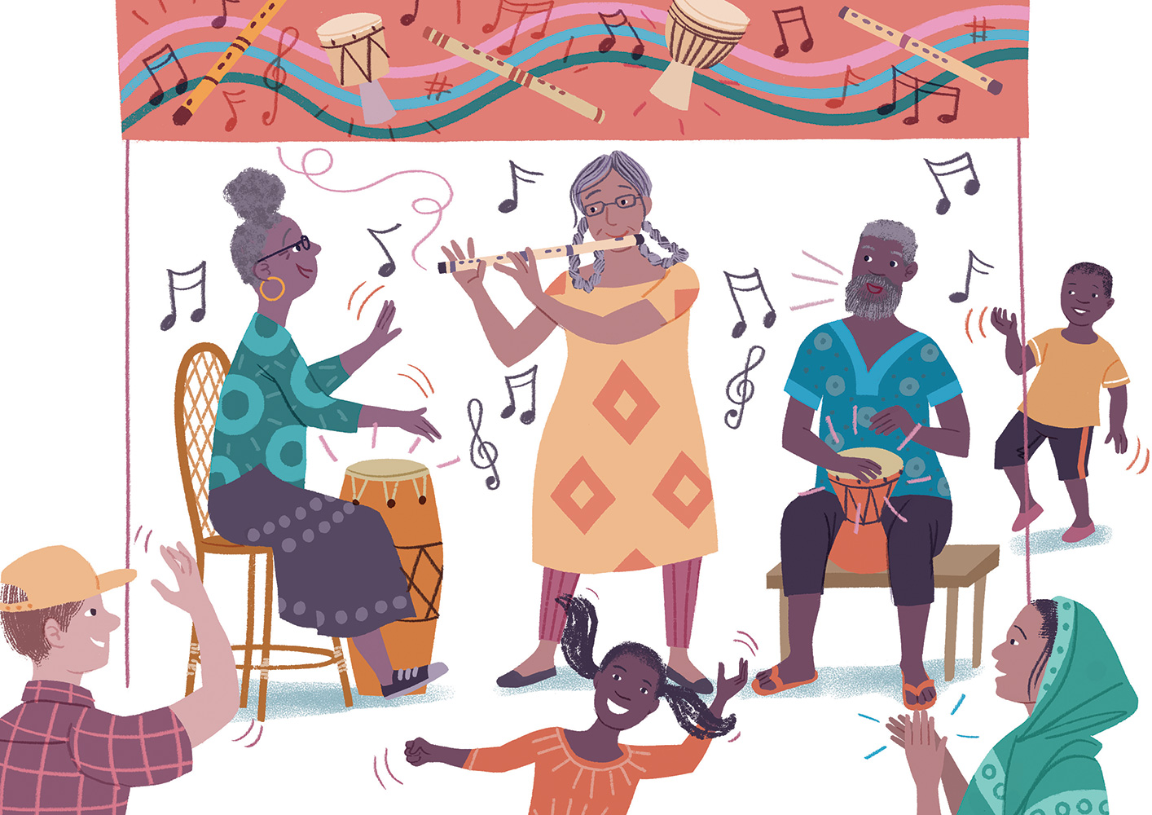
Notes:
re;ijapYs;s midj;J filfspYk; NkskÊ thrpg;gtu;fSf;fhd tuNtw;ig mtu;fs; czUtjw;F gy tUlq;fs; vLj;jd. Mdhy;> Ziana, Ono kw;Wk; Iris MfpNahu; mtu;fSila tpuy;fs; nraypof;Fk;tiuapYk;> jiy eiuf;Fk;tiuapYk; xt;nthU thuKk; xd;whf ,ize;J Gy;yhq;Foy; kw;Wk; NksjÊjpdhy; Md ghly;fis ,irj;J te;jdu;.

Slide 24
rpe;jid nra;jy;> ek;Gjy;> cupatuhapUj;jy;> gapwÊrp nraÊjyÊ;> Nfs;tpnaOg;Gjy;> khw;Wjy;> kWj;jy;
Notes:
(ePq;fs; ‘Kd;ndhU fhyj;jpy;’ gapw;rp njhlu;ghd rpwpa FOf; fye;Jiuahliy mwpKfk; nra;fpd;wNghJ> ,e;j ];iyl; fhz;gpf;fg;gl Ntz;Lk;. ];iyby; cs;s xt;nthU nrhy;Yk; VNjDnkhU topapy; fijAld; njhlu;GgLfpd;wJ vd;gjid tpsf;Fq;fs;.)

Slide 25
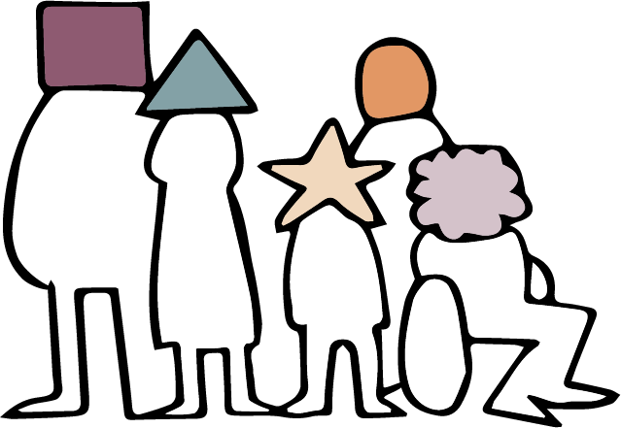
kjk; my;yJ ek;gpf;iff;fhd Rje;jpuk;: ahu; my;yJ vJ ghJfhf;fg;gl;Ls;sJ?
Notes:
24 - 46 tiuahd ];iyLfs; 2tJ mku;tpw;fhd Kd;itg;gpid vLj;Jf;fhl;Lfpd;wd: rpe;jidf;fhd> kdrhl;rp> kjk; kw;Wk; ek;gpf;iff;fhd Rje;jpuk; vd;gdtw;iw mwpKfg;gLj;jy;)
Presentation: Freedom of Thought, Conscience, Religion and Belief
Kd;itg;G rpe;jid Rje;jpuk kdrhl;rp kjk; my;yJ ek;gpf;iff;fhd Rje;jpuk; mwpKfk; MfNt> kjk; my;yJ ek;gpf;iff;fhd Rje;jpuk; ahiu my;yJ vjidg; ghJfhf;fpd;wJ?
,jw;fhd ju;f;fuPjpahd gjpyhf kjq;fs; kw;Wk; ek;gpf;iffs; mikAnkd ePq;fs; epidf;fyhk;. Mdhy;> cz;ikapy;> kjk; my;yJ ek;gpf;iff;fhd Rje;jpukhdJ kjq;fis my;yJ Vida ek;gpf;iffis ghJfhg;gjpy;iy. mJ flTisNah my;yJ Gdpjj;jd;ikapidNah ghJfhg;gjpy;iy. Vida midj;J kdpj cupikfisAk; Nghy> mJ kf;fis ghJfhf;fpd;wJ.
,t; cupikapd; KO ngaupid nrhy;tjhf ,Ue;jhy;> mJ rpe;jidf;fhd> kdrhl;rpf;fhd > kjk; my;yJ ek;gpf;iff;fhd Rje;jpuk; MFk;- ,J xt;nthU kdpjdJk;- mtu; ahuhf ,Ug;gpDk;> vj;jifa ek;gpf;iffisf; nfhz;bUg;gpDk;> ve;j kjj;jpidr; Nru;e;jtuha; ,Ug;gpDk;- cupikfisg; ghJfhf;fpd;wJ.

Slide 26
kdpjj; Njitfs; kw;Wk; kdpj cupikfs;
Notes:
kjk; my;yJ ek;gpf;iff;fhd Rje;jpukhdJ> midj;J kdpju;fSk; fPo;tUk; mbg;gilj; Njitfisf; nfhz;Ls;sdu; vd;w fUj;jpid mbg;gilahff; nfhz;like;jJ MFk;:
vJ ey;yJ kw;Wk; vJ cz;ikahdJ vd mtu;fSf;fhf rpe;jpf;fTk; jPu;khdnkLf;fTk; mDkjpf;fg;gly;
gfpug;gl;l ek;gpf;iffs;> eilKiwfs; kw;Wk; milahsq;fisf; nfhz;Ls;s FOf;fSf;F cupatuhjy;
mgpg;gpuhaq;fs; kw;Wk; eilKiwfisf; Nfs;tpf; Nfl;gjw;Fk;> mtu;fspd; ek;gpf;if njhlu;ghf mtu;fspd; kdq;fis khw;wpf; nfhs;tjw;Fk; kw;Wk; mtu;fSila kdrhl;rpapid kPWfpd;w tplaq;fis nra;a kWg;gjw;Fk; ,aYkhdjhf ,Uj;jy;.
rpe;jpg;gjw;F> ek;Gtjw;F> cupatuhapUg;gjw;F> gapwÊrp nraÊtjw;F Nfs;tpnaOg;Gtjw;F> jq;fSila kdq;fis khw;wpf; nfhs;tjw;F kw;Wk; kWg;gjw;F

Slide 27
Fbapay; kw;Wk; murpay; cupikfSf;fhd ru;tNjr
rkthak;
ICCPR
Notes:
vq;fSf;F ,Uf;fpd;w cupikfs; ahit? MfNt> vq;fSf;F vd;ndd;d cupikfs; ,Uf;fpd;wd? rkthaq;fspy; vd;d vOjg;gl;Ls;sJ vd;gJ gw;wp ehk; ghu;g;Nghk;: Fbapay; kw;Wk; murpay;
cupikfSf;fhd ru;tNjr rkthaj;jpd; (ICCPR) cWg;Giu 18 ,dhy; kjk; my;yJ ek;gpf;iff;fhd Rje;jpuk; ghJfhf;fg;gl;Ls;sJ.
,J rl;luPjpahfg; gpizf;fpd;w rkthankd;gJld; 173 ehLfs; ,r; ru;tNjr rl;lq;fis gpd;gw;Wtjw;F cld;gl;Ls;sd. (cq;fSila ehL ICCPR ,id Vw;Wf; nfhz;Ls;sik Fwpj;J gq;Fgw;Weu;fSf;F nrhy;Yq;fs;)

Slide 28
xtÊtUtUk; rpe;jidr; Rje;jpuk;> kdrhl;rpw;fhd Rje;jpuk; kw;Wk; kjj;jpw;fhd Rje;jpuj;jpw;Fupa cupikapidf; nfhz;bUj;jy; Ntz;Lk;.
cWg;Giu 18
Notes:
cWg;Giu 18 ,d; Kjy; thf;fpak; gpd;tUkhW $Wfpd;wJ:
“xt;nthUtUk; rpe;jidr; Rje;jpuk;> kdrhl;rpf;fhd Rje;jpuk; kw;Wk; kjr;Rje;jpuk; Mfpatw;Wf;fhd cupikapidf; nfhz;bUj;jy; Ntz;Lk;.”

Slide 29
rpe;jpj;jy;
Notes:
xt;nthUtUf;Fk; jq;fSf;fhf rpe;jpg;gjw;fhd cupik cz;L- jhd; xU ngz; gps;isahf ,Ue;jNghjpYk;> Gy;yhq;Foy; mzptjw;F mDkjpf;fg;gl Ntz;Lnkd epidj;j ,f;fijapy; tUk; Ziana ,idg; Nghd;W.

Slide 30
kWj;jyÊ
Notes:
vq;fSila kdrhl;rpfÊF nrtpkLfÊFkÊ cupik vq;fSf;F cz;L- jd;Dila je;ijapd; nray;fs; jtwhdit vd fUjpaikahy; je;ijf;F cjtp nra;tjid kWj;j Brone ,idg; Nghy.

Slide 31
ek;GjYkÊ cupatuhapUj;jYkÊ
Notes:
NkYkÊ vq;fSf;F> kj my;yJ kjk;rhuhj ek;gpf;iffisf; nfhz;bUg;gjw;fhd kw;Wk; kj my;yJ ek;gpf;iff;fhd milahsnkhd;wpidf; nfhz;bUg;gjw;fhd- kjk; my;yJ ek;gpf;ifnahd;wpid ek;Gtjw;fhd kw;Wk; mjw;F cupatuhapUg;gjw;fhd cupik cz;L. Gy;yhq;Foy; kw;Wk;; Nks fpuhkj;jtu;fisNghy> vq;fSs; gyUf;F cs;shu;e;j ek;gpf;iffs; cs;sd. vq;fSila ek;gpf;iffs; kw;Wk; mtw;iw ehk; gfpu;e;J nfhs;fpd;w rKjha cWg;gpdu;fs; vq;fSf;F kpfg; ngupa tplakhf ,Uf;Fk;.

Slide 32
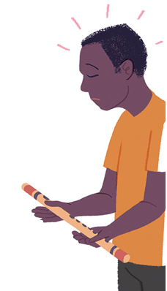
khw;Wjy;
Notes:
Mdhy;> ehq;fs; ve;j r%fj;jpy; tho;fpd;wNghjpYk; my;yJ vq;fSila ek;gpf;iffs; ve;jstpw;F cz;ikahdjhf kw;Wk; rupahdjhf ,Ue;jNghjpYk;> VNjDk; fhuzq;fSf;fhf jq;fSila ek;gpf;iffis my;yJ rKjhaj;jpy; ek;gpf;ifapid ,of;fpd;w egu;fSk; ,Ug;ghu;fs;- jdJ Gy;yhq;Foiy vLj;J itj;Jtpl;L jdJ rKjhaj;jpid tpl;L ntspNawpa Brone ,idg; Nghy.

Slide 33
ICCPR cWg;Giu 18:
,e;j cupikahdJ xUtu; jdJ njuptpd;gb xU kjj;ij my;yJ ek;gpf;ifapidf; nfhz;bUg;gjw;fhd my;yJ Vw;Wf;nfhs;tjw;fhd Rje;jpuj;jpid cs;slf;fpAs;sJ.
UDHR cWg;Giu 18:
,t; cupikahdJ xUtu; kjnkhd;wpid my;yJ ek;gpf;ifnahd;wpidf; nfhz;bUg;gjw;fhd my;yJ mjid khw;wpf;nfhs;tjw;fhd Rje;jpuj;ij cs;slf;fpAs;sJ.
Notes:
ru;tNjr kdpj cupikfs; rl;lj;jpy;> kjk; my;yJ ek;gpf;ifapidf; nfhz;bUg;gjw;fhd cq;fsJ cupikAld; Nru;e;J> cq;fSila kjk; my;yJ ek;gpf;ifapidtpl;L ePq;Ftjw;fhd kw;Wk; mjid khw;Wtjw;fhd cupikAk; ghJfhf;fg;gl;Ls;sJ.

Slide 34
csÊshuÊeÊj RjeÊjpukÊ
Notes:
rpe;jpg;gjw;fhd> ek;Gtjw;fhd> Nfs;tpnaOg;Gtjw;fhd kw;Wk; vq;fsJ ek;gpf;iffis khw;Wtjw;fhd cupikfs; ngUk;ghYk; cs;shu;e;j Rje;jpuq;fs; vd miof;fg;gLfpd;wd. mit vq;fSila kdjpy; kw;Wk; vq;fSila Md;khtpy; vd;d elf;fpd;wJ vd;gd gw;wpaitahFk;> ,it vkJ milahsk;- ehq;fs; ahnud;w vq;fsJ czu;Tld; njhlu;GgLfpd;wd. ,f;fhuzj;jpw;fhf> mit kPwKbahj cupikfshf cs;sd. ru;tNjr rl;lj;jpd;fPo;> ve;jnthU egUk; my;yJ murhq;fKk; vg;NghJk; ,t; cupikfis kl;Lg;gLj;Jtjw;F mDkjpf;fg;gltpy;iy.

Slide 35
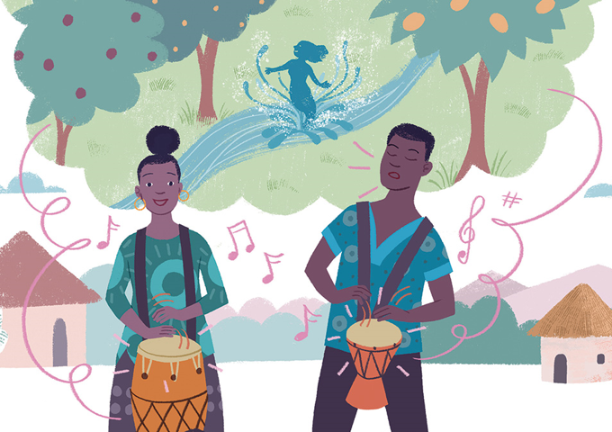
gapwÊrp nraÊjyÊ
Notes:
Mdhy;> re;Njfj;jpw;fplkw;wtifapy;> kjk; kw;Wk; ek;gpf;if vd;gd vq;fsJ kdq;fs; kw;Wk; Md;khf;fspy; vd;d elf;fpd;wJ vd;gjw;Fk; mg;ghw;gl;l tplaq;fisg; gw;wpajhFk;. mJ ehq;fs; vd;d nra;fpNwhk; vd;gJ gw;wpajhFk;- vq;fSila ek;gpf;iffis nrhw;fspy; kw;Wk; nray;fspy; ehk; vt;thW ntspg;gLj;JfpNwhk; vd;gJ gw;wpajhFk;. vq;fSila fijapy;> fpuhkj;jtu;fspd; tho;f;if> mtu;fSila ek;gpf;iffs; kw;Wk; mtu;fs; cupatu;fshAs;stw;wpid ntspg;gLj;Jfpd;w eilKiwfs; epiwe;jjhff; fhzg;gl;lJ.

Slide 36
,t; cupikahdJ> jdpj;Njh gpwUld; $l;lhfNth> gfpuq;fkhd ,lq;fspNyh md;Nwy; jdpg;gl;l ,lq;fspNyh jdJ rkaj;ij my;yJ ek;gpf;ifia topghl;bYk;> mDrupg;gpYk;> tof;fj;jpYk;> fw;gpj;jypYk; ntspg;gLj;Jtjw;fhd Rje;jpuj;jpid cs;slf;Fk;.
cWg;Giu 18
Notes:
kjk; my;yJ ek;gpf;iff;fhd Rje;jpuk; ,t; cupikfisAk; ghJfhf;fpd;wJ. ehq;fs; kPz;Lk; rkthaj;jpidg; ghu;g;Nghk;. cWg;Giu 18 MdJ gpd;tUkhW $Wfpd;wJ: ,t; cupikahdJ>..... jdpj;Njh gpwUld; $l;lhfNth> gfpuq;fkhd ,lq;fspNyh md;Nwy; jdpg;gl;l ,lq;fspNyh jdJ rkaj;ij my;yJ ek;gpf;ifia topghl;bYk;> mDrupg;gpYk;> tof;fj;jpYk;> fw;gpj;jypYk; ntspg;gLj;Jtjw;fhd Rje;jpuj;jpid cs;slf;Fk;.
vq;fSf;F jdpg;gl;luPjpapy; gpuhu;j;jid nra;tjw;fhd cupik kw;Wk; $l;Lg; gpuhu;j;jid kw;Wk; ghuk;gupaq;fspD}lhf rKjhaj;jpd; mq;fnkhd;nwd;wuPjpapy; vq;fsJ kjk; my;yJ ek;gpf;ifapid ntspg;gLj;Jtjw;fhd cupik vd;gd fhzg;gLfpd;wd. mj;Jld;> rKjhaj;jpw;Fk; cupikfs; fhzg;gLfpd;wd- mjd; cWg;gpdu;fisf; fl;Lg;gLj;Jtjw;fhd cupikfs; my;y> Mdhy; muRld; njhlu;Gila cupikfs;. cjhuzkhf> kj kw;Wk; ek;gpf;iff;fhd rKjhaq;fs; jhq;fs; tpUk;Gfpd;wgl;rj;jpy;> rl;l milahsnkhd;wpidg; ngw;Wf;nfhs;sf; $bajhf cs;sd vd;gjid muR cWjpg;gLj;j Ntz;Lk;> MfNt> mit tq;fpf; fzf;Ffis itj;jpUf;fTk;> egu;fis gzpf;fku;j;jTk;> kw;Wk; fl;blq;fis nrhe;jq;nfhs;sTk;> KbAk;.
jdpegu;fSk; FOf;fSk; kjk; my;yJ ek;gpf;ifnahd;wpid eilKiwg;gLj;Jtjw;F NtWgl;l topfs; fhzg;gLfpd;wd vd;gJld; If;fpa ehLfspd; epGzu;fs; ghJfhf;fg;gl;Ls;s gy nraw;ghLfis cjhuzq;fshf; Fwpg;gpl;Ls;sdu;. cjhuzkhf> vkf;F fPo;tUtdtw;Wf;fhd cupikfs; cz;L:

Slide 37
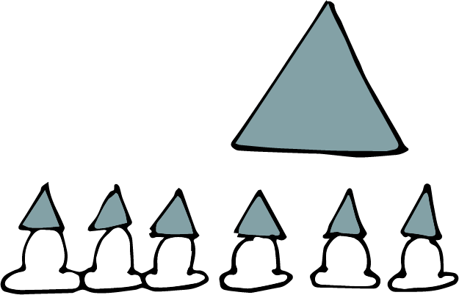
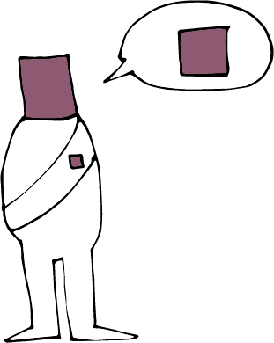
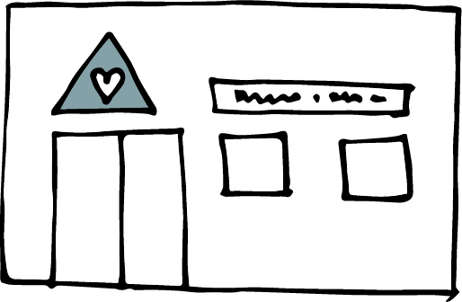
Notes:
topghl;bw;F $l;lhf tUtjw;fhd> gz;biffisf; nfhz;lhLtjw;fhd kw;Wk; Xa;T ehl;fisf; nfhz;bUg;gjw;fhd cupik.
kj Milfis mzptjw;fhd kw;Wk; tpNrl czT Kiwfisg; gpd;gw;Wtjw;fhd cupik.
topghl;blq;fs;> kahdq;fisf; nfhz;bUg;gjw;fhd kw;Wk; kj milahsq;fisf; fhl;rpg;gLj;Jtjw;fhd cupik.
r%fj;jpy; tfpghfnkhd;wpid tfpg;gjw;fhd cupik> cjhuzkhf njhzÊL epWtdqÊfis ];jhgpg;gjw;fhd cupik
kjk; my;yJ ek;gpf;if gw;wp NgRtjw;fhd kw;Wk; mtw;iwf; fw;gpg;gjw;fhd kw;Wk; jiytu;fis gapw;Wtpg;gjw;fhd my;yJ epakpg;gjw;fhd cupik.
,j;jUzj;jpy;> “rpwgÊG -,t; cupikfis vd;Dila rKjhaj;jpy; vdf;F Njitahd cupikfs; vd ePq;fs; vz;zf;$Lk;! my;yJ ePq;fs; ftiyailaf;$Lk;!

Slide 38
Notes:
jd;dhu;tf;nfhs;if kw;Wk; rkj;Jtk;- VidNahUf;F CW tpistpf;f Ntz;lhk;!
jq;fSila kjk; my;yJ ek;gpf;ifapidg; gad;gLj;jp VidNahu;kPjhd ntWg;G my;yJ td;Kiwapid Cf;Ftpf;fpd;w> VidNahiu ghugl;rg;gLj;Jfpd;w my;yJ jq;fSila FOtpDs; VidNahiu mlf;Ffpd;w kw;Wk; fl;Lg;gLj;Jfpd;w egu;fs; my;yJ FOf;fs; gw;wp vd;d nrhy;yyhk;?
kjk; my;yJ ek;gpf;iff;fhd Rje;jpunkd;gJ> Vida egu;fSf;F vd;d jhf;fk; Vw;gl;lhYk;> ,j;jifa egu;fs; my;yJ FOf;fs; ,jid nra;tjw;fhd Rje;jpuj;jpidf; nfhz;Ls;sdu; vd;gjidf; Fwpf;fpd;wjh?
,y;iy vd;gJ ed;wpf;Fupa tplak;!

Slide 39
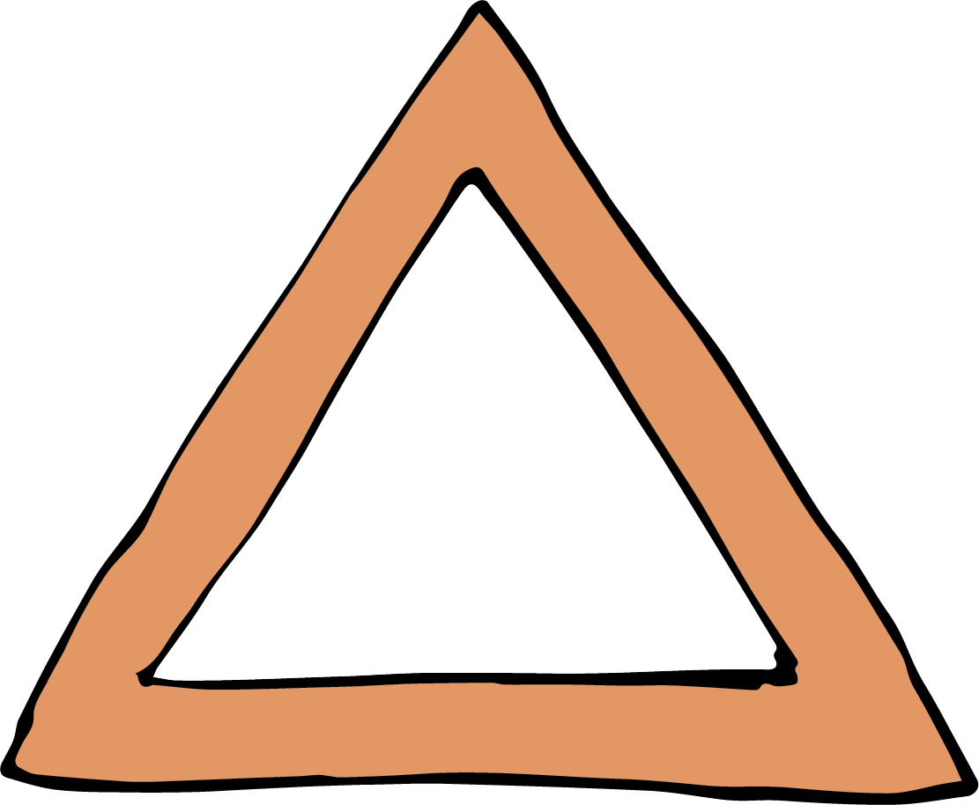
kdpjg; nghWg;Gfs;
Notes:
kdpj cupikfs; rkthaq;fs; vk;Kila cupikfs; kw;Wk; vk;Kila cupikfSf;fhd kl;Lg;ghLfs; Mfpa ,uz;ilAk; $wfpd;wd. my;yJ NtW tifapy; $Wtjhapd;> vq;fSila cupikfis ehq;fs; gpuNahfpf;fpd;wNghJ vq;fSf;Fs;s nghWg;Gf;fs; vitnad $Wfpd;wd. ,g;nghWg;Gf;fisnay;yhk; ehk; njhFj;J $WNthkhapd;> ve;jnthU egUk; jdJ cupikfs; kw;Wk; Rje;jpuq;fis Vida egu;fSf;F CW tpistpf;fpd;w topfspy; gad;gLj;jf;$lhJ vd $wyhk;. kdpj cupikfs; rkthaq;fSf;fika> ,J xt;nthU egupdJk; xOf;ff; flg;ghlhFk;.
mj;Jld; xt;nthUilaJk; cupikfis kjpg;gjw;Fk; kw;Wk; xt;nthUtiuAk; CwpypUe;J ghJfhg;gjw;Fkhd rl;lf; flg;ghnlhd;W murhq;fj;jpw;F ,Uf;fpd;wJ.
ehq;fs; vt;thW CwpypUe;J ghJfhf;fg;gl Ntz;Lk; vd ehq;fs; kpff; Fwpg;ghfg; ghu;g;Nghk;.

Slide 40
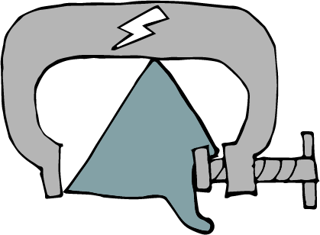
flÊlhagÊgLjÊjYfÊfhdmDkjp ,yÊiy
cWg;Giu 18
Notes:
Kjyhtjhf: gyte;jg;gLj;jypd;ik!
kjk; my;yJ ek;gpf;ifAld; njhlu;GWfpd;w tplaq;fspy; gyte;jg;gLj;jy; mDkjpf;fg;gLtjpy;iy. ek;Gjy; kw;Wk; cupatuhapUj;jy; vd;gd jd;dhu;tkhf ,lk;ngw Ntz;bad. ve;jnthU egiuAk; ek;gr; nrhy;yp my;yJ ek;ghjpUf;fr; nrhy;yp> eilKiwg;gLj;jr; nrhy;yp my;yJ eilKiwg;gLj;j Ntz;lhnkd nrhy;yp> kjnkhd;wpw;F cupatuhapUf;Fk;gb my;yJ kjnkhd;wpw;F cupatuhapUf;f Ntz;lhnkd gyte;jg;gLj;Jtjw;fhf mr;RWj;jy;fs;> kpul;ly;fs; my;yJ td;Kiwapidg; gad;gLj;Jtjw;F mjpfhupfs;> kj rKjhaq;fs; kw;Wk; FLk;gq;fs; mDkjpf;fg;gltpy;iy.

Slide 41
ghuhlÊrkÊ fhlÊl mDkjp ,yÊiy
cWg;Giu 2
Notes:
,uz;lhtjhf: ghugl;rkpd;ik!
rkthaj;jpd; cWg;Giu 2 MdJ> vt;tifahd ghugl;rj;jpidAk;- mJ kjk;> ,dk;> ghy;epiy my;yJ nkhop vd vjd; mbg;gilapy; nra;ag;gbDk;- jil nra;fpd;wJ. kdpj cupikfs; xg;ge;jq;fSf;F ifnahg;gkpl;Ls;s muRfs; xt;nthUtiuAk; rkkhf elj;Jtjw;Fk; r%fj;jpYs;s ghugl;rj;jpid xopg;gjw;Fk;- vkJ fijapy; re;ij rig nra;jJ Nghy- cld;gl;Ls;sd.

Slide 42
ve;jnthU egUk; xU cupikapid Vida kdpj cupikfis mopg;gjw;F gad;gLj;jyhfhJ.
cWg;Giu 5
Notes:
%d;whtjhf: cupikfis mopf;f KbahJ!
cWg;Giu 5 MdJ> murhq;fk;> FOf;fs; my;yJ egu;fs;> ve;jnthU kdpj cupikiaAk;> mt; cupik Vida kdpj cupikfis mopg;gjw;fhd topfspy; nraw;gLtjw;fhd cupikapid mtu;fSf;F toq;Ftjhf nghUl;Nfhly; nra;af;$lhJ vd $Wfpd;wJ.
mj;Jld; cWg;Giu 20 MdJ> ghugl;rk;> tpNuhjk; my;yJ td;Kiwf;fhd J}z;lypD}lhf kj ntWg;gpid Mjupj;J thjhliyj; jil nra;fpd;wJ.
murhq;fnkhd;W my;yJ egnuhUtu; Fwpg;gpl;l tplankhd;iw nra;a Ntz;Lnkd;W jdJ kjk; Njitg;gLj;Jtjhf epidf;fpd;wNghjpYk;> kjk; my;yJ ek;gpf;iff;fhd Rje;jpuk; mtu;fSf;F Vida egu;fspd; cupikfis mlf;Ftjw;fhd cupikapid toq;Ffpd;wJ vd ahUk; thjpl KbahJ. MfNt> NkskÊ thrpg;gtu;fis Jd;GWj;JtJ rupnad Brone ,d; je;ijf;F fw;gpf;fg;gl;bUe;jhYk; mtu;fisj; Jd;GWj;Jtjw;fhd cupik mtUf;F ,y;iy.
td;Kiwapid J}z;;Ltjw;F my;yJ kf;fSf;F CW tpistpf;fpd;w kj eilKiwfis epahag;gLj;Jtjw;F kjk; gad;gLj;jg;gl;Ls;s Vuhskhd cjhuzq;fs; Fwpj;J cq;fshy; rpe;jpf;f KbAnkd vdf;F epr;rakhf njupAk;. egu;fs; jq;fsJ kjj;ij my;yJ ek;gpf;ifapid mikjpahdKiwapy; eilKiwg;gLj;JtjpypUe;J epahakw;w Kiwapy; jLf;fg;gl;l re;ju;g;gq;fs; Fwpj;Jk; cq;fshy; rpe;jpf;ff;$bajhf ,Uf;Fk;.

Slide 43
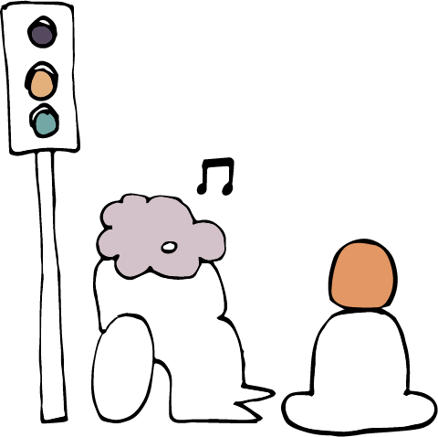
kl;Lg;ghLfs; ,yÊiy
kl;Lg;ghLfs; ?
Notes:
kjk; my;yJ ek;gpf;iff;fhd Rje;jpuj;jpw;fhd kl;Lg;ghLfs;
MfNt> tpjpfs; ahit?
kjk; my;yJ ek;gpf;iff;fhd Rje;jpuj;jpid kl;Lg;gLj;Jtjw;F murhq;fq;fs; mDkjpf;fg;gl;Ls;s re;ju;g;gq;fs;; ahit ?
Kjyhtjhf> rpe;jid nra;tjw;Fk; ek;Gtjw; Fkhd cupik (cs;shu;e;j Rje;jpuk;) xUNghJk; kl;Lg;gLj;j KbahjJ.
,uz;lhtjhf> fPo;tUk; ehd;F tpjpfs; gpd;gw;wg;gLfpd;wNghJ khj;jpuNk kjk; my;yJ ek;gpf;ifapd; eilKiwg;gLj;jy; kl;Lg;gLj;jg;glyhk;.

Slide 44
kl;Lg;ghLfshdit fl;lhakhf:
rl;lj;jpy; vOjg;gl;bUf;f Ntz;Lk;.
tpfpjhrhuKilajha; ,Uj;jy; Ntz;Lk;.
ghugl;rkpyÊyhJ ,Uj;jy; Ntz;Lk;.
nghJ Rfhjhuk;> nghJ xOq;F> nghJ ghJfhg;G> nghJ xOf;fk; my;yJ Vida kf;fspd; cupikfs; my;yJ Rje;jpuq;fs; vd;gdtw;iw ghJfhg;gJ mtrpakhdjhf ,Uj;jy; Ntz;Lk;.
Notes:
kl;Lg;ghbidf; Fwpf;fpd;w rl;lnkhd;W ,Uj;jy; Ntz;Lk;. NtW nrhw;fspy; $WNthkhapd;> nghyp]hu; tpUk;gpatw;iw mtu;fshy; ntWkNd nra;a KbahJ.
kl;Lg;ghlhdJ mJ jPu;f;f vz;Zfpd;w gpur;rpidf;F tpfpjrkdhdjhf mika Ntz;Lk;. cjhuzkhf> kj rKjhankhd;wpd; xypngUf;fpapd; rj;jk; kpf mjpfnkdpy;> mjidf; Fiwf;FkhW my;yJ jz;lg; gzk; nrYj;JkhW Fwpg;gpl;l kj rKjhaj;jpw;F fl;lisaplyhk;. Mdhy;> mtu;fs; re;jpg;gjid Kw;whf jil nra;jyhdJ tpfpjrkdhdjhf mikahJ.
midj;J kl;Lg;ghLfSk; ghugl;rkw;witahff; fhzg;gLjy; Ntz;Lk;- mit midtUf;Fk; Vw;ghf Ntz;Lk;.
Fwpg;gpl;l kl;Lg;ghdJ fPo;tUtdtw;Ws; VNjh xd;wpidg;
ghJfhg;gjw;F mtrpakhdjhf
,Uf;f Ntz;Lk;: nghJ ghJfhg;G>
nghJ xOq;F> nghJ Rfhjhuk;>
nghJ xOf;fq;fs; my;yJ Vida
egu;fspd; cupikfs; my;yJ
Rje;jpuq;fs;.
‘mtrpakhdjhf’ vd;w nrhy; kpf Kf;fpakhdjhFk;. ,t; ,yf;Ffis mile;Jf; nfhs;tjw;F Fwpj;j kl;Lg;ghL tpUk;gj;jf;fJ vd murhq;fk; my;yJ ngUk;ghd;ikahd kf;fs; fUjpdhy; khj;jpuk; NghjhJ. kl;Lg;ghL cz;ikapy; mtrpakhdjhf ,Uf;f Ntz;Lk;. NtW nrhw;fspy; $WNthkhapd;> eilKiwfspdhy; cUthf;fg;gl;l mg;gpur;rpidiaj; jPu;g;gjw;F cupikfis kl;Lg;gLj;Jtjidj;jtpu NtW vt;topAk; ,y;yhjpUf;f Ntz;Lk;. cupikfis kl;Lg;gLj;jnyd;gJ ,Wjpahd toptifahf ,Uf;f Ntz;Lk;. ,Ue;jNghjpYk;> mJ rpyNeuq;fspy; mtrpakhdjhf cs;sJ.

Slide 45
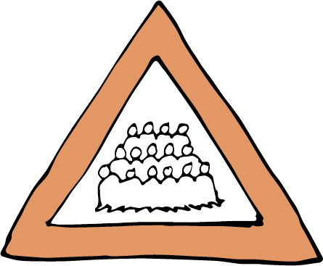
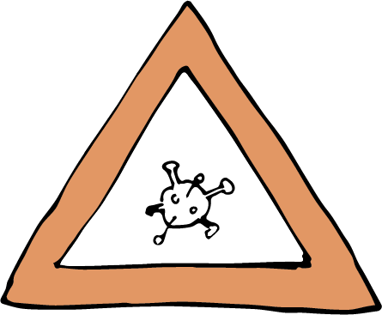
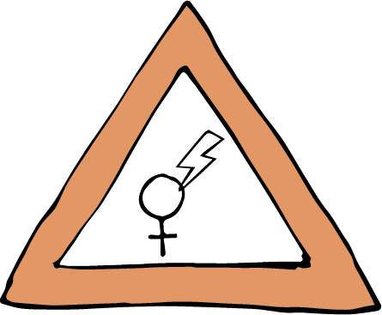
rlÊléuÊtkhd kl;Lg;ghLfs;
Notes:
cjhuzkhf- topghl;blnkhd;wpy; mjpfsthd vz;zpf;ifahd egu;fis epiwj;jy; Mgj;jhdjhf ,Uf;fyhk;. MfNt> nghJ ghJfhg;G vd;w mbg;gilapy; topghl;blnkhd;wpy; xd;WNruf;$ba egu;fspd; vz;zpf;ifapid kl;Lg;gLj;jy; mjpfhupfSf;F mtrpakhdjhf ,Uf;fyhk;.
nfhNuhdh itu]; njhw;wpd;NghJ topghl;bw;fhf xd;W $Ljy; njhlu;gpy; tpjpf;fg;gl;l nghJ Rfhjhu kl;Lg;ghLfs; kpfg; nghJthditahFk;- rpyNeuq;fspy; ,j;jifa kl;Lg;ghLfs; mtrpakhdjhf> tpfpjrkdhdjhf kw;Wk; ghugl;rkw;witahff; fhzg;gl;ld. rpyNeuq;fspy;> mit caupastpy; ghugl;rk;kpf;fitahfTk; tpfpjrkdw;witahfTk; fhzg;gl;ld.
VidNahUila cupikfs; kw;Wk; Rje;jpuq;fisg; ghJfhg;gjw;fhd kl;Lg;ghnlhd;whf ngz; gpwg;GWg;G rpijtpw;fhdj; jilfisf; Fwpg;gplyhk;- ,t;tplaj;jpy; ngz; gps;isfspd; cupikfs; ghJfhf;fg;gl;Ls;sd. ,J fyhrhu my;yJ kj eilKiwnahd;whfg; ghu;f;fg;gLfpd;wNghjpYk;> mJ ngz; gps;isfspd; MNuhf;fpaj;jpidg; ghjpf;fpd;wJ vd;gJld; kjk; my;yJ ek;gpf;iff;fhd Rje;jpuj;jpidf; fhuzk;fhl;b mjid epahag;gLj;j KbahJ.

Slide 46
kl;Lg;ghLfshdit fl;lhakhf:
rl;lj;jpy; vOjg;gl;bUf;f Ntz;Lk;.
tpfpjhrhuKilajha; ,Uj;jy; Ntz;Lk;.
ghugl;rkpyÊyhJ ,Uj;jy; Ntz;Lk;.
nghJ Rfhjhuk;> nghJ xOq;F> nghJ ghJfhg;G> nghJ xOf;fk; my;yJ Vida kf;fspd; cupikfs; my;yJ Rje;jpuq;fs; vd;gdtw;iw ghJfhg;gJ mtrpakhdjhf ,Uj;jy; Ntz;Lk;.
Notes:
,t;tpjpfs; cz;ikapy; Kf;fpakhditahFk;. mit ,d;wp> murhq;fq;fs; mtw;Wf;F gpbf;fhj ve;jnthU kw;Wk; midj;J FOf;fs; kw;Wk; eilKiwfisAk; kl;Lg;gLj;jKbAk;. kl;Lg;ghLfs; ,Wjp topKiwahfNtf; fhzg;gl Ntz;Lk;> mJ mur fl;Lg;ghl;bw;fhd fUtpnahd;wy;y. mLj;j mku;tpy;> cynfq;fpYk; eilngWfpd;w kj my;yJ ek;gpf;iff;fhd Rje;jpuj;jpd; NtWgl;l tifahd kPwy;fs; njhlu;gpy; ehq;fs; kpf Mokhfg; ghu;f;fg; Nghfpd;Nwhk;.

Slide 47
Fwpg;G: kj ek;gpf;iffs; gw;wp cq;fsJ ehl;by; cs;s rl;lk; vd;d nrhy;fpwJ vd;gJ njhlu;ghf xd;W my;yJ xd;wpw;F Nkw;gl;l ];iyLfis Nru;g;gjw;F ePq;fs; tpUk;gyhk;.
Notes:
Fwpg;G: kj ek;gpf;iffs; gw;wp cq;fsJ ehl;by; cs;s rl;lk; vd;d nrhy;fpwJ vd;gJ njhlu;ghf xd;W my;yJ xd;wpw;F Nkw;gl;l ];iyLfis Nru;g;gjw;F ePq;fs; tpUk;gyhk;.

Slide 48
Photo: Robbi Akbari Kamaruddin / Alamy Stock Photo
Notes:
(48 - 60 tiuahd ];iyLfs; ‘vdJ ehspy; kjk;; my;yJ ek;gpf;iff;fhd Rje;jpuk;’ vd;w gapw;rpAld; njhlu;Gilait. tsthsupd; Fwpg;Gf;fspYs;s gpujpia thrpf;Fk;NghJ my;yJ mjidnahj;j tplaq;fis nrhy;Yk;NghJ mtw;iwg; gad;gLj;Jq;fs;.)
cq;fs; tho;f;ifapy; tof;fkhd xU ehs; gw;wp rpe;jpAq;fs;.
(,e;NjhNdrpahtpy; xU K];ypk; Mz; gpuhu;j;jidf;F Kd;ghf Rj;jpfupg;G rlq;nfhd;wpid nra;fpd;whu;)

Slide 49
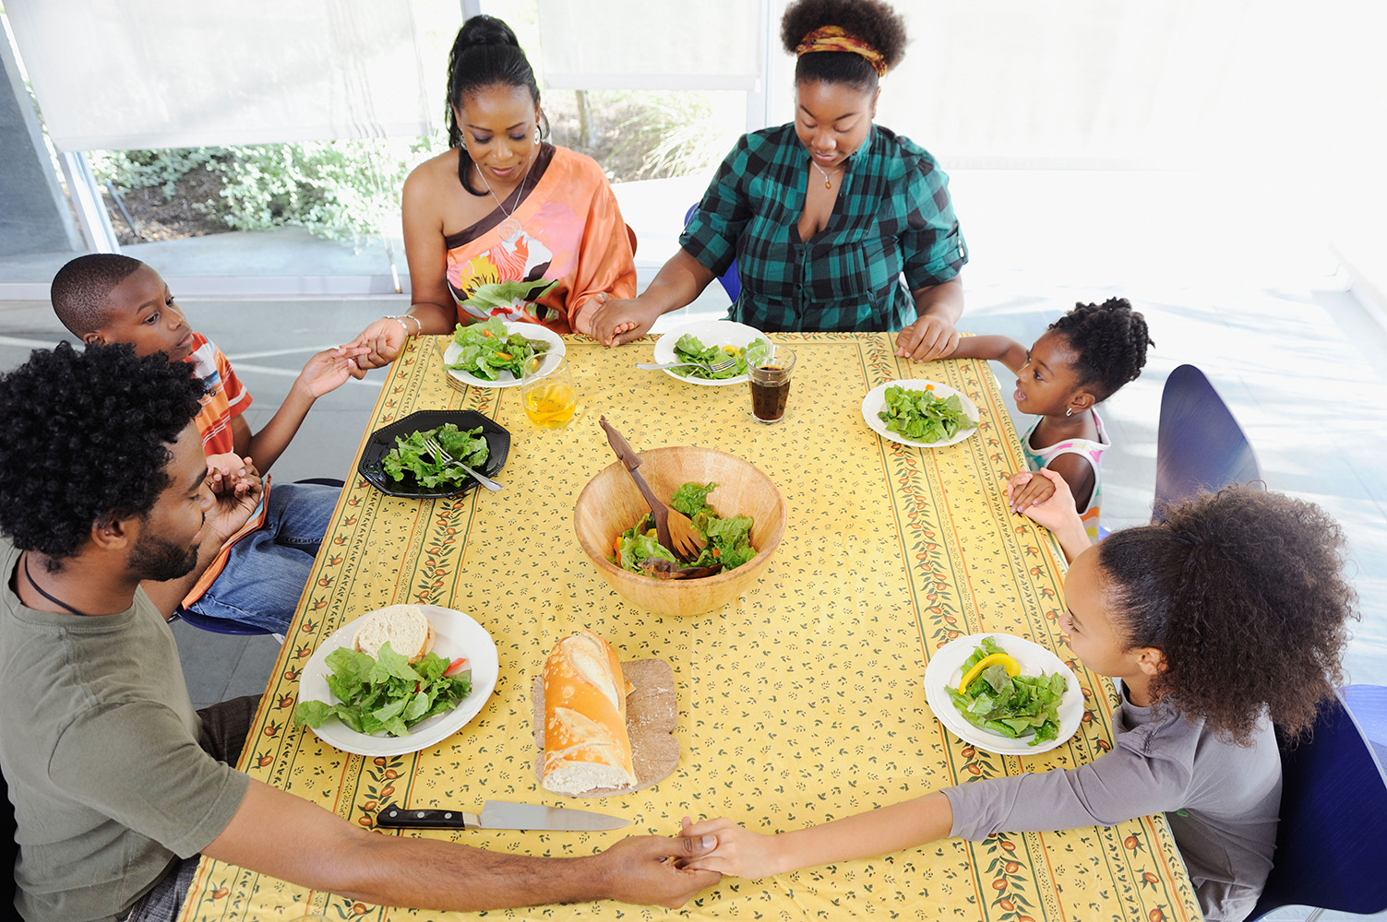
Photo: Tetra Images, LLC / Alamy Stock Photo
Notes:
ePq;fs; cq;fSila rpe;jidfisAk; ek;gpf;iffisAk; tpdhf;fisAk; vtÊthW ntspgÊgLjÊJtPuÊfsÊ
ePq;fs; cq;fSila rpe;jidfisAk; ek;gpf;iffisAk; tpdhf;fisAk; vtÊthW ntspgÊgLjÊJtPuÊfsÊ
(mnkupf;fhtpy; fpwp];jt FLk;gk; czTf;F Kd; ,iwtdpd; fUizapid $Wfpwhu;fs;.)

Slide 50
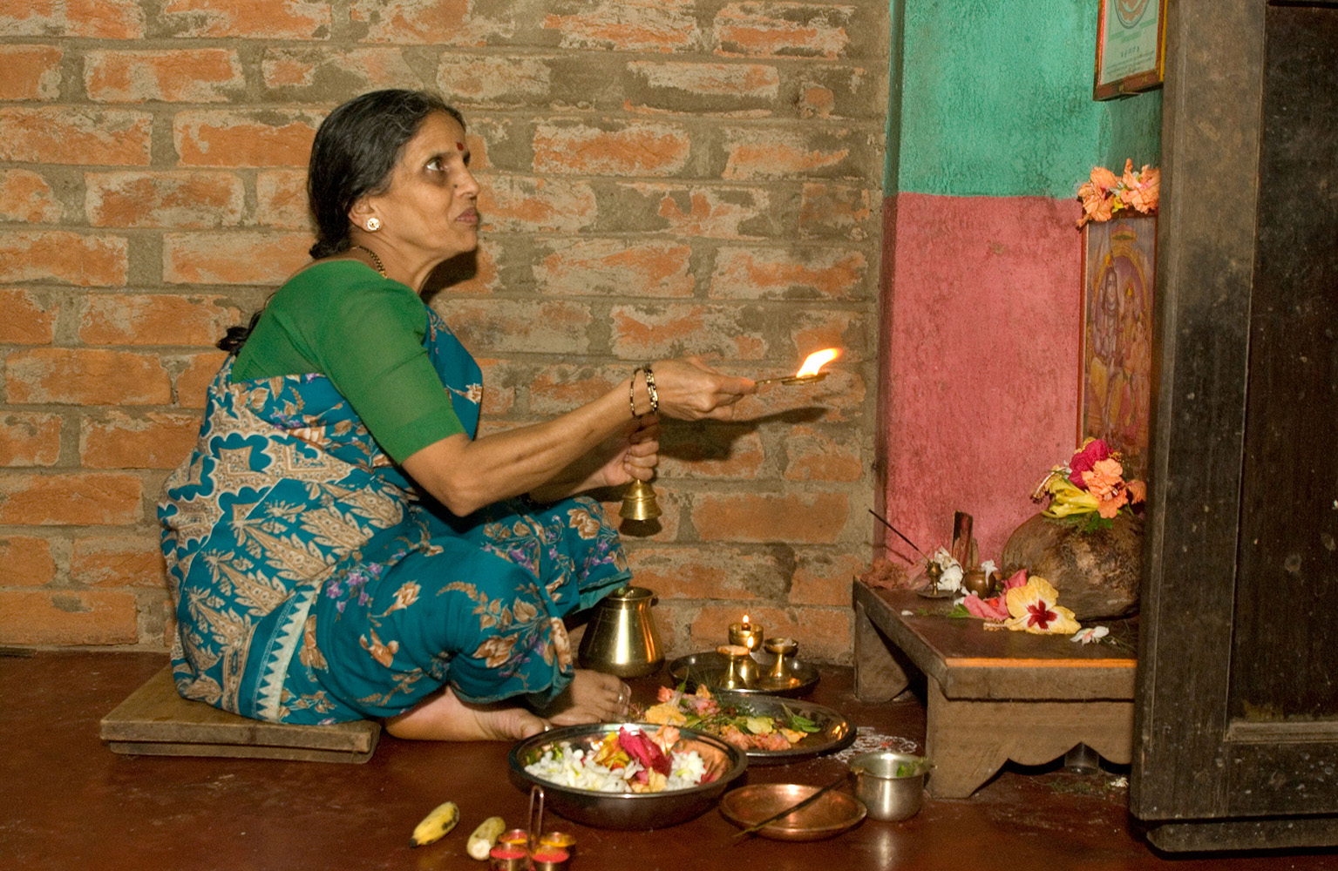
Photo: Simon Rawles / Alamy Stock Photo
Notes:
…..kw;Wk; kjnkhd;wpw;F cupatuhAs;s my;yJ cupatuy;yhJs;s cq;fsJ czu;T kw;Wk; milahsk; vd;gtw;iw vg;NghJ> vt;thW ntspg;gLj;JtPu;fs;...?
(,e;jpahtpYs;s ,e;J ngz; mtsJ tPl;bYs;s topghl;liwapy; gpuhu;j;jid nra;fpd;whs;)

Slide 51
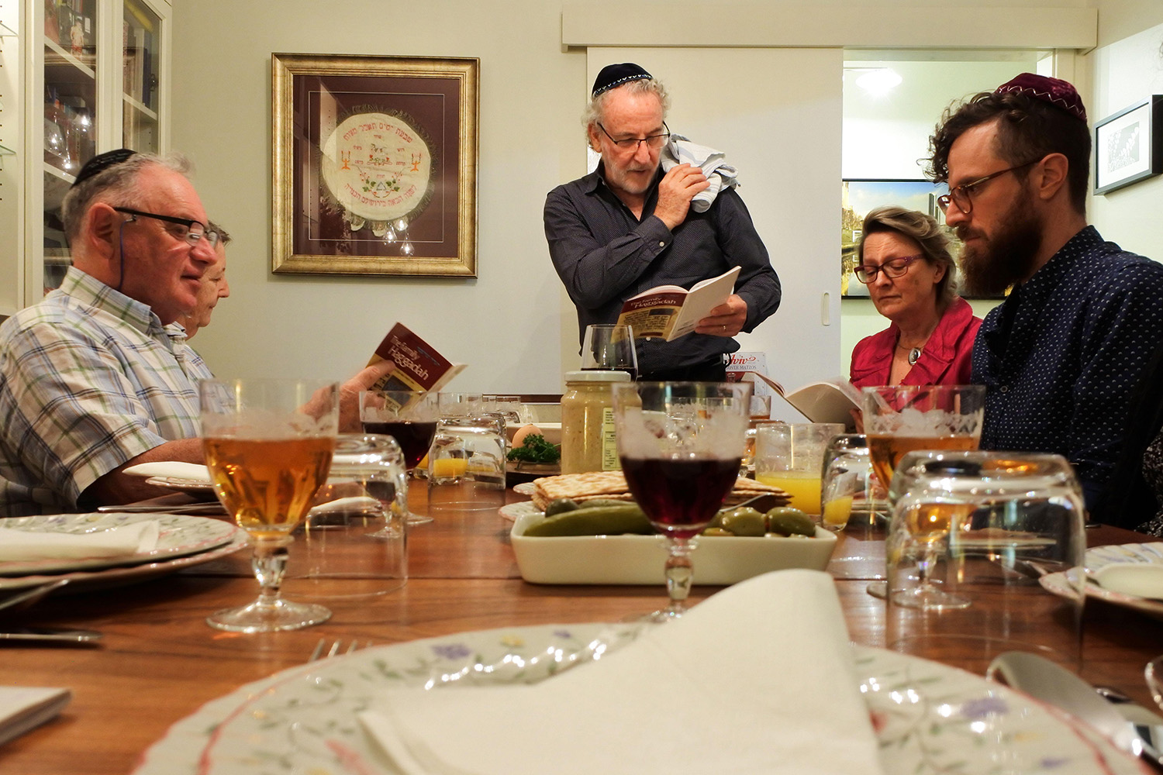
Photo: Rafael Ben Ari / Alamy Stock Photo
Notes:
mJ ePq;fs; cz;Zk; cztpy; $l ,Uf;fyhk;….
(mT]ÊjpNuypahtpdÊ êj FLkÊgnkhzÊwpdÊ g]Êfh czT)

Slide 52
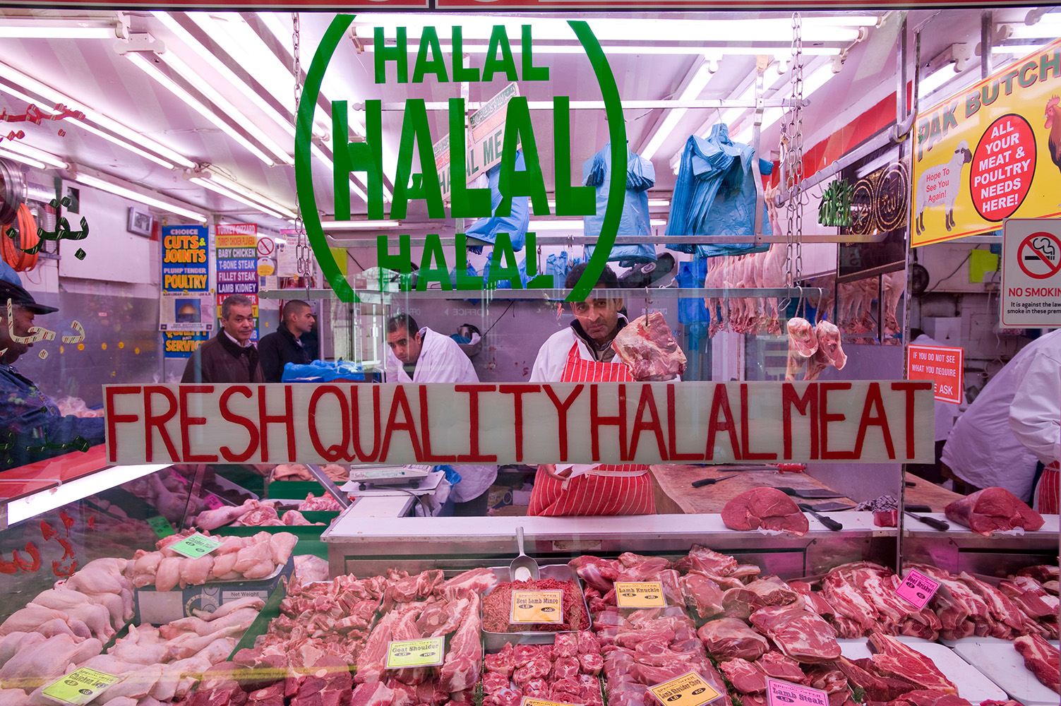
Photo: Gregory Wrona / Alamy Stock Photo
Notes:
….my;yJ cz;zhjtw;wpy; $l ,Uf;fyhk;.
ydÊldpdÊ `yhyÊ ,iwrÊrp filfhuuÊ

Slide 53
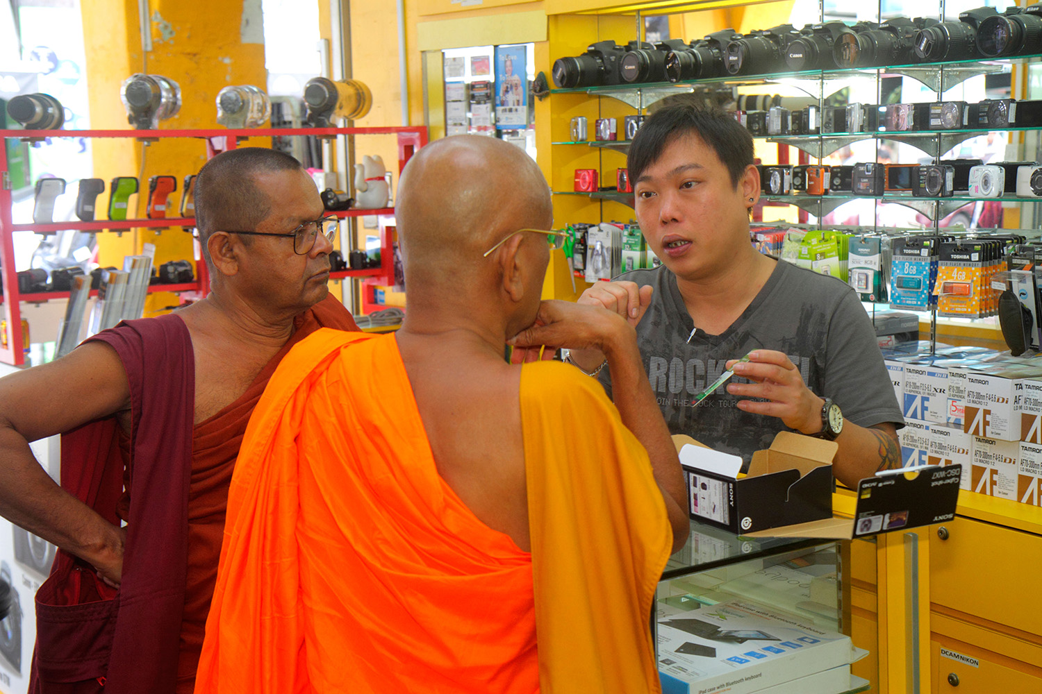
Photo: Jeffrey Isaaz Greenberg / Alamy Stock Photo
Notes:
ePq;fs; mzpAk; Milfspy; my;yJ mzpahjdtw;wpy; ,Uf;fyhk;.
(rpqÊfgÊéupy; ngsjÊj
Jwtpfs; nraÊAkÊ nfhsÊtdTfsÊ

Slide 54
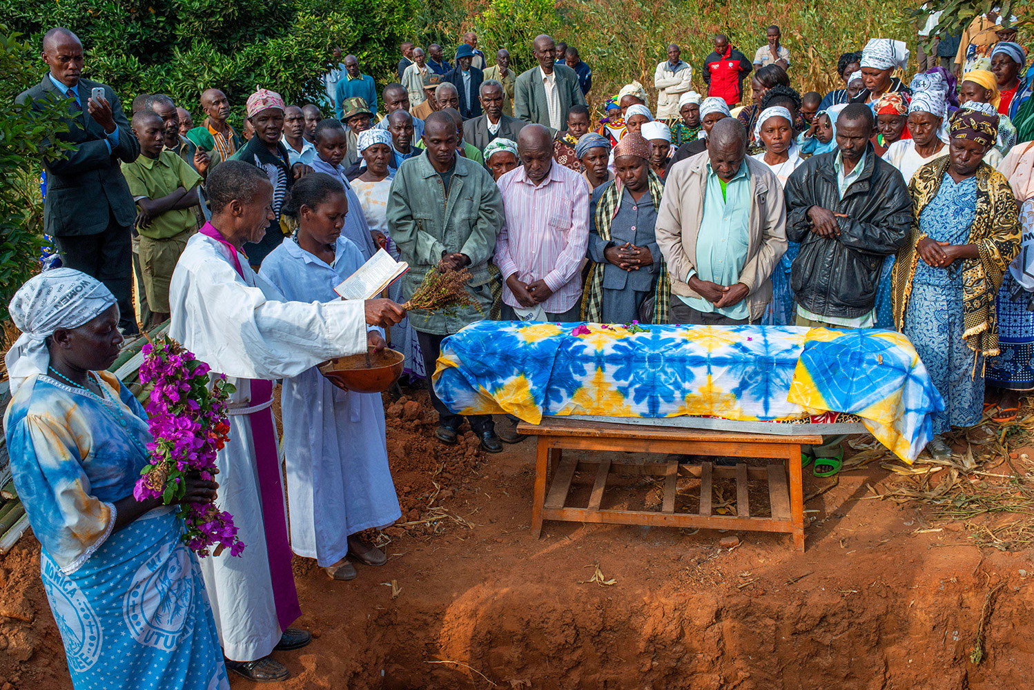
Photo: Sergi Reboredo / Alamy Stock Photo
Notes:
gpuhu;j;jidfspy; my;yJ rlq;Ffspy; ,Uf;fyhk;.....
(nfd;ahtpy; nfhtpl; kw;Wk; va;l;]; ,dhy; ghjpf;fg;gl;ltupd; kuzk;)

Slide 55
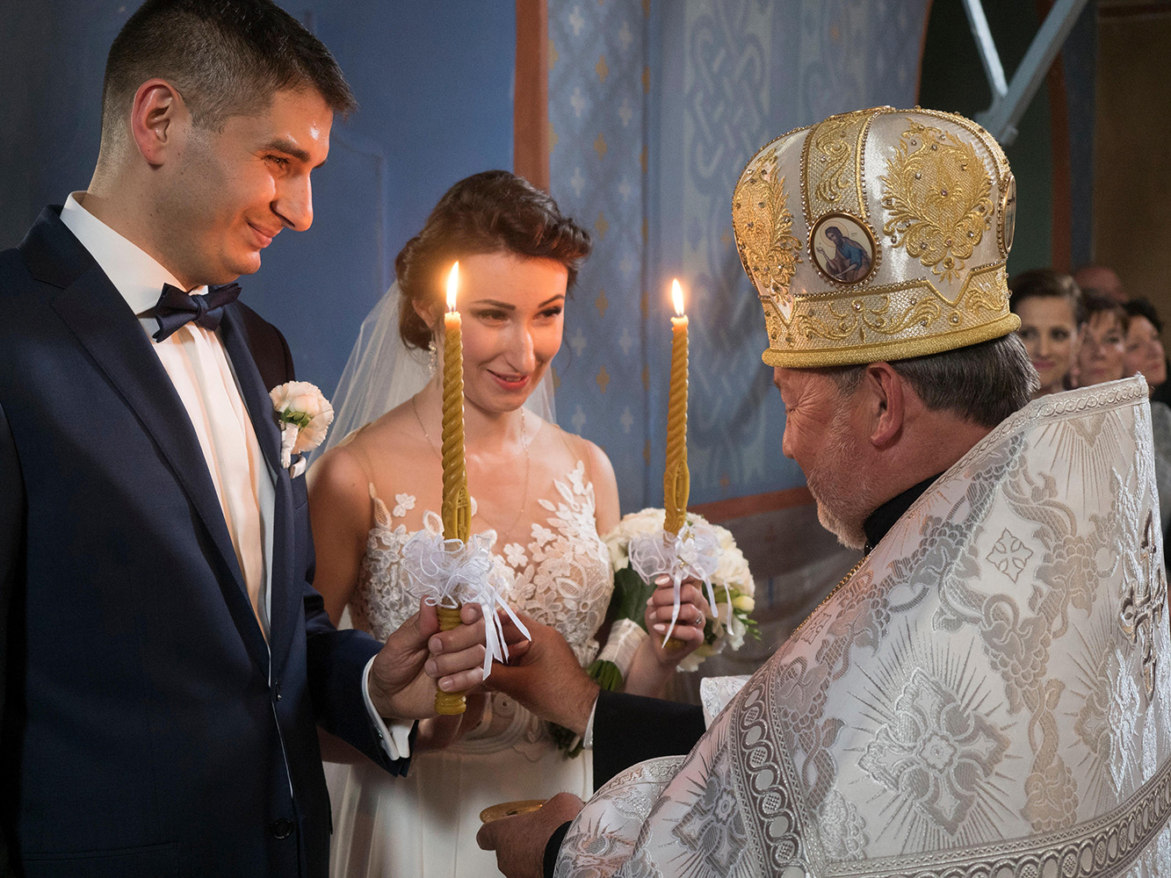
Photo: Agefotostock / Alamy Stock Photo
Notes:
…my;yJ tho;f;ifapd; Kf;fpa jUzq;fsJ nfhz;lhl;lq;fspy; ,Uf;fyhk;.
(goikthj fpwp];jt jpUkzk;> Nghye;J)

Slide 56
Photo: Dieddin Alsoub / Alamy Stock Photo
Notes:
ePq;fs; thrpf;fpd;wtw;wpy; ,Uf;fyhk;.
(K];ypk; FLkÊgqÊfsÊ Gj;jfq;fisg; gw;wp fye;JiuahLjy;)

Slide 57
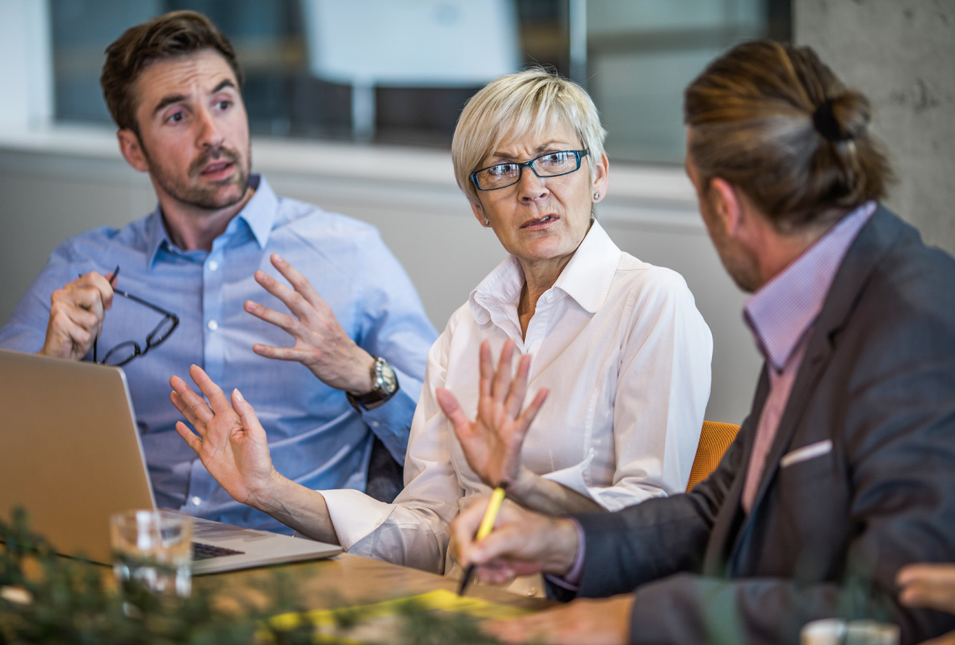
Photo: Skynesher/Istock
Notes:
ePq;fs; cq;fs; FLk;gk;> ez;gu;fs; my;yJ cq;fSld; gzpahw;Wgtu;fSld; Nkw;nfhs;fpd;w fye;Jiuahly;fspy; ,Uf;fyhk;.
(cld; gzpahw;Wgtu;fs; thjpLjyÊ)

Slide 58
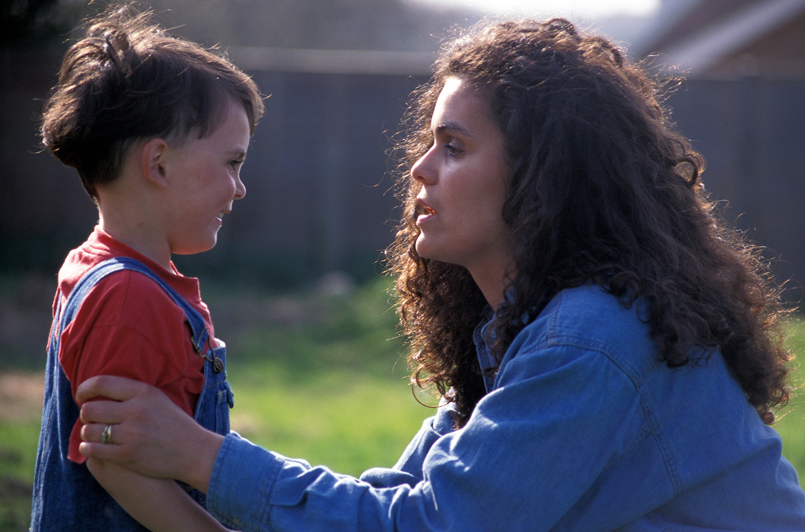
Photo: Angela Hampton Picture Library / Alamy Stock Photo
Notes:
kw;Wk; ePq;fs; cq;fs; Foe;ijfis vt;thW tsu;f;fpwPu;fs; vd;gjpy; ,Uf;fyhk;.
(mk;kh Foe;ijapidf; fz;bf;fpwhu;)

Slide 59
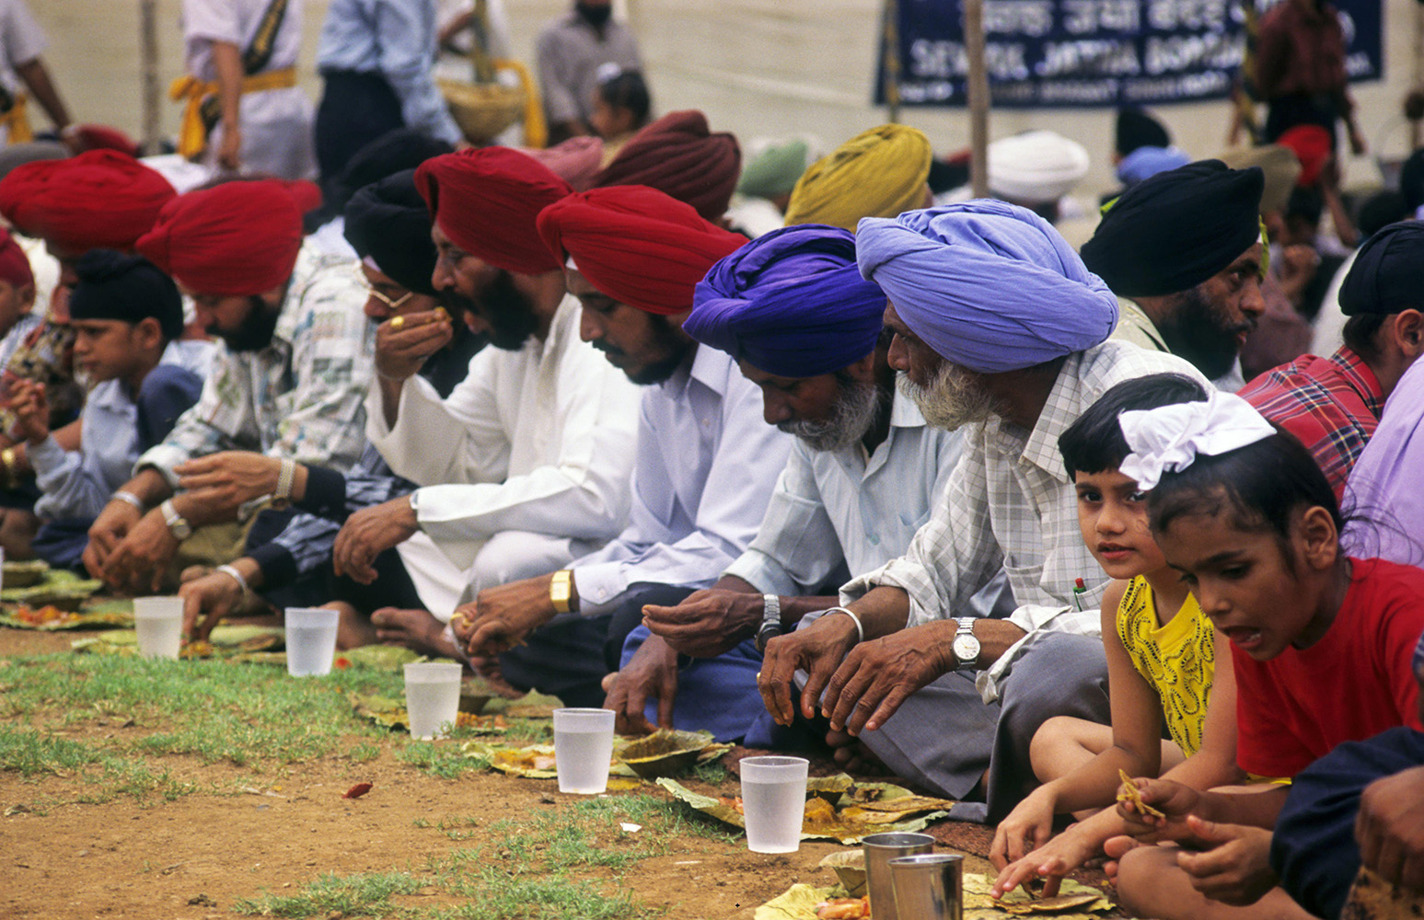
Photo: Dinodia Photos / Alamy Stock Photo
Notes:
ePq;fs; cq;fs; r%fj;jpw;F vt;thW Nritahw;WtPu;fs; vd;gjpy; ,Uf;fyhk;.
(,eÊjpahtpdÊ rPfÊfpauÊfspdÊ
r%f cztfkÊ)

Slide 60
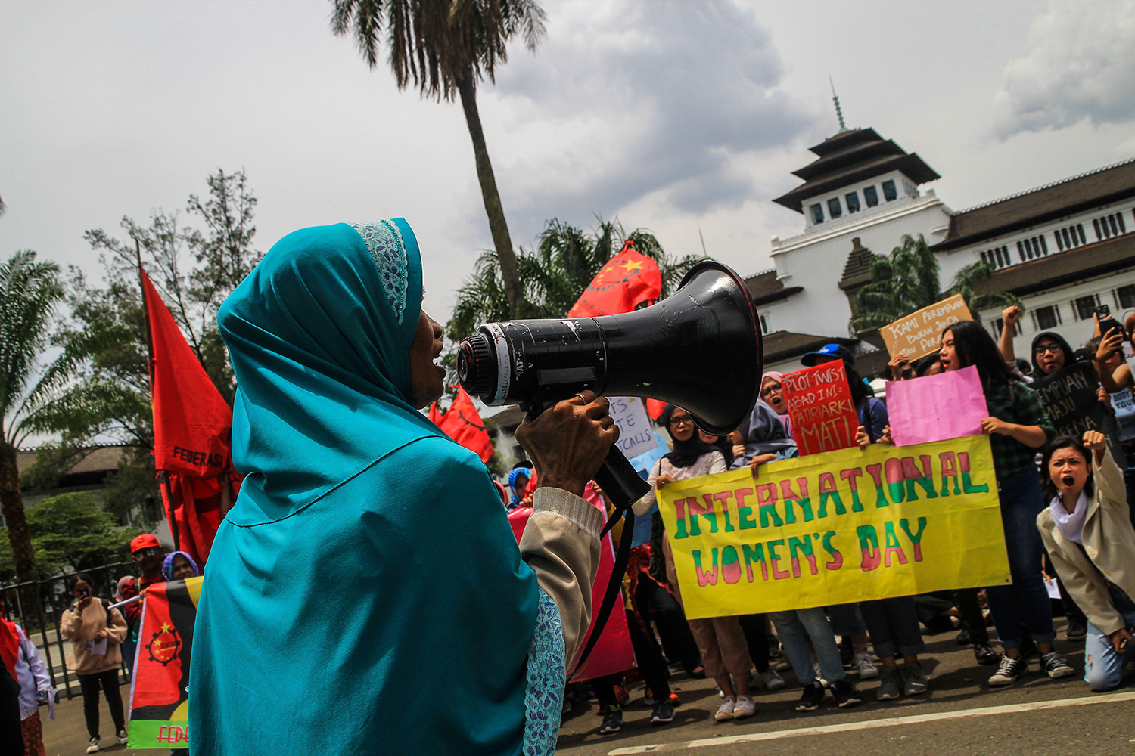
Photo: SOPA Images Limited / Alamy Stock Photo
Notes:
my;yJ cq;fSila r%fj;jpy; fhzg;gLfpd;w gpur;rpidfs; njhlu;ghf ePq;fs; vj;jifa <Lghl;bidf; nfhz;Ls;sPu;fs; vd;gjpy; ,Uf;fyhk;.
(ngz;fspd; cupikfSf;fhdg; Nghuhl;lk;> (,e;NjhNdrpah)

Slide 61
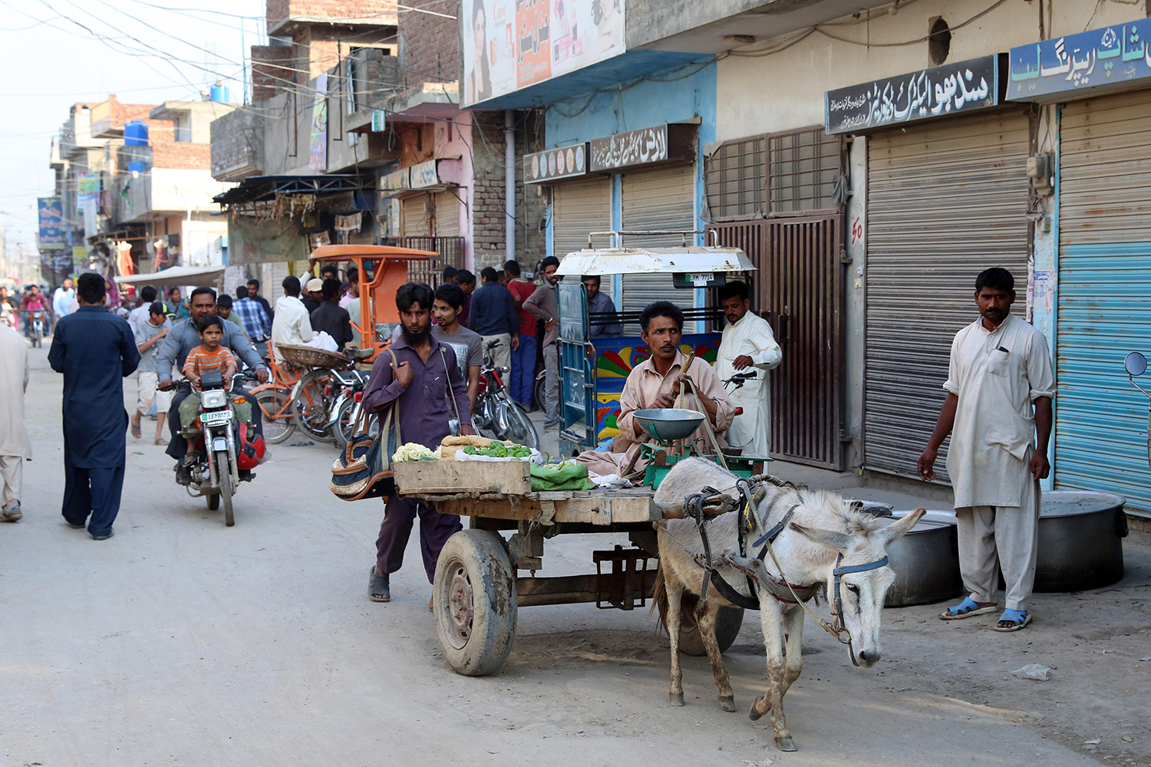
Photo: Friedrich Stark / Alamy Stock Photo
Notes:
(61- 63 tiuahd ];iyLfs; mku;tpd; epiwTf; fUj;Jf;fSf;fhf gad;gLj;jg;gl;l gPl;lupd; fijia vLj;Jf;fhl;Lfpd;wd)
gPl;lupDila fij> ghfp];jhd;
ghf;fp];jhd;> yh$u; vDk; efuj;jpy;; K];ypk;fs; mjpfkhf Mjpf;fk; nrYj;Jk; Kot Lakhpat vDk; ,lj;jpy;; fpwp];jt rKjhaj;jpy; khw;wnkhd;iw Vw;gLj;j cjtpa xU ,sk; egNu gPl;lu; Mthu;. xt;nthU ehSk; fhiyg;nghOjpy; cs;@u; njhiyf;fhl;rp miytupirnahd;wpy; Nghjfu; xUtu; nra;Ak; gpuhu;j;jidia ghu;g;gNjhLjhd; gPl;lu; jdJ ehis Muk;gpg;ghu;. “vdf;F Ntjq;fis thrpf;fNth my;yJ Ntjhfk FO gbg;gpy; gq;nfLf;fNth mjpf Neuk; fpilahJ. Mdhy;> ,e;j gpuhu;j;jidf; $l;lj;ijg; ghu;g;gjhdJ vdJ ehis Muk;gpg;gjw;fhd xU gpukhjkhd topahFk;” vd;W mtu; $Wfpwhu;.

Slide 62
Photo: Simon Mayer
Notes:
xUehs; fhiy me;j fpwp];jt njhiyfhl;rp miytupir Ntiynra;ahky; epd;Wtpl;lJ. Kjypy; gPl;lu; mq;Nf xU njhopEl;gf;NfhshW vd;W Cfpj;jhu;. xUthuk; fle;j gpd;Dk; me;j miytupir Ntiy nra;ahkypUe;jjdhy;> gPl;lUk; xt;nthU ehSk; me;j epfo;r;rpiag; ghu;itapLk; me;j gpuNjr kf;fs; rpyUk; njhiyfhl;rp epfo;r;rp nra;j Nghjfiu mZfpdhu;fs;. mg;NghJ Fwpg;gpl;l miytupir NtW ,lq;fspy; ed;whf Ntiynra;fpwJ vd;W mtu; $wpdhu;.
,jid Muha;e;J ghu;f;ifapy;> me;epfo;r;rp fpwp];jt RtpNr~ epfo;r;rpnahd;W vd mq;Fs;s cs;@u; nksytp xUtu; vz;zpajhy;> me;jg; gpuNjrj;jpNy cs;s gs;spthrypd; ,khk; (njhOifia topelj;Jgtu;) miytupir fk;gp njhopEl;gtpayhsupD}lhf (Nfgps; miytupir nghUj;JdupD}lhf) mt; miytupir Jz;bf;fg;gLtjw;F Vw;ghL nra;Js;shu; vd;gij mtu;fs; fz;lwpe;Jf;nfhz;lhu;fs;.
“ehk; vt;tsT mjpu;r;rpf;Fs;shfpapUg;Nghnkd;W cq;fshy; fw;gid nra;J ghu;f;f KbAk;. ehk; vkJ may; K];ypk;fSld; kpfTk; neUf;fkhf tho;fpd;Nwhk; vd;gJld; vkf;F mtu;fSld; ve;jg; gpur;rpidAkpy;iy” gPl;lu; nrhd;dhu;.

Slide 63
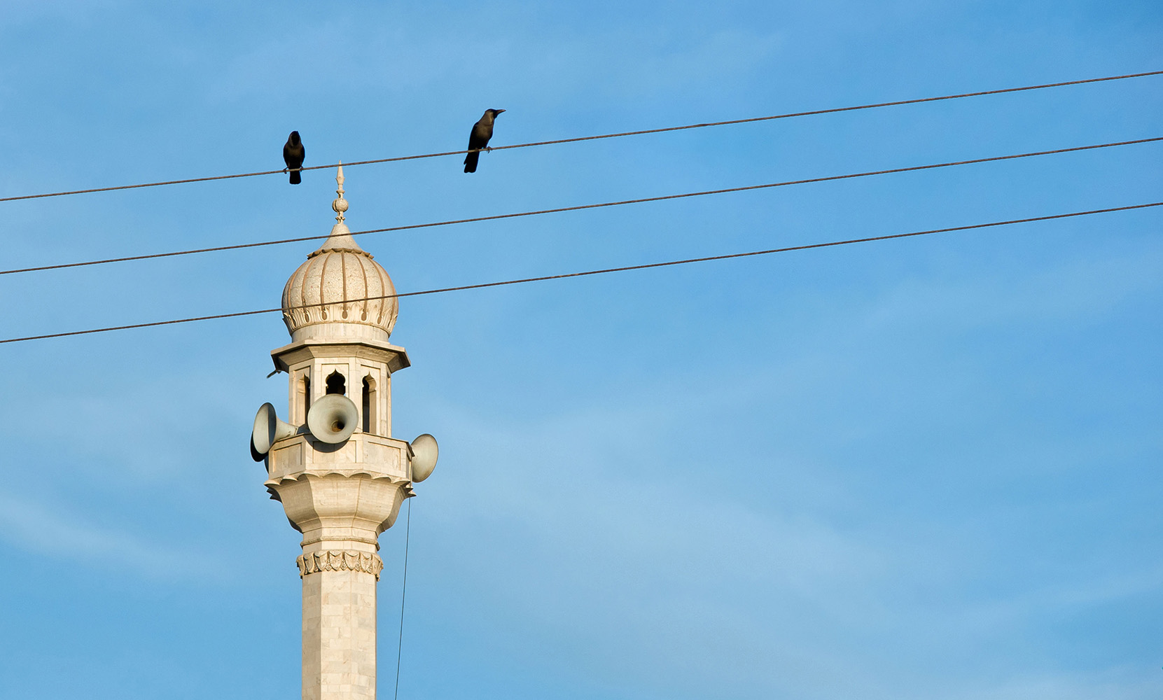
Photo: Agencja Fotograficzna Caro / Alamy Stock Photo
Notes:
,e;j #o;epiy vt;tsT czu;T G+u;tkhdJ vd;gJ FOtpw;Fj; njupAk;. mjd; fhuzkhf MNyhridfs; kw;Wk; jfty;fisg; ngw;Wf; nfhs;tjw;fhf mtu;fs; fpw];jt kj xw;Wikf;fhd Njrpa mikg;nghd;iw njhlu;Gnfhz;lhu;fs;. ,t; MNyhridiag; gpd;gw;wp> Kjyhtjhf mtu;fs; fk;gp njhopEl;gtpayhsid re;jpj;jhu;fs;. mtUf;F fk;gpapidj; njhlu;GgLj;jp mt; miytupirapid kPz;Lk; xspgug;gr; nra;tjpy; Ml;Nrgid vJTk; ,Uf;ftpy;iy> Mdhy; ,khKf;F vjpuhf vd;dhy; nraw;gl KbahJ vd;W mtu; $wpdhu;. mg;NghJ Fwpg;gpl;l nksytpAld; fye;Jiuahlnyhd;iw nra;a Ntz;Lnkd FO jPu;khdnkLj;jJ.
FOtpDila gpujpepjpfs; Rkhu; %d;W kzpNeuj;jpw;FNky; miytupiria xspgug;Gr; nra;a mDkjpf;FkhW Ntz;b mtiu rkurg;gLj;j Kad;Wk; mJ ntw;wpaspf;ftpy;iy. mLj;jehs;> nksytpaplk;> ghfp];jhdpd; murpayikg;gpdhy; xt;nthU gpui[f;Fk; toq;fg;gl;bUf;Fk; kdpj cupikfs;> kjk; my;yJ ek;gpf;iff;fhd Rje;jpuj;jpw;fhd cupikfs; gw;wp vLj;Jf;$wp kPz;Lk; Kaw;rp nra;jhu;fs;. xUehs; KOtJk; epahaq;fis vLj;Jf;$wpagpd;> nksytp miytupiria xspgug;Gr;nra;a xj;Jf;nfhz;lhu;. Mdhy; K];ypk;fspd; gpuhu;j;jid Neuq;fspd;NghJ mtu;fsJ gpuhu;j;jidfis ,ila+W nra;ahjtz;zk; rj;jj;ijf; Fiwj;J itj;J ghu;itapLkhW Ntz;LNfhs; tpLj;jhu;.
“ehk; kpFe;j kfpo;r;rpaile;Njhk;.!”
“rpyUf;F ,J xU rhjhuz njhiyf;fhl;rp xspgug;ghf ,Ue;jNghjpYk;> fpwp];jtu;fnsd;wuPjpapy; ,J vkJ tho;f;ifapy; kpf Kf;fpakhd gFjpahFk;”.

Slide 64
rpwgÊghf KbeÊjJ kPzÊLkÊ tUf
mLjÊj mkuÊT : vkJ gytpjkhd milahsqÊfsÊ

