Slide 1
cs;@u; kl;l khw;wKz;lhf;Feu;fSf;fhd gapw;rp newp

Slide 2
mku;T 4:
kjk; my;yJ ek;gpf;iff;fhd Rje;jpu kPwy;fs;
Notes:
2-3 tiuahd ];iyLfs; mkuÊtpdÊ tuNtw;G kw;Wk; mwpKfj;jpid tpsfÊFfpdÊwd
xt;nthUtiuAk; mku;tpw;F tuNtw;Wf; nfhs;Sq;fs; kw;Wk; fPo;tUk; tplaq;fis tpsf;Fq;fs;:
mku;T 2 ,yÊ kjk; my;yJ ek;gpf;iff;fhd Rje;jpuk; vd;why; vd;d vd ehq;fs; ghu;j;Njhk;. kjk; my;yJ ek;gpf;iff;fhd Rje;jpuj;jpid tpgupg;gjw;F ehk; gad;gLj;jpa gpujhd nrhw;fs; vitnad cq;fSf;F epidtpUf;fpd;wjh?
(cq;fSila FO> rpe;jpj;jy; - ek;Gjy; - cupatuhapUj;jy; - eilKiwg;gLj;jy; - Nfs;tpnaOg;gy; - khw;Wjy; - kWj;jy; Nghd;w gpujhd nrhw;fis $Wfpwhu;fsh vd ghUq;fs;. gpd;du; ];iyl; 3 ,idf; fhl;b mjid thrpAqÊfsÊ.)

Slide 3
Nfs;tpnaOg;Gjy;
ek;Gjy;
khw;Wjy;
rpe;jpj;jy;
cupatuhapUj;jy;
gapwÊrp nraÊjyÊ;
kWj;jy;
Notes:
(gq;Nfw;ghsu;fs; epidtpy; itj;jpUf;fhj ve;jnthU thu;j;ijfisAk; Kd;dpiyg;gLj;jp> gpd;du; gpd;tUkhW njhluTk;.)
mj;Jld; kjk; my;yJ ek;gpf;iff;fhd Rje;jpuk; vg;NghJ kl;Lg;gLj;jg;glyhk; vd;Wk; ehq;fs; fw;Nwhk;. rpe;jpg;gjw;fhd> ek;Gtjw;fhd kw;Wk; ek;gpf;iffs; gw;wpa cq;fSila vz;zq;fis khw;wpf; nfhs;tjw;fhd cs;shu;e;j Rje;jpuq;fis kl;Lg;gLj;j KbahJ vd;Wk;> Mdhy;> ehq;fs; nra;fpd;wit- mjhtJ vq;fsJ kj my;yJ ek;gpf;iff;fhd eilKiwfs; Vida egu;fis Fwpg;ghd topfspy; CWgLj;Jfpd;wNghJ mtw;iw kl;Lj;jyhk; vd;Wk; ehk; fw;Nwhk;. mj;Jld;> ghugl;rk;> gyte;jg;gLj;jy; kw;Wk; td;Kiwf;fhd J}z;Ljy; vd;gd mDkjpf;fg;gl khl;lhJ vd;gjidAk; fw;Nwhk;.
mLj;j ,uz;L mku;TfSk; kjk; my;yJ ek;gpf;iff;fhd Rje;jpuj;jpd; kPwy;fis ikag;gLj;Jfpd;wd. ,t; mku;tpy;> ehq;fs; kjk; my;yJ ek;gpf;iff;fhd Rje;jpuj;jpd; kPwy;fspd; tiffs; Fwpj;Jk; mJ njhlu;ghd cyfshtpa cjhuzq;fisAk; ghu;f;fg; Nghfpd;Nwhk;. midj;J tifahd ,lq;fspYKs;s midj;J kjq;fs; kw;Wk; ek;gpf;iffisAk; rhu;e;j egu;fs; vt;thW ghjpf;fg;gLfpd;wdu; vd;gjid ehk; Gupe;Jf; nfhs;tjw;F ,J cjTk;. mLj;j mku;tpy;> ehq;fs; vq;fSila rKjhaj;jpy; ,lk;ngWfpd;w kPwy;fis Fwpg;gpl;L fhl;l Kaw;rpg;Nghk;.
,t; mku;tpy; ehq;fs; Nfl;fpd;w fijfs; Jd;gk; epiwe;j vq;fSila jdpg;gl;l mDgtq;fis Qhgfg;gLj;jyhk; vd;w fhuzj;jpdhYk;> ,jpy; vOg;gg;gLfpd;w rpy tplaq;fs; r%fj;jpy; vit mDkjpf;fg;gl Ntz;Lk; kw;Wk; vit mDkjpf;fg;glf;$lhJ vd;w vq;fsJ mgpg;gpuhaq;fis rthYf;Fl;gLj;jf; $Lnkd;w fhuzj;jpdhYk;- ,t; mku;Tfs; rpf;fy; kpf;fdthf ,Uf;fyhk;. FOtpy; ehq;fs; cld;glhj tplaq;fs; ,Uf;fyhk;. MfNt> ,t; mku;tpy;> vq;fSila fs tpjpfis epidtpw;nfhz;L> ehq;fs; Vida xt;nthUtu; njhlu;gpYk; ftdk; nrYj;jp mtu;fs; nrhy;tjidf; Nfl;Nghk;! (,f; fs tpjpfs; ahit vd;gJ njhlu;gpy; gq;Fgw;Weu;fSf;F epidTgLj;Jtjw;fhf mit vOjg;gl;Ls;s efu;T tpsf;fg;glj; jhspidg; gad;gLj;Jq;fs;.)
kPwy;fs; njhlu;ghdf; fijfisf; Nfl;lyhdJ vk;ik epiyFiyar; nra;ayhk; my;yJ vjpu;ghu;g;Gf;fsw;wtu;fshf Mf;fyhk;. Mdhy;> gpur;rpidfs; njhlu;ghf vijahtJ nra;tjw;F kw;Wk; khw;wj;jpid Vw;gLj;Jtjw;F> vk;khy; mg;gpur;rpidfis milahsk; fhzTk; Gupe;J nfhs;sTk; $bajhf ,Uj;jy; Ntz;Lk;.

Slide 4
Notes:
4-39 tiuahd ];iyLfs; mku;T 4: ,dÊ Kd;itg;gpid tpsfÊFfpwJ
Kd;itg;G : kjk; my;yJ ek;gpf;iff;fhd Rje;jpuj;jpd; kPwy;fis Gupe;J nfhs;Sjy;
Fwpg;G!
,e;j tpsf;ff;fhl;rp ePz;lJ kw;Wk; gy cjhuzq;fis fis cs;slf;fpAk; cs;sJ. cq;fs; FOtpw;F kpfTk; nghUj;jkw;wjhfj; Njhd;Wk; cjhuzq;fis ePq;fs; Fiwf;f tpUk;gyhk;. rpy cjhuzq;fis cq;fs; nrhe;j R+oypy; ,Ue;j fijfSld; khw;wPL nra;aTk; ePq;fs; tpUk;gyhk;. vOj;J gpujpapd; Kf;fpa nra;jpfs; jbj;j vOj;Jf;fshy; fhz;gpf;fg;gl;Ls;sJ. cq;fs; ciuapy; ,tw;iw cs;slf;Fq;fs;
cq;fs; gq;Nfw;ghsu;fs; cs;slf;fj;ijr; nrayhf;f cjt> gtu; ngha;d;l; > gtu;ngha;d;l; ];iyLfspd; mr;Rf;fs; my;yJ mjw;F ,izahd tpsf;fg;gl efu;T jhs;fisg; gad;gLj;jTk;.
mwpKfk midj;J tifahd ehLfspYKs;s midj;J tifahd egu;fSk; kjk; my;yJ ek;gpf;iff;fhd Rje;jpuk; ,d;ikapdhy; gpur;rpidfis vjpu;nfhs;fpd;wdu;. ghjpf;fg;gLgtu;fs; ahu;> kPwy;fspd; jPtpuj;jd;ik kw;Wk; kPwy;fisg; Gupgtu;fs; ahu; Nghd;w tplaq;fNs NtWgLfpd;wd.

Slide 5
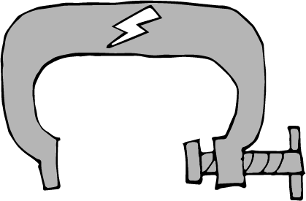
ghugl;rk;
fl;Lg;ghL
td;Kiw
Notes:
,k;Kd;itg;gpy;> ghugl;rk;> cupikfspd; kl;Lg;ghLfs; kw;Wk; td;Kiw njhlu;ghd cz;ikahd tho;f;ifr; rk;gtq;fis Nfl;fg;Nghfpd;Nwhk;.

Slide 6
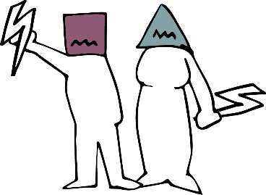
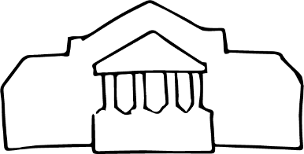
Notes:
,k;kPwy;fs; murpdhYk; kw;Wk; rKjhaj;jpYs;s egu;fspdhYk; Gupag;gl;Ls;sd. ,jid ehq;fs; ngUk;ghYk;> murhq;f kPwy;fs; kw;Wk; r%f tpNuhjq;fs; vd Fwpg;gpLNthk; Mdhy;> kPwy;fs; FLk;gq;fspYk; kj rKjhaq;fspDs;Sk;

Slide 7
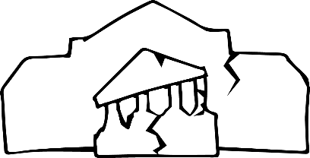
muR ghJfhf;f jtwptpl;lJ
Notes:
ehd;fhtJ tifahd kPwnyhd;Wk; cs;sJ- rKjhaj;jpYs;s kPwy;fspypUe;J egu;fis ghJfhg;gjw;F murhq;fk; jtWjy;. murpd; Ms;Gy vy;iyf;Fs; ,Uf;fpd;w xt;nthU egiuAk; ghugl;rk;> cupikfSf;fhd epahakw;w kl;Lg;ghLfs; kw;Wk; td;KiwapypUe;J ghJfhf;fpd;w flik muRf;F cz;L. gy muRfs; ,jid nra;aj; jtWfpd;wd.

Slide 8
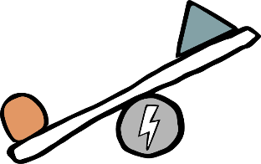
Notes:
ghugl;rk;> cupikfs; kPjhd kl;Lg;ghLfs; kw;Wk; td;Kiw vd;gd nghJthf xd;Wlndhd;W njhlu;GWtdthfTk; xd;iwnahd;W jOtpf; nfhs;tdthfTk; mike;Js;sd. cjhuzkhf> kl;Lg;ghnlhd;W ghugl;rkhdjhf
,Uf;fyhk; vd;gJld; mJ td;Kiwf;F gq;fspg;G nra;ayhk;. mj;Jld; murhq;f kPwy;fs; kw;Wk; r%f tpNuhjq;fs; er;R tl;lnkhd;wpid cUthf;fp xd;Wf;nfhd;W gq;fspg;G nra;fpd;wd. rpWghd;ikapdUf;nfjpuhd ghugl;rkhd murhq;f rl;lthf;fk; r%fj;jpy; rfpg;Gj;jd;ikapd;ikapid NjhwÊWtpfÊfpdÊJ> ,J rKjhaj;jpy; ghugl;rk;> Jd;GWj;jy; kw;Wk; td;Kiwf;F toptFf;fpd;wJ. ,it njhlu;gpy; mjpfhupfs; ghuhKfkha; ,Uf;fpdÊw #oÊepiyapyÊ ,jpypUe;J jgÊgyhkÊ vd kf;fs; epidfÊfpd;wNghJ ghugl;rk;> Jd;GWj;jy; kw;Wk; td;Kiw vd;gd kpf Nkhrkhdjhfpd;wJ.
rpy cz;ikahd tho;f;ifr; rk;gtq;fisg; gad;gLj;jp cyfpd; NtWgl;l gFjpfspy; ghugl;rk;> kl;Lg;ghLfs; kw;Wk; td;Kiw vt;thW fhzg;gLfpd;wd vd;gJ gw;wp ghu;g;Nghk;! mNefkhf mtw;Ws; rpy ePq;fs; mDgtpj;Js;s tplaq;fSld; njhlu;Gglyhk;.

Slide 9
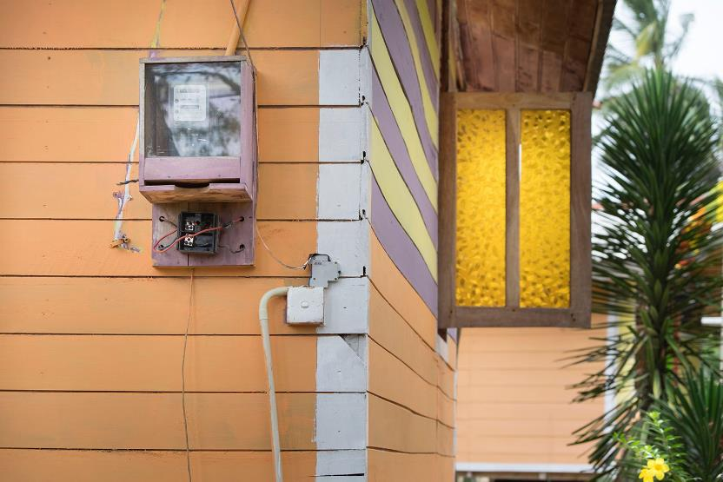
Photo: mauritius images GmbH / Alamy Stock Photo
Notes:
ghugl;rj;jpid vLj;Jf;fhl;Lfpd;w fijfs;
ghugl;rk; kpfg; nghJthdJ vd;gJld; ,J tho;f;ifapd; midj;;Jg; gFjpfisAk; ghjpf;fpd;wJ.
mUlÊjpU.Fkhu; ,yq;ifapd; fpuhknkhdÊwpdÊ xU Nghjfu; Mthu;. mtUila FLk;gk; mtuJ fpuhkj;jpypUe;j ngsj;j ngUk;ghd;ik rKjhaj;jpdhy; ghugl;rj;jpid vjpu;nfhz;bUe;jJ. Mrpupau;fs; kw;Wk; rfghbfs; mtupd; gps;isfis Jd;GWj;jpdu; vd;gJld; mtupd; tPL rl;ltpNuhj topghl;Lj; jynkhd;W vd;w mbg;gilapy; mf;FLk;gj;jpw;fhd kpd;rhu kw;Wk; ePu; ,izg;Gf;fs; Jz;bf;fg;gl;ld.

Slide 10
Notes:
rpy murhq;fq;fs; nghJ epjpapd; xJf;fPl;by; ghugl;rk; fhl;Lfpd;wJ - cjhuzkhf> rpWghd;ik gFjpfspy; cl;fl;likg;G> Rfhjhuk; my;yJ fy;tpf;fhf kpff; Fiwe;j mstpy; KjyPL nra;jy; ,J tFg;Gthj Fog;gq;fs; kw;Wk; murpay; ];jpuj;jd;ikapd;ikf;fhd ePz;l fhy mghaq;fis cUthf;Fk;. epWtdq;fs; njhopw;gLfpd;w topKiwapD}lhfTk; ghugl;rk; Vw;gLj;jg;glyhk;. cjhuzkhf> kj nraw;ghLfspy; gyte;jkhfg; gq;Fngwr; nra;jy; my;yJ jq;fSila rKjhaj;jpid ,opthfg; NgRfpd;w ghlE}y;fs; vd;gtw;wpD}lhf ghlrhiy rpWtu;fs; ghugl;rj;jpid vjpu;nfhs;s KbAk;. mupjhd rpy re;ju;g;gq;fspy;> rpy FOf;fSf;F fy;tp kWf;fg;gLfpd;wJ- <uhdpy; Baha’is rKjhaj;jpdu; gy;fiyf;fofq;fSf;F nry;tjw;F mDkjpf;fg;gLtjpy;iy.

Slide 11
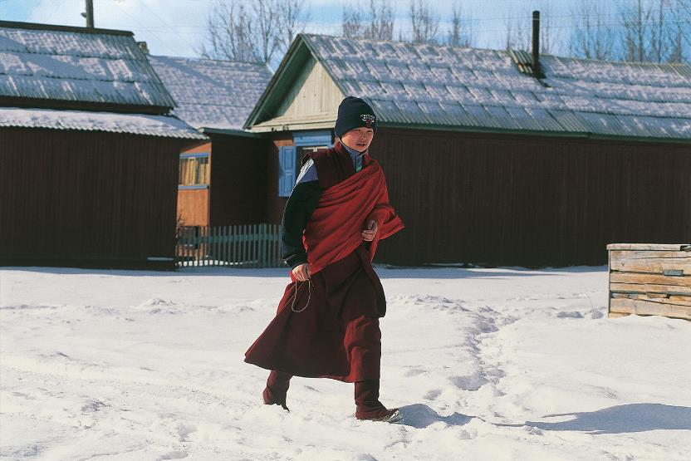
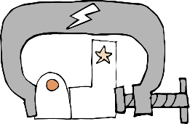
Photo: Universal Images Group North America LLC / DeAgostini / Alamy Stock Photo
Notes:
kl;Lg;gLj;jy; kw;Wk; ghugl;rj;jpid vLj;Jf;fhl;Lfpd;w fijfs;
gy tifahd rl;lq;fs; NeubahfNth my;yJ kiwKfkhfNth ghFghLfis tpistpf;Fk; fl;Lg;ghLfis cUthf;Ffpd;wd.
rpWghd;ikapdu; topghl;Lj; jyq;fisf; fl;Ltijj; jLf;Fk; nghJthd rhiyj; jilahf> eLepiyahfj; Njhd;wf;$ba jpl;lkply; tpjpKiwfs; cs;sd.
u~;ahtpy; gy rpWghd;ikapdu; rpf;fy;fis vjpu;nfhz;Ls;sdu; - cjhuzkhf mDkjp toq;fg;glhjJ> fl;Lkhdg; gzpfs; njhlq;fpa gpwF efuhl;rp Fj;jiffs; epWj;jg;gLjy; my;yJ ,bj;jopg;Gf;fs; .

Slide 12
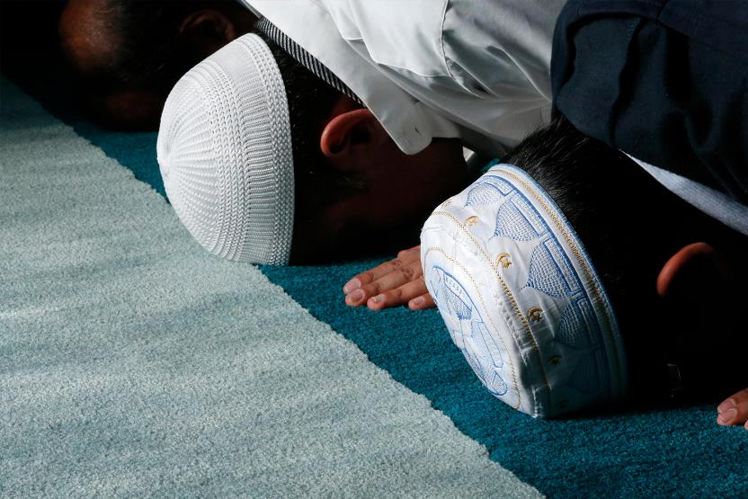
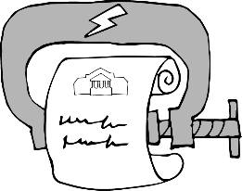
Photo: Godong / Alamy Stock Photo
Notes:
kjr; r%fq;fisg; gjpTnra;tijf; fl;Lg;gLj;Jk; rl;lq;fs; fl;Lg;gLj;JtjhAk; ghFghlhfTk; fhzg;glyhk;.
my;[Pupa murhq;fk; > kjk; rhu;e;j my;yJ NtW midj;J FOf;fSk;> nray;ghLfis elj;Jtjw;F Kd; xU rq;fkhf gjpT nra;a Ntz;Lk; vd njuptpj;jJ. MdhYk; mstpy; rpwpa m`;kjp r%fj;jpw;F gjpT toq;fg;gltpy;iy.
2020 Mk; Mz;bd; ,Wjpapy;> mq;fPfupf;fg;glhj ,lq;fspy; njhOif elj;JtJ Nghd;w Fw;wq;fSf;fhf r%f cWg;gpdu;fs; kPJ 220 rl;l tof;Ffs; gjpT nra;ag;gl;Ls;sd.

Slide 13
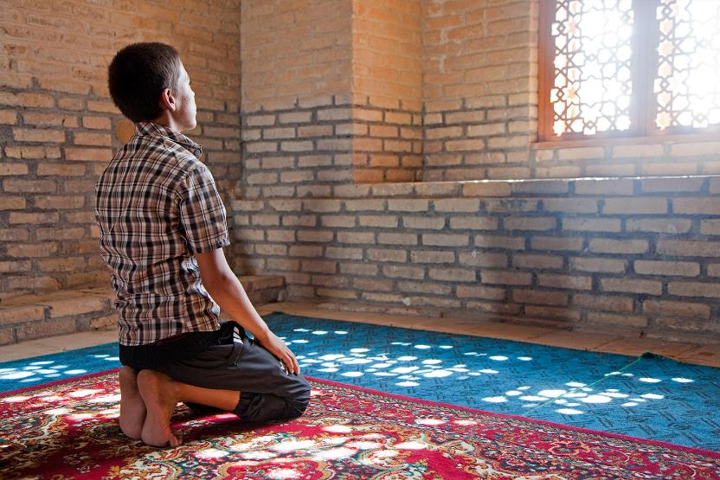
Photo: Arterra Picture Library / Alamy Stock Photo
Notes:
rpy murhq;fq;fs; ngUk;ghd;ik r%fq;fspd; kj eilKiwfisAk; fl;Lg;gLj;Jfpd;wd.
2020 Mk; Mz;by;> Ju;f;nkdp];jhdpd; nyghgp gpuhe;jpaj;jpy; cs;s mur mjpfhupfs;> Mrpupau;fs; kw;Wk; nrtpypau;fs; Nghd;w muR Copau;fis nts;spf;fpoik njhOiffspy; fye;J nfhs;s Ntz;lhk; vd;W cj;jutpl;lNjhL kR+jpfspy; mtu;fisf; fz;lhy; gzpePf;fk; nra;tjhf kpul;bdu;.

Slide 14
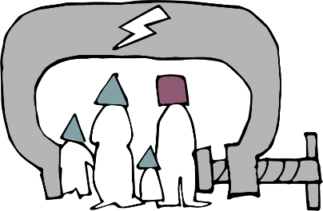
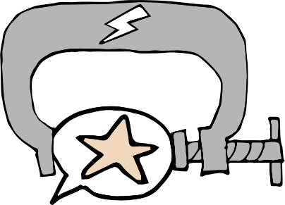
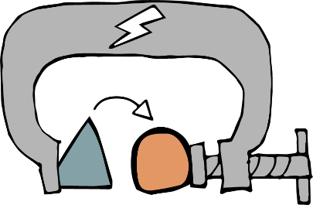
Notes:
fl;Lg;ghLfis cUthf;ff;$ba NkYk; rpy tifahd rl;lq;fisg; gw;wp rpe;jpg;Nghk;: FLk;gr; rl;lk; kw;Wk; epe;jid my;yJ tpRthrr; rl;lq;fs;.
FLk;gr; rl;lk;
jpUkzk;> tpthfuj;J> cupj;Jilik kw;Wk; Foe;ijg; ghJfhg;G Mfpatw;iwf; fl;Lg;gLj;Jk; kjr;rhu;gw;w kw;Wk; kjr; rl;lq;fs; cupikfisf; fl;Lg;gLj;jTk; ghFghL fhl;lTk; $Lk;.

Slide 15
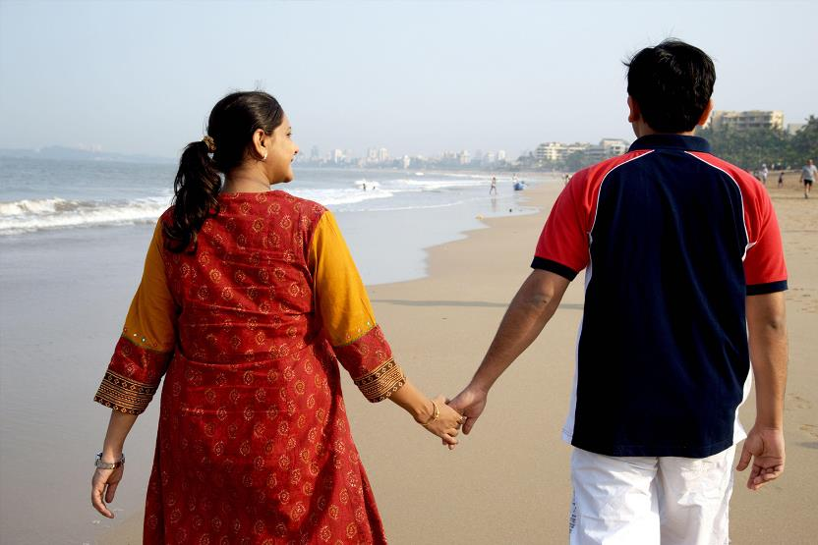
Photo: R.M. Modi / Alamy Stock Photo
Notes:
,e;jpahtpy;> kjr;rhu;gw;w rpwg;Gj; jpUkzr; rl;lj;jpd;gb>ntt;NtW kjq;fSf;fpilapy; jpUkzk; nra;atpUf;Fk; jk;gjpfs;> jpUkzj;jpw;F 30 ehl;fSf;F Kd;G> ePjpgjpaplk; njuptpf;f Ntz;Lk;.
ePjpgjp mt;tpz;zg;gj;ij tprhuiz nra;J me;j jk;gjpapd; FLk;gq;fspd; tPLfSf;F Nehl;B]; mDg;Gfpwhu;. ,J gy jk;gjpfis nfsut mbg;gilapyhd td;Kiw Mgj;jpy; Mo;j;JfpwJ.

Slide 16
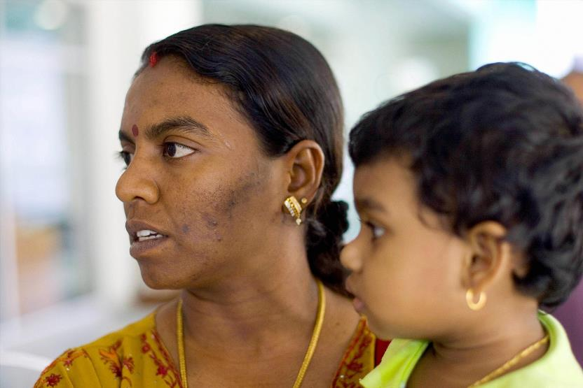
Photo: STR / Stringer
Notes:
Nutjp kR+ir xU kNyrpau;. mtu; K];yPk; ngw;NwhUf;F gpwe;jNghJk;> jdJ ,e;J kj ghl;bahy; xU ,e;Jthf tsu;f;fg;gl;lhu;.
xU ,e;Jitj; jpUkzk; nra;J nfhz;L ,];yhKf;Fj; jpUk;g kWj;jjw;fhf Nutjpia 6 khjq;fSf;F xU ,];yhkpa kW fy;tp ikaj;jpw;F kj ePjpkd;wk; mDg;gpaJ.

Slide 17
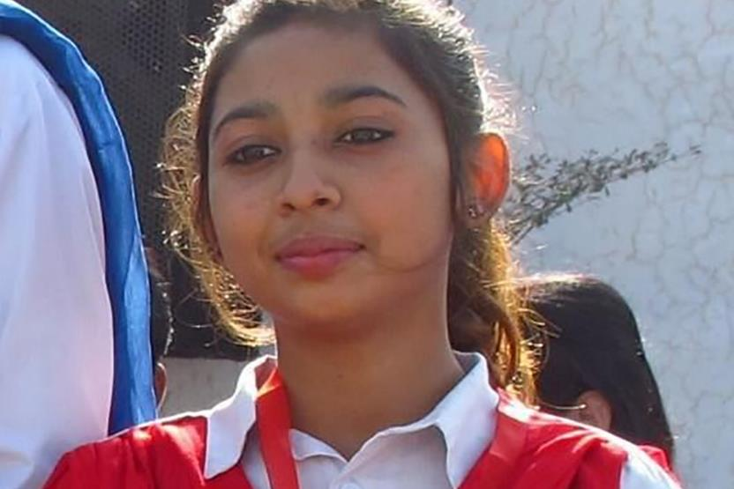
Photo: Aid to the Church in Need
Notes:
rpy rkaq;fspy; kj FLk;gr; rl;lk; kw;Wk; tpRthr JNuhfr; rl;lq;fs; rpWghd;ikapdiu Fw;wtpay; jhf;FjYf;F Mshf;Ffpd;wd .
ghfp];jhdpy; xt;nthU Mz;Lk;> E}w;Wf;fzf;fhd ,e;J kw;Wk; fpwp];jt rpWkpfs; flj;jy;> fl;lha kjkhw;wk; kw;Wk; jpUkzj;ij mDgtpf;fpd;wdu;. ,J ikuh \hgh]{f;F 14 tajpy; ele;jJ. mtisj; jpUk;gg; ngw mtSila ngw;Nwhu; ePjpkd;wj;jpw;Fr; nrd;wdu;> Mdhy; ghfp];jhdpy; ,];yhj;ij tpl;L ntspNaWtJ jilnra;ag;gl;Ls;sJ> NkYk; fpwp];jt ngw;NwhUf;F K];yPk; Foe;ijfis jkJ ghJfhg;gpy; itf;f KbahJ> vdNt mtis flj;jpatuplNk jpUg;gp mDg;g cau; ePjpkd;wk; jPu;g;gspj;jJ. ,uz;L thuq;fSf;Fg; gpwF ikuh jg;gpj;J jiykiwthf tho;fpwhu;> mtSila jpUkzj;ij uj;J nra;a Ntz;Lk; vd;Wk;> mtSila rl;l me;j];J kPz;Lk; fpwp];jtshf khw Ntz;Lnkd;Wk; NghuhbtUfpwhu; .

Slide 18
ey;ypzf;fj;ij ?
Notes:
epe;jid kw;Wk; tpRthr JNuhfr; rl;lq;fs;
epe;jid kw;Wk; tpRthr JNuhfk; (cq;fs; kjj;ij tpl;L ntspNaWjy;) njhlu;ghd rl;lq;fs; ngUk;ghYk; ey;ypzf;fj;ijg; NgZtijf; Fwpf;Fk; tifapy; epahag;gLj;jg;gLfpd;wd. ,Ug;gpDk;> ,e;jr; rl;lq;fs; vjpu; tpisTfis Vw;gLj;jyhk;.
rpy ehLfspy; rl;lq;fs; jtwhfg; gad;gLj;jg;gLfpd;wd> jdpg;gl;l gopthq;fy;fSf;fhf jtwhd Fw;wr;rhl;Lfs; gad;gLj;jg;gLfpd;wd. Mdhy; rl;lq;fs; ngUk;ghYk; Ngr;irAk; elj;ijiaAk; kjk; my;yJ ek;gpf;ifapd; Rje;jpuj;ij rkurk; nra;Ak; topfspy; fl;Lg;gLj;Jfpd;wd - Fwpg;ghf muR my;yJ ngUk;ghd;ik r%fk; tpUk;ghj ek;gpf;iffs;.
KfkJTf;Fg; gpd;duhd xU jPu;f;fjuprpia ek;Gk; m`;kjpau;fs;> ehj;jpfu;fs; kw;Wk; muR my;yJ kj mjpfhuj;ij itj;jpUg;gtu;fis tpku;rpf;Fk; egu;fs; ngUk;ghYk; Mgj;jpy; cs;sdu;> Mdhy; vtUk; ,jdhy; ghjpg;gilayhk; .

Slide 19
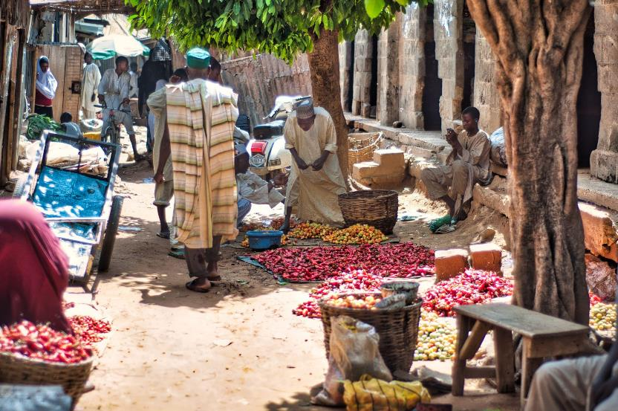
Photo: Donnie Evans / Alamy Stock Photo
Notes:
2020 Mk; Mz;by;> tlf;F ie[Pupahtpy; cs;s kj ePjpkd;wk;> jPu;f;fjuprp xUtiu mtkjpj;j Fw;wj;jpw;fhf 12 taJ K];yPk; rpWtDf;F 10 Mz;Lfs; rpiwj;jz;lid tpjpj;jJ.
mtuJ jz;lid 2021 ,y; kjr;rhu;gw;w Nky;KiwaPl;L ePjpkd;wj;jhy; uj;J nra;ag;gl;lJ> Mdhy; gopthq;Fk; jhf;Fjy;fspd; mr;RWj;jyhy; mtuJ FLk;gk; me;jg; gFjpapy; tho;tjw;F ghJfhg;gw;wjhf;FfpwJ.

Slide 20
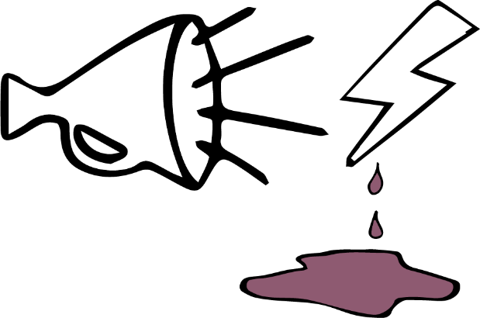
Notes:
ru;tNjr rl;lj;jpd;gb jil nra;ag;gl Ntz;ba Ngr;R td;Kiwiaj; J}z;LtjhFk;.
td;Kiwia epWj;Jtjw;Fg; gjpyhf> kj epe;jid kw;Wk; tpRthr JNuhfr; rl;lq;fs;> ngUk;ghd;ikapdu; tpUk;ghj ek;gpf;iffis mikjpahd Kiwapy; ntspg;gLj;Jk; egu;fs; jz;bf;fg;gl Ntz;Lk; vd;w fUj;ij Mjupg;gjd; %yk; mij Cf;Ftpf;f Kidfpd;wd.

Slide 21
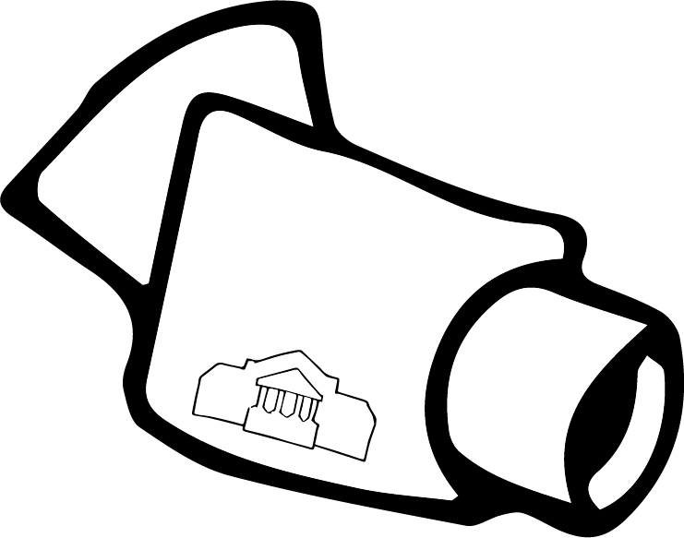
Notes:
khepy fz;fhzpg;Gk; fl;Lg;ghLk;
fl;Lg;ghLfis cUthf;Fk; murpd; nray;ghl;bd; kw;nwhU gFjp> ek;gpf;if r%fq;fspd; nray;ghLfs; kw;Wk; epjpfis fLikahf fz;fhzpj;jy;> Nkw;ghu;itaply; kw;Wk; fl;Lg;gLj;Jjy;. cjhuzkhf> ,yq;ifapy; cs;s rpy Njthyaq;fs; muR mjpfhupfshy; fz;fhzpf;fg;gLtjhf njuptpf;fpd;wd. ,J rptpy; r%fj;jpw;fhd ,lj;ijr; RUf;Fk; gue;j Nghf;fpd; xU gFjpahFk;.
Nkw;F rPdhit tpl NtW vq;Fk; jPtpu fz;fhzpg;G ,y;iy> mq;F Kfj;ij milahsk; fhZk; njhopy;El;gk; cUthf;fg;gl;L> mq;F ghJfhg;G Nfkuhf;fshy; ngUk;ghyhd K];yPk; ca;Fu; rpWghd;ikapdiu milahsk; fhzTk; mtu;fs; ,Ug;gplj;ij fhty;Jiwf;F njuptpf;fTk; KbAk;.

Slide 22
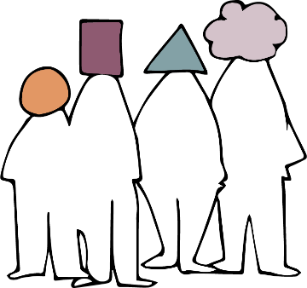
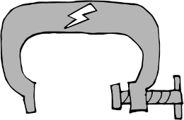
Notes:
r%f fl;Lg;ghLfs;
FLk;gq;fs;> ek;gpf;iff; FOf;fs; my;yJ gue;j r%fj;jpYk; cupikfs; fl;Lg;gLj;jg;glyhk;
,J ngUk;ghYk; Mz;fs; kw;Wk; ngz;fis tpj;jpahrkhf ghjpf;fpwJ. ngz;fSf;F ngUk;ghYk; tha;g;Gfs; kWf;fg;gLfpd;wd - cjhuzkhf ,iwapay; gbg;gJ> NkYk; ngz;fspd; elj;ij kw;Wk; kj mDrupg;G Mfpait kj mbg;gilapy; FLk;gk; my;yJ r%ff; fl;Lg;ghl;bd; nghUshf ,Uf;fyhk;.
ngUk;ghd;ik r%fq;fs; rpWghd;ikg; ngz;fspd; kj ntspg;ghl;ilAk; mbf;fb fl;Lg;gLj;Jfpd;wd> cjhuzkhf ngz;fs; jkJ njhopyplj;jpw;F nry;tjw;F jkJ kj milahsj;ij kiwf;f Nfhwg;gLfpd;wdu;.

Slide 23
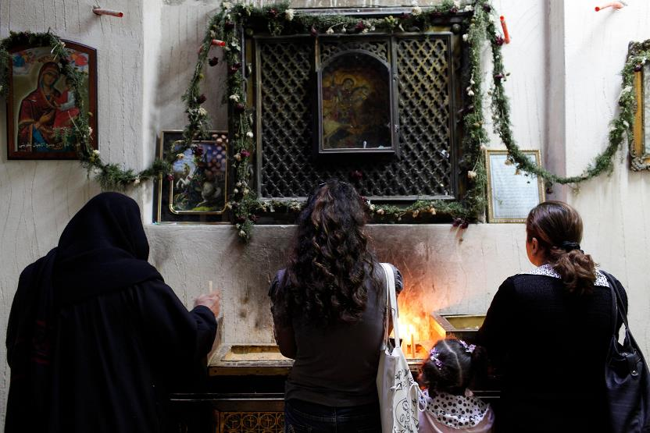
Photo Godong / Alamy Stock Photo
Notes:
kupah vfpg;jpy; trpf;Fk; ,sk; fpwp];jtu;.
mtu; gy;fiyf;fofj;jpy; gl;lk; ngw;wNghJ> ​​​​kupahTf;F xU tq;fpapy; Ntiy toq;fg;gl;lJ> Mdhy; mtu; mij vLj;Jf; nfhz;lhy;> mtu; `p[hg; mzpa Ntz;Lk; vd;W $wpdhu;.
NtnwhU kj milahsj;ijf; nfhz;bUg;gjhff; fhl;LtJ epahakhdJ vd;W kupah epidf;ftpy;iy> mjdhy; mtu; Ntiyia epuhfupj;jhu;.

Slide 24
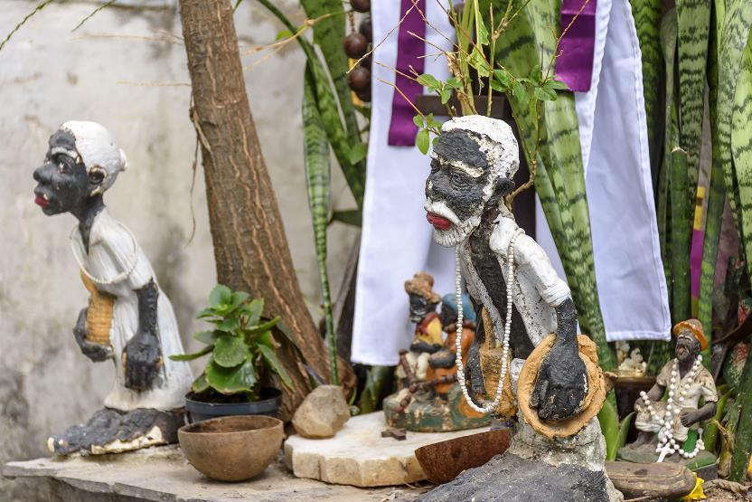
Photo: Zoonar/Fred Pinheiro
Notes:
td;Kiw fijfs;
td;Kiwiag; gw;wp rpe;jpg;Nghk;.
ntWg;Gg; Ngr;R kw;Wk; ntWg;Gf; Fw;wq;fs; vd;gd nghJthff;fhzg;gLk; td;Kiwr;nray;fSy; rpythFk; .
topghl;Lj; jyq;fs; kw;Wk; mtw;wpy; fye;Jnfhs;Sk; kf;fs; Fwpg;ghf ntWg;Gf; Fw;wq;fSf;F Mshfpwhu;fs;.
gpNurpypy;> ghuk;gupa Mg;Nuh-gpNurpypa kjj;ij gpd;gw;Wgtu;fs; jq;fs; kjj;ij jPa rf;jpahf fUJk; epNah - nge;jNfh];Nj fpwp];jt maytu;fsplkpUe;J td;Kiw jhf;Fjy;fis vjpu;nfhs;fpd;wdu;
mUl;je;ij khu;rpNah> fz;lk;g;Ny kjj;jpd; ghjpupahu; mtuJ Nfhtpypy; 20f;Fk; Nkw;gl;l jhf;Fjy;fs; ele;jjhfg; Gfhuspj;Js;shu;. ,Ug;gpDk; NghyPrhu; ve;j eltbf;ifAk; vLf;ftpy;iy.

Slide 25
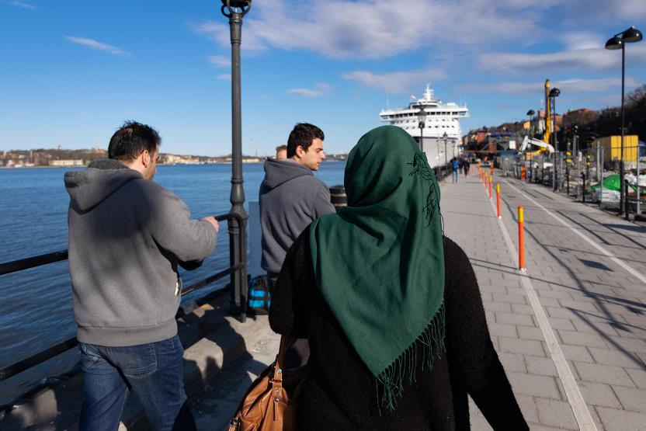
Photo: Image Leaks / Alamy Stock Photo
Notes:
kPz;Lk;> ngz;fSk; Mz;fSk; tpj;jpahrkhf ghjpf;fg;gLfpd;wdu;. ];tPldpy; cs;s K];yPk; ngz;fs;> Fwpg;ghf `p[hg; Nghd;w kj cilfis mzpgtu;fs;> nghJ ,lq;fspy; me;epau;fshy; ,iof;fg;gLk; ntWg;Gf; Fw;wq;fis mDgtpf;fpd;w mNjNtis K];ypk; r%f Mz;fs; jkJ maytu; my;yJ cld; njhopy; GupNthuplkpUe;J ntWg;G Fw;wq;fis mDgtpf;Fk; tha;g;Gfs; mjpfk;.

Slide 26
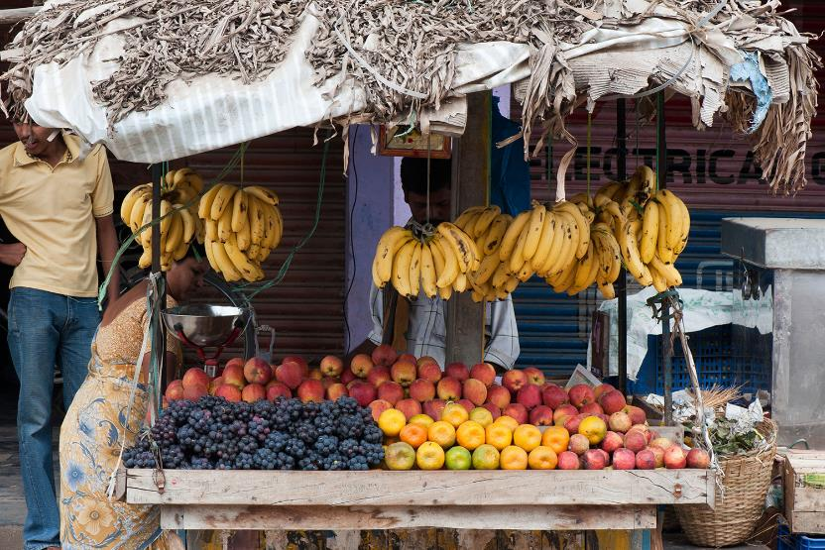
Photo: Tim Gainey / Alamy Stock Photo
Notes:
gy ,lq;fspy;> nfhNuhdh itu]; njhw;W eilKiwapYs;s ghFghL kw;Wk; ntWg;G tbtq;fis tYg;gLj;jpAs;sJ.
K];yPk; kj jpUtpohitj; njhlu;e;J itu]; guty; mjpfupj;jij mLj;J ,e;jpahtpy; cs;s K];ypk;fs; nfhNuhdh [p`hj; elj;jpajhf Fw;wk; rhl;lg;gl;ldu;
m`;kj; N\f; xU K];yPk; tPjp tpw;gidahsu;> mtu; tho;f;if elj;j NghuhLfpwhu;.
Vg;uy; 2020 ,y;> K];ypk;fs; nfhNuhdhitg; gug;g rjp nra;tjhf njuptpj;J ,e;J Njrpathj Fk;gy; xd;W mtiu jdJ filia %l;il fl;bf; nfhz;L ntspNawr; nrhd;dhu;fs;.
mfkJ nfQ;rpa NghJk; fLikahf jbfshy; mbf;fg;gl;lhu;.
mtu; nghyp]py; Gfhu; mspf;f Kad;whu;> Mdhy; tof;ifg; gjpT nra;a kWj;J> njUNthu tpahghuk; rl;ltpNuhjkhdJ vd;W NghyPrhu; $wpdu;.

Slide 27
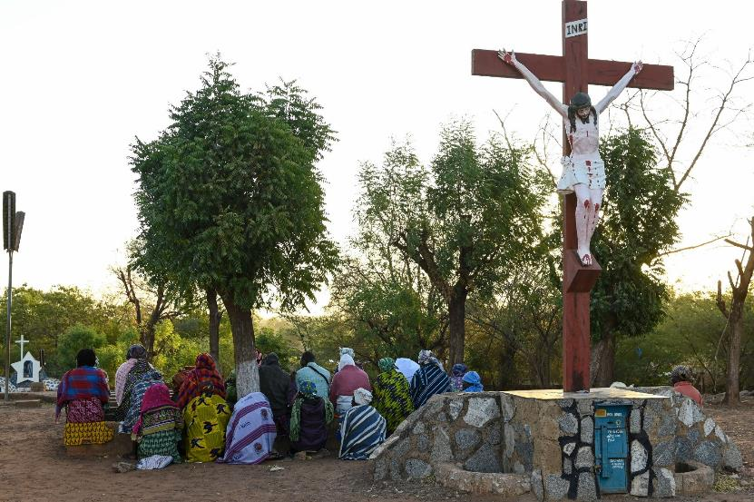
Photo: Joerg Boethling/Alamy Stock Photo
Notes:
r%fj;jpy; kpfTk; jPtpukhd kPwy; tbtq;fshtd tFg;Gthj td;Kiw kw;Wk; gaq;futhj jhf;Fjy;fs; MFk;.
gh];lu; rhKNty; tlf;F Gu;fpdh ghNrhit Nru;e;jtu;. ehl;by; kj rfpg;Gj;jd;ikapd; ghuk;gupak; cs;sJ> mij gaq;futhj FOf;fs; Fiwkjpg;gpw;F cl;gLj;Jfpd;wd. 2019 ,y;> Njthyaq;fs; kPjhd jhf;Fjy;fs; mtu;fspd; %Nyhghaj;jpd; xU gFjpahf khwpaJ. gh];lu; rhKNty; ,g;NghJ cs;ehl;by; ,lk;ngau;e;j kf;fSf;fhd Kfhkpy; trpf;fpwhu;. “,e;j jhf;Fjy;fs; ekJ kf;fspd; tho;f;ifia rpijj;Jtpl;ld. ehq;fs; typahy; epuk;gpAs;Nshk;>” vd;W mtu; $Wfpwhu;. xU kpy;ypaDf;Fk; mjpfkhd kf;fs; ,lk;ngau;e;j epiyapy;> 2019 Mk; Mz;bypUe;J gaq;futhjj; jhf;Fjy;fs; mjpfupj;Js;sd.

Slide 28
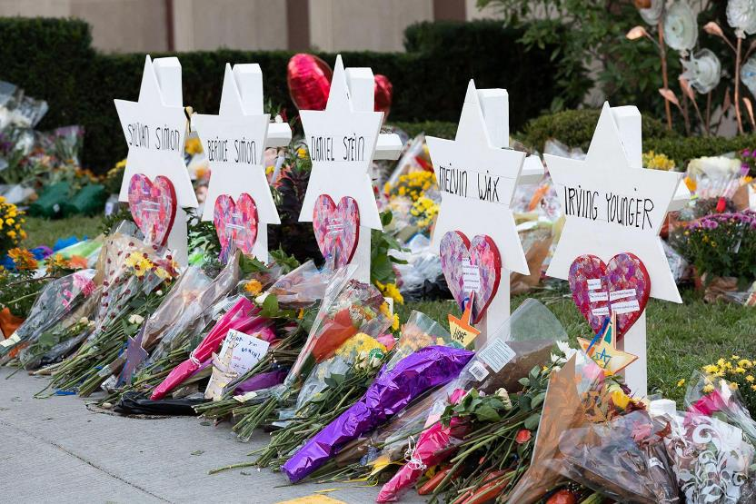
Photo: 2020 Images / Alamy Stock Photo
Notes:
,];yhj;Jld; njhlu;Gs;s gaq;futhj FOf;fs; cyfshtpa Gs;sptpguq;fspy; Mjpf;fk; nrYj;jpdhYk;> gpw FOf;fs; mjpf mr;RWj;jiy Vw;gLj;Jk; gy Njrpa R+oy;fs; cs;sd.
rpy Nkw;fj;jpa ehLfspy; ghJfhg;G Nritfs; mjpf tyJrhup jPtputhjpfis kpfg;ngupa cs;ehl;L gaq;futhj mr;RWj;jyhff; fUJfpd;wd.,e;j FOf;fs; kj rpWghd;ikapdiu Fwpitf;fpd;wd. 2018 Mk; Mz;by;> mnkupf;fhtpYs;s gpl;];gu;f;fpy; cs;s xU n[g Myaj;jpy; gjpndhU A+ju;fs; nfhy;yg;gl;ldu;.NkYk; 2019 ,y; epA+rpyhe;jpd; fpwp];l;ru;r;rpy; cs;s kR+jpapy; 51 K];ypk;fs; nfhy;yg;gl;ldu;.

Slide 29
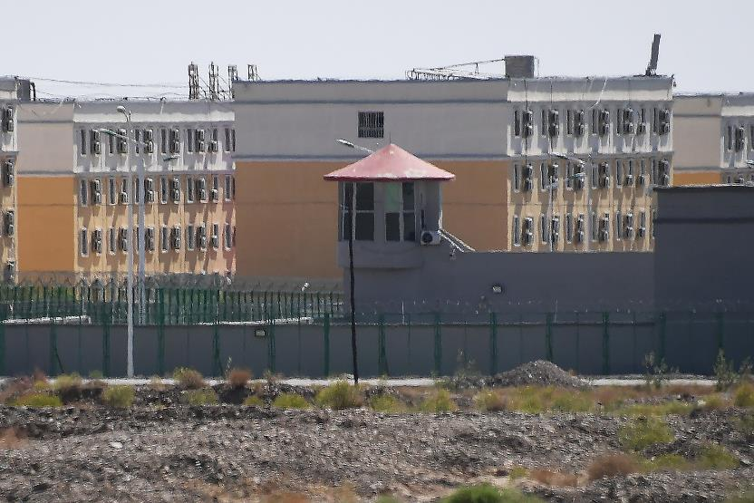
Photo: GREG BAKER / Getty images
Notes:
fhty;Jiw> ghJfhg;Gg; gilapdu; my;yJ uhZtj;jhy; my;yJ murhy; gzpaku;j;jg;gl;l Fk;gy; td;Kiwapy; <Lglyhk;> jdpegu;fs; my;yJ KO r%fq;fisAk; ,J Fwpitf;fyhk;.
Nkw;F rPdhtpy; ca;Fu;fspd; epiy> murhq;f td;Kiw vt;tsT mjpfkhf ,Uf;fyhk; vd;gij tpsf;FfpwJ. ca;Fu; ngz;fs; fl;lha FLk;g fl;Lg;ghL kw;Wk; fUj;jilfis vjpu;nfhz;Ls;sdu;
Rkhu; 1.8 kpy;ypad; ca;Fu;fs; kWfy;tp Kfhk;fSf;F `p[hg; mzptJ my;yJ jhb itj;jpUj;jy; Nghd;w fhuzq;fSf;fhf mDg;gg;gl;Ls;sdu;. rpj;jputij kw;Wk; fw;gopg;G rk;gtq;fs; ,k; Kfhk;fspy; ,Ue;J njuptpf;fg;gLfpwJ> mq;F ifjpfSf;F mtu;fspd; nkhop kw;Wk; kjk; kWf;fg;gLfpwJ kw;Wk; khepy rpj;jhe;jj;jpy; fw;gpf;fg;gLfpwJ.
,e;j Kfhk;fs; jd;dhu;t fy;tp ikaq;fs; vd;W rPd murhq;fk; $WfpwJ.

Slide 30
Notes:
murhq;fg; nghWg;Gfs; kw;Wk; murhq;fj; Njhy;tpfs;
kf;fisg; ghJfhg;gjpy; muR jtwpaijf; ,Wjpahf xUKiw ghu;g;Nghk;.
kdpj cupikfis ghJfhf;f Ntz;ba nghWg;G murhq;fq;fSf;F cs;sJ.
mtu;fs; mt;thW nra;aj; jtWk; NghJ> ghFghL kw;Wk; td;Kiwfs; mjpfupf;f Kidfpd;wd> Mdhy; jdpg;gl;l tof;Ffspy; gaDs;s fhty;Jiw eltbf;iffs; ,k;kPwy;fisj; jLf;f cjTk;

Slide 31
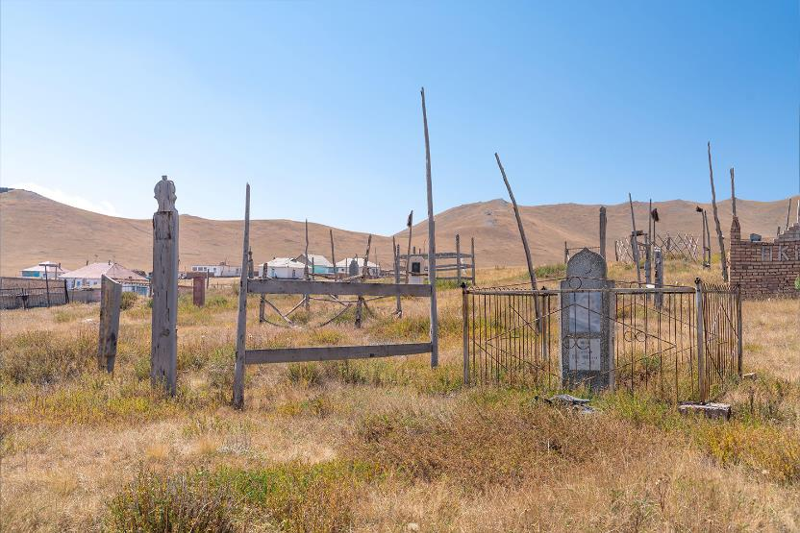
Photo: Alex Gavrikov / Alamy Stock Photo
Notes:
2017 Mk; Mz;by;> njw;F fpu;fp];jhdpy; ,];yhkpypUe;J fpwp];jt kjj;jpw;F khwpa tajhd ngz; xUtu; ,we;jhu;. mtuJ kfs; khefu rig fy;yiwapy; mtis mlf;fk; nra;a Kad;wNghJ> ​​cs;Shu; ,khk; jiyikapyhd FO td;Kiwapy; vjpu;g;Gj; njuptpj;jJ. nghJkf;fspd; ftdk; mjpfhupfs; eltbf;if vLf;f J}z;Lk; tiu mt;Tly; kPz;Lk; kPz;Lk; Njhz;lg;gl;lJ. Fw;wthspfs; kPJ Fw;wk; rhl;lg;gl;lJ> mjd; gpwF> kjk; khwpatu;fSf;F vjpuhd jPtpuf; Fuy;fs; FiwthfNt ,Ue;jd

Slide 32
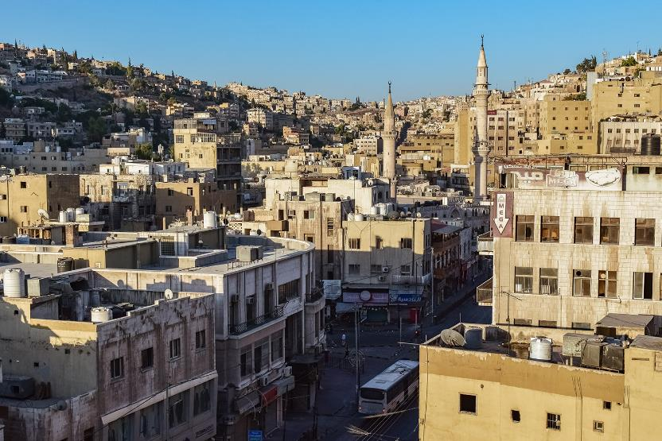
Notes:
FLk;gq;fs; my;yJ ek;gpf;if r%fq;fSf;Fs; elf;Fk; kPwy;fs; njhlu;ghf mjpfhupfs; ngUk;ghYk; jiyaplj; jtwptpLfpwhu;fs;.
N[hu;lhdpy; cs;s 22 tajhd fpwp];jt gy;fiyf;fof khztpahd ejpah> xU K];yPk; vd;w rf khztpia fhjypj;jhu;.
,ijawpe;j mtuJ FLk;gj;jpdu;> mtis tPl;il tpl;L ntspNaw kWj;J> nfhLikg;gLj;jpdu;. ejpah mq;fpUe;J jg;gpj;jhu;> Mdhy; ,uz;L khjq;fSf;Fg; gpwF> mtSila je;ij mtisf; fz;Lgpbj;J mtis nfhiy nra;jhu;.
ePjpkd;wk; mtuJ 'nfsutk;' mbg;gilapyhd Nehf;fq;fis jzpf;Fk; R+o;epiyahf fUjpaJld; mtiu rpiwf;F mDg;gtpy;iy.

Slide 33
Notes:
epiwT
,e;j Kd;itg;gpy;> murhq;fq;fs; kw;Wk; r%fj;jpy; cs;stu;fs; nra;Ak; ghFghL> fl;Lg;ghLfs; kw;Wk; td;Kiw Mfpatw;iwg; ghu;j;Njhk;.
kf;fisg; ghJfhg;gjpy; murpd; Njhy;tpfisAk; ghu;j;Njhk;.
ehk; Nfs;tpg;gl;l fijfspypUe;J> ehk; gy KbTfis vLf;fyhk;:

Slide 34
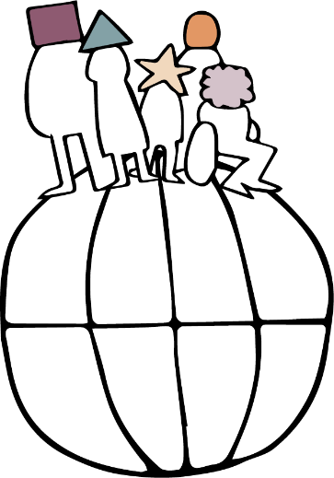
ghjpf;fg;gl;Ls;sJ ahu; ?
vt;tsT gutyhf cs;sJ ?
vt;tsT toik ?
vt;tsT jPtpu ?
muR cs;spl;Ls;sjh ?
Notes:
midj;J tifahd ehLfspYk; kPwy;fs; elf;fpd;wd kw;Wk; midj;J kjq;fs; kw;Wk; ek;gpf;iffis nfhz;Ls;s kf;fisAk; ghjpf;fpd;wd. ahu; ghjpf;fg;gLfpwhu;fs;> vt;tsT gutyhf ,it eilngWfpwJ> vt;tsT toikahf kw;Wk; fLikahd kPwy;fs; cs;sd kw;Wk; mtw;iwr; nra;tjpy; murhq;fk; ve;j mstpw;F <Lgl;Ls;sJ vd;gdNt R+oy;fSf;F ,ilapy; khWgLk;.

Slide 35
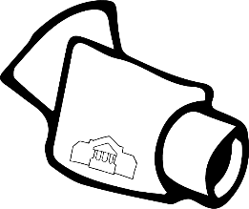
Notes:
gy;NtW tifahd rl;lq;fSk; murhq;ff; nfhs;iffSk; kPwy;fSf;F gq;fspf;fyhk;.

Slide 36
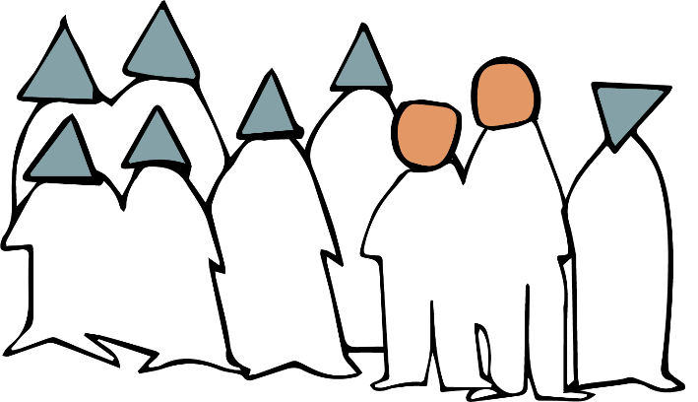
Notes:
nghJthf> rpWghd;ikapdu; kpfTk; fLikahfg; ghjpf;fg;gLfpwhu;fs;> mtu;fSld; ngUk;ghd;ikapdUf;Fs; tpj;jpahrkhfr; rpe;jpg;gtu;fSk; mlq;Ftu;.
Mdhy; ngUk;ghd;ik r%fq;fSk; kPwy;fshy; ghjpf;fg;glyhk; - Fiwe;jJ gaq;futhj td;Kiwapdhy;

Slide 37
ngzËfSk;
,skË ngzËfSk;
MzËfSk;
,sk; MzËfSk;
Notes:
ehk; Nfs;tpg;gl;l fijfs;> kjk; my;yJ ek;gpf;ifapd; Rje;jpuj;ij kPWtJ nghJthf vt;thW kw;w cupik kPwy;fisAk; cs;slf;fpAs;sJ vd;gij tpsf;FfpwJ - cjhuzkhf> fy;tp my;yJ jpUkzk; my;yJ tho;tjw;fhd cupik. ntWg;Gf; Fw;wq;fs;> fl;lhaj; jpUkzk;> fw;gopg;G> tYf;fl;lhakhf fUj;jil nra;jy; tiu - Mz;fSk; ngz;fSk; vt;tsT tpj;jpahrkhf ghjpf;fg;glyhk; vd;gij gy fijfs; tpsf;Ffpd;wd.

Slide 38
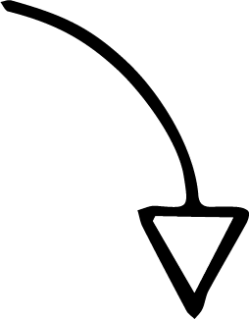
Notes:
NkYk; ehk; Nfs;tpg;gl;l gy fijfs;> r%fj;jpy; Vw;gLk; kPwy;fs;> murhq;fj; Njhy;tpfs; kw;Wk; murhq;f kPwy;fs; vt;thW xUtiunahUtu; tYg;gLj;jp> xU jPa Row;rpia cUthf;Ffpd;wd vd;gij tpsf;Ffpd;wd.

Slide 39
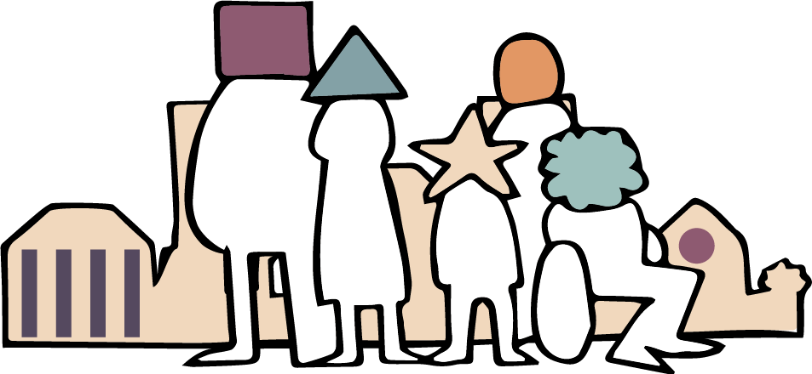
Notes:
kjk; my;yJ ek;gpf;ifapd; Rje;jpuj;ij kPWtJ rhjhuz kf;fSf;F khngUk; jdpg;gl;l Jd;gq;fis Vw;gLj;JfpwJ. r%fj;ijAk; rPu;Fiyf;fpwhu;fs;. ,Wjpapy;> xt;nthUtUk; ghJfhg;gpd;ik kw;Wk; nghUshjhu kw;Wk; r%f jhf;fj;jhy; ghjpf;fg;gLfpd;wdu;
ehk; ahuhf ,Ue;jhYk; my;yJ ve;j ek;gpf;if r%fj;ijr; Nru;e;jtu;fshf ,Ue;jhYk;> ekJ nrhe;j ehl;by; cs;s midj;J kf;fshYk; kj Rje;jpuk; my;yJ ek;gpf;if kjpf;fg;gLtjd; %yk; ehk; mjpfk; ed;ikfis <l;l KbAk;.
kw;w ehLfspy; rpWghd;ikapduhf thOk; rf tpRthrpfSk; rk cupikfisg; ngw;wtu;fshf ,Uf;f tpUk;Gtijg; ghu;f;fpNwhk;.
vy;yh ,lq;fspYk; midtUf;Fk; rk cupik vd;gJ ek; midtUf;Fk; kfpo;r;rpahd> ghJfhg;ghd cyfj;ij cUthf;Fk;.

Slide 40
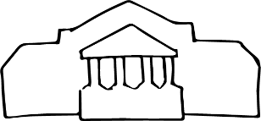
vt;tifahd kPwy;fs; eilngWfpd;wd> mjw;F ahu; nghWg;G?
Notes:
,uz;L epkpl k.m.e.R. njhlu;ghd FW ehlfq;fs;
FW ehlfq;fspd; Kd;itg;G kw;Wk; fye;Jiuahlypd; NghJ ,e;j ];iyilf; fhz;gpj;J gq;Nfw;ghsu;fs; ve;j tifahd kPwy;fs; eilngWfpd;wd kw;Wk; mtw;Wf;F ahu; nghWg;G vd;gij milahsk; fhz cjTq;fs;.
,e;j ];iyby; cs;s rpd;dq;fs; - murhq;f kPwy;fs;> r%f tpNuhjq;fs;> murhq;f Njhy;tpfs;> ghFghL> cupikfs; kw;Wk; td;Kiw kPjhd fl;Lg;ghLfs; Mfpatw;iw tpsf;FfpwJ.

Slide 41
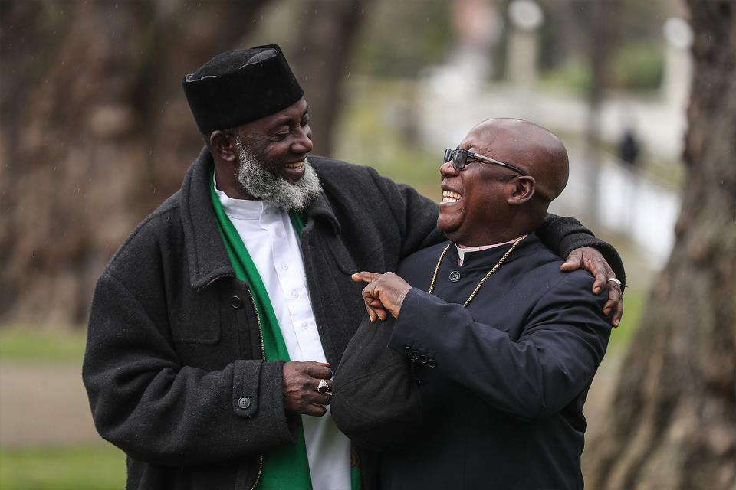
Photo: Stuff Limited
Notes:
41-43 tiuahd ];iyLfs; mkuÊtpdÊ epiwT fUjÊjpy ÊgadÊgLjÊjgÊglÊl Nghjfu; N[k;]; kw;Wk; ,khk; m~hgh ,d; fijapid tpsfÊFfpdÊwJ
,J gh];lu; N[k;]; kw;Wk; ,khkh m\hgh. 1992 ,y;> tlf;F ie[Pupahtpy; xU kj Nkhjypd; NghJ xUtiunahUtu; fLikahfg; Nghupl;l ,isQu;fs; vjpu;f;Fk; Nghuhspf; FOf;fis topelj;jpdu;.
gh];lu; N[k;];> td;Kiw Nkhjypy; ifia ,oe;jhu;> mNj Neuj;jpy; ,khk; m\hgh mtuJ Md;kPf topfhl;b kw;Wk; ,uz;L neUq;fpa cwtpdu;fis ,oe;jhu;. ,UtUk; guk vjpupfshf khwp gopthq;Ftjhf rgjk; nra;jdu;.
rpy tUlq;fs; fopj;J> xU re;jpg;gpd; re;ju;g;gk; vy;yhtw;iwAk; khw;wpaJ. NghypNahTf;F vjpuhd Foe;ijfSf;F jLg;G+rp NghLtJ Fwpj;j r%fj; jiytu;fspd; re;jpg;gpd; NghJ> ​​,U kjj; jiytu;fSk; gu];gu ez;gu; xUtuhy; xd;wpizf;fg;gl;ldu;. ez;gu; mtu;fspd; iffis xd;whf ,izj;J mtu;fsplk; $wpdhu;> “khepyj;ij mikjpahf itj;jpUf;Fk; jpwd; cq;fSf;F cs;sJ vd;W vdf;Fj; njupAk;. ePq;fs; Ngr Ntz;Lk; vd;W ehd; tpUk;GfpNwd;.

Slide 42
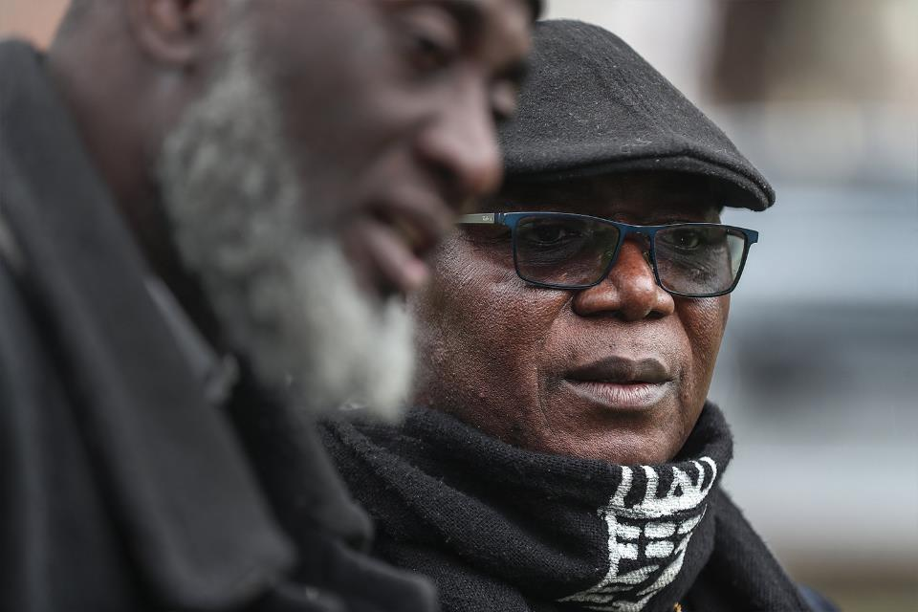
Photo: Stuff Limited
Notes:
,UtUNk kw;wtUld; Ngr tpUk;gtpy;iy vd;whYk;> ie[Pupah kPjhd mtu;fspd; md;gpYk;> jq;fs; ehl;bd; Kd;Ndw;wj;jpw;fhd mu;g;gzpg;gpYk; nghJthd jsj;ijf; fz;lwpe;jdu;.
"K];ypk;fs; kPjhd vdJ ntWg;Gf;F vy;iyNa ,y;iy" vd;W gh];lu; N[k;]; gpujpgypf;fpwhu;."xUtiunahUtu; Nfl;Fk; ,e;j jpwidf; fw;Wf;nfhz;ljw;Fk;> ciuahlYf;fhd ghJfhg;ghd ,lj;ij cUthf;Ftjw;Fk; ehq;fs; flTSf;F ed;wpAs;stu;fshf ,Uf;fpNwhk;> ,t;thW ,y;yhky; ,Ue;jhy; ehq;fs; vg;NghJk; J}uj;jpypUe;J tp\aq;fisf; fUJNthk;>" vd;W mtu; njhlu;e;jhu;. "ehq;fs; xU frg;ghd ghlk; fw;Wf;nfhz;Nlhk;."

Slide 43
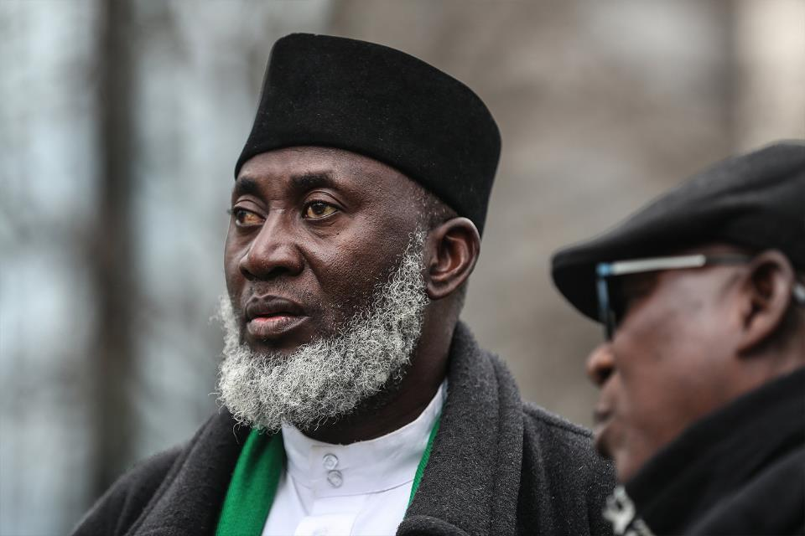
Photo: Stuff Limited
Notes:
1992 ,y; fLdhtpy; ele;j td;Kiwf;Fg; gpwF> mtUk; mtuJ Nghuhspf; FOTk; gopthq;fj; jpl;lkpl;bUe;jij ,khk; m\hgh epidTgLj;Jfpwhu;. Mdhy; xU ehs;> mtuJ kR+jpapy; njhOifapd; NghJ> ​​mtu;> “jPikia khw;w ey;yijg; gad;gLj;JtJ ey;yJ vd;W Fuhd; Nghjpf;fpwJ vd;gij czu;e;jhu;. vdNt> ePq;fs; xU K];ypkhf ,Ue;J> cq;fisg; Gz;gLj;jpatu;fis kd;dpf;f kWj;jhy;> ePq;fs; vg;gb KfkJtpd; cz;ikahd cUtkhf ,Uf;f KbAk;?
,U kjj; jiytu;fSk; gopthq;Fk; tpUg;gj;Jld; Nghuhbdu;. Mdhy; mtu;fs; kdjpy; ntWg;G ,Ue;jhy; cz;ikahd jiytu;fshf ,Uf;f KbahJ vd;gijAk; czu;e;jdu;.

Slide 44
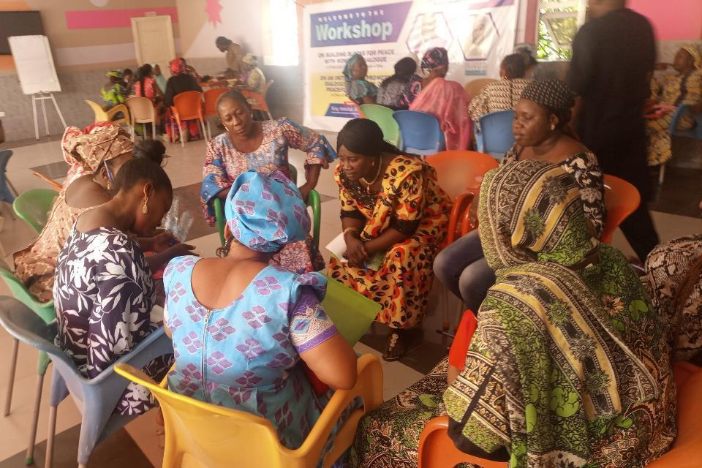
Photo: Muslim-Christian Interfaith Mediation Centre
Notes:
,khk; M\hgh kw;Wk; gh];lu; N[k;]; ,ilNa nkJthd> Mdhy; epiyahd ek;gpf;if tsu;e;jJ. mtu;fspd; cwT el;ghf kyu;e;jJ> ,J K];yPk;-fpwp];Jt rka kj;jpa];j ikaj;ij epWt toptFj;jJ.
,e;j ikak; mikjpahd rftho;Tf;fhf thjpLfpwJ kw;Wk; gpuhe;jpaj;jpy; td;Kiw kj Nkhjy;fs; kPz;Lk; epfohky; jLg;gij Nehf;fkhff; nfhz;Ls;sJ. ie[PupahtpYk; mjw;F mg;ghYk; td;Kiwiaj; njhlu;e;J rkhjhd cld;gbf;iffisf; nfhz;Ltu cjtpaJ> NkYk; midj;J kjj;jpdUf;Fk; ,ilNa mikjpahd rftho;Tf;fhf thjpLtjw;F cs;Shu; ek;gpf;if rhu;e;j mikg;GfSf;F topfhl;LfpwJ.

Slide 45
rpwgÊghf KbeÊjJ kPzÊLkÊ tUf
mLjÊj mkuÊT :
vkJ rKjhajÊjpyÊ kjk; myyJ; ek;gpf;iff;fhd Rje;jpukÊ

