Slide 1
m%dfoaYSh iudc mßj¾;l mdGud,dj

Slide 2
5 jeks ieish
wmf.a m%cdj ;=< wd.u weoySfï fyda úYajdi oeÍfï ksoyi
Notes:
ish¨‍ fokd ieishg idorfhka ms<s.kak'
my; i|yka lreKq meyeÈ,s lrñka ieish y÷kajd fokak(
miq.sh ieis ;=fka oS wms wd.u weoySfï fyda úYajdi oeÍfï ksoyi i|yd we;s udkj ysñlu ms<sn|j idlÉPd lf<uq' wmg ;sfnk whs;sjdislï ms<sn|j iy isÿ úh yels úúO W,a,x>khùï j¾. ms<sn|j o wmss bf.k .;af;uq' tfukau" wms fuu udkj ysñlu wmg jeo.;a jkafka flfiao hkak ms<sn|j wdj¾ckh lr" wkkH;djh" jrm%ido iy wjdis hk .eg¿ ms<sn|j o úuid ne¨fjuq'
fuu ieisfha oS wms úúO mqoa.,hskag fyda lKavdhïj,g uqyqK oSug isÿúh yels .eg¿ fudkjdo hkak y÷kd .ekSu msKsi wmf.a u ixo¾Nh úYaf,aIKh lsÍu flfrys wjOdkh fhduq lrkafkuq' wms tfia lrkafka wms tlg tlaj wmf.a k.rfha wd.u weoySfï fyda úYajdi oeÍfï ksoyi ms<sn| oDYH zis;shulaZ ks¾udKh lsÍu u.sks' kuq;a" wms .eg¿ foi ne,Sug fmr" wms fyd| foaj,a ms<sn| n,uqæ

Slide 3
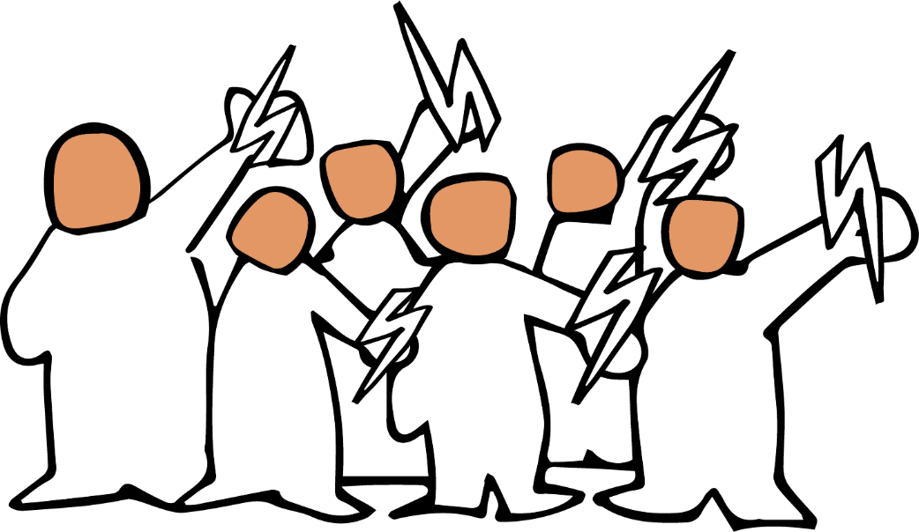
Notes:
wxl 3 isg 13 olajd jk ia,hsâ u.ska 5 jeks ieish i|yd jk bÈßm;a lsÍu ksrEmKh lrhs(
;;a;ajh krl w;g ^iy fyd| w;g& yefrk wdldrh
ye|skaùu miq.sh ieisfha§(
wd.u weoySfï fyda úYajdi ±Ífï ksoyi W,a,x>khùï hkq ljr wdldrfha fohlao hkak iy tajd ñksiqkaf.a Ôú;j,g n,mdkafka flfiao hkak ms<sn|j wms wjOdkh fhduq l<d'
W,a,x>khùï isÿ lrkafka ljqrekao - tkï kS;sh yryd iy ks,OdÍkaf.a l%shdud¾. fyda l%shd fkdlsÍu yryd rch o" ke; fyd;a m%cdfõ mqoa.,hskao hkak .ek wms is;d ne¨jd'
fuu W,a,x>khùï fln÷ úh yels oehs .fõIKh lsÍug iy tajd y÷kd .ekSug mqreÿ ùu i|yd fuj,ula f,i wms kdgH Ndú;d l<d'

Slide 4
Notes:
oeka wms fuu ieish wjika lsÍug iQodkï fjkafka W,a,x>khùï uOHia: ;;ajfha isg krl iy jvd;a krl ;;ajhg yefrkafka flfiao hkak iy b|ysg mqoa.,hkag n,mdk isÿùïj, isg ck;djf.a whs;sjdislï j,g tfrysj t,a,jk l%udkql+," mq¿,aj me;sreKq yd ±ä m%ydr njg m;ajkafka flfiao hkak ms<sn|j is;d ne,Sfuka'
;;ajh jvd;a krl w;g yefrk wdldrh .ek is;Sfï tla l%uhla jkafka óg wÞ< wÈhr ;=k .ek is;Suhs - fndrem%pdr" fjkia fldg ie,lSu iy m%pKav;ajh lshkafka tu wÈhr ;=khs'

Slide 5
fndrem%pdr
Notes:
ysxid lsÍfuys wjê ;=k
m<uq wjêh jkafka fndrem%pdrhs' fuu wjêfhaoS mqoa.,hska .ek fyda mqoa., lKavdhï .ek - WodyrKhla f,i wd.ñl iq¿;r lKavdhï .ek - l,skau t<Uqkq ks.uk" tkï Tjqka fujeks wh hehs lshk taldlD;s iy uqidjka me;sfrkjd' fouõmshka" .=rejreka iy mdi,a fm<fmd;a j,ska <uhskag W.kajk foa" .=jkaúÿ,sh fyda iudc udOH yryd fyda foaYmd,k{hskaf.a l:d iy wd.ñl kdhlhskaf.a foaYk yryd jeks úúOdldr l%u j,ska iq¿;r lKavdhï .ek l,skau t<UqKq ks.uk jHdma; fjkjd'

Slide 6
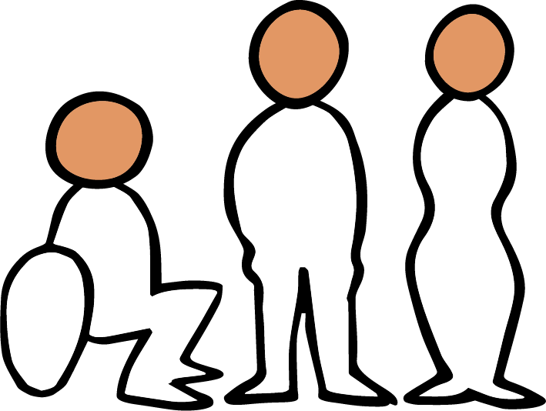
Notes:
mqoa.,hska .ek l,skau ks.ukj,g t,an .ekSfuka f;dr jQ iudchla fidhd .ekSug;a ÿIalrhs' fuh iEu iudchlu olskakg ;sfnkjd' kuq;a mqoa.,hska .ek l,skau ks.ukj,g t,an .ekSu iy taldlD;s wNsfhda.hg ,la fkdjk úg" iy úfYaIfhka u foaYmd,k yd wd.ñl kdhlhska úiska tajd m%j¾Okh lrk úg" tajd fkdbjiSfï ixialD;shla ks¾udKh ùug iy lKavdhï w;r wd;;Ska we;s ùug fya;= fjkjd'
th isÿ jk úg" idudkH ckhdg" m%dfoaYSh ks,OdÍkag iy rchg mjd wka whg fjkiafldg i,lk wdldrfhka is;Sug yd l:d lsÍug muKla fkdj" tf,i l%shd lsÍug mjd myiq fyda idudkH fohla njg m;afjkjd' fndre m%pdr mqoa.,hskag tfia fjkia fldg i,lkq ,eîu ms<s.; yels fohla fia fmfkkakla njg m;a lrkjd' tys jvd;au wka; iajrEmfha §" fjkia fldg ie,lSu muKla fkdj" wka whg tfrys m%pKav;ajh mjd ms<s.; yels fyda ksjerÈ hehs úYajdi lsÍug ñksiqka fm<Uùu i|yd fndrem%pdr Ndú;d lrkq ,nkjd'

Slide 7
fjkiafldg ie,lSu
Notes:
fjkiafldg ie,lSu Ôú;fha iEu wxYhlu ñksiqkag n,mdkjd' miq.sh ieisfha§" wms rch úiska isÿ lrk fjkiafldg ie,lSu ms<sn| WodyrK i,ld ne¨‍jd - WodyrK f,i" fjkia fldg i,lk wdldrfha mjq,a kS;s iy mqoa., wkkH;d kS;s" fmd,sish iy wêlrKh úiska kS;sh l%shd;aul lrk wdldrfhys we;s fjkia fldg ie,lSu" iy wOHdmkh jeks fiajd iemhSfï§ we;s fjkia fldg ie,lSu' tfuka u" wms ñksiqkag /lshd i|yd we;s m%fõYhg n,mdk whqßka mqoa.,sl wxYfha isÿjk fjkiafldg ie,lSu i|yd o WÞyrK i,ld ne¨jd'
lsisu iudchla fjkia fldg ie,lSfuka f;dr iudchla fjkafka keye" kuq;a mq¿,a yd l%udkql+, fjkiafldg ie,lSula mej;sh yelafla th fkdoekqj;alu yd fkdßiaiSu ms<sn| ixialD;shla u; f.dvkeÕ=‍Kq úg muKhs' nyq;rhla fokd fjkiafldg ie,lSu ms<s.kafka ke;s kï th È.ska È.gu isÿ jkafka keye'

Slide 8
m%pKav;ajh
Notes:
fndrem%pdr" fjkia fldg ie,lSu i|yd mokula ks¾udKh lrkjd fiau" fndrem%pdr iy fjkia fldg ie,lSu tlg tlajQ úg" m%pKav;ajhg o wä;d,ula imhd fokjd' m%cdj ;=< isÿjk m%pKav;ajh foam< úkdY lsÍfñ isg ysßyer lsÍï" iy YdÍßl ysxikh ms<sn| ;¾ckh lsÍï olajd jQ úúOdldr iajrEm .; yelshs' rdcH m%pKav;ajhg w;a;fkdau;sl f,i isr.; lsÍu" jOysxid meñKùu iy ia;%S mqreI iudcNdjh u; mokï jQ m%pKav;ajh wdÈh we;=<;a úh yelshs'

Slide 9
úYd,;ajh
jdr .Kk
n,mEu
Notes:
úYd,;ajh" jdr.Kk iy n,mEu
.eg¿ j¾. ;=k u" tkï" fndre m%pdr" fjkia fldg ie,lSu iy m%pKav;ajh isÿjk mßudKh" jdr.Kk iy n,mEï we;sjk uÜgï" úúOdldr úh yelshs' W,a,x>kh ùula mqoa.,hska lsysm fofkl=g fyda úYd, lKavdhïj,g n,mE yelshs'
th b|ysg" ks;sm;d fyda l%udkql+,j isÿ úh yelshs - thska woyia jkafka th iudcfha moaO;s yd jHqyhka ;=<g ld jeoS we;s njhs' n,mEug ,lajk ck;djg bka iSñ; fyda úkdYldÍ n,mEula we;s l< yelshs'

Slide 10
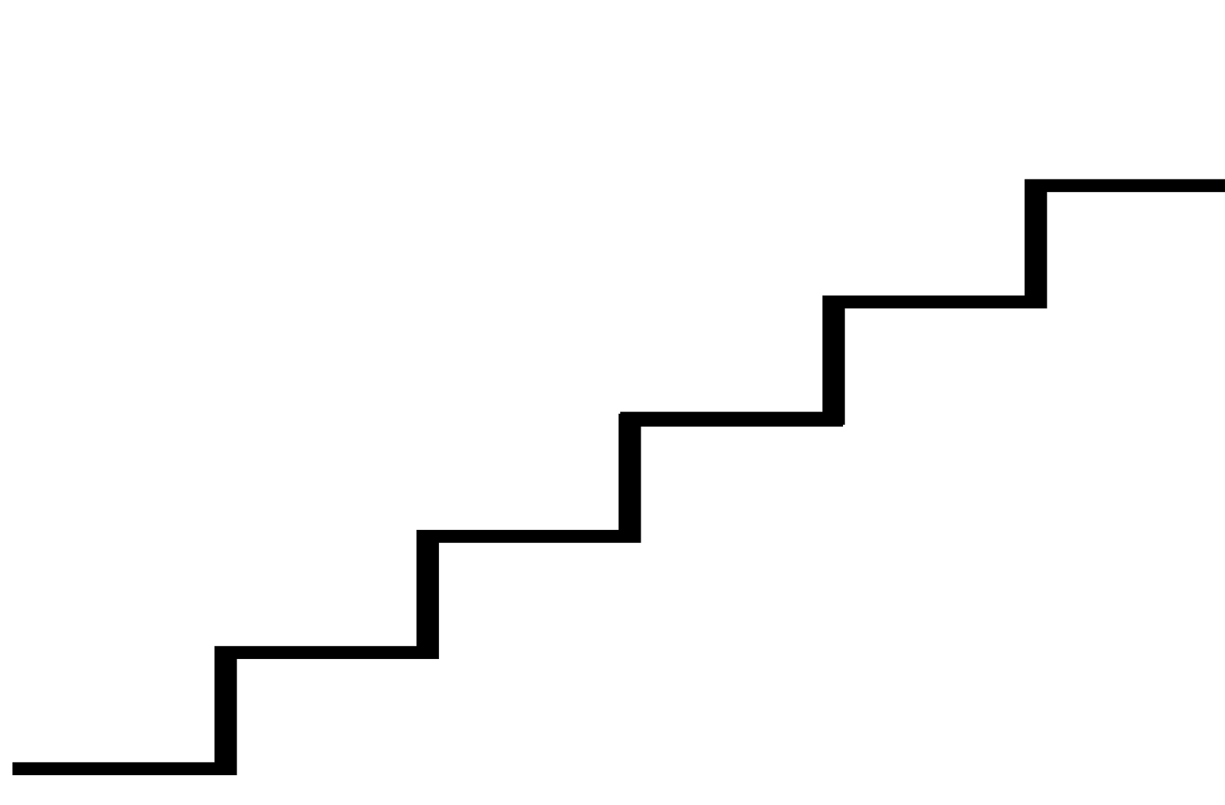
Notes:
fndfyda rgj, w;aoelSï wmg mjikafka wúpdrl ye`.Sï iy fndrem%pdr jvd;a mq¿,aj me;sreKq yd jvd;a oeä jk ;rug" fjkiafldg ie,lSu o jvd;a mq¿,aj me;sreKq yd oeä njg m;ajk nj;a" fï folu jvd;a mq¿,a jk ;rug mq¿,a yd oreKq m%pKav;ajhg we;s bvlv o jvd;a jeä jk nj;a h' tla fohla ;j;a fohlg fya;= fjhs'
fuh l,lsÍu we;slrjkakla f,i ±lsh yels kuq;a" foaj,a krl w;g yefrkafka flfiao hkak wjfndaO lr .ekSu foaj,a hym;a w;g yefrkafka flfia oehs is;d ne,Sug o wmg WmldÍ fjhs'

Slide 11
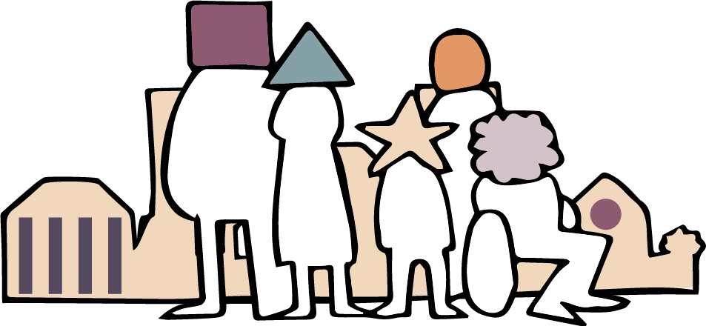
Notes:
ye|skaùu iEu fohlau wdrïN jkafka wms tlsfkld ms<sn|j is;k m;k yd l:d lrk wdldrfhka' tA iïnkaOfhka wms iEu flfkl=g u wmf.a mjq,a ;=< iy wmf.a mqoa.,sl cd, ;=< hïlsis fohla l< yelshs' tfuka u wmg m%cd uÜgñka o - WodyrKhla f,i wmf.a wd.fï m%cdjka" mdi,a iy fiajd ia:dk iïnkaOfhka o - ta ms<sn|j hula l< yels fjkakg;a yelshdj ;sfnkjd'
we;a; jYfhkau" fuh m%udKj;a keye' wms ñksiqkag fjkia fldg i,lk yd ydks lrk wdldrfha ks, l%ufõo" tkï krl kS;sj, isg mdi,a .=rejreka fyda fmd,sia ks,OdÍka jeks ks,OdÍkaf.a yeisÍu olajd jQ foa fjkia l< hq;=hs'

Slide 12
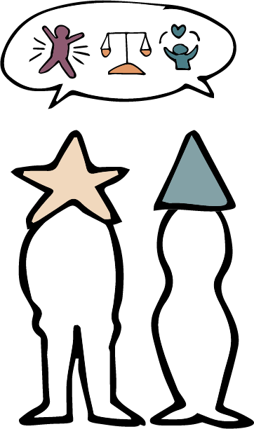
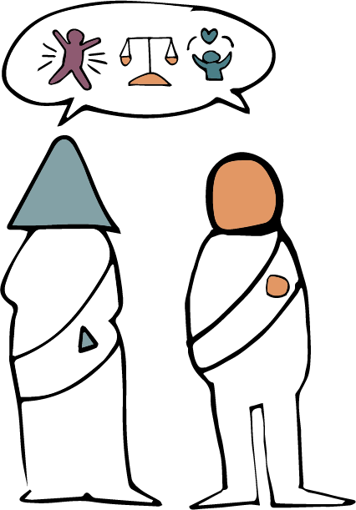
Notes:
tjeks fjkila isÿ lsÍu yels lrjkq msKsi wmg ;ukaf.a whs;sjdislï ms<sn|j okakd iy ;uka fjkqfjka fmkS isàug wjYH yelshd j,ska ikakoaO iq¿;rhka" Tjqka iu. ke.S isàug iQodkïj isák nyq;rhka iy udkj ysñlï j,g .re lsÍu" tajd wdrlaId lsÍu iy m%j¾Okh lsÍu i|yd ;uka i;= jk j.lSï wjfndaO lr.;a foaYmd,k yd wd.ñl kdhlhska wjYH hs'

Slide 13
fndrem%pdr - fjkiafldg ie,lSu - m%pKav;ajh
Notes:
fuh h:d¾:hla njg m;a lsÍu fifuka isÿjk" ÿIalr l%shdj,shla'
tu l%shdj,sh wdrïN jkafka wm wmf.a miqìu úYaf,aIKh lr tys we;s .eg¿ fudkjdoehs y÷kd.;a úghs'
tfia lsÍu i|yd wmg fuu wjê ;=fkka" tkï fndrem%pdr - fjkia fldg ie,lSu - m%pKav;ajh hk ;=fkka iukaú; wdlD;sh Ndú;d l< yelshs'

Slide 14
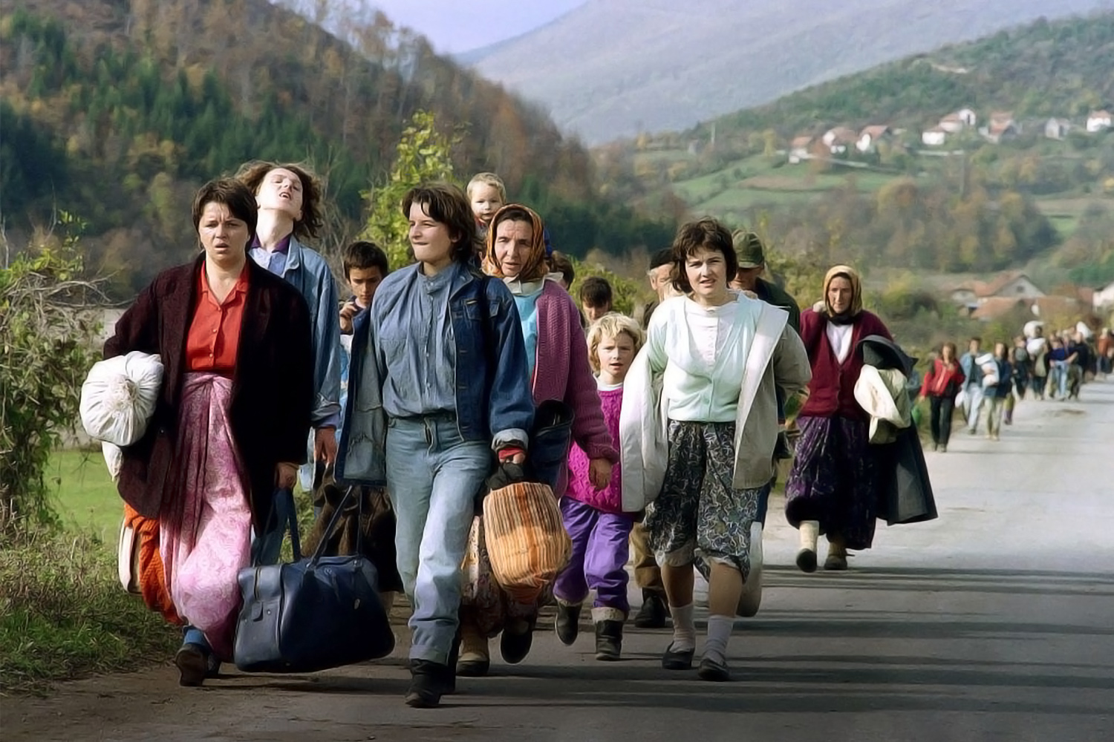
PdhdrEmh( Patrick Baz / Getty Images
Notes:
wxl 14 isg 19 olajd jQ ia,hsv u.ska ieish wjika lsÍfï woyiaj, fldgila jk tókd f.a l;dj ksrEmKh lrhs'
tókdf.a l;dj" fndiakshd y¾if.dùkdj
1995 j¾Ifha§ fndiakshdkq hqoaOh wjidkfha §" fndiakshd y¾if.dùkdfjys wd.ñl jd;djrKh úYd, jYfhka fjkia jqKd' uqia,sï nyq;rhla ;snQ iuyr m%foaY l%sia;shdks nyq;rhla iys; m%foaY njg m;a jQ w;r wfkla w;g l%sia;shdks nyq;rh ;snQ iuyr m%foaY uqia,sï nyq;rh iys; m%foaY njg m;a jqKd' ckjd¾.sl yd wd.ñl wd;;Ska wog;a b;sßj mj;sk w;r" ;ukaf.a uq,a .ï ìï fj; wdmiq hk mqoa.,hska úfYaIfhka wjodkug ,la fjkjd'

Slide 15
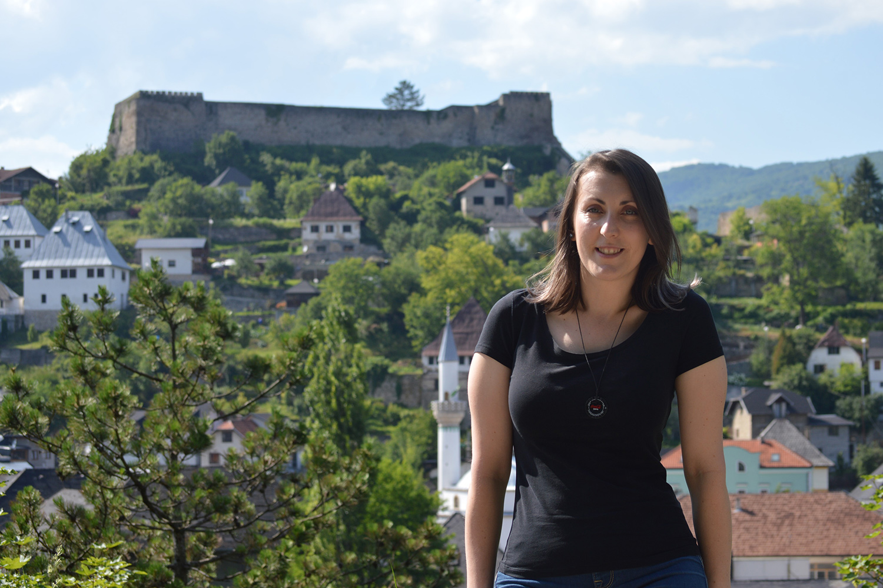
PdhdrEmh( Emina Frljak
Notes:
fï bkafka tókd' tókdg Okd;aul fjkilg odhl ùug wjYH jqKd' tu ksid weh kdya,d kï jQ fndiakshdkq rdcH fkdjk ixúOdkhlska meje;ajq flá ld,Sk udkj ysñlï mqyqKq mdGud,djlg iyNd.S jqKd'
—uu ta mdGud,dfjka fndfyda foa bf.k .;a;d' wd.u weoySfï fyda úYajdi ±Ífï ksoyi hkafkys w¾:h l=ulao lshd ug wjfndaO jqKd" uu uf.a miqìu ;=< isÿ jk W,a,x>khùï y÷kd .ekSug mgka .;a;d' uu ffjÍ l:k iïnkaOfhka iudc udOHj, jd¾;d lrkak mgka .;a;d'˜

Slide 16
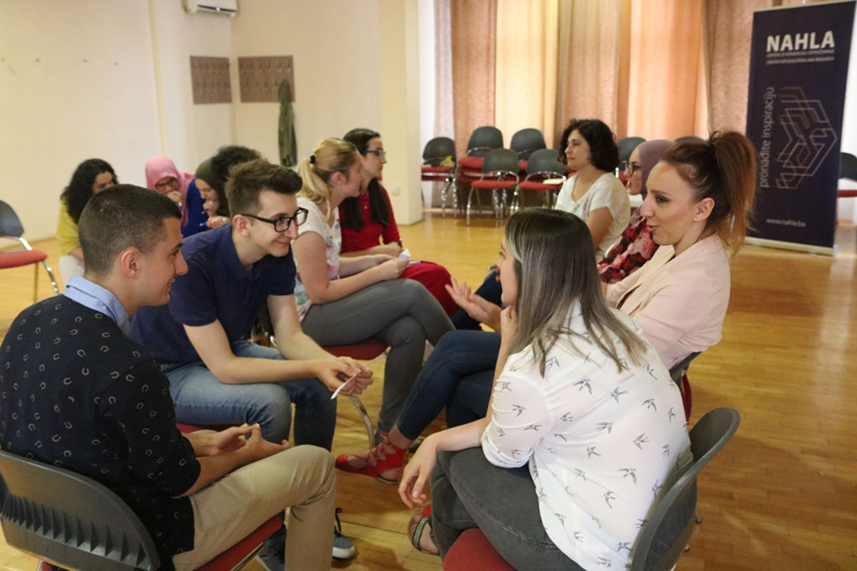
PdhdrEmh( Nahla Center for Education and Research
Notes:
tu mdGud,dfjka miqj" kdya,d ixúOdkh" f.!rjh Èkd we;s yd úYajdiodhl m%dfoaYSh yd cd;sl udOH j, m<jk jd¾;d Ndú;d lrñka trg isÿjk wd.u weoySfï fyda úYajdi ±Ífï ksoyi W,a,x>khùï f,aLk.; lr" tla tla j¾Ifha§ isÿjk ish¨u isoaëka ms<sn| úia;r ,ehsia;=jla iïmdokh lrk ;reK iafõÉPd lKavdhulg tókdj y÷kajd ÿkakd'

Slide 17
;¾ckh lsÍu ^uqia,sïjrekag tfrys mlaImd;S;ajh&
i¾ìhdkq cd;sljdohg iïnkaO ÈkhloS cd;sljdoS ffjÍ .S; jdokh lrñka meñKs fudag¾ r: iuQyhl isá wh tu m%foaYh lrd wdmiq meñKs uqia,sïjrekag ;¾ckh lr Tjqkaj wd.ï úfrdaë wmydihkag ,la lrk ,oS'
foam<j,g myroSu ^l%sia;shdks m%cdjkag tfrys mlaImd;S;ajh&
úfidaflda ^Visoko) k.rfha fplafrlaÑfca ^Čekrekčije) m%foaYfha msysá “Nativity of Holy Mary" keu;s i¾ìhdkq ´;fvdlaia m,a,sfha oS wd.ñl mqrdjia;= mq¿iaid oukq ,eîh'
Notes:
tókd fufia mjihs"—isÿùï j¾.SlrKh lsÍu i|yd wms Ndú;d lrk m%Yak ud,djla ;sfnkjd – WodyrK f,i" n,mEug ,lajkafka l=uk m%cdj o hkak iy isÿ jk W,a,x>khùï j¾. – ;¾ck" foam<j,g myr §u fyda ñksiqkag myr §u hkd§ jYfhka'˜

Slide 18
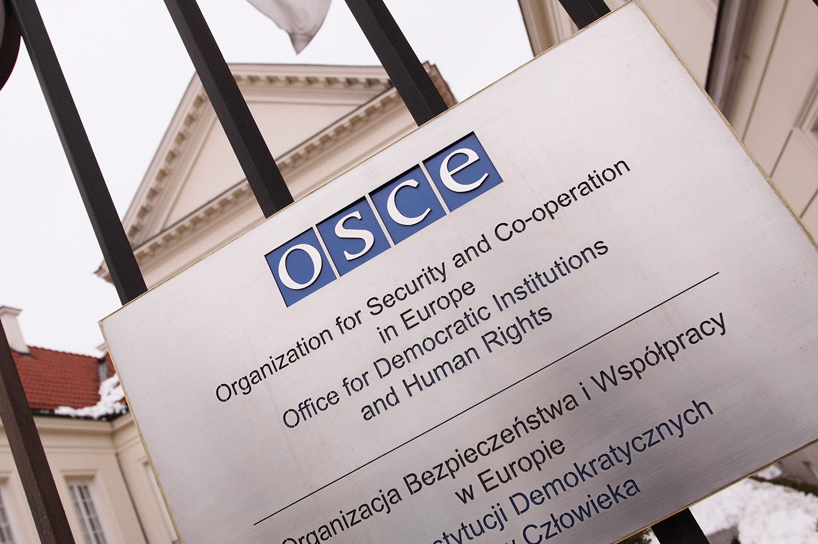
PdhdrEmh( Steven May / Alamy Stock Photo
Notes:
fuu lKavdhu Tjqkaf.a jd¾;d fndiakshdfõ n,OdÍkag iy udOHj,g;a" iafõÉPd fiajlhskaf.ka ,efnk f;dr;=re ks;ru iajlSh jd¾Isl jd¾;djg we;=<;a lrk" hqfrdamfha wdrlaIdj iy iyfhda.S;djh i|yd jk ixúOdkh (Organisation for Security and Cooperation in Europe) (OSCE) jeks cd;Hka;r wdh;k j,g;a ,nd fokjd'

Slide 19
PdhdrEmh( Emina Frljak
Notes:
—uu ys;kafka fl;rï l=vdjg fmkqk;a wmf.a ish¨‍ l%shd jeo.;a n,mEula we;s lrkjd' W,a,x>khùï f,aLk.; lr tajd flfrys cd;Hka;r wjOdkh fhduq lrùu tu isÿùï nrm;, f,i ie,lSug n,OdÍkaj fm<Uùug WmldÍ fjkjd' udkj ysñlï W,a,x>khùï ms<sn|j oekqj;a lsÍu wm ;=< mj;sk mlaI.%dyS;ajhka wjfndaO lr .ekSug;a WmldÍ fjkjd˜ tókd mjikjd'

Slide 20
b;d fyd|hs" idorfhka kej; ms<s.kakjdæ
ó<Õ ieish(
l;kaor j,ska fm<Uùu - Wml%u j,ska iún, .ekaùu

