Slide 1


cs;@u; kl;l khw;wKz;lhf;Feu;fSf;fhd gapw;rp newp

Slide 2

mku;T 5:
vkJ rKjhaj;jpy; kjk; my;yJ ek;gpf;iff;fhd Rje;jpuk;
Notes:
midtiuAk; mku;tpw;F tuNtw;Wf; nfhs;Sq;fs;. fPo;tUtdtw;iw tpsf;FtjD}lhf mku;tpid mwpKfg;gLj;Jq;fs;:
fle;j 3 mku;Tfspy;> kjk; my;yJ ek;gpf;iff;fhd kdpj cupik gw;wp ehq;fs; ghu;j;Njhk;. vq;fsplk; cs;s cupikfs; kw;Wk; epfof;$ba gy;NtW tifahd kPwy;fs; gw;wp mwpe;J nfhz;Nlhk;. ,e;j kdpj cupik ekf;F vg;gb mu;j;jg;gLfpd;wJ vd;gijAk; ehq;fs; rpe;jpj;Njhk; mj;NjhL milahsk;> rYif kw;Wk; ghjfkhd rpf;fy;fis Muha;e;Njhk;.
,e;j mku;tpy;> ntt;NtW egu;fs; my;yJ FOf;fs; vd;ndd;d gpur;ridfis vjpu;nfhs;sf;$Lk; vd;gij milahsk; fhz> vq;fs; nrhe;j R+oiy gFg;gha;T nra;tjpy; ftdk; nrYj;jg; NghfpNwhk;. ehq;fs; xd;whf Nru;e;J ekJ efuj;jpd; kjk; my;yJ ek;gpf;if Rje;jpuj;jpd; 'tiuglj;ij' cUthf;Ftjd; %yk; mijr; nra;ag; NghfpNwhk;. Mdhy; gpur;ridfisg; ghu;f;fj; njhlq;Fk; Kd;> ey;y tplaq;fisg; gw;wp Nahrpg;Nghk;!

Slide 3

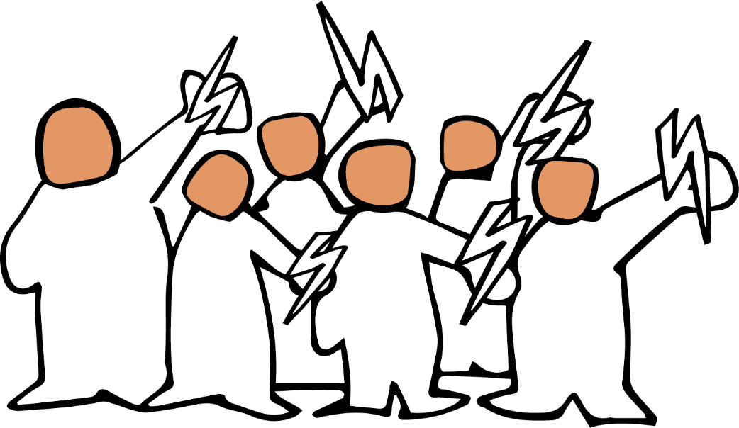
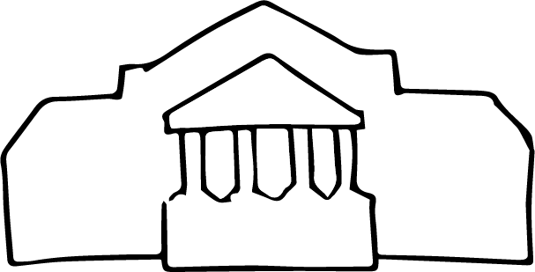
Notes:
3-13 tiuahd ];iyLfs; mku;T 5 ,w;fhd Kd;itg;gpid vLj;Jf; fhl;Lfpd;wd:
vt;thW tplaq;fs; Nkhrkilfpd;wd
mwpKfk;:
fle;j mku;tpy;
kjk; my;yJ ek;gpf;ifapd; Rje;jpuj;jpd; kPwy;fs; vg;gb ,Uf;Fk; kw;Wk; mit kf;fspd; tho;f;ifia vt;thW ghjpf;fpd;wd vd;gjpy; ehq;fs; ftdk; nrYj;jpNdhk;.
tpjpkPwy;fis ahu; nra;fpwhu;fs; vd;W ehq;fs; rpe;jpj;Njhk; - muR> rl;lk; kw;Wk; eltbf;iffs; my;yJ mjpfhupfs; my;yJ r%fj;jpy; cs;stu;fspd; nrayw;w jd;ik>
kw;Wk; ,e;j kPwy;fs; vg;gb ,Uf;Fk; vd;gij Muha;tjw;Fk; mtw;iw milahsk; fhz;gjw;Fk; ehlfj;ij xU fUtpahfg; gad;gLj;jpNdhk;.

Slide 4




Notes:
tpjpkPwy;fs; kpjkhdjhfTk;> NkhrkhfTk; ,Ue;J Nkhrkhd epiyf;Fr; nry;fpd;wd - jdpegu;fisg; ghjpf;Fk; mt;tg;NghJ elf;Fk; rk;gtq;fs;> Kiwahd> gutyhd kw;Wk; kf;fspd; cupikfs; kPjhd fLikahd jhf;Fjy;fs; tiu vg;gbr; nry;fpwJ vd;gijg; gw;wp ,g;NghJ rpe;jpf;fg; NghfpNwhk;.
tplaq;fs; vt;thW Nkhrkilfpd;wd vd;gijg; gw;wp rpe;jpg;gjw;fhf %d;W fl;lq;fisg; gw;wp rpe;jpf;f Ntz;Lk; - jtwhd jfty;> ghFghL kw;Wk; td;Kiw.

Slide 5




jtwhd jftyÊ
Notes:
Jd;GWj;jypd; %d;W fl;lq;fs;
Kjy; fl;lk; jtwhd jfty;. ,e;j fl;lj;jpy;> jdpegu;fs; kw;Wk; kj rpWghd;ikapdu; Nghd;w kf;fs; FOf;fisg; gw;wp jtwhd vz;zq;fs;> epiyahd cs vz;zq;fs; fUj;Jf;fs; kw;Wk; ngha;fs; gug;gg;gLfpd;wd.
,e;j jtwhd vz;zq;fs; gy topfspy; guTfpd;wd - ngw;Nwhu;fs;> Mrpupau;fs; kw;Wk; gs;sp Gj;jfq;fs; Foe;ijfSf;F fw;gpf;fpd;w tplaq;fs;> thndhyp r%f Clfq;fs; my;yJ murpay;thjpfspd; Ngr;Rfs; kw;Wk; kjj; jiytu;fspd; gpurq;fq;fs; %yk;

Slide 6







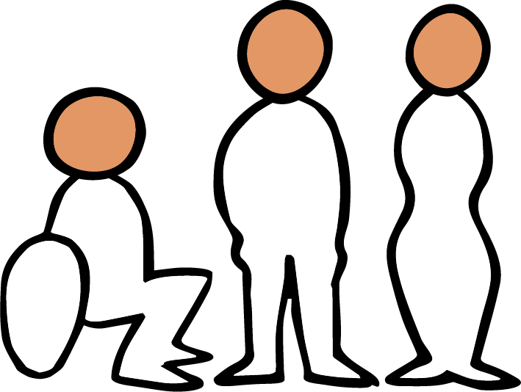
Notes:
ve;jnthU r%fKk; jg;ngz;zj;jpypUe;J tpLgltpy;iy> Mdhy; jg;ngz;zq;fs; kw;Wk; xNu khjpupahdit rthy; nra;ahky; NghFk;NghJ> ​​Fwpg;ghf murpay; kw;Wk; kjj; jiytu;fshy; Cf;Ftpf;fg;gLk;NghJ> ​​​​mtu;fs; rfpg;gpd;ik fyhr;rhuj;ij cUthf;fp FOf;fspilNa mjpf mOj;jq;fis cUthf;Ffpwhu;fs;.
mJ epfOk;NghJ> ​​rhjhuz kf;fSk;> cs;Shu; mjpfhupfSk;> murhq;fKk; $l rpe;jpf;fTk; NgrTk; kl;Lky;y> kw;wtu;fsplk; ghFghL fhl;Lk; tpjj;jpy; nray;glTk; njhlq;FtJ RygkhfNth my;yJ rhjhuzkhfNth MfptpLfpwJ.
jtwhd jfty; ghFghL Vw;Wf;nfhs;sf;$ba xU tlakhf Njhd;w nra;fpd;wJ. kpfTk; jPtpukhd tbtj;jpy;> jtwhd jfty; vd;gJ ghFghL kl;Lky;y> kw;wtu;fsplk; td;KiwAk; Vw;Wf;nfhs;sj;jf;fJ my;yJ rupahdJ vd;W ek;Gtjw;F kf;fisj; J}z;Ltjw;Fg; gad;gLj;jg;gLfpwJ.

Slide 7

ghuglÊrkÊ
Notes:
tho;f;ifapd; xt;nthU gFjpapYk; ghFghL kf;fis ghjpf;fpwJ. fle;j mku;tpy;> khepy ghFghl;bd; vLj;Jf;fhl;Lfisg; ghu;j;Njhk; - cjhuzkhf FLk;gk; kw;Wk; jdpg;gl;l milahsr; rl;lk;> fhty;Jiw kw;Wk; ePjpkd;wj;jhy; nray;gLj;jg;gLk; tpjj;jpy; ghFghL kw;Wk; fy;tp Nghd;w Nritfis toq;Ftjpy; ghFghL fhl;lg;gl;lJ. jdpahu; Jiwapy; ghFghL fhl;lg;gLtjw;fhd cjhuzq;fisAk; ehq;fs; ghu;j;Njhk;> ,J kf;fspd; Ntiy tha;g;Gfis ghjpf;fpwJ.
ve;j r%fKk; ghFghl;bypUe;J tpLgltpy;iy> Mdhy; gutyhd kw;Wk; Kiwahd ghFghL mJ mwpahik kw;Wk; rfpg;Gj;jd;ikapd; fyhr;rhuj;jpd; kPJ fl;likf;fg;gl;lhy; kl;LNk njhlu KbAk;. ngUk;ghd;ikahd kf;fs; mij Vw;ftpy;iy vd;why;> ghFghL elf;fhJ.

Slide 8

tdÊKiw
Notes:
jtwhd jfty; ghFghl;bw;fhd mbj;jsj;ij cUthf;FtJ Nghy;> jtwhd jfty; kw;Wk; ghFghL Mfpait td;Kiwf;F mbj;jskhf mikfpd;wd. r%fj;jpy; td;Kiw gy tbtq;fis vLf;fyhk; - fho;g;Gzu;r;rpapypUe;J Jd;GWj;jy;> mr;RWj;jy;fs; tiu cly;uPjpahd td;Kiw tiu. NkYk; mur td;Kiwapy; jd;dpr;irahd rpiwgpbg;G> rpj;jputij kw;Wk; ghypd mbg;gilapyhd td;Kiw Mfpait mlq;Fk;.

Slide 9
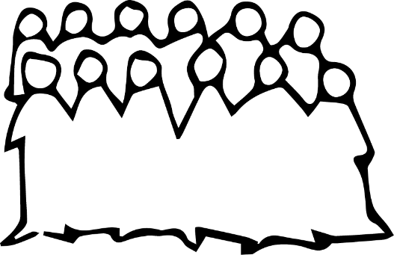


msT
jlitfsÊ
jhfÊfkÊ
Notes:
msT jlitfs;> jhf;fk;
%d;W tifahd gpur;ridfSk; - jtwhd jfty;> ghFghL kw;Wk; td;Kiw ntt;NtW msTfs; kw;Wk; mjpu;ntz;fs; kw;Wk; ntt;NtW mstpyhd jhf;fq;fSld; eilngwyhk;.
xU tpjpkPwy; rpy jdpegu;fs; my;yJ FOf;fis ghjpf;fyhk;.
,J vg;NghjhtJ> tof;fkhd my;yJ Kiwahdjhf ,Uf;fyhk; - mjhtJ r%fj;jpd; mikg;Gfs; kw;Wk; fl;likg;Gfspy; fl;likf;fg;gl;Ls;sJ. NkYk; ,J ghjpf;fg;gl;l kf;fs; kPJ kl;Lg;gLj;jg;gl;l my;yJ NguopT jUk; jhf;fj;ij Vw;gLj;jyhk;

Slide 10

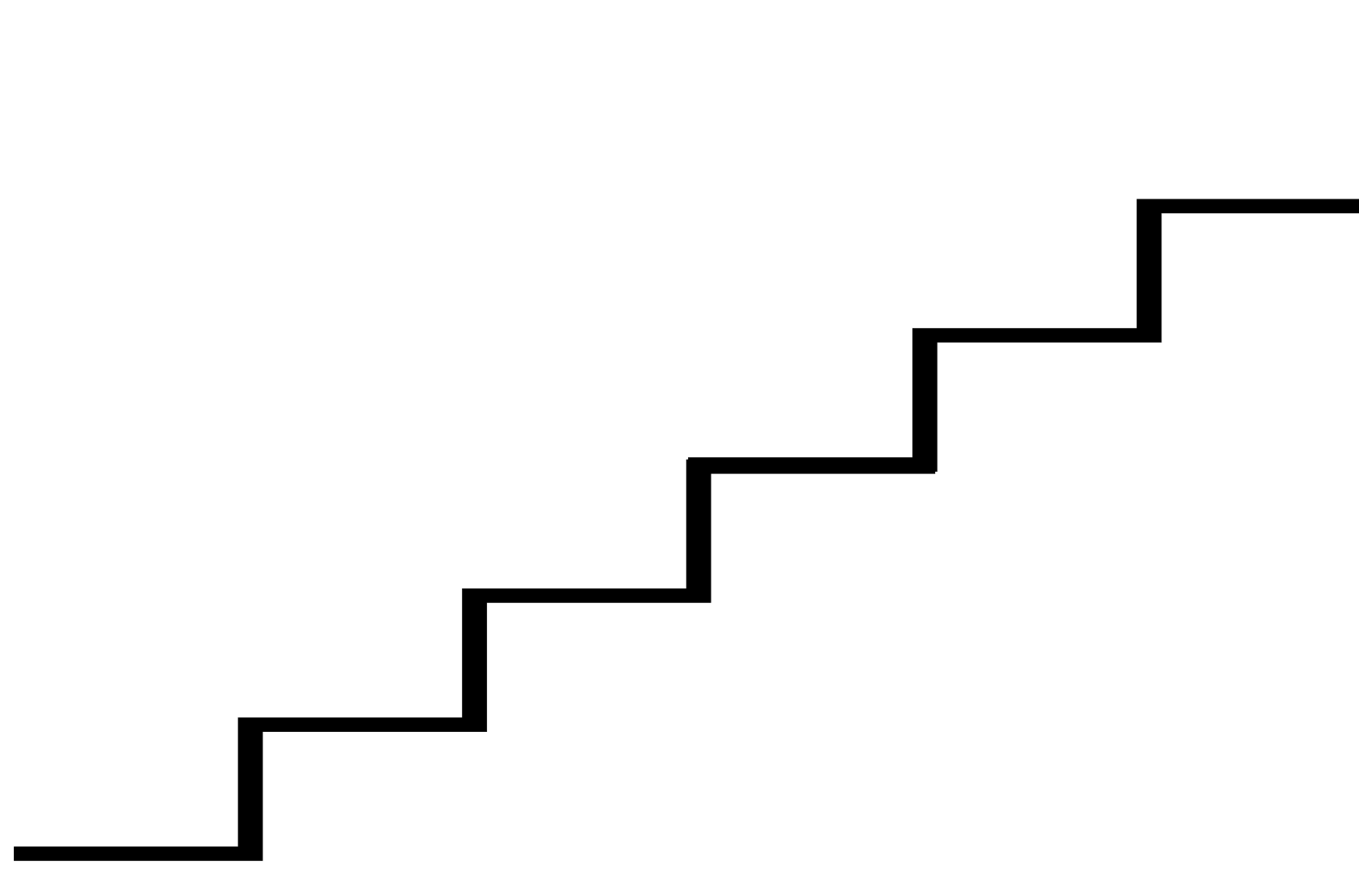


Notes:
gy ehLfspy; cs;s mDgtk; ekf;Fr; nrhy;itj;J ahnjdpy; > vt;tsT gutyhf kw;Wk; fLikahf jg;ngz;zq;fs; kw;Wk; jtwhd jfty;fs; fhzg;gLfpwNjh mt;tsT gutyhd kw;Wk; fLikahf ghFghLk; fhzgg;Lk;.
NkYk; ,it ,uz;Lk; vt;tsT mjpfkhfg; guTfpwNjh> me;j msTf;Fg; gutyhd kw;Wk; fLikahd td;Kiwf;fhd tha;g;Gfs; mjpfk;. xd;W kw;nwhd;Wf;F toptFf;fpwJ.
,J kdr;Nrhu;itj; jUfpw NghJk; tplaq;fs; vt;thW Nkhrkhfpd;wd vd;gijg; Gupe;Jnfhs;tJ> tplaq;fs; vt;thW rpwg;ghf ,Uf;Fk; vd;gijg; gw;wp rpe;jpf;f cjTk;

Slide 11
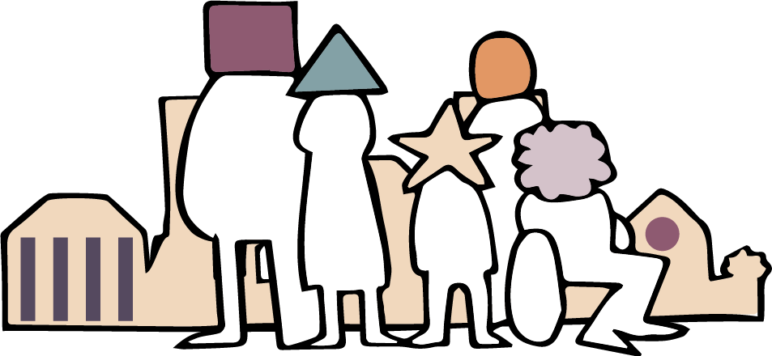
Notes:
epiwT.
vy;yhk; ehk; rpe;jpf;Fk; tpjj;jpy;> NgRk; tpjj;jpy;> xUtiunahUtu; elj;Jk; tpjj;jpy; njhlq;FfpwJ. mJ ek; FLk;gq;fs; kw;Wk; jdpg;gl;l njhlu;ghdtu;fSf;fpilapy; ehk; xt;nthUtUk; nra;af; $bajhFk;. r%f kl;lj;jpy; ehk; ,ijg; gw;wp VjhtJ nra;a KbAk; - cjhuzkhf ekJ ek;gpf;if r%fq;fs;> gs;spfs; kw;Wk; gzpaplq;fspy;.
epr;rakhf> ,J NghjhJ. Nkhrkhd rl;lq;fs; Kjy; gs;sp Mrpupau;fs; my;yJ fhty;Jiw mjpfhupfs; Nghd;w mjpfhupfspd; elj;ij tiu - kf;fisg; ghFgLj;Jk; kw;Wk; jPq;F tpistpf;Fk; mjpfhug;G+u;t mikg;GfisAk; ehk; khw;w Ntz;Lk;

Slide 12

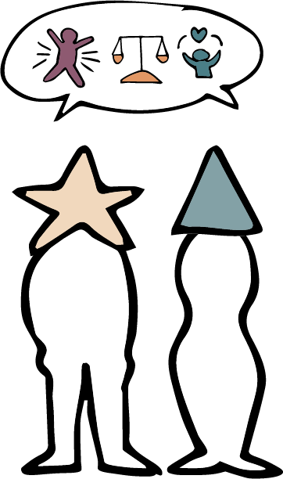
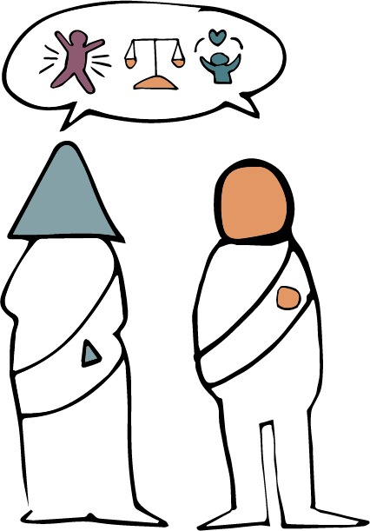
Notes:
mj;jifa khw;wj;ij rhj;jpakhf;Ftjw;F> jkJ cupikfis mwpe;j rpWghd;ikapdu;> mtu;fSf;fhf epw;fj; jahuhf ,Uf;Fk; ngUk;ghd;ikapdu;> kw;Wk; kdpj cupikfis kjpf;f> ghJfhf;f kw;Wk; Nkk;gLj;Jtjw;fhd jq;fs; nghWg;Gfisg; Gupe;Jnfhs;Sk; murpay; kw;Wk; kjj; jiytu;fs; Njit.

Slide 13

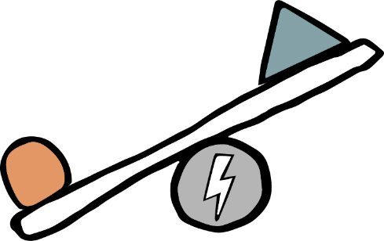


jtwhd jftyÊ – ghuglÊrk; – tdÊKiw
Notes:
,ij ajhu;j;jkhf;FtJ xU nkJthd kw;Wk; fbdkhd nrayhFk;. ekJ R+oiy myrp Muha;e;J> gpur;ridfs; vd;d vd;gij fz;lwpAk; NghJ me;j nray;Kiw njhlq;FfpwJ.
,jidr; nra;a vq;fSf;F cjt ,e;j %d;W fl;l khjpupahd - jtwhd jfty; - ghugl;rk; - td;Kiwiag; gad;gLj;jyhk;

Slide 14
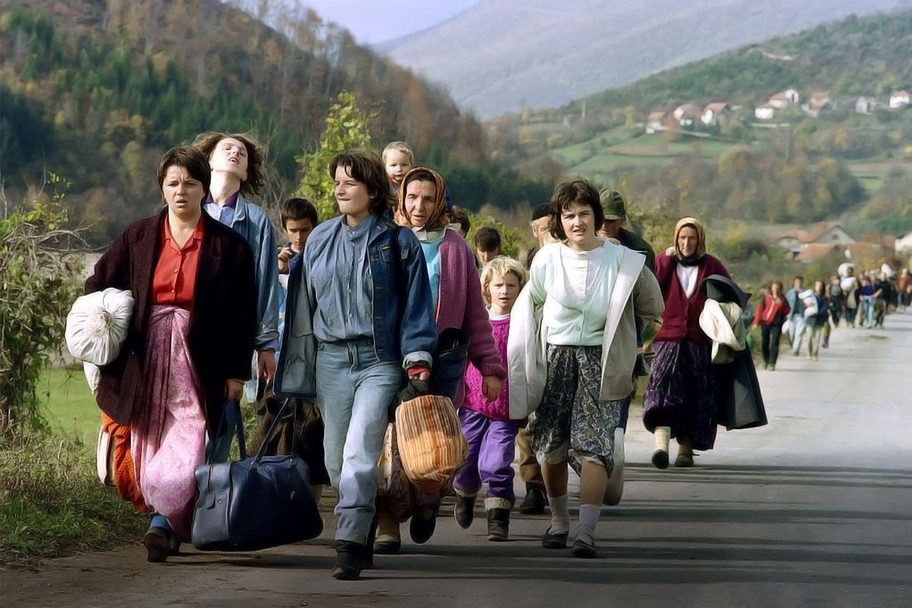
Photo: Patrick Baz / Getty Images
Notes:
14-19 tiuahd ];iyLfs; vkpdhtpd; fijapid tpsfÊFfpd;wd- ,J mku;tpw;fhd epiwT nra;fpd;w fUj;Jf;fspd; xU gFjpahFk;.
vkpdhtpd; fij> Ngh];dpah n`u;rNfhtpdh
1995 ,y; Ngh];dpag; Nghupd; Kbtpy;> Ngh];dpah n`u;rNfhtpdpahtpd; kjuPjpahd epyg;gug;G tpaj;jF Kiwapy; khwpaJ.
K];yPk; ngUk;ghd;ikahf ,Ue;j rpy gFjpfs; fpwp];jtu;fs; ngUk;ghd;ikahf khwpaJ.
,d kw;Wk; kj gjl;lq;fs; mt;thNw ,Ue;j epiyapy;> NkYk; jq;fs; nrhe;j gFjpfSf;Fj; jpUk;Gk; kf;fs; Fwpg;ghf ghjpf;fg;glf;$batu;fshf fhzg;gl;ldu;.

Slide 15
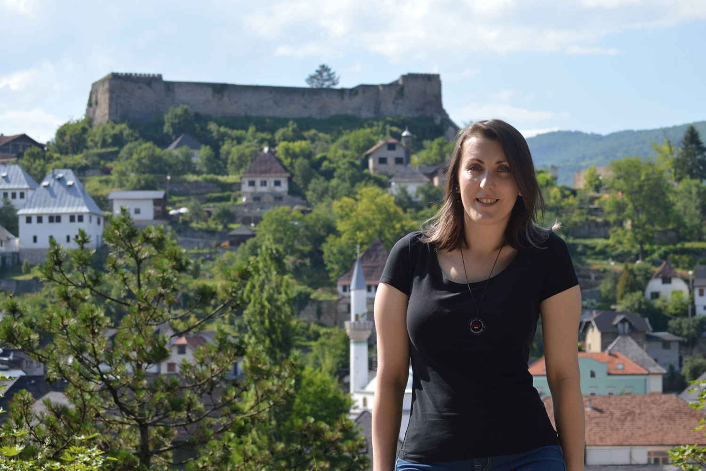
Photo: Emina Frljak
Notes:
,tu; vkpdh> ,tu; rhjfkhd khw;wj;jpw;F gq;fspf;f tpUk;gpdhu;> vdNt e`;yh vdg;gLk; Ngh];dpa muR rhuh epWtdj;jhy; elj;jg;gLk; rpwpa kdpj cupikf;fhd ghl newpf;fhd gapw;rp tFg;ig Nkw;nfhz;lhu;. "ehd; ,g;ghl newpapd;%yk; epiwa tplaq;fis ngw;Wf;nfhz;Nld;. kj Rje;jpuk; my;yJ ek;gpf;if vd;why; vd;d vd;gij ehd; Gupe;Jnfhz;Nld;> NkYk; vdJ nrhe;j R+oypy; kPwy;fis milahsk; Muk;gpj;Njd;. ehd; r%f Clfq;fspy; ntWg;Gg; Ngr;Rf;fs; njhlu;ghf Gfhuspf;f Muk;gpj;Njd;”

Slide 16
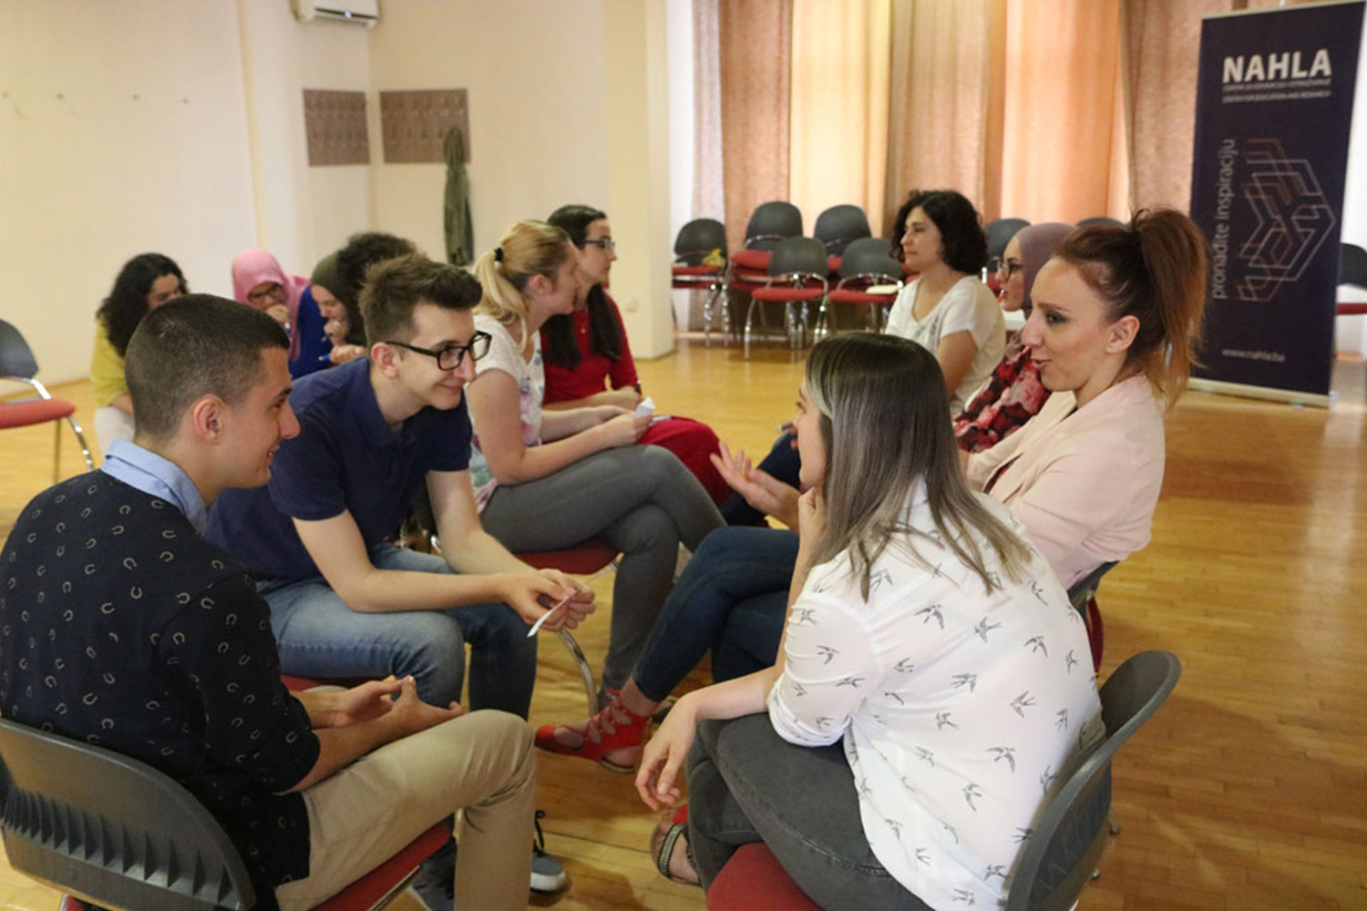
Photo: Nahla Center for Education and Research
Notes:
,g;ghlnewpf;Fg; gpwF> ehyh`;> vkpdhtpw;F> ehlshtpa uPjpapy; kj my;yJ ek;gpf;if Rje;jpu kPwy;fs; gw;wpa nra;jpapid ntspapLk; kupahijf;Fupa kw;Wk; ek;gfkhd cs;Shu; kw;Wk; Njrpa Clfq;fspd; mwpf;ifapid cgNahfpj;J xt;nthU Mz;Lk; elf;Fk; midj;J rk;gtq;fspd; gl;baiyj; njhFj;jJ mwpf;iffshf ntspapLk; ,sk; jd;dhu;tj; njhz;lu;fs; FOit mwpKfg;gLj;jpaJ.

Slide 17
mr;RWj;jy; (K];ypk;fSf;nfjpuhd gf;fr;rhu;G)
nru;gpa Njrpaj;Jld; njhlu;GWfpd;w ehnshd;wpy; Njrpa ntWg;G ghly;fis ,irj;Jf; nfhz;L Nkhl;lhu; fhu; thfd gtdpnahd;W> K];ypk;fspd; fpuhkj;jpD}lhf nrd;wNghJ> ehl;bw;F kPsj; jpUk;gpUe;j K];ypk;fs; mr;RWj;jg;gl;lJld;> mtu;fs; K];ypk;fSf;nfjpuhd mtkhdg;gLj;jy;fSf;Fk; cl;gl;ldu;.
nrhjÊJfÊfs; kPjhd jhfÊFjyÊ (fpwp];jtu;fSf;nfjpuhd gf;fr;rhu;G)
tpNrhNfh efupd; Čekrekčije ,y; cs;s Nel;btpl;b> Gdpj Nkup nru;gpa Mu;j;jlhf;]; Njthyaj;jpd; kj fiyg;nghUl;fs; vupf;fg;gl;ld.
Notes:
vkpdh gpd;tUkhW $Wfpwhu;> "vk;kplKs;s rpy Nfs;tp njhFjpfs; %yk; rk;gtq;fis tifg;gLj;JfpNwhk;> cjhuzkhf> ve;j r%fk; ghjpf;fg;gLfpwJ kw;Wk; kPwy;fspd; tif vd;d - mr;RWj;jy;fs;> nrhj;Jf;fs; kPjhd jhf;Fjy;fs; my;yJ kf;fs; kPjhd jhf;Fjy;fs; Nghd;wit."

Slide 18
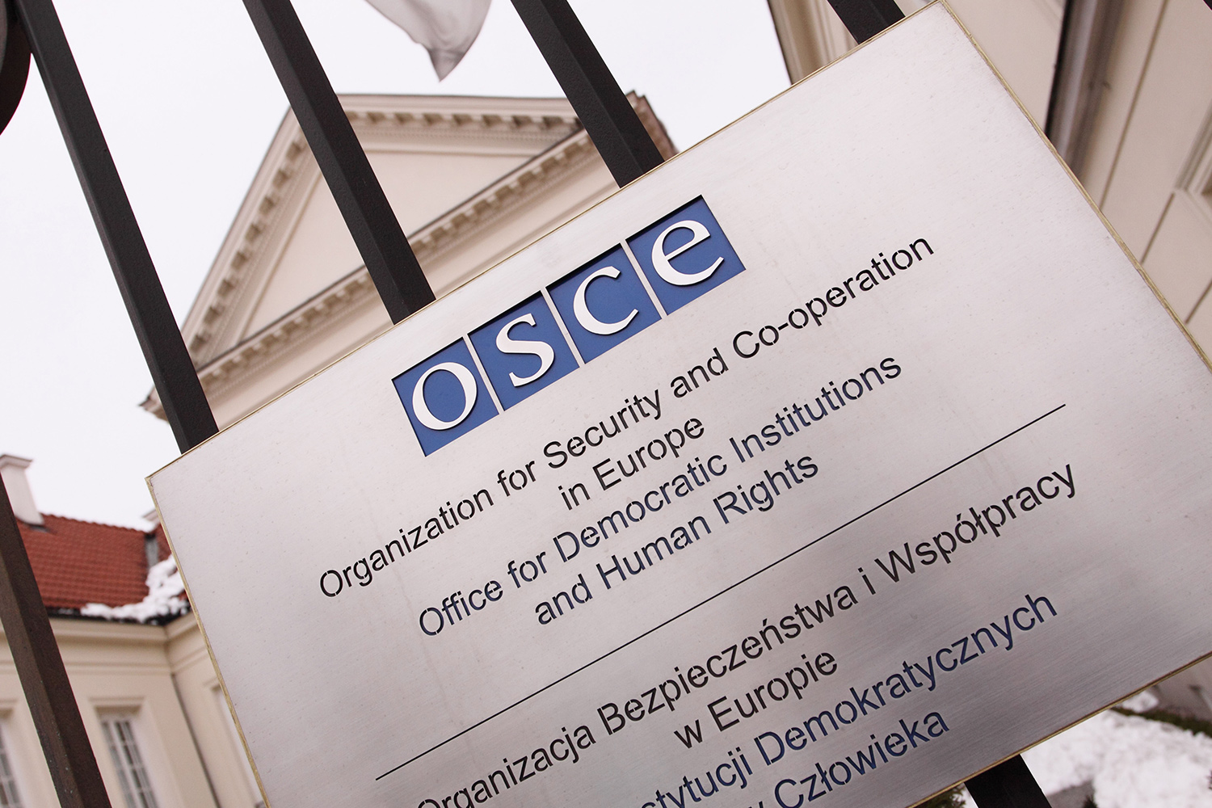
Photo: Steven May / Alamy Stock Photo
Notes:
,f;FO> ngh];dpahtpy; cs;s mjpfhupfs; kw;Wk; Clfq;fSf;Fk;> INuhg;ghtpy; ghJfhg;G kw;Wk; xj;Jiog;Gf;fhd mikg;G (OSCE) Nghd;w ru;tNjr mikg;GfSf;Fk; jq;fs; mwpf;iffis mDg;GfpwJ> ,jpy; ngUk;ghYk; jd;dhu;tyu;fspd; tUlhe;j mwpf;ifapd; jfty;fNs cs;slq;Fk;.

Slide 19
Photo: Emina Frljak
Notes:
"vq;fs; nray;fs; midj;Jk; rpwpajhfj; Njhd;wpdhYk; mit khw;wj;ij Vw;gLj;Jk; vd;W ehd; epidf;fpNwd;. kPwy;fis Mtzg;gLj;Jjy; kw;Wk; ru;tNjr ftdj;jpw;F nfhz;L tUtJ> gpur;rpidfis jPtpukhf vLj;Jf;nfhs;s mjpfhupfis tw;GWj;j cjTk;. kdpj cupik kPwy;fs; gw;wpa tpopg;Gzu;it Vw;gLj;JtJ> ekJ nrhe;j ghugl;rq;fisg; Gupe;Jnfhs;s cjTfpwJ".vd vkpdh njuptpf;fpd;whu;.

Slide 20

rpwgÊghf KbeÊjJ kPzÊLkÊ tUf
mLjÊj mkuÊT :
fijfspdhy; <u;f;fg;gly; - cj;jpfspdhy; tYg;ngwy

