Slide 1
The Local Changemakers Course

Slide 2
SESSION 6
Inspired by stories
- Empowered by tactics
Notes:
Welcome everyone to the session and explain the following:
In the sessions so far, we have learned about human rights, about the right to freedom of religion or belief and about violations of the right. We’ve also mapped what FORB violations look like in our community.
From now on we are going to focus on action! In this and the next session, we are going to discover a range of different methods or tactics that can be used to promote human rights and think about how we could use these tactics. In the final two sessions we will focus on developing action plans.
We are going to start by hearing three stories of people who are making change for freedom of religion or belief in their communities.

Slide 3
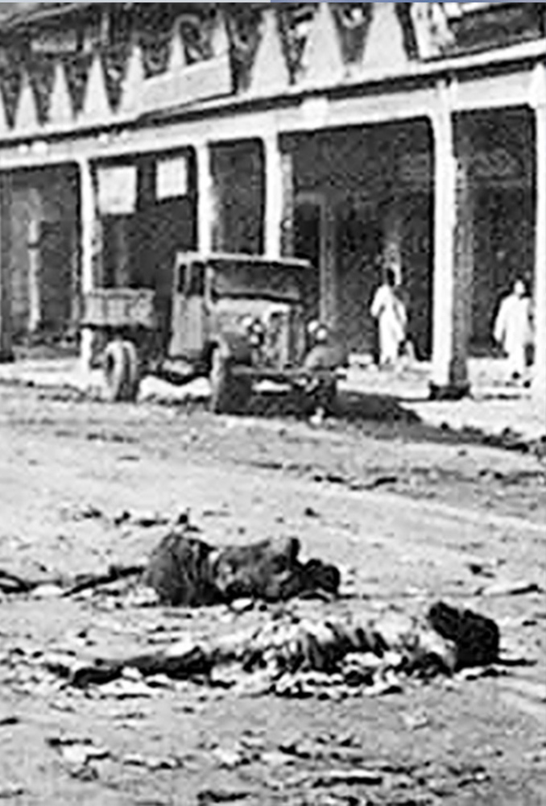
Bhagalpur, India
Riots of 1989
Photo: Vikramvisu / Shutterstock Photo:Unknown
Notes:
Changemaker story buzz group exercise Slides 3-10 illustrate the 3 changemaker stories from the exercise.
Rahul’s story
Rahul lives in Bhagalpur in eastern India. About 80% of the city’s population is Hindu and 18% Muslim, and the city has a history of violence. In 1989, over 1000 Muslims were reported dead after riots that displaced 50,000 people.

Slide 4
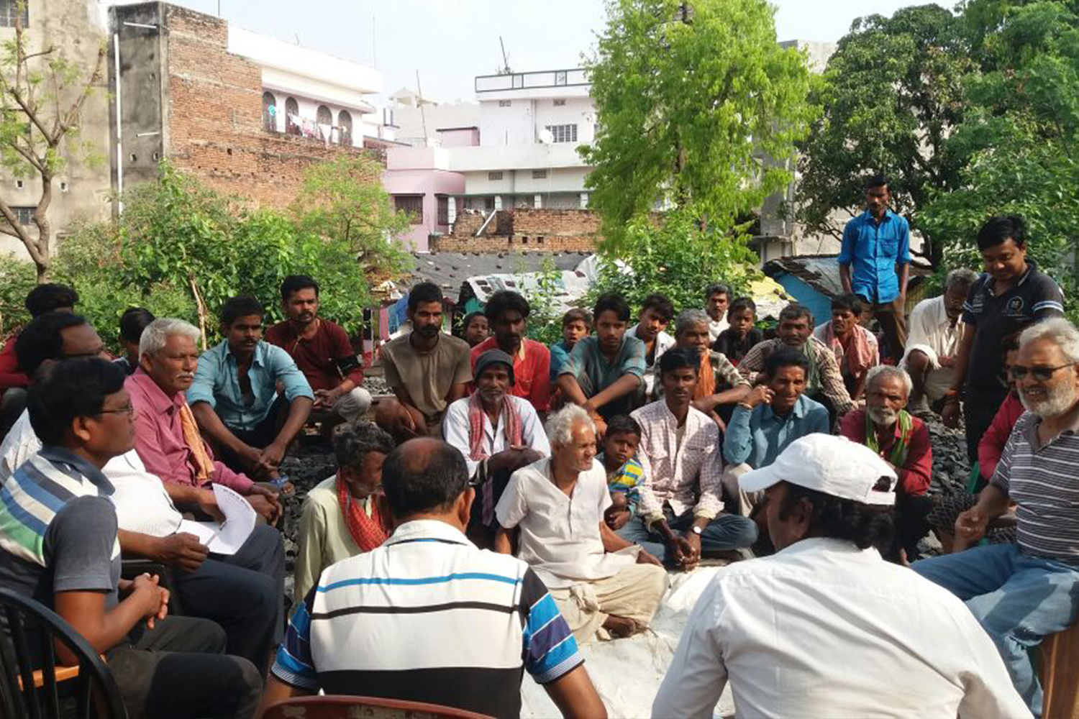
Peace committee meeting
Photo: Supplied
Notes:
Rahul, a Hindu, is involved in the interfaith peace centre in the city. They work to build relationships and trust across divides, for example through peace committees, by arranging an annual cultural festival and by connecting religious leaders. This long-term peace work forms a foundation from which urgent action can be taken when events begin to spiral out of control. This is needed all too often.

Slide 5
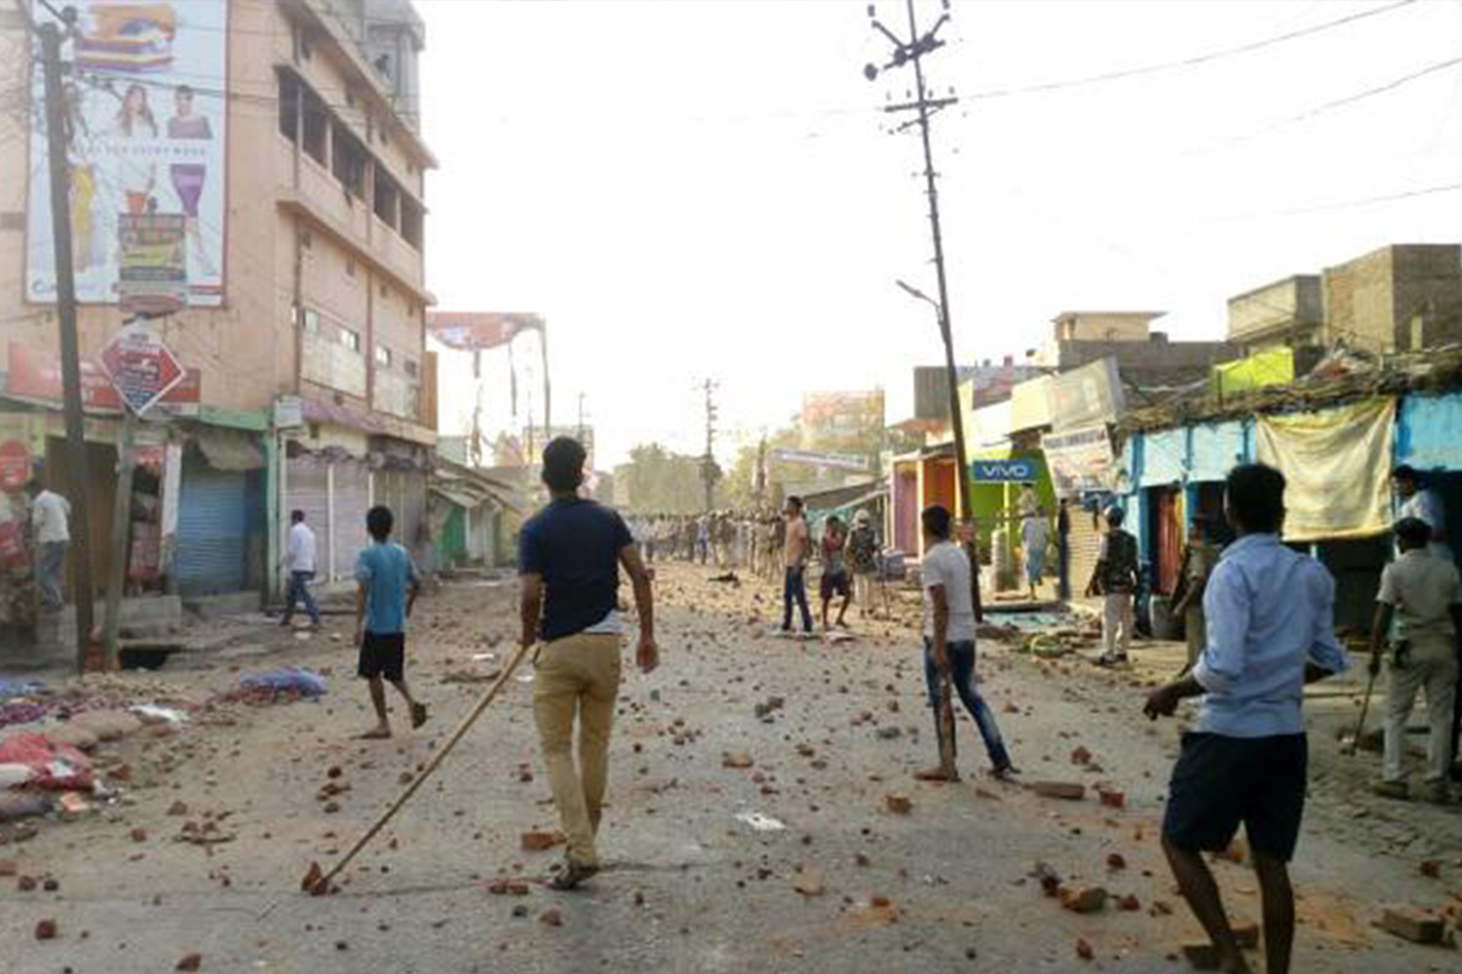
Modern day rioting in
Bhagalpur
Photo: David Talukdar / Alamy Stock Photo
Notes:
Violence is particularly common during election campaigns. In 2019, a Hindu nationalist election candidate led a parade through a Muslim area and used hate speech taunts to try to spark a riot. When some Muslim youths shouted back angrily, the candidate started the violence, which led to shops and homes being damaged. There was a serious risk that rioting would spread to other areas and become more violent. Rahul and his colleagues knew how dangerous this could be.

Slide 6
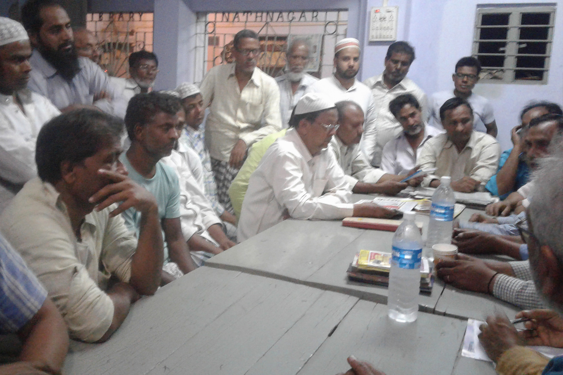
Neighbour- hood peace group
Photo: Supplied
Notes:
In the following days, Rahul and his colleagues held community meetings in the Muslim and Hindu neighbourhoods most at risk of violence. At the meetings, groups of peace volunteers were formed, who went from door to door in their own neighbourhoods.
Rahul says: It was important that men and women went together in pairs, so that there was someone who could talk freely with whoever opened the door.

Slide 7
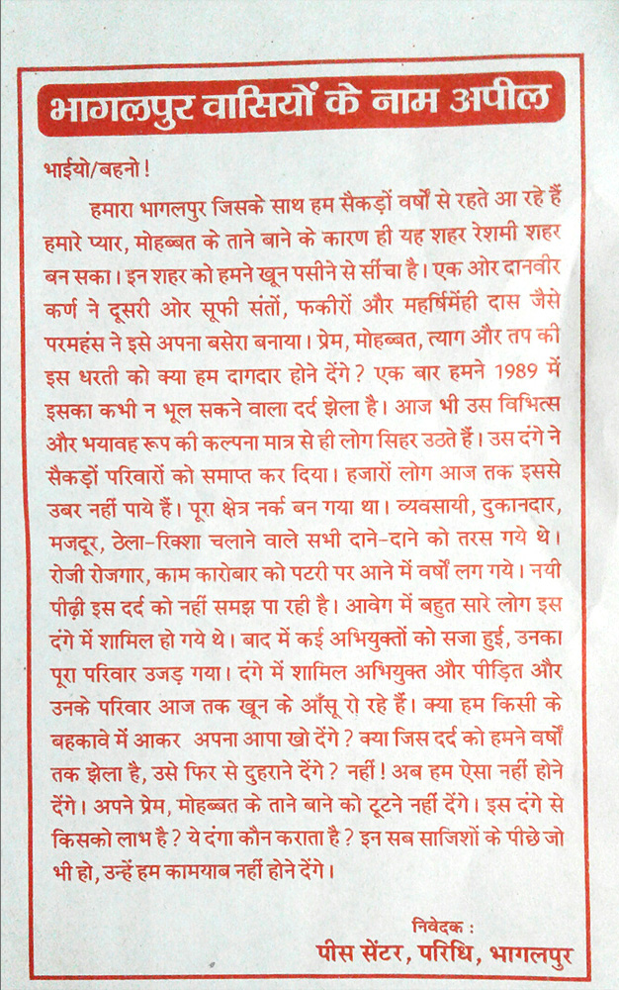
Leaflets handed out by the volunteers
Photo: Supplied
Notes:
The volunteers handed out leaflets and talked and listened to their neighbours, emphasising how rioting would make things worse for everyone, regardless of religion. Thankfully the neighbourhood meetings and volunteers helped calm the situation in the city.

Slide 8
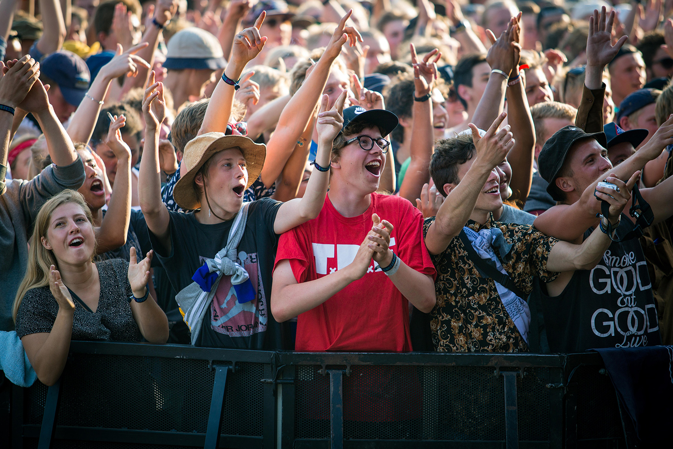
Roskilde music festival, Denmark
Photo: Gonzales Photo / Alamy Stock Photo
Notes:
Don’t judge a book by its cover – The Human Library™, Denmark
In the mid-1990s four friends started a youth organisation to campaign against urban violence. Its membership grew and the organiser of a Danish music festival asked them to come up with an idea for an event to foster dialogue between festival visitors. They came up with the idea of a human library from which visitors can borrow human ‘books’: people who are willing to engage in respectful conversations about their identity, life experiences and opinions.

Slide 9
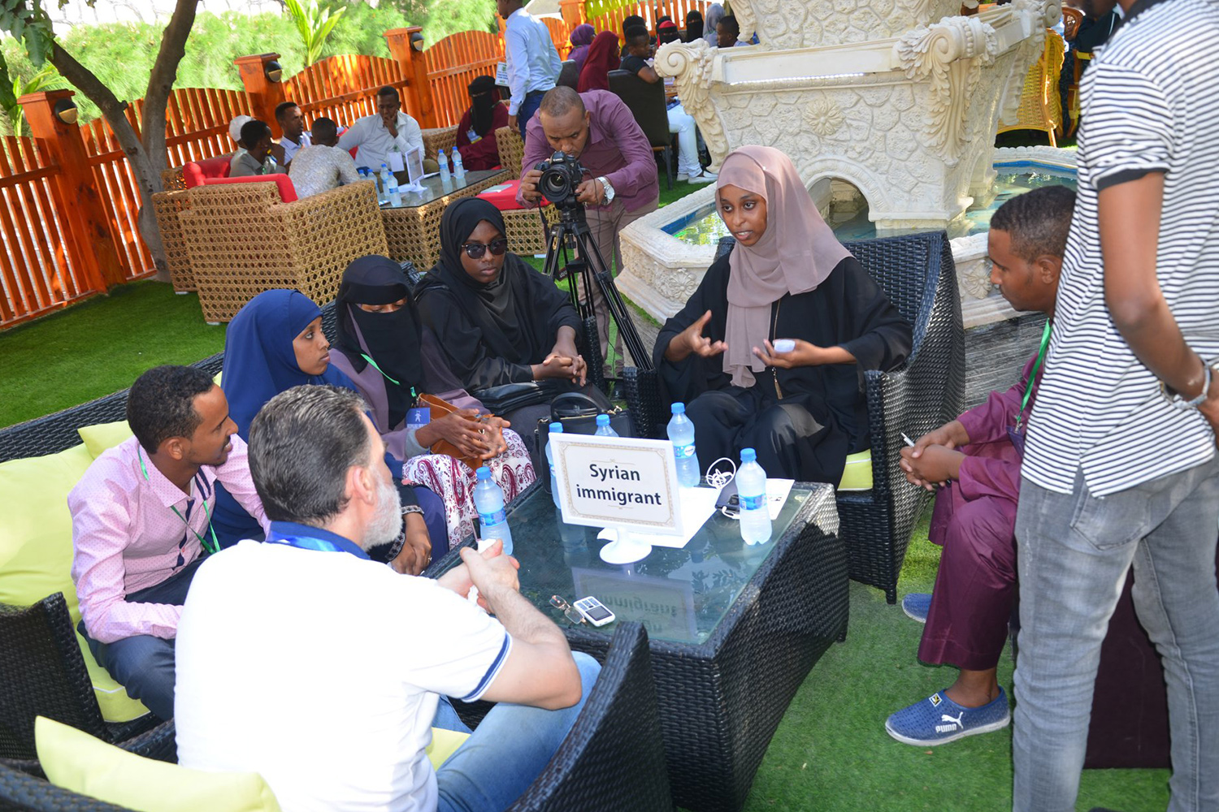
Human library event, Somalia
Photo: Human Library Organisation
Notes:
Usually, human books are people from the local community who volunteer to let their ‘story’ be a learning experience for others, reducing misinformed stereotypes. Volunteers are typically people for whom an aspect of their identity is associated with prejudice or stigma – for example their religion, belief, ethnicity, sexual orientation, disability or HIV positive status. The Human Library™ Organisation now has activities in over 85 countries.

Slide 10
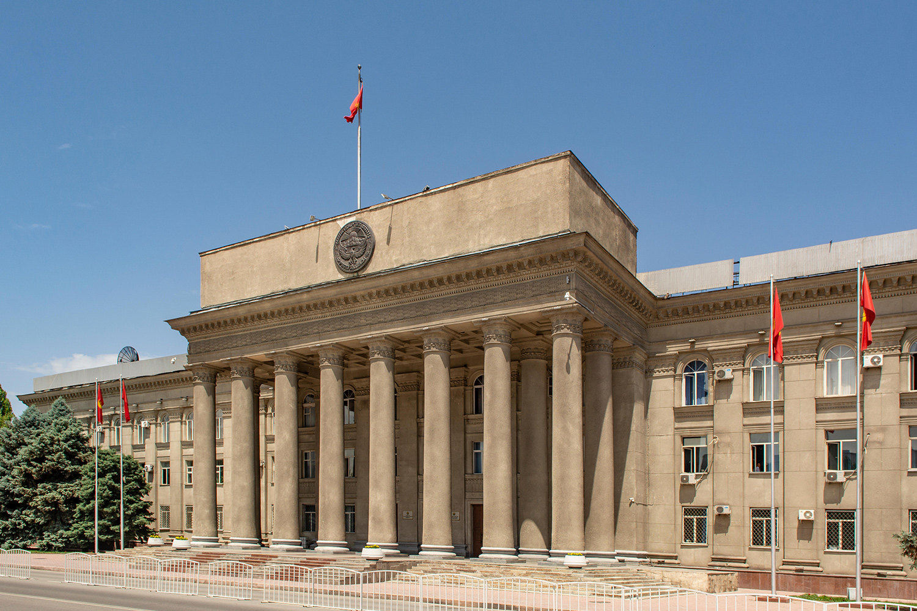
Parliament house, Kyrgyzstan
Photo: Robert Wyatt / Alamy Stock Photo
Notes:
Persuading power to act, Kyrgyzstan
Following the revolution of 2010, a small gang of intolerant vandals started looting places of worship belonging to Protestant and Orthodox Christian denominations. The attacks continued for about six months. Despite many complaints, there was no reaction from the Prosecutor’s Office, the State Commission on Religious Affairs or the Ministry of Internal Affairs. The authorities even advised the communities to deal with the issue themselves.
Frustrated, religious leaders got together to contact a national newspaper to highlight the incidents and the authorities’ inaction. Information reached the President who took the case under her direct control. All the gang members were caught within 4 days.

Slide 11
Healers
Build relationships
Work together
Seek information
Plan and prepare
Notes:
Bystander-Healer exercise Use this slide when concluding the exercise, making the following points.
We can take conscious decisions to become healers instead of bystanders, for example by building relationships with people who are affected by rights violations, getting organised in groups, seeking out the information we need and planning how we want to act together.
We won’t always be able to act – it won’t always be safe or constructive to do so! But we’ll be more likely to act and more effective if we build relationships and work together.
Point to the FORB map of our town flip chart sheets. Ask people to silently think about which of the problems that they identified they would like to be a healer for. (Allow a moment for people to think, but don’t invite responses.)
In the remaining sessions, we are going to think about HOW to go from being bystanders to healers in relation to these problems.

Slide 12
Who am I exercise
What could I do?
What could we do?
What can we encourage others to do?
Notes:
Who am I exercise
Use this slide when concluding the exercise, making the following points.
In each of the different settings we identified, we can play the role of being a bystander or a proactive healer. We could be a resource promoting Freedom of Religion or Belief in and through these networks and groups.
In everything you hear and do in the rest of the course please think about 3 questions.
What could I do? For example, in my role as a parent, a child, a friend or a neighbour. What could I do through my role at work or through roles I have in my private life – in my faith community for example?
What could we do? If we get organised and work together. Could my faith community, youth group or workplace take an initiative for example.
What could we encourage other people/organisations to do? There are things we can’t do that others can do – perhaps another faith community, or the local school rector. Who could we encourage to act?

Slide 13
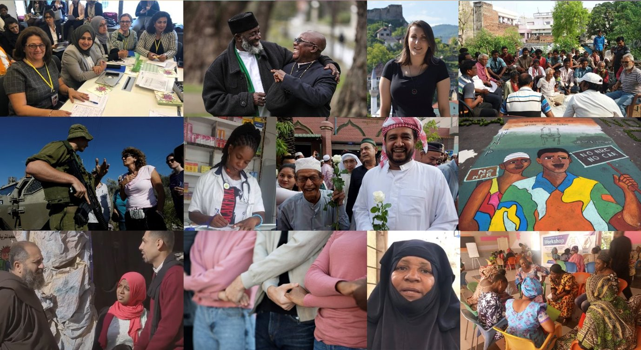
Notes:
Slides 13-24 illustrate the session 6 presentation
Presentation: Tactics for promoting human rights
In this and previous sessions, we’ve heard stories about different people doing different things to try and make the situation for freedom of religion or belief better in their community. We’ve also reminded ourselves of the problems for FORB in our community (point to the FORB in our town flip chart sheets).
We are now going to learn about different tactics that can be used to promote and protect human rights at the community level. And we are going to think about how we could use these tactics to tackle the problems we’ve identified in our community.

Slide 14
Definition: Tactics
A planned set of actions done to achieve a goal.
Notes:
So, what do we mean by tactics? Tactics are defined as ‘a planned set of actions done to achieve a goal’.

Slide 15
Notes:
There are four different types of tactics for human rights work. To help explain these four types of tactics we can think about Fire as a metaphor to represent human rights violations. Not a nice fire that we sit around to get warm, but a dangerous, out of control fire. Just like human rights violations, fires harm people – they traumatise, injure and kill people, and destroy property and land.
So how do we stop fires? We do four types of things:

Slide 16
Emergency tactics
Prevent
Stop and save
Call for help
and warn
Notes:
A: Emergency tactics Emergency tactics are about stopping fires before they start, putting out fires and saving people. What would you do if you saw a child playing with matches? You would blow the match out and take the matches away! You would try to prevent the fire from starting. If you were too late and a small fire had started already, you might try to put it out yourself, with a fire extinguisher or a bucket of water. You would try to protect the people and property at risk by stopping the fire. And if the fire was too big for that, you would call for help from the fire brigade and warn people to get out.
Emergency tactics for human rights are just like this! We use emergency tactics for human rights abuses that are about to happen or happening now to particular people, in particular places. That might mean intervening directly to prevent or stop an abuse and to save people or it might mean calling for help and warning people who are in danger.

Slide 17
Harassment
Hate speech
Vandalism
Assault
Attacks on places of worship
Communal violence
Arbitrary arrests
Notes:
So, what kind of FORB violations might we use ‘emergency’ tactics for? Harassment, hate speech, assaults, vandalism of property, attacks on places of worship, communal violence and arbitrary arrests are all examples of violations that can happen to specific people or groups, in specific places, at specific times.
Although emergency tactics respond to immediate events like these, they require us to be prepared. To know what to do. Just as people learn the number of the fire brigade or learn how to use a fire extinguisher, we can learn about ways to prevent, stop and call for help when human rights violations happen.

Slide 18
Notes:
B: Change tactics Fires happen and spread for reasons – for example dangerous electrical wiring. Change tactics are about changing the situations that lead to fires happening – for example making sure there are building regulations that ensure that wiring is safe. Human rights violations happen for reasons too – for example because society doesn’t have the rules needed to protect people or because the people who are meant to ensure those rules are followed don’t do so. Because society is ‘wired’ wrongly.

Slide 19
Change tactics
Campaigning
Advocacy
Incentives
Defiance
Notes:
Many human rights violations can only be solved by convincing people to change the rules or the way things are done.
We can do that in 4 different ways:
by campaigning and protesting to highlight the problem,
by persuading people who have the power to change things that they should do something about the problem – let’s call this advocacy,
by providing incentives for people to behave differently,
or by peacefully defying bad laws or social norms to show that we don’t accept them.
These are change tactics. They tend to focus on longer-term, more systematic problems in society – that affect lots of people in many places.

Slide 20
Notes:
C: Building tactics
Another way we can work to stop fires is by building public awareness and changing attitudes, for example awareness of the dangers of throwing cigarette butts on dry ground. We can also build public engagement – getting more people involved in volunteer fire fighting and build skills – for example making sure people know how to use a fire extinguisher.
In relation to human rights, building tactics are about the long-term work to build a culture of human rights. That means working towards a society in which everybody knows their rights and the rights of others, sees respect for human rights as normal and right, knows HOW to respect and stand up for other people’s rights and what to do if rights are violated.

Slide 21
Building tactics
Awareness
Engagement
Skills
Networks
Notes:
Building this kind of society involves doing 4 things:
Building awareness of the importance of human rights, and awareness of the violations taking place and the damage they do.
Building engagement – getting more and more people to be committed to taking action to promote human rights.
Building skills – so that people know how to promote human rights.
And building networks of people and organisations, who are doing different things in different places, but working towards common goals in a co-ordinated manner.
These are long term tactics that create the pre-conditions for change. They build a foundation for us to stand on when we use all the other tactics.

Slide 22
Notes:
D: Finally, we have Healing tactics
Just like fires, human rights violations damage people, property and communities. Healing tactics are about what we do to look after people after human rights violations have taken place.

Slide 23
Healing tactics
Material and psychosocial support
Document violations
Seek justice
Commemorate
Notes:
Partly, this is about making sure people get the medical, material and psychosocial support they need to recover. But it’s also about dignity and justice.
About documenting what happened to make sure it can’t be swept under the carpet,
about giving people the opportunity to speak of and commemorate what happened,
and about making sure people get justice and compensation.

Slide 24
Prevent Stop and save
Call for help and warn
Campaigning Advocacy
Incentives
Defiance
Awareness Engagement
Skills Networks
Support
Document
Seek justice
Commemorate
Notes:
CONCLUSION
All these different ways of working are important for promoting human rights. They complement, overlap and can be used in parallel with each other.
No one person or organisation can use all the tactics – we have different roles, skills and opportunities that rightly affect our choice of which tactics to use. The important thing is that everyone can do something and that between us, through networks of people and organisations who are pulling in the same direction, we can do make things change.
We can all contribute to stopping the fires of human rights violations and building a society where human rights are respected in our homes and communities and by our governments.

Slide 25
Harassment
Hate speech
Vandalism
Assault
Attacks on places of worship
Communal violence
Arbitrary arrests
Notes:
Taking emergency tactics exercise
Introduce the exercise by making the following points and showing this slide.
In the rest of this session, we are going to focus on Emergency tactics and think about if we could use them to tackle FORB related problems in our communities. We’ll look at the other tactics in the next session.
Through this exercise we’re going to both learn about emergency tactics and brainstorm as many ideas as possible for action in our community. Thinking – what can I do, what can we do and what could we encourage others to do?
But before we start, let’s remind ourselves of what constitutes a FORB ‘emergency’.
Emergency tactics are used when a specific human rights abuse is happening or about to happen to a specific person in a specific place. So, what kind of FORB violations are we trying to tackle with these tactics?
Harassment – for example street harassment of minority women
Hate speech (online or in person)
Hate crimes such as vandalism or assault
Attacks on places of worship
Communal violence or
Arbitrary arrests

Slide 26
Healers
Build relationships
Work together
Seek information
Plan and prepare
Notes:
Concluding comments Conclude the session by sharing the following comments, showing slides 26-28:
Earlier in the session we talked about ways to move from being bystanders to being healers. We talked about building relationships, working together, seeking information and planning and preparing.

Slide 27
Preparing to use emergency tactics
Identify potential violations – who, what, where, when
Identify possible responses
Get together
Get informed
Assess risks
Notes:
In relation to emergency tactics, this involves asking the kinds of questions we’ve just been discussing, for example:
Identifying who might be affected by FORB emergencies, where and when.
Thinking about how we could respond to these emergencies in advance of them happening.
For example: How do I personally want to act when I see hate speech on social media or harassment on the street?
Or do we want I develop a more organised, proactive response as part of a group that plans, prepares and acts together?
Checking if we have all the information and contacts we need to be able to respond?
And of course, assessing risks to make sure we stay safe and don’t make things worse.

Slide 28
Emergency tactics
Change
tactics
Building
tactics
Healing
tactics
Notes:
Of course, it may be that Emergency tactics aren’t the tactics we want to use. For example, we may be better placed to work with building awareness or campaigning for change. No-one can or should try to do everything!
In the next session, we are going to learn about and brainstorm action ideas for change tactics, building tactics and healing tactics. We’re aiming to gather as many action ideas as possible!
Then, in the last two sessions of the course, we will start narrowing things down – thinking about which problems we actually want to tackle, and which of the actions we’ve identified will be most effective and realistic for us to use.
Conclude the session by thanking everyone for their active participation.

Slide 29
Well done and welcome back!
Next session: Talking tactics

