Slide 1


Koyarwar Masu kawo Sauyi na Asali

Slide 2

SASHI NA 6
Labaru masu burgewa wa ɗanda suka sami ƙarfafawa daga dabaru
Notes:
A yi maraba ga dukkan mahalarta sannan ayi bayani dangane da wadannan abubuwan:
A cikin darusan da muka gabatar, mun yi duba game da 'Hakkin Ɗan’Adam, sannan kuma yancin addini da imani tare da take wadannan haƙƙoƙin. sa’annan kuma mun yi taswirar take yancin addini ko imaniYAKI a cikin al’ummarmu.
Daga yanzu, za mu mai da hankali kan ayyuka! A wannan sashin da na gaba, za mu gano dabaru daban-daban da za a iya amfani da su don kare hakkin Ɗan’Adam, sannan mu yi tunani kan yadda za mu iya amfani da su. A sashin ƙarshe, za mu mayar da hankali kan tsara tsare-tsaren aiki.
Za mu fara ne da jin labaran mutane uku da suka yi sauyi don kare ‘yancin addini ko aƙida a al’ummominsu.

Slide 3
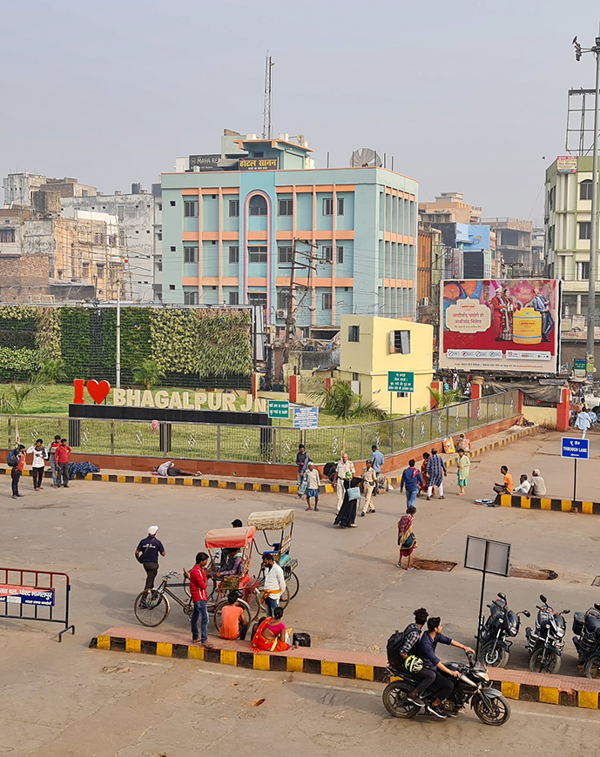
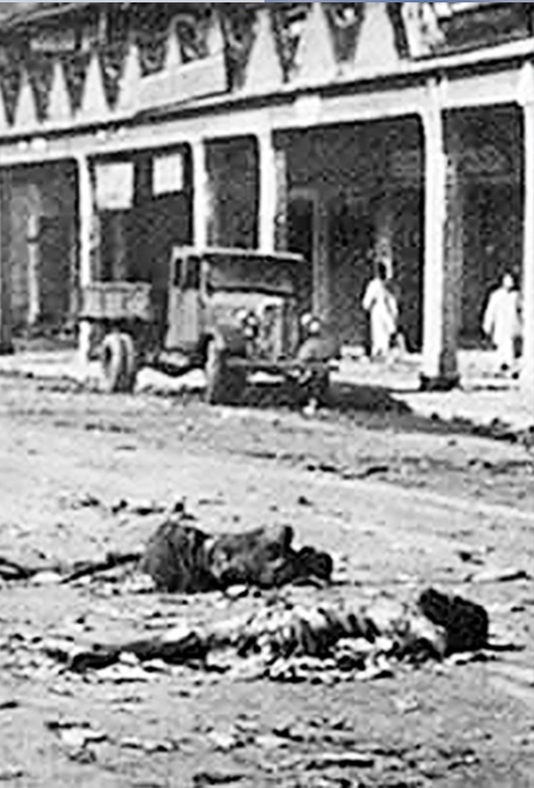
Bhagalpur, India
Zanga-zangar shekarar 1989
Photo: Vikramvisu / Shutterstock Photo:Unknown
Notes:
Aikin farkon budewa: Rukunoni masu kawo sauyi na Qugi
(Slides na 3 zuwa 10 suna bayyana labarai guda 3 na masu kawo canji daga aikin motsa jiki.)
Labarin Rahul, Indiya
Rahul yana zaune a Bhagalpur, wani gari a gabashin Indiya. Kimanin 80% na al'ummar garin Hindu ne, yayin da 18% Musulmi ne. Garin yana fuskantar tashin hankali. A shekarar 1989, an yi rikici da ya halaka sama da Musulmi 1000, inda aka kona sama da 50,000 barin gidajensu.

Slide 4
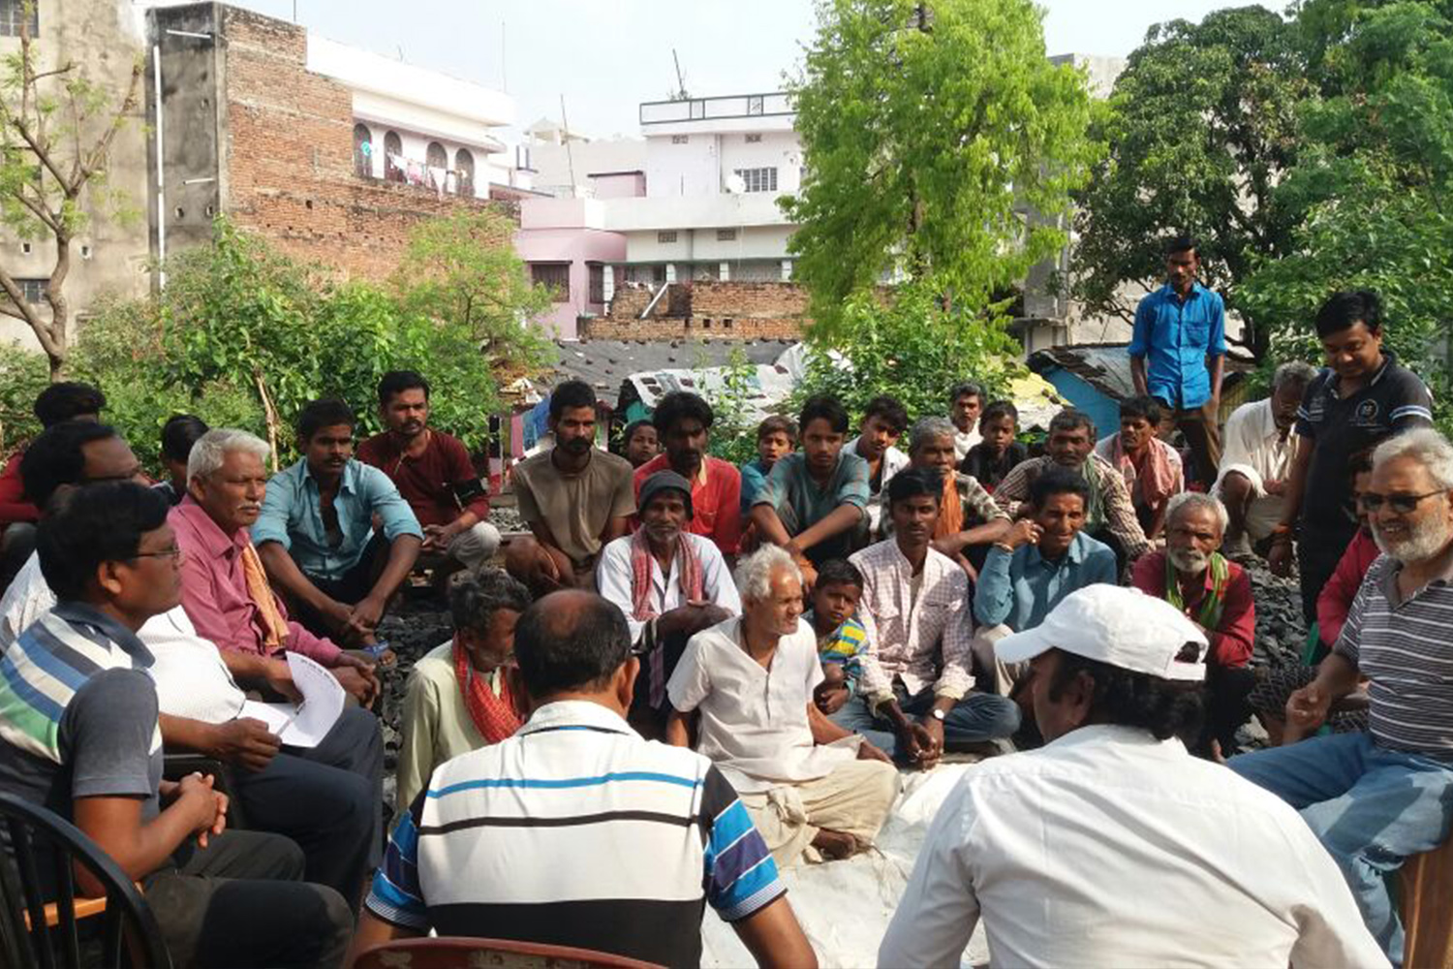
Kwamitin zaman lafiya
Photo: Supplied
Notes:
Rahul, wanda Hindu ne, ya yanke shawarar zama lafiya da addinai dabandaban a garin. Aikin su yana nufin ayi hankali kai tsaye da kuma ɗaukan mataki da amsa buƙatun bangarorin da ke gaba da juna. Wannan yana gudana a hanyoyi kama Kirkirar kwamitocin zaman lafiya, Shirya bukukuwan addinai na shekarashekara, Hada shugaban addinai domin su yi aiki tare. Wannan aikin dogon lokaci ne, kuma yana tushe da za’a iya dogaro da shi a lokutan da ake fuskantar barazanar tashin hankali.

Slide 5
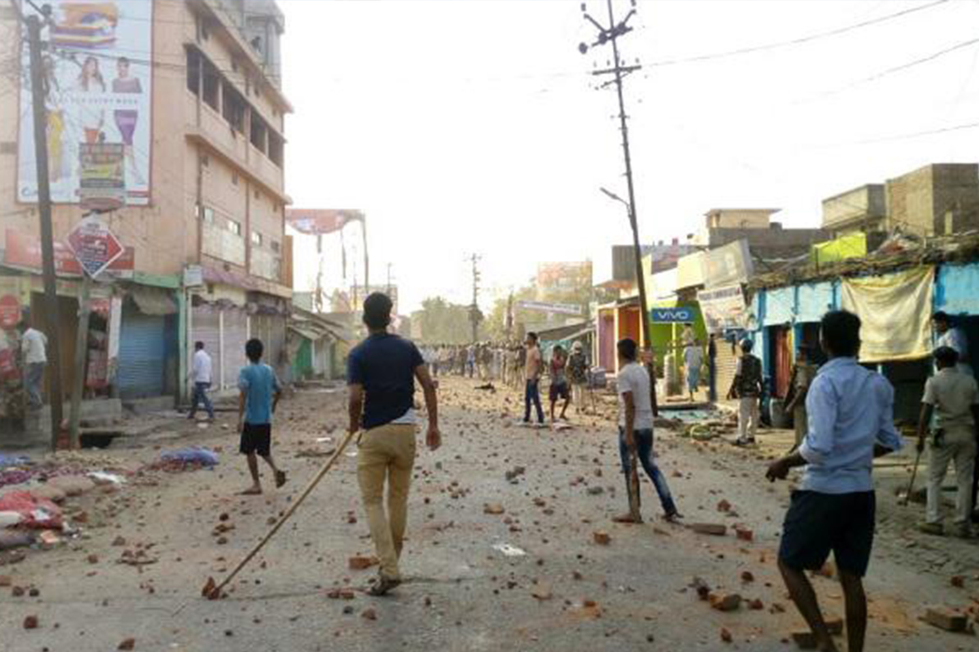
Zanga-zanga a birnin
Bhagalpur
Photo: David Talukdar / Alamy Stock Photo
Notes:
Tashin hankali yana koma wa sosai lokacin Yaƙin neman zabe. A shekarar 2019, wani ɗan takarar kishin Hindu ya jagoranci wata gangamin kamfen a yankin Musulmi tare da fadar kalaman ƙiyayya da nufin tayar da fitina.
Yayin da wasu matasan Musulmi suka mayar da martani da fushi, ɗan takarar ya ƙaddamar da tashin hankali, wanda ya kai ga kashekashe, lalata shaguna da gidaje. Hakan ya haifar da barazanar cewa rikicin zai bazu zuwa wasu yankuna kuma ya kara muni. Rahul da abokan aikinsa sun fahimci irin hadarin da hakan zai iya haifarwa.

Slide 6
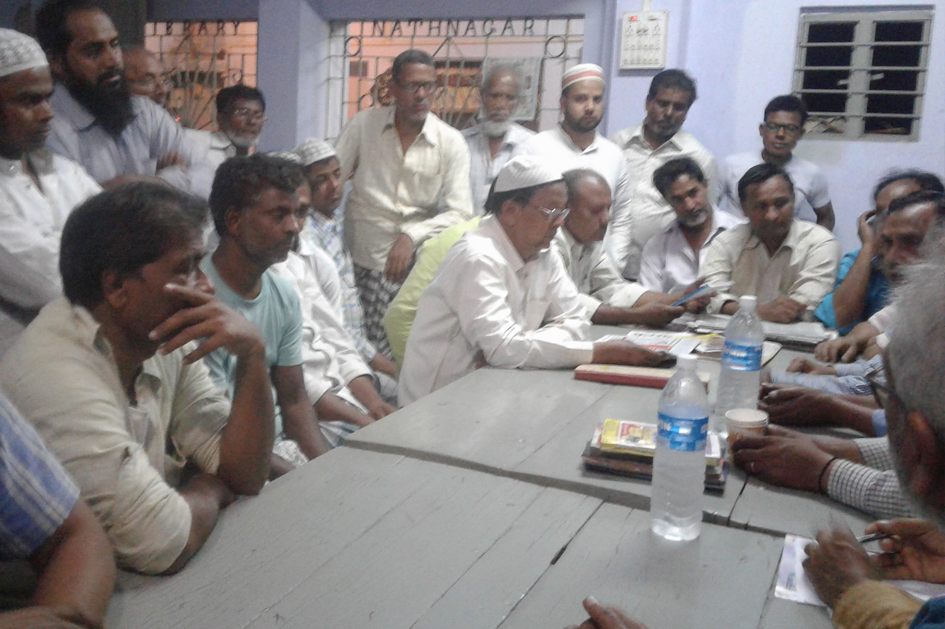
Taron maƙwabtaka domin wanzar da zaman lafiya
Photo: Supplied
Notes:
A kwanaki masu yawa, Rahul da abokan aikinsa sun shirya tarukan al’umma a yankunan Musulmi da Hindu da suka fi fuskantar haɗari. A tarukan, sun ƙir-ƙiriƙungiyoyin masu sa kai da suka bazu cikin yankunansu domin su shawo kan jama’a su guji tashin hankali.
Rahul ya ce: "Abu mai muhimmanci shi ne, maza da mata su tafi tare a matsayin jami’an sakai, domin kowannensu zai yi gudanarwa da wanda zai fi yiwa saurare sa a cikin gidan."

Slide 7
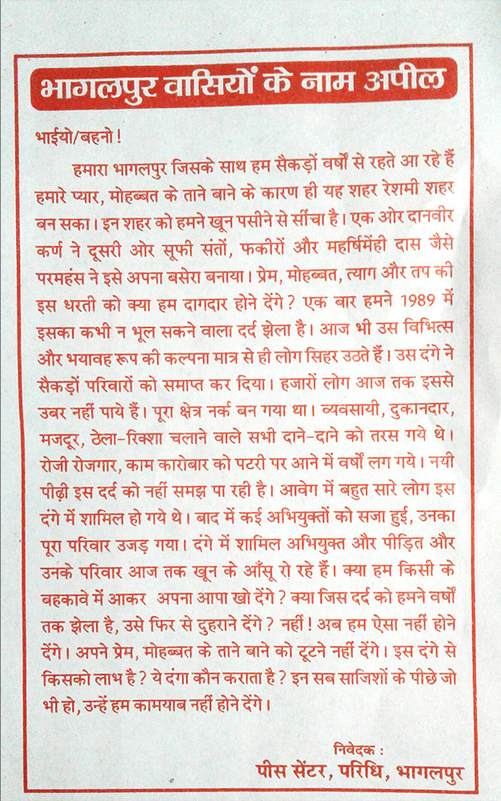
Litaffin da
masu aikin sa kai suka raba
Photo: Supplied
Notes:
Masu sakai sun Raba takardun wayar da kai a kan hatsarin tashin hankali, sannan yi wa mutane bayani da sauraron su domin su fahimci cewa rikici ba zai amfanar da kowa ba, komai addininsa. Da yardar Allah, wadannan matakan sun taimaka wajen kwantar da tarzoma a cikin garin.

Slide 8
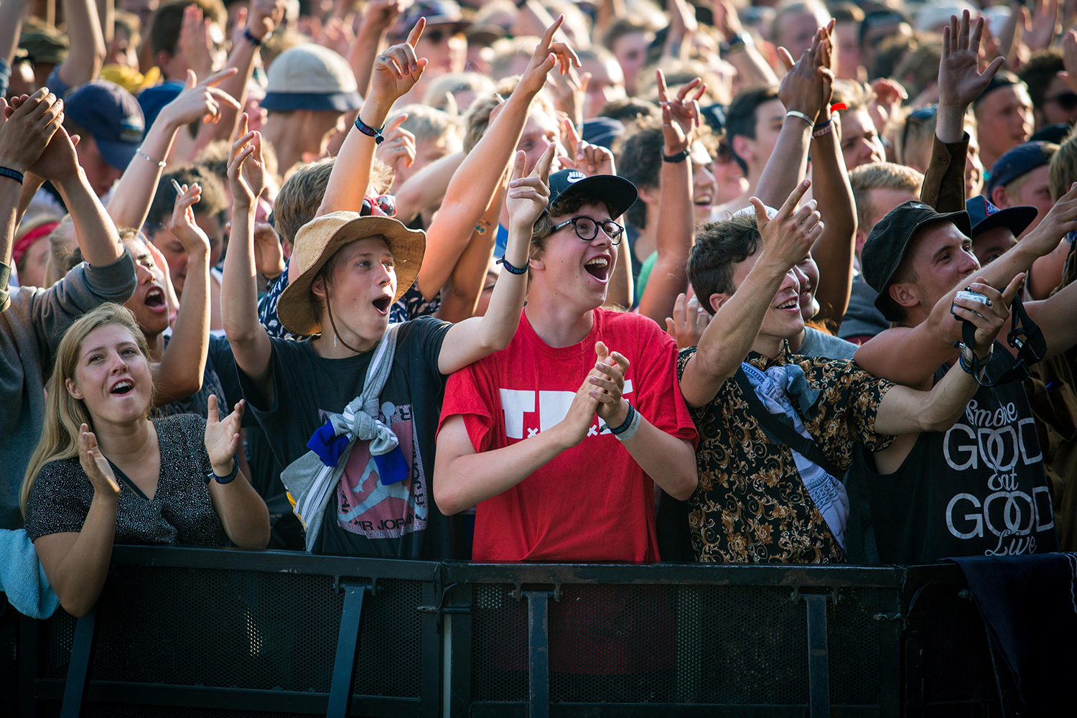
Taron
gangamin
kiɗe-kiɗe da
raye-raye na
Roskilde,
Denmark​
Photo: Gonzales Photo / Alamy Stock Photo
Notes:
Kada a yi saurin yanke hukunci da abinda aka fara gani – Human Library™, Denmark
A tsakiyar shekarun 1990, wasu abokai hudu sun ƙir-ƙiri wata ƙungiya ta matasa domin yak’ar tashin hankali a birane. Yayin da ƙungiyar ta girma, mai shiryawa wani babban bikin kida a Denmark ya nemi su fito da wata hanya da za ta taimaka wajen habaka gudanarwa tsakanin mahalarta bikin. A nan ne suka ƙir-ƙiri Human Library™ – wani gungu na mutane inda baki za su iya aro "littattafai" na mutane – wato, mutanen da suka yarda su shiga cikin gudanarwa mai girmamawa game da asalin su da rayuwar su.

Slide 9
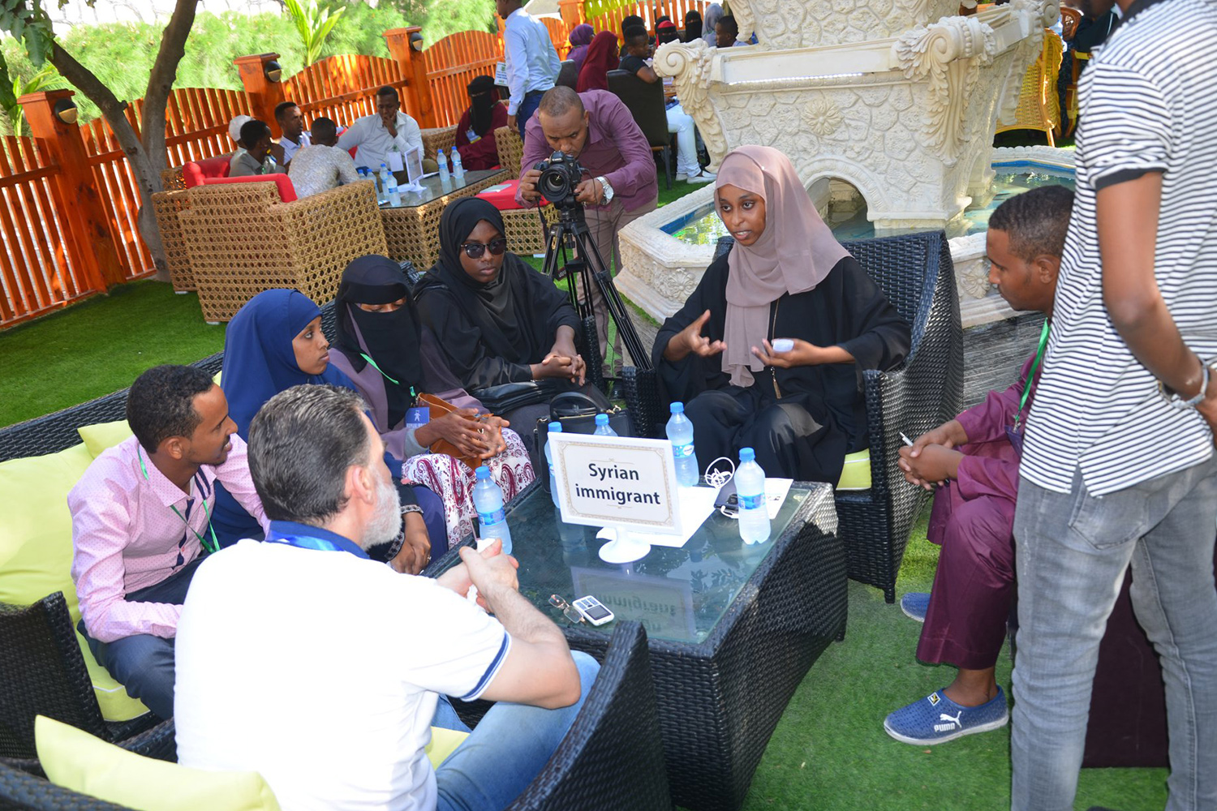
Taron ɗakin
karatun
mutane na
ƙasar Somalia
Photo: Human Library Organisation
Notes:
Yawanci, "littattafai" mutane ne daga cikin al’umma, wadanda suka zabi su ba da labarinsu don ya zama darasi ga wasu. Wadanda suka fi shiga ciki su ne wadanda wani bangare na asalin su yana da alaka da tauye haƙƙi, wariya ko kyama, kamar Addini ko imanin su, Kabilanci ko asalinsu, Yanayin jima'i ko yanayin sha’awar jima’i dinsu ko Nakasa ko wata matsala ta lafiyar su (misali, masu fama da cutar HIV/ AIDS). A taƙaice , wannan maktabar mutane tana taimakawa wajen karya kage da ra’ayoyin da ba su da tushe. A halin yanzu, Human Library tana da ayyuka a kasashe sama da 85.

Slide 10
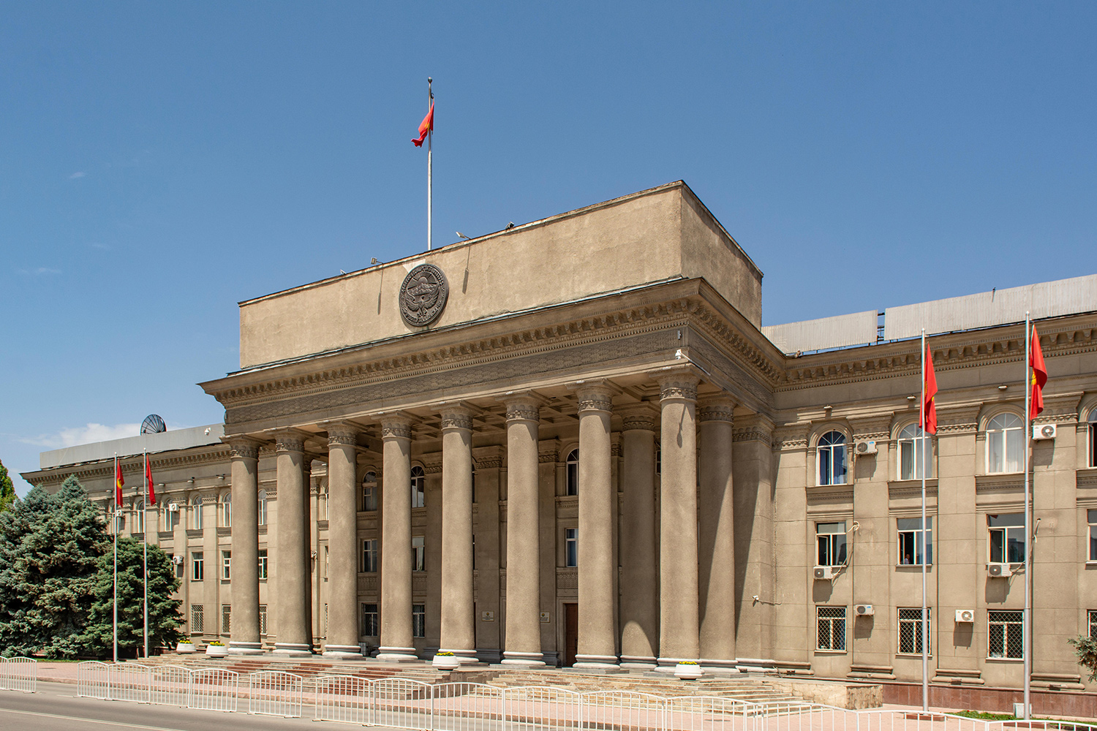
Majalisar
dokokin Ƙasar
Kyrgyzstan
Photo: Robert Wyatt / Alamy Stock Photo
Notes:
Yadda ake tilasta gwamnati ta yi aiki, Kyrgyzstan
Bayan juyin mulki na 2010 a Kyrgyzstan, wata ƙungiya karama ta matasan masu tsattsauran ra'ayi ta fara far wa wuraren ibadar Kiristoci da suka hada da Protestant da Orthodox. Wannan harehare sun dauki kusan wata shida, amma duk da yawan kokekoke, babu wanimataki da gwamnati ta dauka. Hukumar Al'amuran Addini, Ofishin Mai Gabatar da Kara da Ma'aikatar Harkokin Cikin Gida sun kasa yin wani abu, har ma suka ba da shawara cewa al'ummomin addinan su nemo mafita da kansu.
Cike da takaici, shugabannin addinai suka haɗu, suka nemi wata jarida ta kasa domin ta fallasa rashin aikin da mahukunta suka yi. Lokacin da labarin ya isa ga Shugaban Kasa, sai ta dauki matakin gaggawa. Bayan kwana hudu kacal, dukkan 'yan ƙungiyar da suka aikata hareharen an kama su.

Slide 11
Abubawa masu haifar da waraka
​A gina alƙoƙi​
Ayi aiki tare​
A nemi labaru​
A zauna cikin shiri
Notes:
Aikin Tunani: Masu tsayuwar daka da warkarwa
Ayi amfani da wannan bangare domin kammala wannan aikin, a gabatar da wadannan abubuwa.
Zamu iya daukan mataki domin kasancewa masu samar da waraka ba yan kallo ba, misali, ta hanyar gina alaka da mutanen da suka fuskanci kalubalen take 'Hakkin Ɗan’Adam, shiryawa a matakin ƙungiyoyi, neman rahotonnin da muke buƙata tare da shirya yadda muke da buƙatar daukar mataki tare.
Ba a ko da yaushe bane zamu iya daukan mataki ba – ba kuma zai kasance a ko da yaushe abu mafi tsira domin aikata haka! Amma zamu fi iya daukan mataki idan muka gina alakoki, muka yi aiki tare da sauransu.
A yi nuni da taswirar YAKI ta garinmu dake jikin flip chart sheets. A yi umarni ga mahlartan domin yin tunani cikin a tsanake akan wacce daga cikin matsalolin da aka zayyano suke da buƙatar zama masu samar da waraka ga. (A bai wa mahlartan lokaci domin yin tunani, amma ka da a bayar da damar bayar da amsa.)
A cikin darusan da suka saura, zamu yi tunani akan YAYA yakamata mu bar fagen yan kallo izuwa fagen masu samar da waraka dangane da wadannan matsalolin.

Slide 12
Aikin ‘Wa nene ni?’
Mai zan iya aikatawa?​
Mai zamu iya aikatawa?​
Mai zamu iya bai wa wasu ƙwarin gwiwa su aikata?
Notes:
Aikin Zane: Wa nene ni?
Ayi amfani da wannan sashen wajen kammala wadannan tambayoyin, ayi wadannan abubuwa masu zuwa.
A cikin duka waɗannan hanyoyin da muka yi duba akai, zamu iya bayar da gudunmawa wajen kasancewa yan kallo ko kuma masu samar da waraka. Zamu iya kasancewa jigo wajen wanzar da yancin addini da imani ta hanyar wadannan ƙungiyoyin.
Dangane da ko wani abu kuka saurara ko kuma kuka aikata a cikin abinda ya saura a cikin wannan kwas din, kuyi tunani akan wadannan tambayoyi guda uku. (A nuna shafirPowerpoint na 12 ko kuma flip chart mai dauke da irin wadannan tambayoyin.)
Me zan iya aikatawa? Zan iya daukan mataki a matsayina na mahaifi ko mahaifiya, da, aboki ko kuma maqwabci? Me zan iya aikatawa ta hanyar kasancewata ma’aikaci ko kuma ta hanyar gudunmawar d azan bayar a rayuwata ta ni kadai – ko kuma a gurin bautata alal misali?
Wacce irin gudunmawa zamu iya bayarwa idan muka hada kanmu kuma mukayi aiki a tare? Shin abokan ibadata, ƙungiyar matasa ko kuma gurin aikina zasu iya yin wani shiri domin daukan mataki, alal misali?
Me zamu iya yi yin domin ƙarfafa sauran al’umma da kuma suran ƙungiyoyi su aikata? Da akwai abubuwan dab a zamu iya aikatawa ba, amma wadansu mutanen zasu iya aikatawa. Wata ƙila wasu abokan bauta, ko wani shugaban makaranta zasu iya daukan mataki. Wa zamu iya ba ƙarfin gwiwa domin daukan mataki?

Slide 13
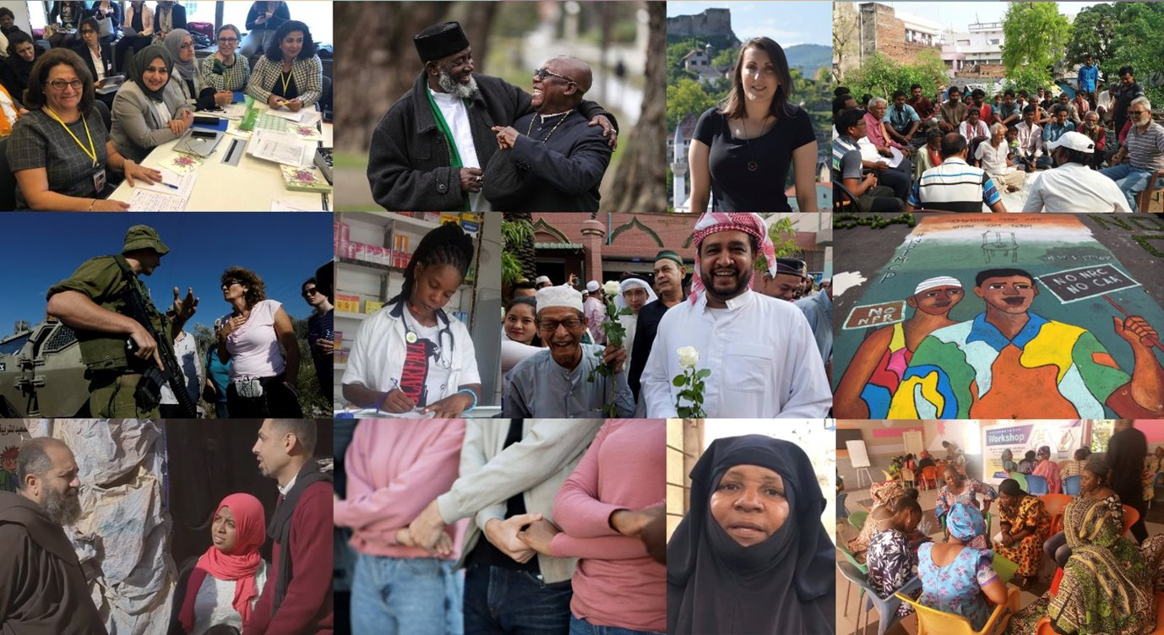
Notes:
(Slides 13 zuwa 24 suna bayyana gabatarwar sashi na shida.)
Takardar gabatarwa: Dabarun inganta ‘haqqin dan adam
A zama na baya, mun ji labarai game da yadda mutane daban-daban ke ɗaukar matakai daban-daban don inganta ’yancin addini ko imani (YAKI) a cikin al’ummominsu. Haka nan kuma, mun sake tunawa da matsalolin da ke shafar YAKI a cikin al’ummarmu. (Nuna takardun flip chart na "Taswirar YAKI ta garinmu”).
A yau, za mu koyi hanyoyin dabaru daban-daban da ake amfani da su don kare da kuma inganta ’yancin dan adam a matakin al’umma. Haka kuma, za mu yi tunanin yadda za mu iya amfani da waɗannan dabarun domin tinkarar matsalolin da muka gano a cikin al’ummarmu.

Slide 14
Ayyanawa: Dabaru
Tsarin ayyuka da aka tsara domin cimma wani buri.
Notes:
Toh menene Dabara (Tactic)? Dabara na nufin tsarin ayyuka da aka tsara domin cimma wani buri.

Slide 15

Notes:
Akwai nau’ukan dabaru guda hudu da ake amfani da su a fagen kare hakkin Ɗan’Adam. Don fahimtar su, za mu yi amfani da misalin wuta domin wakiltar cin zarafi da take hakkin Ɗan’Adam. Ba wutar da muke jin daɗin dumin ta ba, amma wata mummunar wuta da ke fita daga hayyacinta. Kamar take hakkin Ɗan’Adam, irin wannan wuta na cutar da mutane — tana haifar da tashin hankali, rauni da mutuwa, kuma tana lalata dukiya da muhalli.
To, ta yaya ake kashe wutar? Akwai hanyoyi guda hudu da ake bi:

Slide 16




Dabarun gaggawa
Kiyayewa
Tsaya don ceto
Kira don taimako da gargadi
Notes:
DABARUN GAGGAWA
Dabarun gaggawa suna da nasaba da hana wuta tun kafin ta fara ruruwa ko ci, kashe wuta da kuma ceto mutane.
Me za ka yi idan ka ga yaro yana wasa da ashana (matches)? Za ka hure wutar kuma ka karɓe kibiyar wutar daga hannunsa! Wannan yana nufin hana wutar tun kafin ta fara ruruwa ko ci.
Idan har wutar ta riga ta fara ruruwa, kuma tana ƙarama, za ka iya qoqarin kashe ta da burushi ko kuma da ruwa. Wannan yana nufin kare mutane da dukiya daga haɗarin wuta. Amma idan wutar ta fi ƙarfin ka, za ka kira jami’an kashe gobara da kuma gargadi mutane su fita domin su tsira da rayukansu.
Dabarun gaggawa a fagen kare hakkin Ɗan’Adam suna aiki da irin wannan tunani! Ana amfani da su wajen daqile cin zarafi ko take hakkin Ɗan’Adam da ke gab da faruwa ko kuma wanda yake faruwa a halin yanzu ga wasu mutane a wasu wurare na musamman! Wannan na iya nufin: Tsoma baki kai tsaye don dakatar da cin zarafi da kuma ceto mutane ko Nema ko kiran taimako daga hukumomi ko ƙungiyoyin agaji. Ko Gargadi da fadakar da mutane da ke cikin hatsari domin su dauki matakin kare kansu.

Slide 17

Cin zarafi​
Maganganun ƙiyayya​
Lalata dukiya da fasawa​
Hare hare​
Hare-hare a wuraren ibada​
Rikicin ƙabilanci ko addini​
Kama mutane ba bisa ƙa’ida ba​
Notes:
Wadanne irin take hakkin YAKI ne za mu iya amfani da dabarun gaggawa a kansu? Ana amfani da dabarun gaggawa domin daƙile wasu nau’ukan take hakkin addini ko imani (YAKI), kamar: Cin zarafi da muzgunawa (harassment), Maganganun ƙiyayya (hate speech), Hare-hare da duka (assaults), Lalata dukiya da fasawa (vandalism of property), Hare-hare a wuraren ibada (attacks on places of worship), Rikicin ƙabilanci ko addini (communal violence) da kuma Kama mutane ba bisa qa’ida ba (arbitrary arrests).
Duk da cewa dabarun gaggawa suna mayar da martani ga wadannan abubuwan da ke faruwa nan take, suna bu ƙatar shiri tun da wuri. Dole ne mu san abin da za mu yi idan irin wadannan cin zarafi suka faru. Kamar yadda mutane ke koyon lambar wayar jami’an kashe gobara ko yadda ake amfani da burushin kashe wuta, haka ma za mu iya koyon hanyoyin hana, dakatar da, ko kuma neman taimako idan ana take hakkin Ɗan’Adam.

Slide 18

Notes:
2. DABARUN SAUYI
Wuta na faruwa kuma tana yaduwa saboda wasu dalilai – misali, wayoyin lantarki da ba su da inganci. Dabarun sauyi suna mayar da hankali wajen gyara dalilan da ke haddasa wuta, misali, tabbatar da cewa an samar da dokokin gari da za su tabbatar da cewa wayoyin lantarki suna da inganci.
Haka ma, cin zarafin hakkin Ɗan’Adam yana faruwa saboda wasu dalilai – misali: Rashin dokokin da za su kare mutane daga cin zarafi, Rashin aiwatar da dokoki da suka dace domin kare mutane ko Rashin adalci da tsarin al’umma da ba su dace ba – wato kamar yadda muka ce, ana “sanye da wayoyi” marasa kyau a cikin al’umma.

Slide 19




Dabarun sauyi
Ba da shawara ko yin kira
Gangami
Bayar da ƙarfafawa
Watsi
Notes:
Wasu nau’ukan cin zarafin hakkin Ɗan’Adam ba za a iya magance su ba sai an tilasta wa mutane su sauya dokoki ko hanyoyin da ake tafiyar da lamura. Ana iya yin hakan ta hanyoyi guda hudu:
yin yaƙin neman sauyi da zanga-zanga domin a fito da matsalar fili (campaigning and protesting),
shawartar masu mulki ko masu iko da su dauki mataki kan matsalar—wannan shi ake kira ba da shawara ko yin kira (lobbying and advocacy),
kirkirar hanyoyin da za su sa mutane su canza halayensu ta hanyar basu kwarin gwiwa ko lada,
ƙin bin dokoki marasa adalci ko ƙa’idojin al’umma domin nuna cewa ba mu yarda da su ba.
Waɗannan su ne dabarun sauyi. Ana amfani da su domin magance dogon lokaci, matsaloli masu zurfi da ke cikin tsarin al’umma – wato matsalolin da ke shafar mutane da yawa a wurare daban-daban.

Slide 20

Notes:
3. GINA DABARU
Wata hanya da za mu iya dakatar da wuta ita ce ta hanyar gina fahimta da wayar da kan jama’a domin canza tunaninsu. Misali, ana iya fadakar da mutane game da hatsarin jefar da gutsuren sigari a kan busasshen kara. Haka nan kuma, ana iya kawo mutane cikin sahun aiki – misali, karfafa mutane su shiga cikin aikin kashe gobara na sa-kai. Bugu da qari, za a iya gina ƙwarewa – ta yadda mutane za su san yadda ake amfani da burushin kashe gobara.
A fannin kare hakkin Ɗan’Adam, dokokin suna nufin dogon aiki na gina al'adar mutunta yancin Ɗan’Adam. Wannan yana nufin ƙoƙarin samar da al'umma da kowa yana fahimtar haƙƙoƙinsa da haƙƙoƙin wasu. Mutane suna ganin mutunta haƙƙoƙin Ɗan’Adam a matsayin abu na alfahari kuma abu ne da ya dace. Mutane suna daukan abin da za su yi idan haƙƙoƙinsu ko na wasu aka take. Suna iya taimakawa su kuma su tsayu tsayin daka wajen kare haƙƙoƙinsu da na wasu.

Slide 21





Gina dabaru
Samar ko gina faɗakarwa
Samar da
mu’amala
Samar da
ƙwarewa
Samar da dangantaka da kuma ƙulla hulda
Notes:
Gina al'umma mai mutunta ‘hakkin Ɗan’Adam kamar wannan ya qunshi yin abubuwa guda hudu:
Gina da wayar da kai muna nufin samun hakkin Ɗan’Adam da kuma illar take hakkin da ake yi.
Gina shari'a mai adalci karfafa mutane su shiga cikin aikin kare hakkin Ɗan’Adam.
Gina da koya wa mutane yadda za su kare da inganta haƙƙoƙin Ɗan’Adam.
Gina hanyoyin hadin gwiwa yadda ƙungiyoyi na gwamnati da na al'umma za su hada dabaru don kare hakkin Ɗan’Adam da fataucin Ɗan’Adam musamman yara.
Waɗannan dabarun ne na dogon lokaci. Suna gina tushe da harsashi wanda zai ba mu damar amfani da sauran dabaru cikin ƙarfi da inganci.

Slide 22

Notes:
4. DABARUN WARKARWA
Daga ƙarshe, Kamar yadda gobara ke lalata mutane, dukiya, da al'umma, haka ma take ‘hakkin Ɗan’Adam yana jefa mutane cikin mummunan hali. Dabarun warkarwa suna mayar da hankali kan abin da za mu yi domin tallafa wa mutanen da suka fuskanci irin zafin.

Slide 23





Dabarun warkarwa
Samar da kayayyaki da kuma taimakon zuci
Sabawa maƙunshin bayanai
Nemi adalci da diyya
Ƙarin haske da tunawa
Notes:
A wani bangare, hakan yana nufin tabbatar da cewa mutanen da suka sha wahala sun sami: Kulawar lafiya wato magani da jinya, Tallafi na kayan bukata kayan abinci, muhalli, da kayan more rayuwa da kuma Tallafin tunani da jaddad daidaituwa wato kulawa ta fuskar tunani da zamantakewa. Amma warkarwa ba wai kawai game da taimakon rayuwa ba ne. Hakanan yana shafar mutunci da adalci:
rubuta da adana abin da ya faru domin kada a rufe batun ko a manta da shi,
bawa mutane damar su bayyana abin da ya faru da kuma tunawa da shi domin su sami nutsuwa,
tabbatar da cewa an yi adalci kuma an biya su diyya domin su samu ƙƙoƙinsu.

Slide 24















Ƙiyayewa Tsaya don ceto
Kira don taimako da gargadi
Gangami Shawara
Ƙarfafawa
Watsi
Faɗakarwa Mu’amala
Ƙwarewa Ƙulla hulda
Taimakon
Sabawa maƙunshin bayanai
Nemi adalci
Tunawa da
Notes:
KAMMALAWA
Duk wadannan bayanan da muka tattauna a cikin wannan gudunmuwar wajibi kare hakkin Ɗan’Adam. Wadannan dabi'un suna ƙarfafa juna, suna kuma taimakawa wajen karewa da adalci nan gaba.
"Babu wani mutum shi kadai ko wata ƙungiya da za ta iya amfani da dukkan dabarun - muna da mtsayi daban-daban, ƙwarewa da kuma dama da suka shafi irin zabin dabarun da za mu yi amfani da su. Abu mai mahimmanci shi ne kowa zai iya yin wani abu da kuma abin da ke tsakaninmu, ta hanyar hanyoyin sadarwa na mutane da ƙungiyoyi masu jawo hankali ta hanya daya, za mu iya canza abubuwa."
Za mu iya bayar da gudunmuwa wajen daukar dabarun kare hakkin Ɗan’Adam da kuma gina al'umma da ke mutunta hakkin Ɗan’Adam a cikin gidajensu, al'ummarsu, da kuma gwamnatinsu.

Slide 25

Cin zarafi​
Maganganun ƙiyayya​
Lalata dukiya da fasawa​
Hare hare​
Hare-hare a wuraren ibada​
Rikicin ƙabilanci ko addini​
Kama mutane ba bisa ƙa’ida ba​
Notes:
Aikin gudanarwa: Maganar game da dabarun gaggawa
A gabatar da wadannan abubuwan:
Dangane da abinda ya saura a cikin wannan darasin, zamu mayar da hankali a kan dabarun gaggawa sannan muyi tunanin yadda za muyi amfani dasu wajen dakile matsalolin yancin addini da imani a cikin al’umominmu. Za muyi duba izuwa ga sauran dabarun a darasi na gaba.
Ta hanyar wannan darasin, za mu koyi dabarun gaggawa sannan muyi tunani mai zurfi akan wasu dabarun domin daukar mataki a cikin al’ummarmu. Yin tunani – me zan iya aikatawa, me zamu iya aikatawa sannan ta yaya zamu iya bawa wasu qwarin gwiwa domin aikatawa?
Amma kafin mu fara, bari mu tunatar da kawukanmu akan abinda ya ƙunshi yancin addini da imani. Ana yin amfani da dabarun gaggawa ne a lokacin da aka ci zarafin yancin ɗan’Adam ko kuma hakan yana ƙoƙarin faruwa ga wani mutum a wani kebantaccen guri. Yanzu, wasu irin take hakkokin addini ko imani muke ƙoƙarin dakilewa da wadannan dabarun? A nuna Powerpoint slide na 24 sannan a karanta wadannan misalan:
Cin zarafi, misali cin zarafin mata marasa galihu
Kalaman batanci (a kafafen sada zumunta ko kuma ido-da-ido)
Ayyukan laifi kamarsu ta’annati na dukiyoyi ko kuma kai hari
Kai hare-hare a guraren ibada
Rikicin al’umma
Tsare mutum ba bisa ka’ida ba

Slide 26
Abubawa masu haifar da waraka
A gina alaƙoƙi​ Ayi aiki tare​
A nemi labaru​
A zauna cikin shiri​
Notes:
Bayanan kammalawa
A kammala darasin tare da yin wannan sahrhin, tare da nuna shafuka na 26 zuwa 28:
A farkon darasin, munyi bayani akan yadda zamu bar matakin yan kallo zuwa masu samar da waraka. Sannan kuma munyi bayani dangane da gina alakoki, yin aiki tare neman bayanai, da kuma gabatar da shirye-shirye.

Slide 27
Shiryawa domin yin amfani dadabarun gaggawa
Ayi duba ga al’amuran take ‘Hakkin Ɗan’Adam masu zuwa – kamar waye, menene, a ina ne, kuma yaushe ne​
Ayi duba ga martanin da za’a iya samu​
A yi mu’amala tare​
A nemi sani​
A yi duba ga abubuwa masu hatsari​
Notes:
Dangane da dabarun gaggawa, hakan ya qunshi irin wadannan tambayoyin gajerun maganganu wadanda muka tayin bayani akai misali:
Yin duba ga wanda zai iya cutar da al’amuran YAKI, a ina ne kuma yaushe ne?
Yin tunani dangane da yadda ya kamata mu bayar da martini akan wadannan al’amuran gaggawa kafin su faru. Misali: Ta yaya ya kamata in dauki mataki a daidai lokacin da naga an yi kalaman batanci ga wani ko kuma anyi cin zarafi a kan hanya? Ko kuma ina da buƙatar in kirkiri shiryayyen martani a matakin qungiya da take shirye-shirye wajen daukan mataki?
Tare da yin duba da cewa ko muna da bayanai da hanyar sadarwar da muke buƙata domin bayar da martani.
Sannan kuma, yin duba ga abubuwa masu hatsari domin tabbatar da cewa muna cikin aminci da kiyayewa wajen ɓata al’amura.

Slide 28
Dabarun Gaggawa
Dabarun Sauyi
Gina Dabaru
Dabarun Warkarwa
Notes:
Kwarai kuwa, wataƙila zai iya kasancewa wannan dabarun gaggawar bashi muke da buqatar amfani dashi a wannan lokacin ba. Alal misali, zamu fi dacewa wajen wayar da kai domin samar da sauyi. Bai kyautu ace kowa zai yi komai da komai ba!
A darasi na gaba, zamu koyi akan yadda za muyi tunani mai zurfi domin samar da dabarun sauyi, dabarun ginawa da kuma dabarun warkarwa. Muna da manufar samar da dabarun daukar mataki masu yawa.
Sannan, a cikin darusa guda biyu na qarshe na kwas din, zamu fara fadada abubuwa – tare da yin tunanin wadanne matsalolin ya kamata mu dakile, sannan wane daga cikin dabarun daukar mataki ne zai fi inganci wajen amfani dashi.
A kammala darasin tare da godewa kowa-da-kowa saboda halarta da suka yi.

Slide 29

Sannu da ƙoƙari kuma sannu da dawowa!
Sashi na gaba: Magana game da dabaru

