Slide 1
m%dfoaYSh iudc mßj¾;l mdGud,dj

Slide 2
6 jeks ieish
l;kaor j,ska fm<Uùu -
Wml%u j,ska iún, .ekaùu
Notes:
ish¨ fokd ieish fj; idorfhka ms<sf.k my; i|yka lreKq úia;r lr fokak(
fï olajd mj;ajk ,o ieis j,oS wms udkj ysñlï ms<sn|j" wd.u weoySfï fyda úYajdi oeÍfï ksoyi i|yd we;s whs;sh ms<sn|j iy whs;sjdislï W,a,x>khùï ms<sn|j bf.k .;af;uq' tfukau wms wmf.a m%cdj ;=< isÿjk wd.u weoySfï fyda úYajdi oeÍfï ksoyi W,a,x>khùï ljr wdldrfha W,a,x>khùï o hkak is;shï.; lf<uq'
fu;eka isg bosßhg wms l%shdud¾. ms<sn|j wjOdkh fhduq lrkafkuqæ fuu ieisfha oS iy ñ<`. ieisfha oS wms udkj ysñlï m%j¾Okh lsÍu i|yd fhdod .; yels úúO l%u" ke; fyd;a Wml%u j¾. fudkjdo hkak fidhd ne,Sug iy wmsg tu Wml%u fhdod .; yelafla flfiao hkak ms<sn| is;d ne,Sug lghq;= lrkafkuq' wjika ieis fofla oS wms l%shdldÍ ie,iqï ilia lsÍu flfrys wjOdkh fhduq lrkafkuq'
;u m%cdjka ;=< wd.u weoySfï fyda úYajdi oeÍfï ksoyi i|yd mßj¾;khla isÿ lrñka isák ñksiqka ms<sn| l;kaor ;=klg ijka foñka wms fuh wdrïN lruq'

Slide 3
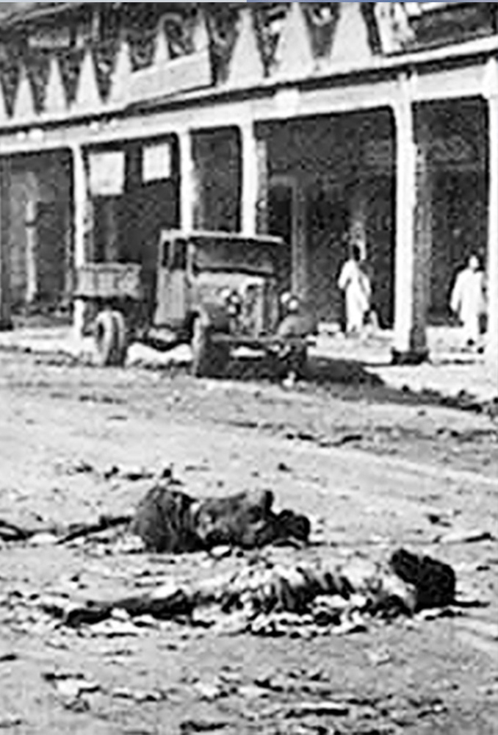
Nd.,amQ¾" bkaoshdj
1989 flda,dy,
PdhdrEmh( Vikramvisu / Shutterstock Photo:Unknown
Notes:
iudc mßj¾;l l;kaor - l=vd idlÉPd lKavdhï wNHdih
wxl3 isg 10 olajd jk ia,hsv j,ska wNHdifha § we;s iudc mßj¾;l l;kaor ;=k ksrEmKh lrhs'
rdyq,af.a l;dj" bkaÈhdj
rdyq,a Ôj;a fjkafka kef.kysr bkaÈhdfõ Nd.,amQ¾ k.rfha h' tu k.rfha ck.ykfhka 80] la muK fokd yskaÿjreka o" 18] la muK fokd uqia,sïjreka o jk w;r" k.rhg m%pKav;ajfhka msß b;sydihla we;' 1989 j¾Ifha §" 50"000 la muK ck;dj wj;eka l< flda,dy, j,oS uqia,sïjreka 1"000 g wêl ixLHdjla ñh .sh nj jd¾;d úh'

Slide 4
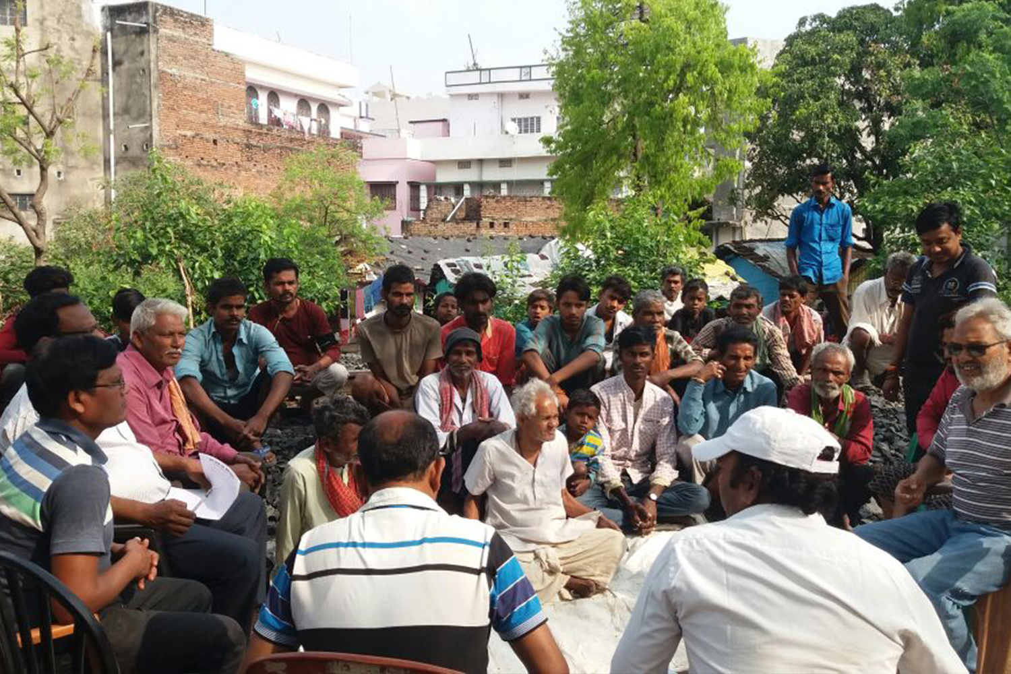
idu lñgq /iaùu
PdhdrEmh( Supplied
Notes:
yskaÿ Nla;slfhl= jk rdyq,a k.rfha wka;¾-wd.ñl idu uOHia:dkhg iïnkaOù isáhs' Tjqka idu lñgq yryd;a" jd¾Isl ixialD;sl W;aijhla ixúOdkh lsÍu iy wd.ñl kdhlhska iïnkaO lr .ekSu yryd;a lKavdhï w;r iïnkaO;d iy úYajdih f.dvke.Sug lghq;= lr;s' fuu È.=ld,Sk idu ld¾hh u.ska we;eï isÿùï md,kfhka Tíng f.dia" iS>%fhka me;sr hdug mgka .kakd úg yÈis mshjr .ekSug yels lrjk mokula ks¾udKh lr fohs' fujeks mokula fndfyda úg wjYH fõ'

Slide 5
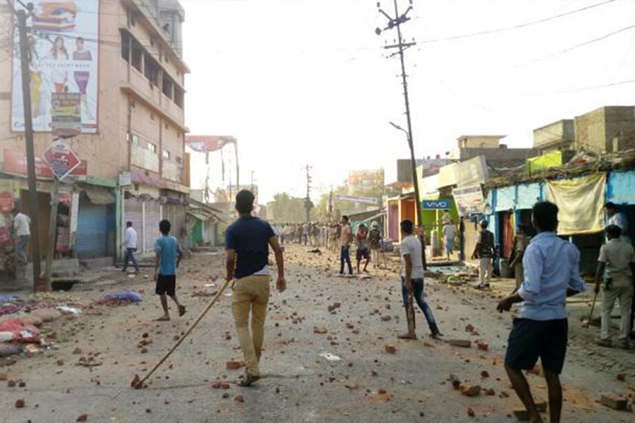
Nd.,amQ¾ m%foaYfha uE;ld,Sk flda,dy,
PdhdrEmh( David Talukdar / Alamy Stock Photo
Notes:
ue;sjrK jHdmdr j,§ m%pKav;ajh úfYaIfhka u iq,N fõ'
2019 j¾Ifha §" yskaÿ cd;sljd§ ue;sjrK wfmalaIlfhl= uqia,sï jeishka cSj;a jk m%foaYhla yryd fm<md<shla fufyhjñka" ffjÍ m%ldY yd wekqï mo mjiñka flda,dy,hla we;s lsÍug W;aidy lf<ah' we;eï uqia,sï ;reKhska thg tfrysj fldamfhka lE .eiQ úg tu wfmalaIlhd m%pKav;ajh wdrïN l< w;r" ta fya;=fjka fj<|ie,a j,g iy ksjdi j,g ydks isÿ úh' fuu ler,s flda,dy, fjk;a m%foaYj,g o jHdma; ù m%pKav;ajh we;sùfï nrm;< wjodkula Woa.; úh' fuh fl;rï Nhdkl úh yels oehs rdyq,a iy Tyqf.a ñ;=rka oek isáhy'

Slide 6
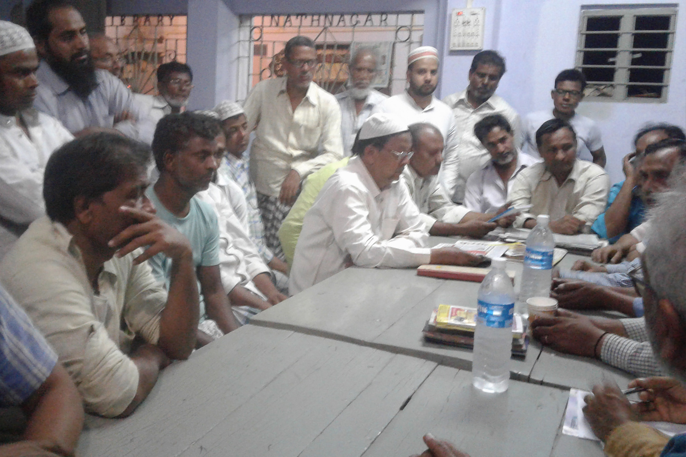
wi,ajdiS idu lKavdhï
PdhdrEmh( Supplied
Notes:
bka miq t<ô osk lsysmfha §" rdyq,a iy Tyqf.a ñ;=rka m%pKav;ajhg ,laùfï jeä wjodkula mej;s uqia,sï iy yskaÿ wi,ajeis m%foaYj, m%cd /iaùï meje;ajQy' tu /iaùïj,§" iafõÉPd idu fiajlhskaf.a lKavdhï msysgqjd .kakd ,o w;r" Tjqka ;u wi,ajeis m%foaYj, f.hska f.g .shy'
rdyq,a fufia mjihs( —ldka;djka iy msßñka hq., jYfhka tlg hdu jeo.;a jqKd" fudlo túg fodr újD; lrk mqoa.,hd ljqre jqk;a" tu mqoa.,hd iu. ksoyfia l;d l< yels wfhla isáh ksid'˜

Slide 7
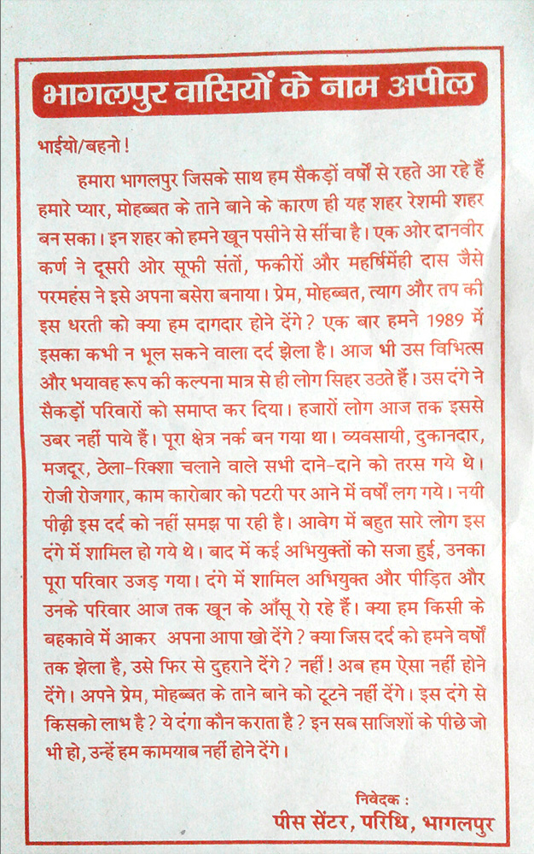
iafõÉPd fiajlhka úiska fnod fokq ,nk m;%sld
PdhdrEmh( Supplied
Notes:
iafõÉPd fiajlhska m;%sld fnod foñka" ;u wi,ajeishkag l;d lrñka iy Tjqkag ijka foñka" wd.ï l=ula jqj;a ler,s flda,dy, fya;=fjka ish,a, krl w;g yefrk wdldrh wjOdrKh lr fmkajd ÿkay' wjg m%foaYfha meje;ajQ /iaùï iy iafõÉPd fiajlhskaf.a l%shdldrlï k.rfha ;;ajh iukh lsÍug WmldÍ úh'

Slide 8
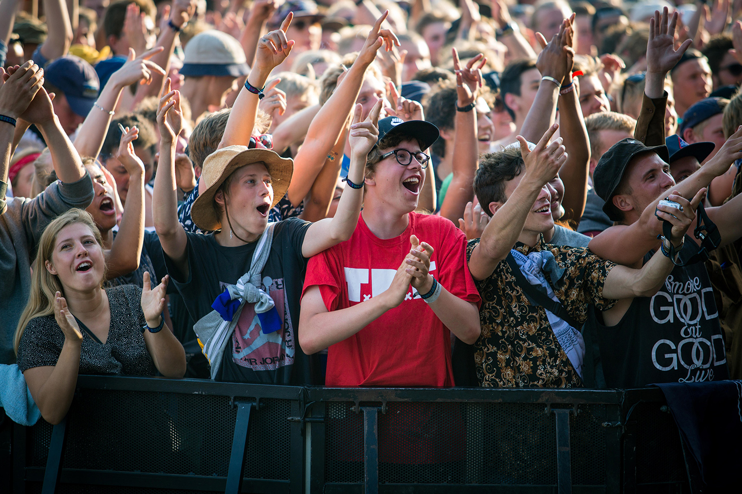
frdials,aâ ix.S; Wf<,"
fvkaud¾lh
PdhdrEmh( Gonzales Photo / Alamy Stock Photo
Notes:
fmd;la tys msgljrfhka ukskak tmd - The Human Library™, fvkaud¾lh'
1990 oYlfha ueo Nd.fha § ñ;=rka y;r fofkla kd.ßl m%pKav;ajhg tfrys úfrdaO;d jHdmdrhla isÿ lsÍu i|yd ;reK ixúOdkhla wdrïN l<y' tys idudðl;ajh l%ufhka j¾Okh jQ w;r" fvkaud¾l ix.S; Wf<,l ixúOdhljrhd tu W;aijh keröug meñfKkakka w;r ixjdohla we;s lsÍu i|yd meje;aúh yels wx.hla ms<sn| woyila bÈßm;a lrk f,i fuu ;reKhskaf.ka b,a,d isáfhah' Tjqyq zudkj fmd;aZ- tkï ;ukaf.a wkkH;djh iy ;u Ôú; w;aoelSï ms<sn| f.!rjkSh ixjdoj, ksr; ùug leu;s mqoa.,hskaj ,nd .; yels zudkj mqia;ld,hlaZ ms<sn| woyi bÈßm;a l<y'

Slide 9
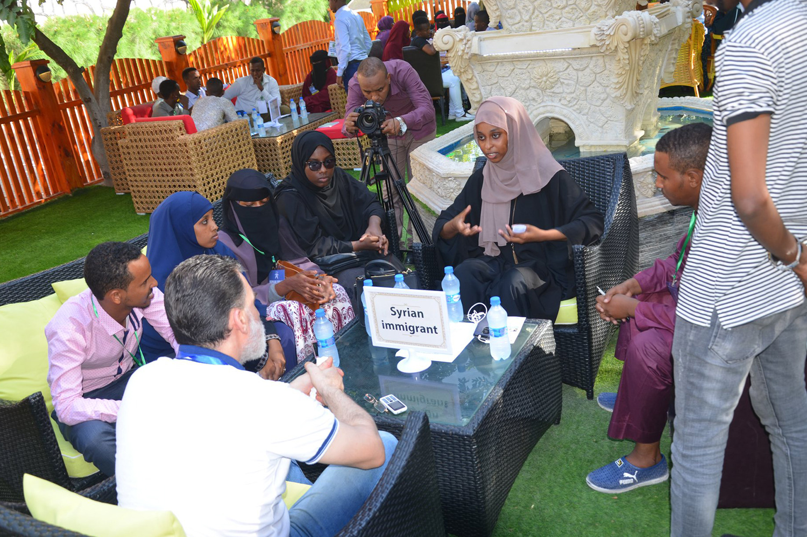
udkj mqia;ld,h"
fidaud,shdj
PdhdrEmh( Human Library Organisation
Notes:
idudkHfhka" zudkj fmd;aZ hkq ;ukaf.a zl;djz wkHhskag bf.kqï w;aoelSula lr oSug iafõÉPdfjka bÈßm;a jk" tu m%dfoaYSh m%cdj ;=< u isák mqoa.,hska fõ' fuu iafõÉPdfjka bosßm;a jkakka idudkHfhka Tjqkaf.a wkkH;djfha hï wx.hla - WodyrKhla f,i" Tjqkaf.a wd.u" úYajdih" jd¾.sl;ajh" ,sx.sl ÈYdk;sh" wdndê;Ndjh fyda tÉ'whs'ù' wdidÈ; ;;a;ajh jeks hï wx.hla ksid w.;sh fyda wmlS¾;sh w;aú|sk mqoa.,hska fõ' fuh jerÈ f;dr;=re u; mokï jQ taldlD;s wvq lsÍug WmldÍ fõ' The Human Library™ ixúOdkh oeka rgj,a 85 g wêl ixLHdjl l%shdldrlï isÿ lrhs'

Slide 10
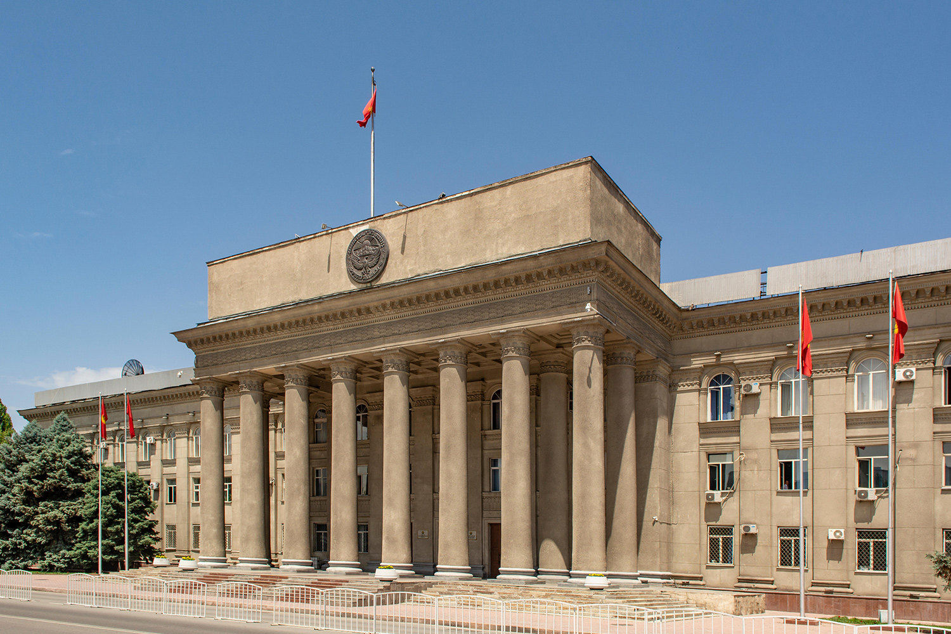
md¾,sfïka;= f.dvke.s,a,"
ls¾.sia;dkh
PdhdrEmh( Robert Wyatt / Alamy Stock Photo
Notes:
n,fha isákakkaj l%shdlsÍug fm<Uùu" ls¾.sia;dkh
2010 úma,jfhka miqj" bjis,sjka; njla ke;s" úkdYldÍ l,a,shla frmrudÿ iy ´;fvdlaia l%sia;shdks ksldhkag wh;a mQckSh ia:dk fld,a,lEug mgka .;ay' fuu m%ydr udi yhl muK ld,hla mqrd wLKavj mej;=Ks' fndfyda meñ‚,s bosßm;aù ;snqK o" wNsfpdaol ld¾hd,h" wd.ñl lghq;= ms<sn| rdcH fldñIka iNdj fyda wNHka;r lghq;= wud;HdxYh tu meñKs,s iïnkaOfhka lsisÿ m%;spdrhla oelajQfha ke;' n,OdÍka mjd m%cdjg Wmfoia ,nd ÿkafka m%cdj úiska u .eg¨‍j u.yrjd .ekSug lghq;= lrk f,ighs'
fuhska l,lsreKq wd.ñl kdhlhska tlg tlaù" cd;sl mqj;am;la wu;d" fuu isoaëka iy n,OdÍkaf.a wld¾hlaIu;djh wjOdrKh l<y' ckdêm;sksh fj; fuu f;dr;=re jd¾;d ùu;a iu. weh fuu isÿùï wehf.a iDcq md,khg k;= lr .;a;dh' Èk y;rla we;=<; ish¨‍ u l,a,s idudðlhskaj w,a,d .kakd ,§'

Slide 11
iqj lrkakka
iïnkaO;d f.dvk.d .kak
tlaj jev lrkak
f;dr;=re fidhkak
ie,iqï lr iQodkï fjkak
Notes:
wi, isákakd - iqj lrkakd wNHdih wNHdih wjika lsÍfï§ fuu ia,hsvh Ndú;d lrñka my; oelafjk lreKq olajkak'
wmsg n,d isákakka fjkjd fjkqjg iqj lrkakka njg m;a ùu i|yd iú{dksl ;SrK .; yel( WodyrKhla f,i whs;sjdislï W,a,x>khùï j,ska mSvdjg m;a jQ mqoa.,hska iu. iïnkaO;d f.dvk.d .ekSu" lKavdhï jYfhka ixúOdkh ùu" wmg wjYH f;dr;=re fiùu iy wms tlg tlaj l%shd lsÍug wjYH wdldrh ie,iqï lsÍu u.ska'
wmg ieuúgu l%shd lsÍug fkdyels jkq we; - th ieuúgu wdrlaIs; fyda M,odhS fkdúh yelæ kuq;a wms in|;d f.dvk.d f.k tlg tlaj lghq;= lrkafka kï wmsg l%shdud¾. .ekSug jeä wjldYhla ;sfnk w;r th jvd;a M,odhS jkq we;'
wmf.a k.rfha wd.u weoySfï fyda úYajdi oeÍfï ksoyi is;shu iys; *a,sma pd¾Ü lvodis fj; wjOdkh fhduq lrjkak' ;uka y÷kd.;a .eg¿ j,ska ;uka iqj lrkafkl= ùug leu;s l=uk .eg¿ i|yd oehs ksy`vj is;d n,k f,i iyNd.Sjkakka f.ka b,a,d isákak' ^iyNd.Sjkakkag is;kakg fudfyd;la bv fokak" kuq;a m%;spdr bosßm;a lrk f,i b,a,d fkdisákak'&
bosß ieisj,§" fuu .eg¨‍j,g wod<j krUkakka ùfï isg iqj lrkakka ùu olajd .uka lrkafka flfia oehs wms is;kafkuq'

Slide 12
uu ljqo wNHdih
ug l=ula l< yelso@
wmg l=ula l< yelso@
wmg wka whj Èßu;a l< yelafla l=ula lsÍugo@
Notes:
uu ljqo wNHdih
wNHdih wjika lsÍfï§ fuu ia,hsvh Ndú;d lrñka my; oelafjk lreKq olajkak'
wms y÷kd.;a tla tla úúO jd;djrKhka ;=<" wmsg krUkafkl= fyda l%shdldÍ iqj lrkafkl= f,i N+ñldjla bgq l< yel' wmsg fuu cd, iy lKavdhï ;=< iy ta yryd wd.u weoSfï fyda úYajdi oeÍfï ksoyi m%j¾Okh lrk iïm;la úh yel'
fuu mdGud,dfõ b;sß fldgfia oS Tn wik iy isÿ lrk iEu fohl§ u lreKdlr m%Yak 3 la .ek is;kak(
ug l< yelafla l=ulao@
WodyrKhla f,i" fouõmsfhla" orefjla" ñ;=frla fyda wi,ajeisfhla f,i uf.a N+ñldj ;=<' /lshdfõ§ uf.a N+ñldj yryd fyda uf.a fm!oa.,sl Ôú;fha oS" WodyrKhla f,i uf.a weoys,s m%cdj ;=< ug we;s N+ñldjka yryd" ug l=ula l< yelso@
wmsg l< yelafla l=ulao@
wms ixúOdkh ù tlg tlaj lghq;= l< fyd;a' WodyrKhla f,i uf.a weoys,s m%cdjg" ;reK lKavdhug fyda fiajd ia:dkhg hï l%shdud¾.hla .; yelso@
wmsg fjk;a mqoa.,hskaj$ixúOdk Èßu;a l< yelafla l=ula lsÍugo@
wka whg l< yels" tfy;a wmsg l< fkdyels foa ;sfí - we;eï úg fjk;a weoys,s m%cdjla fyda m%foaYfha mdif,a m%Odkshd fyda foaj.e;sjrhd' wmsg l%shd lsÍu i|yd Èß.ekaúh yelafla ldjo@

Slide 13
Notes:
wxl 13 isg 23 olajd jk ia,hsv j,ska 6 jeks ieisfha bosßm;a lsÍu ksrEmKh lrhs'
udkj ysñlï m%j¾‍Okh i|yd Wml%u
fuu ieisfha§ iy fmr ieis j,§" wd.u weoySfï iy úYajdi ±Ífï ksoyi i|yd ;ukaf.a m%cdj ;=< hym;a jd;djrKhla we;s lr .ekSu i|yd úúO mqoa.,hska úúO foa lsÍug W;aidy oeÍu ms<sn| l;kaor wms wid ;sfnkjd' tfuka u" wmf.aa m%cdj ;=< wd.u weoySfï fyda úYajdi ±Ífï ksoyi iïnkaOfhka we;s .eg¨‍ ms<sn|j o wms isysm;a lr f.k ;sfnkjd ^wmf.a k.rfha wd.u weoySfï iy úYajdi ±Ífï ksoyi ksrEmKh lrk *a,sma pd¾Ü lvodis fj; wjOdkh fhduq lrkak&'
wms ±ka m%cd uÜgñka udkj ysñlï m%j¾‍Okh lsÍug iy wdrla‍Id lsÍug Ndú;d l< yels úúO Wml%u .ek bf.k .ekSughs iQodkï fjkafka' wmf.a m%cdj ;=< wms y÷kdf.k we;s .eg¨‍ úi£u i|yd wmg fuu Wml%u Ndú;d l< yelafla flfiao hkak .ek wms ±ka is;d n,uq'

Slide 14
w¾:oelaùu( Wml%u
b,lalhla imqrd .ekSu i|yd ie,iqï lrk ,o l%shdud¾. iuQyhls'
Notes:
b;ska" wms zWml%uZ hkafkka woyia lrkafka l=ula±hs n,uq' Wml%u w¾: oelafjkafka zb,lalhla imqrd .ekSu i|yd isÿ lrkq ,nk ie,iqï iy.; l%shdud¾. iuQyhlaZ f,i hs'

Slide 15
Notes:
udkj ysñlï l%shdldrlï i|yd úúO Wml%u j¾. y;rla ;sfnkjd' fuu Wml%u j¾. y;r meyeÈ,s lsÍug WmldÍ ùu i|yd wmg udkj ysñlï W,a,x>khùï ksrEmKh lsÍfï Wmudjla f,i z.skaorZ .ek is;sh yelshs' th wms isrer WKqiqï lr .ekSu i|yd wi,ska jdä ù isáh yels m%ikak .skakla fkdj" Nhdkl" md,kh l< fkdyels .skakla' udkj ysñlï W,a,x>khùï j,ska fuka u" .skafkka o ñksiqkag ydks isÿ fjkjd - tajd ñksiqkag lïmkh" ;=jd, yd urKh f.k fok w;r" foam< yd bvï o úkdY lrkjd'
b;ska wms fldfyduo .sks kj;ajkafka@ wms j¾. y;rlg wh;a l%shdud¾. .kakjd(

Slide 16
yÈis Wml%u
j<lajd .ekSu
keje;aùu iy fírd.ekSu
Wmldr b,a,d isàu iy wk;=re weÕùu
Notes:
w( yÈis Wml%u
yÈis Wml%u hkq .skak wdrïN ùug fmr keje;aùu" .skak ksjd oeóu iy ñksiqka fírd .ekSuhs'
<ufhla .sksl+re iu. fi,a,ï lrñka isákjd Tn ÿgqj fyd;a Tn lrkafka l=ulao@ Tn .skaor ksjd oud .sksl+re ál bj;a lrkjdæ .skakla wdrïN ùu je<elaùug Tn W;aidy lrkjd'
Tn m%udo ù" l=vd .skakla ta jk úg;a wdrïN ù ;snqfKa kï" Tn .sks ksjk WmlrKhla fyda j;=r nd,aÈhla f.k th ksjd oeóug W;aidy lrkjd' .skak keje;aùu u.ska Tn wjodkug ,laj we;s mqoa.,hska iy foam< wdrlaId lsÍug W;aidy lrkjd'
tfy;a .skak b;d úYd, kï" Tn .sks ksjk yuqodfõ Woõ b,a,d isáñka ñksiqkag t;kska bj;a jk f,i wk;=re wÕjkjd'
udkj ysñlï i|yd ;sfnk yÈis Wml%u;a fï yd iudkhsæ úfYaIs; mqoa.,hskag" úfYaIs; ia:dkj,§ isÿùug hk fyda isÿ fjñka mj;sk udkj ysñlï W,a,x>khùï i|yd wms yÈis Wml%u Ndú;d lrkjd' W,a,x>kùula j<lajd .ekSug fyda keje;aùug iy ñksiqka fírd .ekSug iDcqju ueÈy;a ùu" tfia;a ke;skï" Woõ b,a,d isàu iy wjodkug uqyqK § isák mqoa.,hskag wk;=re weÕùu hk folu bka woyia fjkjd'

Slide 17
ysßyer lsÍu
ffjÍ l:kh
foam< úkdY lsÍu
myroSu
wd.ñl ia:dkj,g myroSu
jd¾.sl m%pKav;ajh
w;a;fkdau;sl w;awvx.=jg .ekSï
Notes:
ta wkqj" yÈis wjia:d Wml%u Ndú;d lrkafka l=uk wdldrfha wd.u weoySfï fyda úYajdi ±Ífï ksoyi (FORB) W,a,x>kùï i|yd o@ ysßyer lsÍu" ffjÍ m%ldY isÿ lsÍu" myr§ï" foam< úkdY lsÍu" wd.ñl ia:dkj,g myr §u" jd¾.sl ysxikh iy w;a;fkdau;sl w;awvx.=jg .ekSï hk ish,a, ksYaÑ; mqoa.,hskag fyda lKavdhïj,g ksYaÑ; ia:dkj,§ ksYaÑ; fõ,djl isÿ úh yels W,a,x>kùï j,g WodyrK fjkjd'
yÈis Wml%u u.ska fujeks yÈis isÿùïj,g m%;spdr oelaùug kï" wms tjeks yÈis isÿùïj,g iQodkïj isáh hq;=hs' l=ula l< hq;= oehs oek isáh hq;=hs' ñksiqka .sks ksjk yuqodfõ wxlh ±k isák wdldrfhka u" fyda .sks ksjk WmlrKhla Ndú;d lsÍug bf.k .kakd wdldrhgu" udkj ysñlï W,a,x>k isÿ jk úg tajd je<elaùug" keje;aùug iy Wmldr b,a,d isàug wms bf.k .; hq;=hs'

Slide 18
Notes:
wd( fjkia lsÍfï Wml%u
.skakla ygf.k me;sr hkafka hï fya;=jla ksidhss' WodyrKhla f,i wk;=reodhl f,i úÿ,s /yeka we§u ksid' fjkia lsÍfï Wml%u hkq .skak we;sùug fya;= jk ;;ajhka fjkia lsÍuhs - úÿ,s /yeka wdrla‍Is; nj ;yjqre lr .ekSu i|yd bÈlsÍï fr.=,dis wkq.ukh lsÍu ;yjqre lr .ekSu thg WodyrKhla'
udkj ysñlï W,a,x>khùï o fya;= we;sj isÿ fjkjd' WodyrKhla f,i" ñksiqka wdrlaId lsÍug wjYH kS;s iudchg ke;s ksid fyda tu kS;s wkq.ukh lrkq ,nk njg j. n,d .; hq;= mqoa.,hska tfia fkdlrk ksid W,a,x>khùï isÿ fjkjd' th;a" iudch yryd jeros wdldrhg úÿ,s /yeka weoSula yd iudkhs'

Slide 19
mßj¾;k Wml%u
úfrdaO;d jHdmdr
WoafoaYkh
Èß.ekaùï ,ndoSu
m%;slafIam lsÍu
Notes:
fndfyda udkj ysñlï W,a,x>kùï úi¢h yelafla kS;s fyda hï hï foaj,a isÿ lrk wdldrh fjkia lrk f,i ck;djg ta;a;= .ekaùfuka muKhs'
wmg th úúO wdldr y;rlska isÿ l< yelshs(
.eg¨‍j biau;= lr fmkaùu i|yd Woaf>daIK yd úfrdaO;d oelaùfuka
.eg¨‍j fjkia lsÍu i|yd hï fohla l< hq;= hehs th fjkia lsÍug n,h we;s mqoa.,hskag ta;a;= .ekaùfuka - wms fuh WoafoaYkh f,i y÷kajkjd
ñksiqkag fjkia f,i yeisÍug Èß.ekaùï ,nd §fuka
ke; fyd;a" wms tajd ms<s fkd.kakd nj fmkaùug krl kS;s fyda iudc iïu;hka iduldój m%;slafIam lsÍfuka'
fïjd fjkia lsÍfï Wml%u hs' tajd jvd;a È.= ld,Skj" jvd;a l%udkql+,j" iudcfha mj;sk" fndfyda ia:dk j, isák ñksiqka úYd, ixLHdjlg n,mdk .eg¨‍ flfrys wjOdkh fhduq lsÍug WmldÍ fjkjd'

Slide 20
Notes:
we( f.dvke.Sfï Wml%u
.skak keje;aùu i|yd wmg l< yels ;j;a fohla jkafka uyck;dj oekqj;a lsÍu iy Tjqkaf.a wdl,am fjkia lsÍuhs¦ ±,afjk is./Ü fldg úh<s ìïj,g úis lsÍfuka we;s úh yels wka;rdhka ms<sn|j oekqj;a lsÍu thg tla WodyrKhla' tfuka u" wmg uyck iïkaOùula o f.dvk.d .; yelshs - tkï iafõÉPd .sks ksùïj,g jeä msßila iïnkaO lr .; yelshs' Tjqkaf.a l=i,;d f.dvke.sh yelshs - WodyKhla f,i" .sks ksjk WmlrKhla Ndú;d lrkafka flfia oehs ñksiqka oekqj;aj isák nj iy;sl lr .ekSug lghq;= l< yelshs'
udkj ysñlï iïnkaOfhka .;a l," f.dvke.Sfï Wml%u hkq udkj ysñlï ixialD;shla f.dvke.Su i|yd lrk È.= ld,Sk ld¾hhla' tkï" iEu flfkl= u ;ukaf.a whs;sjdislï iy wkqkaf.a whs;sjdislï okakd" udkj ysñlï j,g .re lsÍu idudkH iy ksjeros fohla f,i olsk" whs;sjdislï W,a,x>kh jqj fyd;a l=ula l< hq;= hehs okakd" ;ukaf.a iy wfkla whf.a whs;sjdislï j,g .re lrk iy ke.S isàk wdldrh okakd iudchla Wfoid lghq;= lsÍu hs'

Slide 21
f.dvke.Sfï Wml%u
oekqj;aNdjh f.dvk.kak
iïnkaOùï f.dvk.kak
l=i,;d f.dvk.kak
cd, f.dvk.kak
Notes:
fujeks iudchla f.dvke.Sfï ld¾hhg lreKq 4 la we;=<;a fjkjd(
udkj ysñlï j, jeo.;alu ms<sn|j oekqj;a lsÍu" iy isÿfjñka mj;sk W,a,x>khùï iy tajdhska isÿjk ydksh ms<sn|j oekqj;a lsÍu'
iïnkaOùï f.dvke.Su - udkj ysñlï m%j¾Okh lsÍug mshjr .ekSu i|yd lemùug jeä jeäfhka ñksiqka fhduq lsÍu'
l=i,;d f.dvke.Su - udkj ysñlï m%j¾‍Okh lrkafka flfia oehs ñksiqka ±kqj;a jk mßÈ l=i,;d f.dvke.Su'
;jo" úúO ia:dk j, úúO foa lrk" tfy;a iïnkaëlrKhlska hq;= wdldrhlg fmdÿ wruqKq lrd lghq;= lrk" mqoa.,hska iy ixúOdk cd,hla f.dvke.Su'
fïjd fjkia ùu i|yd mQ¾j fldkafoais ks¾‍udKh lrk" È.= ld,Sk Wml%uhs' tajd wms wfkla ish¨u Wml%u Ndú;d lrk úg wmsg ke.S isàug wjYH mokula f.dv k.kjd'

Slide 22
Notes:
wE( wjidk jYfhka" wmg iqj lsÍfï Wml%u ;sfnkjd'
.skakla fuka u" udkj ysñlï W,a,x>khùï o ñksiqkag" foam<j,g iy m%cdjkag ydks lrkjd' iqj lsÍfï Wml%u hkq udkj ysñlï W,a,x>k isÿ jQ miq ñksiqkaj /ln,d .ekSu i|yd wm lrk foaj,a j,ghs'

Slide 23
iqj lsÍfï Wml%u
øjHuh yd ufkdaiudchSh iydh
W,a,x>khùï f,aLk.; lsÍu
hqla;sh b,a,d isàu
wkqiaurKh lsÍu
Notes:
tla w;lska óg ñksiqkag iqjh ,eîu i|yd wjYH lrk ffjoH" øjHuh yd ufkda-iudchSh iydh imhd fok nj iy;sl lr .ekSu we;=<;a fjkjd' kuq;a .re;ajh yd hqla;sh o we;=<;a fjkjd'
isÿjQ foh ie`.úh fkdyels njg iy;sl lr .ekSu i|yd" th f,aLk.; lsÍu"
isÿ jQ foa ms<sn|j l:d lsÍug yd isysm;a lsÍug ñksiqkag wjia:dj ,nd §u¦ iy
ñksiqkag hqla;sh bgqjk nj yd jkaÈ ,efnk nj iy;sl lr .ekSu'

Slide 24
j<lajd .ekSu keje;aùu iy fírd.ekSu
Wmldr b,a,d isàu iy wk;=re weÕùu
úfrdaO;d jHdmdr
WoafoaYkh
Èß.ekaùï ,ndoSu
m%;slafIam lsÍu
oekqj;aNdjh f.dvk.kak
iïnkaOùï f.dv k.kak
l=i,;d f.dvk.kak
cd, f.dvk.kak
iydh oSu
f,aLk.; lsÍu
hqla;sh b,a,d isàu wkqiaurKh lsrSu
Notes:
iudma;sh
udkj ysñlï m%j¾‍Okh lsÍu i|yd fï úúO l%u ish,a, u jeo.;a fjkjd' tajd tllska wfkflys wvqj mqrjkjd" tlsfkl wka;¾ iïnkaê;hs" tlsfkl iu.dó f,i Ndú;d l< yelshs'
lsisÿ ;ks mqoa.,fhl=g fyda ixúOdkhlg ish¨‍ Wml%u Ndú;d l< fkdyelshs - l=uk Wml%u Ndú;d l< hq;=o hkak ms<sn| wmf.a f;aÍug ksis f,i n,mdk úúO N+ñld" l=i,;d iy wjia:d wmg ;sfnkjd' jeo.;au foh jkafka" iEu flfkl=gu hula l< yels ùuhs' wm w;f¾ isák" tlu wdldrhlg is;k mqoa.,hskaf.a iy ixúOdk cd, yryd wmg foaj,a fjkia l< yelsùuhs'
udkj ysñlï W,a,x>khùï keue;s .sks keje;aùug" iy wmf.a ksfjiaj, iy m%cdjka ;=< iy wmf.a rchka úiska udkj ysñlï j,g .re lrkq ,nk iudchla f.dvke.Su i|yd wm ish¨ fokdgu odhl úh yelshs'

Slide 25
ysßyer lsÍu
ffjÍ l:kh
foam< úkdY lsÍu
myroSu
wd.ñl ia:dkj,g myroSu
jd¾.sl m%pKav;ajh
w;a;fkdau;sl w;awvx.=jg .ekSï
Notes:
l:d lsÍfï yÈis Wml%u wNHdih
my; i|yka lreKq i|yka lrñka iy fuu ia,hsvh fmkajñka wNHdih y÷kajd fokak'
fuu ieisfha b;sß fldgfia§" wms yÈis Wml%u flfrys wjOdkh fhduq lrk w;r" wmf.a m%cdjka ;=< mj;sk wd.u weoySfï fyda úYajdi oeÍfï ksoyi iïnkaO .eg¿ úi£ug wmg tajd Ndú;d l< yelso hkak ms<sn|j is;d n,kafkuq' wms ó<Õ ieisfha § wfkl=;a Wml%u foi n,kafkuq'
fuu wNHdih yryd wms wmf.a m%cdj ;=< l%shd;aul ùu i|yd fhdod.; yels yosis Wml%u bf.k .ekSug fukau yels ;dla jeä woyia m%udKhla nqoaê l,ïNkh lsÍug o lghq;= lrkafkuq' is;d ne,Su - ug l< yelafla l=ulao@" wmsg l< yelafla l=ulao@ iy wmg wka whj osßu;a l< yelafla l=ula lsÍugo@
kuq;a wms th wdrïN lsÍug fmr" wd.u weoySfï fyda úYajdi oeÍfï ksoyi iïnkaO zyÈis wjia:djlaZ hkq l=ulaoehs wms u isysm;a lr .ksuq'
lsishï ia:dkhl isák lsishï mqoa.,fhlf.a udkj ysñlï W,a,x>khùula isÿ jk úg fyda isÿùug wdikak úg yÈis Wml%u Ndú;d lrkq ,efí' tu ksid" wms fuu Wml%u fhdod .ksñka l%shd lsÍug W;aidy lrkafka l=uk wdldrfha wd.u weoySfï fyda úYajdi oeÍfï ksoyi W,a,x>khùï iïnkaOfhkao@
ysßyer lsÍu - WodyrKhla f,i iq¿ cd;sl ldka;djkag uyu. oS ysßyer lsÍu
ffjÍ m%ldY ^ud¾..;j fyda mqoa.,sl jYfhka&
úkdY lsÍï fyda myr§ï jeks ffjÍ wmrdO
wd.ñl ia:dk j,g myr §u
jd¾.sl m%pKav;ajh
w;a;fkdau;sl w;awvx.=jg .ekSï

Slide 26
iqj lrkakka
iïnkaO;d f.dvk.d .kak
tlaj jev lrkak
f;dr;=re fidhkak
ie,iqï lr iQodkï fjkak
Notes:
wjidk woyia ±laùu
wxl 26 isg 28 olajd jk ia,hsv fmkajñka" my; oelafjk woyia fnod foñka ieish wjika lrkak(
fuu ieisfha fuhg fmr wms krUkakka ùfï isg iqj lrkakka njg m;a úh yels l%u ms<sn|j l:d lf<uq' wms in|;d f.dvkÕd .ekSu" tlaj jev lsÍu" f;dr;=re fiùu" iy ie,iqï lsÍu iy fmr iQodkïùu ms<sn|j l:d lf<uq'

Slide 27
yÈis Wml%u Ndú;d lsÍug iQodkï ùu
isÿ úh yels W,a,x>kh lsÍï y÷kd .kak - ljqo" l=ulao" fldfyao" ljodo
,nd Èh yels m%;spdr y÷kd .kak
tlajkak
oekqj;a fjkak
wjodkï ;lafiare lrkak
Notes:
yÈis Wml%u iïnkaOfhka ie,lSfïoS" wms oeka idlÉPd lrñka isá wdldrfha m%Yak weiSu fuhg we;=<;a fõ' WodyrK f,i(
wd.u weoySfï fyda úYajdi oeÍfï ksoyi iïnkaO yÈis wjia:d u.ska n,mEug ,laúh yelafla ljqrekao" fldfyaoS iy ljodo hkak y÷kd .ekSu'
fuu yÈis wjia:d isÿùug fmr wmsg tajdg m%;spdr oelaúh yelafla flfiao hkak .ek is;Su'
WodyrK f,i( iudc udOHj, ffjÍ m%ldY m<lr ;sîu fyda uyu.oS ysßyer lsÍï isÿjkq olsk úg uu fm!oa.,slj l%shd l< hq;af;a flfiao@
tfia;a ke;s kï" uu tlaj ie,iqï lrk" fmriQodkï jk iy tlaj l%shd lrk lKavdhul fldgila f,i jvd;a ixúOdkd;aul" l%shdYS,S m%;spdrhla ilia l< hq;= jkafkao@
m%;spdr oelaùug wmsg yels jk mßos wjYH ish¨ ‍u f;dr;=re iy iïnkaO;d wm i;=j ;sfí oehs mÍlaId lr ne,Su'
tfuka u" we;a; jYfhkau" wms wdrlaIs;j isákafkah iy foaj,a jvd;a krl w;g yefrkafka ke; hkak iy;sl lr .ekSu i|yd wjodkï ;lafiare lsÍu'

Slide 28
yÈis Wml%u
mßj¾;k Wml%u
f.dvke.Sfï Wml%u
iqj lsÍfï Wml%u
Notes:
we;a; jYfhkau" yÈis Wml%u hkq wms Ndú;d lsÍug leu;s Wml%u fkdúh yel' WodyrKhla f,i" oekqj;aNdjh we;slsÍu fyda mßj¾;khla isÿlsÍu i|yd úfrdaO;d jHdmdr meje;aùu wms jvd;a leue;a;la olajk l%shdud¾. úh yelsh' lsisfjl=g iEu fohlau lsÍug fkdyel" ke; fyd;a ish¨ foa lsÍug W;aidy fkdl< hq;=hæ
ó<Õ ieisfha§" wms mßj¾;kh lsÍfï Wml%u" f.dvke.Sfï Wml%u iy iqj lsÍfï Wml%u i|yd l%shdldÍ woyia bf.k f.k tajd nqoaê l,ïNkh lrkafkuq' wms yels ;rï l%shdldÍ woyia /ia lsÍug b,lal lrkafkuqæ
bkamiqj" mdGud,dfõ wjidk ieis fofla§" wms fuu foaj,a jvd;a iSud lr .ksuq - wmsg ienúka u úi|d .ekSug wjYH .eg¿ fudkjdo hkak iy wms y÷kdf.k we;s l%shdud¾. j,ska jvd;a u M,odhS iy h:d¾:jd§ jkafka ljr tajdo hkak is;d n,uq'
ish¨ fokdgu Tjqkaf.a il%Sh iyNd.S;ajh fjkqfjka ia;+;s lrñka ieish wjika lrkak'

Slide 29
b;d fyd|hs" idorfhka kej; ms<s.kakjdæ
ó<Õ ieish(
l:d lsÍfï Wml%u

