Slide 1
cs;@u; kl;l khw;wKz;lhf;Feu;fSf;fhd gapw;rp newp

Slide 2
mku;T 6:
fijfspdhy; <u;f;fg;gly; - cj;jpfspdhy; tYg;ngwy;
Notes:
midtiuAk; mku;tpw;F tuNtw;W gpd;tUtdtw;iw tpsf;Fq;fs;:
,Jtiu ,lk;ngw;w mku;Tfspy;> ehk; kdpj cupikfs;> kjk; my;yJ ek;gpf;iff;fhd Rje;jpuk; kw;Wk; kdpj cupik kPwy;fs; njhlu;gpy; fw;Ws;Nshk;. mj;Jld; vkJ rKjhaj;jpy; kjk; my;yJ ek;gpf;iff;fhd Rje;jpuj;jpd; kPwy;fs; vt;thW fhzg;gLk; vd;gJ gw;wpAk; ghu;j;Njhk;.
jw;NghJ Kjy; ehq;fs; nraw;ghl;bid ikag;gLj;jg; Nghfpd;Nwhk;. ,t; mku;tpYk; mLj;j mku;tpYk;> kdpj cupikfis Nkk;gLj;Jtjw;F gad;gLj;jf;$ba NtWgl;l Kiwfs; my;yJ cj;jpfs; gw;wp fz;lwpag;Nghfpd;Nwhk; vd;gJld; mt; cj;jpfis ehk; vt;thW gad;gLj;jg;Nghfpd;Nwhk; vd;gJ Fwpj;Jk; rpe;jpf;fg; Nghfpd;Nwhk;. ,Wjp ,U mku;Tfspy; ehq;fs; nraw;jpl;lq;fis Mf;FtJ njhlu;gpy; ikag;gLj;jp ghu;g;Nghk;.
jq;fSila rKjhaq;fspy; kjk; my;yJ ek;gpf;iff;fhd Rje;jpuk; njhlu;gpy; khw;wj;jpid Vw;gLj;Jfpd;w %d;W egu;fspd; fijfisf; Nfl;gjD}lhf ehk; ,jid Muk;gpf;fg; Nghfpd;Nwhk;.

Slide 3
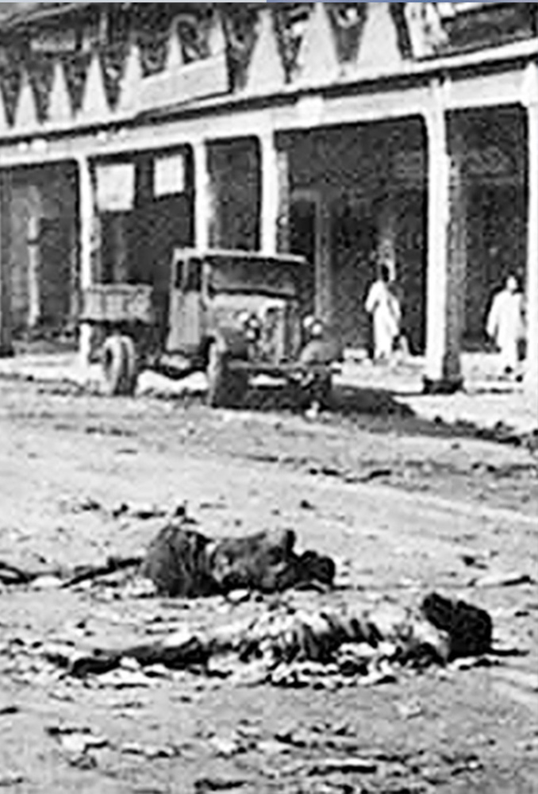
ghfy;G+u; ,e;jpah
1989 ,d; fytuq;fs;
Photo: Vikramvisu / Shutterstock Photo:Unknown
Notes:
khw;wKz;lhf;Feu;fspd; fijfs; rpW FO gapw;r 3-10 tiuahd ];iyLfs; gapw;rpapypUe;J 3 khw;wKz;lhf;Feu;fspd; fijfis vLj;Jf; fhl;Lfpd;wd.
uhFypd; fij
uhFy; fpof;F ,e;jpahtpd; ghfy;Gupdpy; trpf;fpwhu;. efuj;jpd; kf;fs;njhifapy; Rkhu; 80% ,e;Jf;fs; kw;Wk; 18% K];ypk;fs;> vd;gNjhL me;efuk; td;Kiw tuyhw;iwf; nfhz;Ls;sJ.1989 ,y;> ,lk;ngw;w fytuj;jpy; 1000f;Fk; Nkw;gl;l K];ypk;fs; nfhy;yg;gl;ljhfTk; 50>000 kf;fs; ,lk;ngau;e;jjhfTk; mwptpf;fg;gl;lJ.

Slide 4
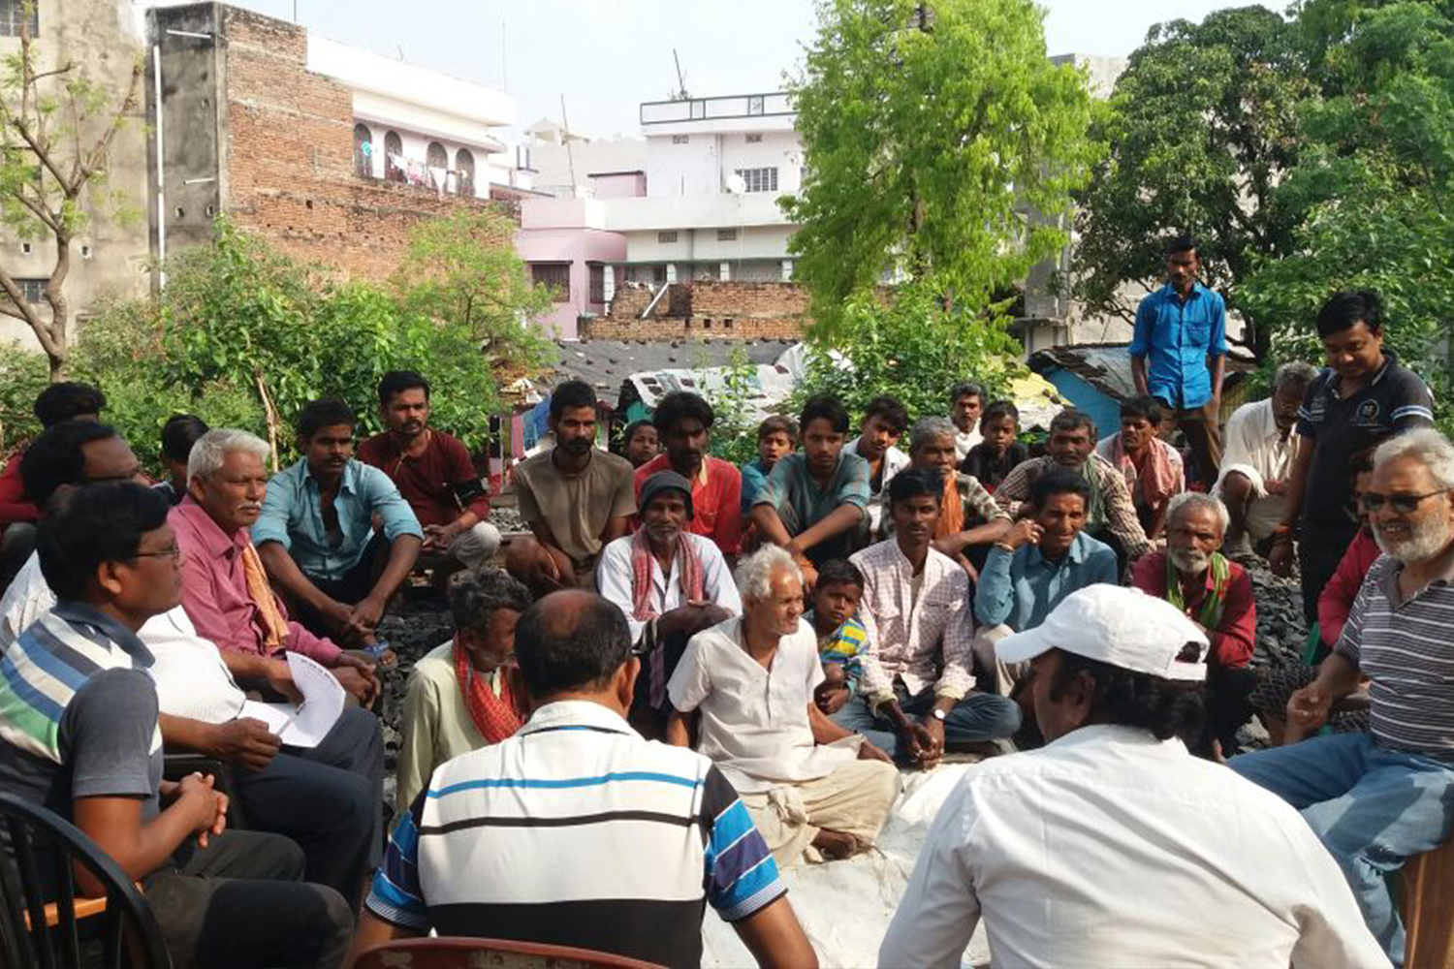
rkhjhdf; FOtpd; $l;lk;
Photo: Supplied
Notes:
,e;J kjj;ijr; Nru;e;j uhFy;> efupy; cs;s ru;tkj mikjp ikaj;jpy; <Lgl;Ls;shu;. gpuptpdUf;F ,ilapy; cwTfisAk; ek;gpf;ifiaAk; fl;bnaOg;g mtu;fs; Ntiy nra;fpwhu;fs;. cjhuzkhf> mikjpf; FOf;fspD}lhf fyhr;rhu tpohit Vw;ghL nra;tjd; %yk;> kjj; jiytu;fis ,izf;fpwhu;fs;. ,e;j ePz;l fhy mikjpg; gzpahdJ> epfo;Tfs; fl;Lg;ghl;il kPwpr; nry;yj; njhlq;Fk; NghJ> ​​mtru eltbf;if vLf;ff;$ba mbj;jskhf mikfpwJ. ,J mjpf toikahf Njitg;gLk;.

Slide 5
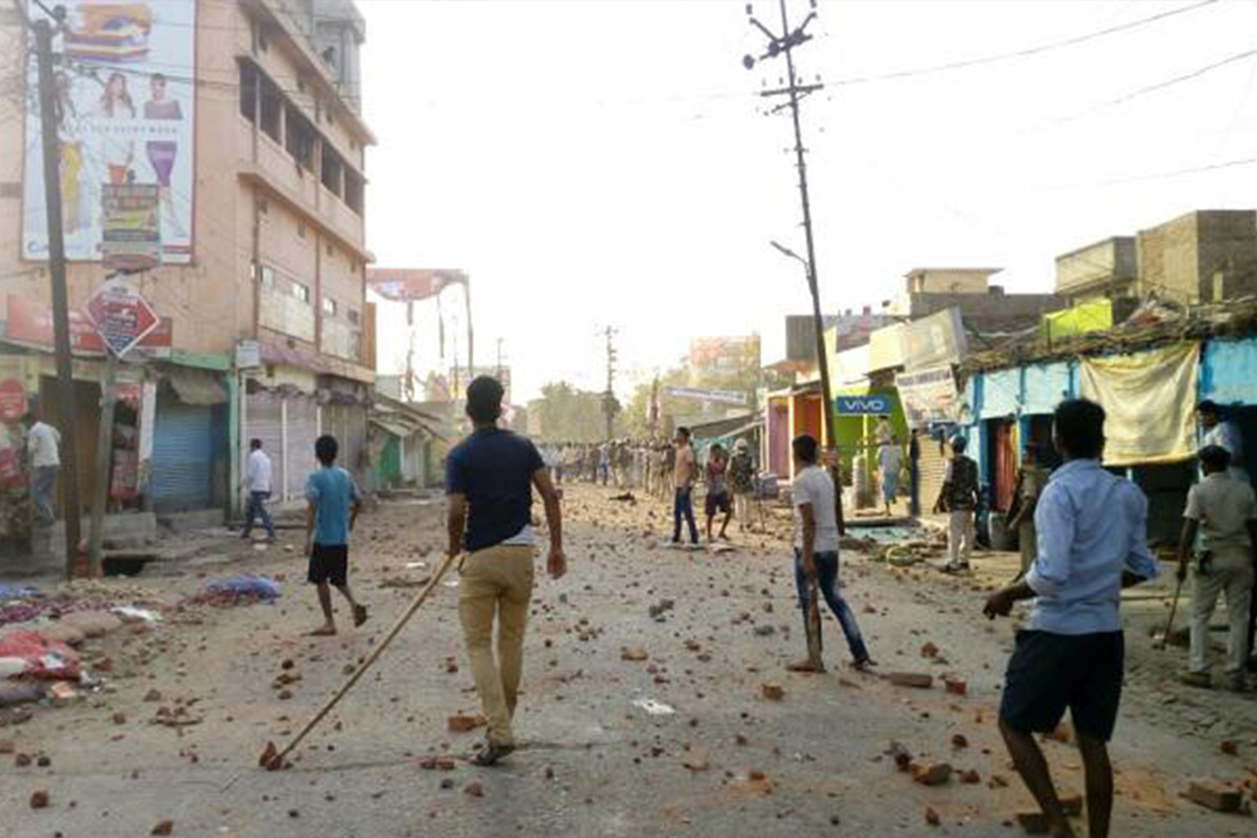
ghfy;G+upy; etPd fytuk;
Photo: David Talukdar / Alamy Stock Photo
Notes:
Fwpg;ghf Nju;jy; gpurhuq;fspd; NghJ td;Kiwfs; Vw;gLtJ rf[k;. 2019 ,y;> xU ,e;J Njrpathj Nju;jy; Ntl;ghsu; xU K];yPk; gFjp topahf mzptFg;G elj;jpdhu; kw;Wk; fytuj;ijj; J}z;Ltjw;F ntWg;G+l;Lk; Ngr;Rfisg; gad;gLj;jpdhu;. rpy K];yPk; ,isQu;fs; Nfhgj;Jld; $r;rypl;lNghJ> ​​Ntl;ghsu; td;Kiwiaj; njhlq;fpdhu;> ,jdhy; filfs; kw;Wk; tPLfs; Nrjkile;jd. fytuk; kw;w gFjpfSf;Fk; gutp td;Kiwahf khWk; mghak; ,Ue;jJ. ,J vt;tsT Mgj;jhdJ vd;gij uhFYk; mtuJ rfhf;fSk; mwpe;jpUe;jdu;.

Slide 6
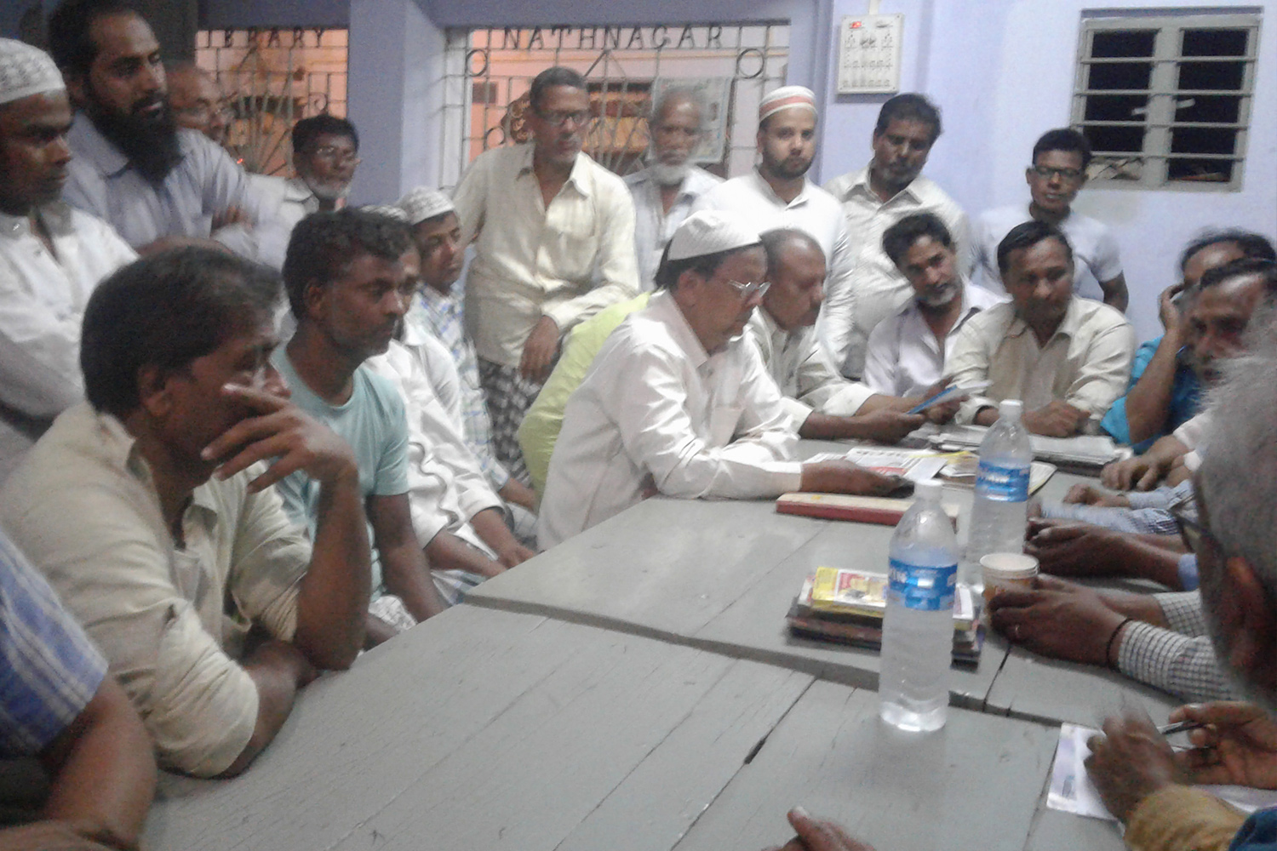
mayf mikjpf; FO
Photo: Supplied
Notes:
mLj;jLj;j ehl;fspy;> uhFYk; mtuJ rfhf;fSk; td;Kiw mghaj;jpy; cs;s K];ypk; kw;Wk; ,e;J Rw;Wg;Gwq;fspy; r%ff; $l;lq;fis elj;jpdu;. $l;lq;fspy;> mikjp jd;dhu;tyu;fspd; FOf;fs; cUthf;fg;gl;ld> mtu;fs; jq;fs; nrhe;j Rw;Wg;Gwq;fspy; tPL tPlhfr; nrd;wdu;.
“Mz;fSk; ngz;fSk; Nru;e;J nry;tJ Kf;fpak;> Vnddpy; fjitj; jpwe;jg;gtu;fs; ahuhf ,Ue;jhYk; Rje;jpukhfg; Ngrf;$ba xUtu; mq;F ,UNgg;gu;" vd uhFy; njuptpj;jhu; .

Slide 7
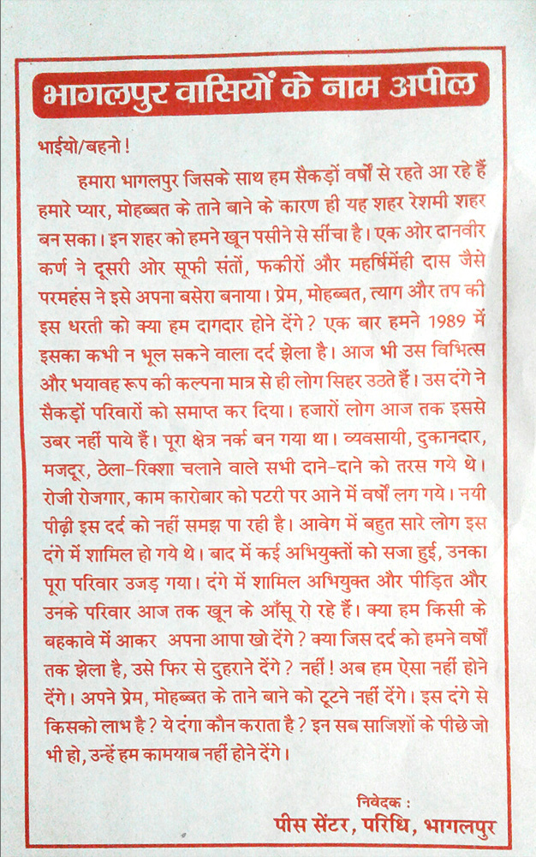
jd;dhu;tsu;fspdhy; gfpug;gl;l Jz;L gpuRuq;fs;
Photo: Supplied
Notes:
jd;dhu;tj; njhz;lu;fs; Jz;Lg; gpuRuq;fis toq;fpdu; kw;Wk; jq;fs; maytu;fsplk; Ngrpmtu;fsJ fUj;ijAk; nrtpkLj;jdu;> fytuk; vt;thW ve;j kjj;ijg; nghUl;gLj;jhky; midtiuAk; Nkhrkhf ghjpf;Fk; vd;gij typAWj;jpdhu;fs;. mjpu;\;ltrkhf ,t; maytu;fSldhd $l;lq;fs; kw;Wk; jd;dhu;tyu;fs; efuj;jpd; R+o;epiyia mikjpg;gLj;j cjtpdhu;fs;.

Slide 8
nld;khu;f;fpd; nuh];fpy;Nl ,irj; jpUtpoh
Photo: Gonzales Photo / Alamy Stock Photo
Notes:
xU Gj;jfj;ij mjd; ml;ilia itj;J kjpg;gplhjPu;fs; -kdpj E}yfk;™> nld;khu;f;
1990 fspd; eLg;gFjpapy; ehd;F ez;gu;fs; efu;g;Gw td;Kiwf;F vjpuhf gpur;rhuk; nra;a xU ,isQu; mikg;igj; njhlq;fpdu;. mjd; cWg;gpdu; vz;zpf;if mjpfupj;jJ kw;Wk; Nldp\; ,ir tpohtpd; mikg;ghsu;> tpoh ghu;itahsu;fspilNa ciuahliy tsu;g;gjw;fhd xU epfo;tpw;fhd Nahridiaf; nfhz;L tUkhW mtu;fsplk; Nfl;lhu;. ghu;itahsu;fs; "kdpj Gj;jfq;fis" fld; thq;ff;$ba xU kdpj E}yfj;jpd; Nahridia mtu;fs; nfhz;L te;jdu;: mtu;fspd; milahsk;> tho;f;if mDgtq;fs; kw;Wk; fUj;Jf;fisg; gw;wp kupahijahd ciuahly;fspy; <Lgl tpUk;Gk; egu;fs;.

Slide 9
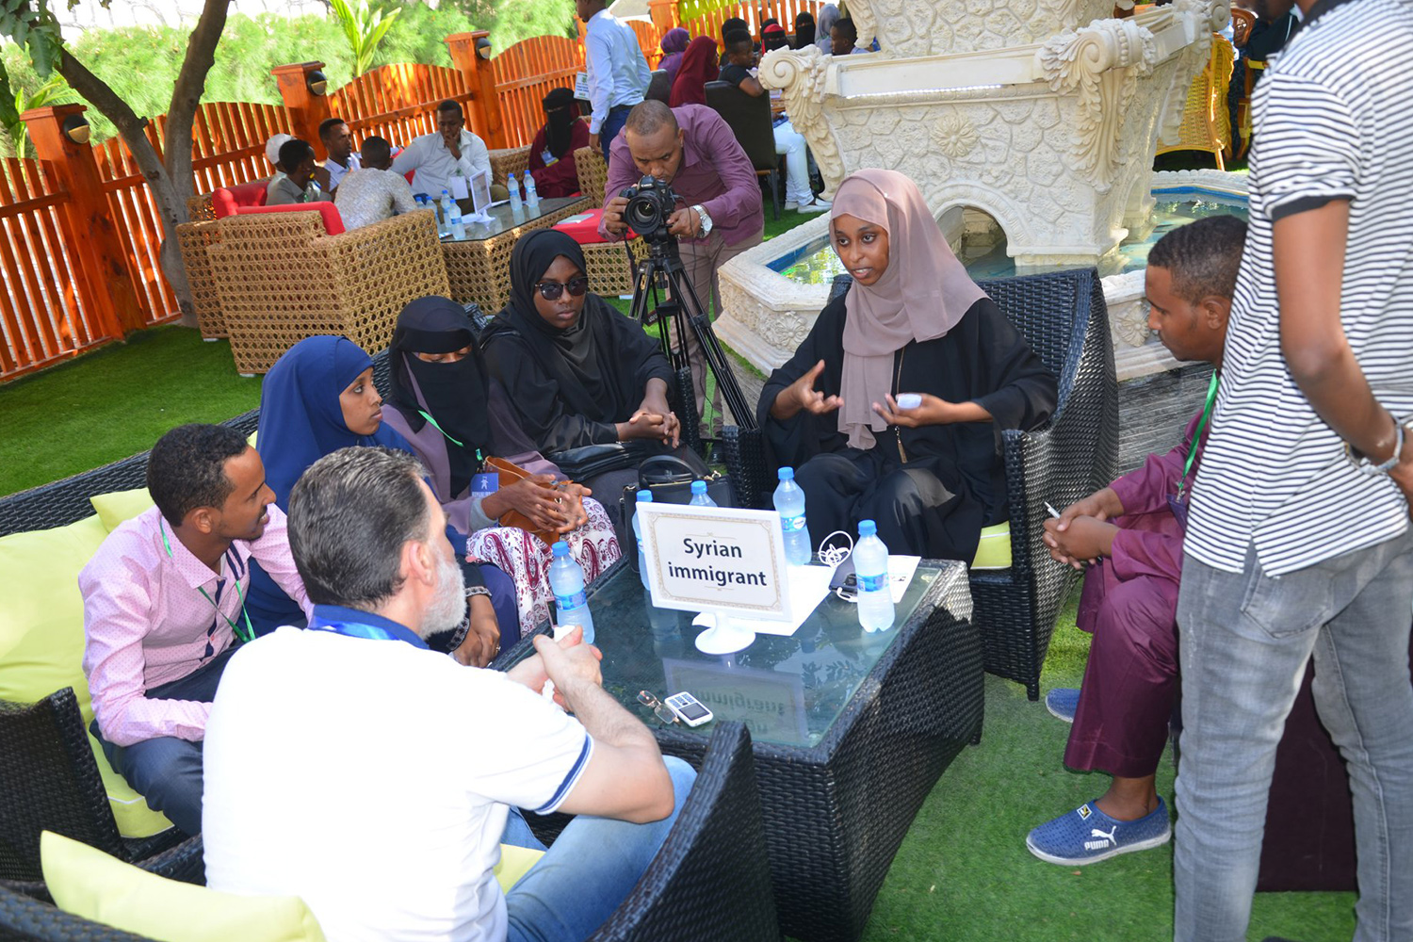
kdpj E}yf epfo;T
Photo: Human Library Organisation
Notes:
nghJthf> kdpjg; Gj;jfq;fs; vd;gJ cs;Shu; r%fj;ijr; Nru;e;jtu;fs;> jq;fspd; ‘fij’ fw;wy; mDgtj;ij kw;wtu;fSf;F toq;f Kd;te;J> jtwhd jftywpe;j epiyahd vz;zg;Nghf;if nfhz;ltu;fis Fiwf;fpwJ. jd;dhu;tyu;fs; nghJthf jq;fs; milahsj;jpd; xU mk;rk; jtwhf czug;gl;ljhf my;yJ fsq;fj;Jld; njhlu;Ggl;ljhf ,Uf;Fk;. - cjhuzkhf mtu;fspd; kjk;> ek;gpf;if> ,dk;> ghypay; Nehf;Fepiy> ,ayhik my;yJ vr;.I.tp.Njhw;W Nghd;wit. kdpj E}yfk;™ mikg;G ,g;NghJ 85f;Fk; Nkw;gl;l ehLfspy; nray;ghLfisf; nfhz;Ls;sJ

Slide 10
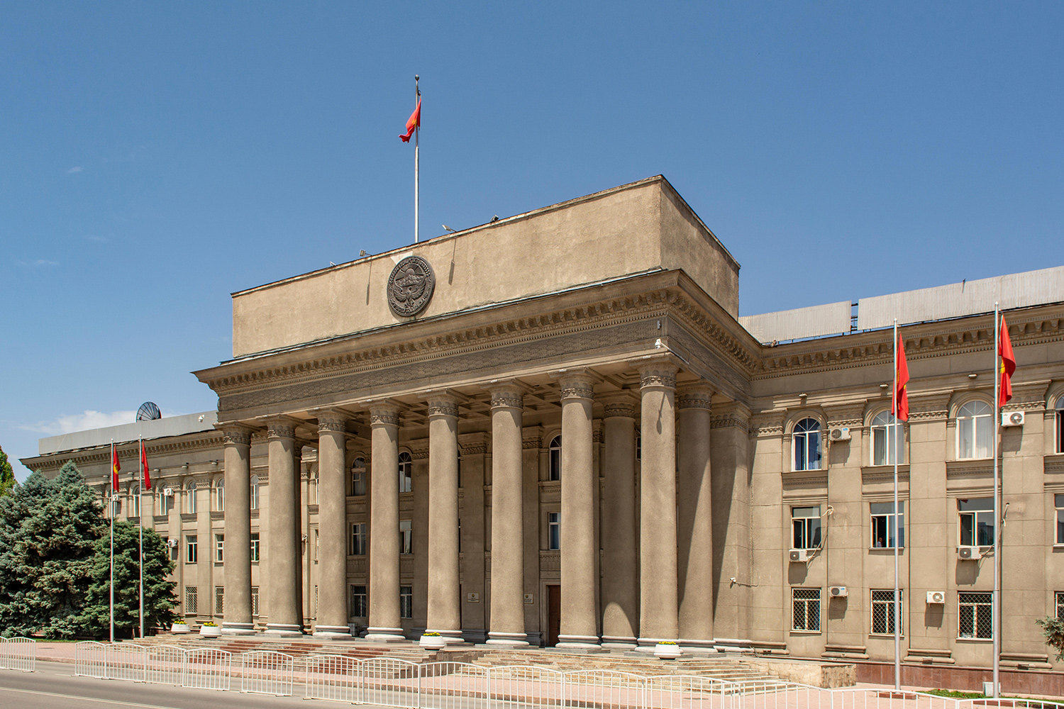
ghuhSkd;wk; > fpu;fp];jhd;
Photo: Robert Wyatt / Alamy Stock Photo
Notes:
nray;gl J}z;Ljy;> fpu;fp];jhd;
2010 Gul;rpiaj; njhlu;e;J> rfpg;Gj;jd;ikaw;w ehrfhuu;fspd; xU rpwpa Fk;gy; Guhl;l];jhe;J kw;Wk; goikthj fpwp];jt gpupTfSf;F nrhe;jkhd topghl;Lj; jyq;fis R+iwahlj; njhlq;fpaJ. Rkhu; MW khjq;fSf;F jhf;Fjy;fs; njhlu;e;jd. gy Gfhu;fs; ,Ue;jNghjpYk;> tof;fwpQu; mYtyfk;> kj tptfhuq;fSf;fhd khepy Mizak;> cs;Jiw mikr;rfk; Mfpatw;wpypUe;J ve;j vjpu; eltbf;ifAk; vLf;fg;gltpy;iy ,y;iy. ,g;gpur;idia jhq;fshfNt ifahSk;gb> mjpfhupfs; r%fq;fSf;F mwpTWj;jpdu;. tpuf;jpaile;j kjj; jiytu;fs; xd;W$b> rk;gtq;fisAk; mjpfhupfspd; nrayw;w jd;ikiaAk; ntspr;rk; Nghl;Lf; fhl;l Njrpa nra;jpj;jhs; xd;iwj; njhlu;G nfhz;ldu;. jftywpe;j [dhjpgjp ,t;tplaj;ij mtuJ Neubf; fl;Lg;ghl;bd; fPo; vLj;Jf;nfhz;lJld; 4 ehl;fSf;Fs; Fk;giyr; Nru;e;jtu;fs; midtUk; gpbgl;ldu;.

Slide 11
Njw;Weu;fs;
cwTepiyfisf; fl;bnaOg;Gjy;
xd;wpize;J gzpahw;Wjy;
jfty;fis ehLjy;
jpl;lkply; kw;Wk; jahuhjy;
Notes:
ghu;itahsu;-Njw;Weu; gapw;rp
fPo;tUk; tplaq;fis nrhy;yp> gapw;rpapid epiwT nra;Ak;NghJ ,e;j ];iybidg; gad;gLj;Jq;fs;.
ghu;itahsu;fshf ,Ug;gjw;F gjpyhf Njw;Weuhf khWtjw;fhd czu;T tpopg;Gila jPu;khdq;fis ehk; vLf;f KbAk;> cjhuzkhf cupik kPwy;fspdhy; ghjpf;fg;gl;Ls;s egu;fSld; cwTepiyapidf; fl;bnaOg;GtjD}lhf> FOf;fshf xOq;fikf;fg;gl;Lf; nfhs;tjD}lhf> vkf;F Njitahdj; jfty;fisj; NjLtjD}lhf kw;Wk; ehq;fs; vt;thW xd;wpize;J nraw;glNtz;Lnkd jpl;lkpLtjD}lhf.
vq;fshy; vg;NghJk; nray;gl KbahJ - mt;thW nra;tJ vg;NghJk; ghJfhg;ghfNth> Mf;fg;G+u;tkhfNth ,Uf;fhJ! Mdhy; ehk; cwTfis fl;bnaOg;GtJ> xd;whf Ntiy nra;tJ Nghd;wtw;wpd; %yk; nray;gLtjw;fhd tha;g;Gfs; mjpfk; kw;Wk; kpfTk; gaDs;sjhf ,Uf;Fk;.
vkJ efuj;jpd; kjk; my;yJ ek;gpf;iff;fhd Rje;jpuj;jpd; tiuglj;jpidf; nfhz;Ls;s efu;T tpsf;fg;glj; jhisf; fhl;Lq;fs;. gq;Fgw;Weu;fs; milahsg;gLj;jpAs;s gpur;rpidfspy; vit Fwpj;J mtu;fs; Njw;Weu;fshf ,Uf;f tpUk;Gfpwhu;fs; vd mikjpahf rpe;jpf;FkhW gq;Fgw;Weu;fisf; Nfl;Lf; nfhs;Sq;fs;. (egu;fs; rpe;jpg;gjw;F rpy nehbfis toq;Fq;fs;> Mdhy; mtu;fspd; gjpy;fis $WkhW Nfl;f Ntz;lhk;.)
,dptUk; mku;Tfspy;> ,j;jifa gpur;rpidfs; njhlu;ghf ghu;itahsuhf ,Ue;J vt;thW Njw;WeuhtJ vd;gJ Fwpj;J rpe;jpf;fg; Nghfpd;Nwhk;.

Slide 12
ehd; ahu; gapw;rp
ehd; vd;d nra;a KbAk;?
ehq;fs; vd;d nra;a KbAk;?
VidNahu; nra;a Ntz;Lnkd ehk; vjid Cf;fg;gLj;j KbAk;?
Notes:
ehd; ahu; gapw;rp
fPo;tUk; tplaq;fis nrhy;yp> gapw;rpapid epiwT nra;Ak;NghJ ,e;j ];iybidg; gad;gLj;Jq;fs;.
ehq;fs; milahsg;gLj;jpa xt;nthU NtWgl;l mikg;gpYk;> ehq;fs; ‘ghu;itahsuhf’ my;yJ ‘Kidg;ghd Njw;Weuhf’ tfpghfnkhd;iw tfpf;f KbAk;. ,t;tiyaikg;Gf;fs; kw;Wk; FOf;fspy;> kw;Wk; mtw;wpD}lhf> kjk; my;yJ ek;gpf;iff;fhd Rje;jpuj;jpid Nkk;gLj;Jtjw;fhd tsnkhd;whf vk;khy; ,Uf;f KbAk;.
gapw;rp newpapd; vQ;rpa gFjpfspy; ePq;fs; Nfl;fpd;w kw;Wk; nra;fpd;w rfy tplaq;fs; njhlu;gpYk;> 3 tpdhf;fs; gw;wp rpe;jpAq;fs;. (12 MtJ ];iyL my;yJ mNj Nfs;tpfisf; nfhz;Ls;s efu;T tpsf;fg;glj; jhspidf; fhl;Lq;fs;.)
ehd; vd;d nra;a KbAk;?
ngw;Nwhuhf> gps;isahf> ez;gdhf my;yJ maytuhf vdJ tfpghfj;jpy;> gzpapy; vdJ tfpghfj;jpD}lhf my;yJ vd;Dila jdpg;gl;l tho;f;ifapy;- vd;Dila kj rKjhaj;jpy; ehd; nfhz;Ls;s tfpghfq;fspD}lhf vd;d nra;a KbAk;.
ehq;fs; vd;d nra;a KbAk;?
cjhuzkhf> ehq;fs; xOq;fikf;fg;gl;L xd;wpize;J gzpahw;WNthkhapd;> vd;Dila kj rKjhak;> ,isQu; FO my;yJ njhopyplk; Kd;ndLg;nghd;wpid vLf;f KbAkh?
Vida egu;fs;/ mikg;Gf;fs; nra;a Ntz;Lnkd ehk; vtw;iw Cf;fg;gLj;jyhk;?
vk;khy; nra;a Kbahj> Mdhy; VidNahuhy; nra;af;$ba tplaq;fSz;L- ngUk;ghYk; kw;WnkhU kj rKjhaj;jpdhy; my;yJ cs;@u; ghlrhiyapdhy;. nraw;gLtjw;fhf ehk; ahiu Cf;fg;gLj;j Ntz;Lk;?

Slide 13
Notes:
13-24 tiuahd ];iyLfs;
kdpj cupikfis Nkk;gLj;Jtjw;fhd cj;jpfs; njhlu;ghd Kd;itg;gpid vLj;Jf;fhl;Lfpd;wd.
,t; mku;tpy; kw;Wk; Kd;ida mku;Tfspy;> jq;fSila rKjhaq;fspy; kjk; my;yJ ek;gpf;iff;fhd Rje;jpuj;jpw;fhd #oiy rpwg;ghdjhf;Ftjw;fhf kw;Wk; rpwg;ghf;f Kaw;rpg;gjw;fhf NtWgl;l tplaq;fisr; nra;Js;s NtWgl;l egu;fspd; fijfisf; Nfl;bUe;Njhk;. mj;Jld;> ehk; vkJ rKjhaq;fspy; cs;s kjk; my;yJ ek;gpf;iff;fhd Rje;jpuj;Jld; njhlu;Gila gpur;rpidfisAk; epidTgLj;jpf; nfhz;Nlhk; (vkJ efuj;jpd; kjk; my;yJ ek;gpf;iff;fhd Rje;jpuj;jpd; tiuglKs;s efu;T tpsf;fg;glj; jhs;fis Rl;bf; fhl;Lq;fs;).
ehq;fs; ,g;NghJ rKjha kl;lj;jpy; kdpj cupikfis Nkk;gLj;Jtjw;fhf kw;Wk; ghJfhg;gjw;fhfg; gad;gLj;jg;glf;$ba NtWgl;l cj;jpfisg; gw;wpf; fw;fg; Nghfpd;Nwhk;. mj;Jld; vkJ rKjhaj;jpy; cs;sjhf ehk; milahsk; fz;Ls;s gpur;rpidfisf; ifahs;tjw;F ,t; cj;jpfis ehk; vt;thW gad;gLj;j KbAnkd;gJ gw;wp rpe;jpf;fg; NghfpNwhk;.

Slide 14
tiutpyf;fzk;:
cj;jpfs;
,yf;nfhd;wpid miltjw;fhd jpl;lkplg;gl;l nraw;ghLfspd; njhFjpnahd;W
Notes:
MfNt> cj;jpfs; vd;gjd; %yk; ehq;fs; vij Fwpg;gpLfpd;Nwhk;? cj;jpfs; vd;gd> ‘,yf;nfhd;wpid miltjw;fhfj; jpl;lkplg;gl;Ls;s nraw;ghLfspd; njhFjpnahd;whFk;’ vd tiutpyf;fzg;gLj;jg;gLfpd;wd.

Slide 15
Notes:
kdpj cupikfs; nraw;ghL njhlu;gpy; ehd;F tifahd cj;jpfs; fhzg;gLfpd;wd. ,e;ehd;F tifahd cj;jpfisAk; ,yFthf tpsf;Ftjw;fhf> kdpj cupik kPwy;fSf;fhd cUtfkhf jPapidf; nfhz;L rpe;jpe;Jg; ghu;f;f KbAk;. ,q;F jP vDk;NghJ> mJ vkJ cliy #lhf;fpf; nfhs;tjw;fhf ehk; Rw;wp mku;e;J nfhz;L %l;Lfpd;w jPay;y> khwhf> Mgj;jhd> fl;Lg;ghLfisj; jhz;bAs;s jP. kdpj cupik kPwy;fisg; NghyNt> jPAk; kf;fis CWgLj;Jfpd;wJ> kd cisr;rYf;F Mshf;Ffpd;wJ> fhag;gLj;Jfpd;wJ> nfhy;fpd;wJ kw;Wk; Mjdk; kw;Wk; epyq;fis mopf;fpd;wJ.
MfNt> ehq;fs; vt;thW jPapid mizf;fpd;Nwhk;? ehq;fs; ehd;F tifahd tplaq;fisr; nra;fpd;Nwhk;:

Slide 16
jiyg;G: mtrufhy cj;jpfs;:
jLj;jy;
epWj;jy; kw;Wk;
cjtp NfhUjy; kw;Wk; vr;rupj;jy;
Notes:
m: mtrufhy cj;jpfs; mtrufhy cj;jpfs; vd;gd jP gw;w Muk;gpg;gjw;F Kd;dNu mjid mizj;jy;> kw;Wk; kf;fis fhg;ghw;Wjy; gw;wpajhFk;.
gps;isnahd;W jPf;Fr;rpfSld; tpisahbf; nfhz;bUe;jhy; ePq;fs; vd;d nra;tPu;fs;? ePq;fs; mtw;iw Cjp mizj;Jtpl;L jPf;Fr;rpfis gps;isaplkpUe;J vLj;Jf; nfhs;tPu;fs;! ePq;fs; jPg;gw;w Muk;gpg;gjidj; jLg;gjw;F Kaw;rp nra;tPu;fs;.
ePq;fs; jhkjkhf nrd;W> Vw;fdNt rpwpastpy; jPg;gw;w Muk;gpj;jpUg;gpd;> mjid jPaizg;ghd; my;yJ xU thspj; jz;zPupD}lhf ePq;fshfNt mizf;f Kaw;rp nra;tPu;fs;. jPia mizg;gjD}lhf ePq;fs; Mgj;jpYs;s egu;fs; kw;Wk; Mjdj;jpidg; ghJfhg;gjw;F Kaw;rp nra;tPu;fs;. jP ngupa mstpy; gutpapUe;jhy;> ePq;fs; jPaizg;G gilaplkpUe;J cjtp NfhUtPu;fs; kw;Wk; egu;fis ntspNaWk;gb vr;rupg;gPu;fs;.
kdpj cupikfSf;fhd mtrufhy cj;jpfs; ,it Nghd;wdNt! Fwpg;gpl;l egu;fSf;F Fwpg;gpl;l ,lq;fspy; ,lk;ngWfpd;w my;yJ ,lk;ngwTs;s kdpj cupikj; J~;gpuNahfq;fisf; ifahs;tjw;fhf ehk; mtrufhy cj;jpfisg; gad;gLj;Jfpd;Nwhk;. mJ J~;gpuNahfj;jpidj; jLg;gjw;fhf my;yJ epWj;Jtjw;fhf kw;Wk; egu;fis fhg;ghw;Wtjw;fhf Neubahf jiyapLjiy Fwpf;Fk; my;yJ mJ cjtp NfhUjiy kw;Wk; Mgj;jpYs;s egu;fis vr;rupj;jiyf; Fwpf;Fk;

Slide 17
njhe;juT
ntWg;G Ngr;R
moptpid Vw;gLj;jy;
jhf;Fjy;
topghl;Lj; jyq;fisj; jhf;Fjy;
tFg;Gthj td;Kiw
jd;dpr;irahd ifJfs;
Notes:
MfNt> vt;tifahd kjk; my;yJ ek;gpf;iff;fhd Rje;jpuj;jpd; kPwy;fs; njhlu;gpy; mtrufhy cj;jpfisg; gad;gLj;jyhk;? njhe;juT> ntWg;G Ngr;R> jhf;Fjy;fs;> Mjdj;jpid Nrjg;gLj;jy;> topghl;Lj; jyq;fs; kPjhd jhf;Fjy;> tFg;Gthj td;Kiw kw;Wk; jd;dpr;irahd ifJ vd;;gd Fwpg;gpl;l egu;fSf;F my;yJ FOf;fSf;F> Fwpg;gpl;l ,lq;fspy;> Fwpg;gpl;l Neuq;fspy; elf;ff;$ba kPwy;fSf;fhd cjhuzq;fshFk;.
mtrufhy cj;jpfs; ,JNghd;w cldbahd epfo;TfSf;fhd Jyq;fy;fis nra;fpd;wNghJk;> mtw;Wf;fhf ehk; jahuhapUf;f Ntz;baJk; mtrpakhFk;. vd;d nra;a Ntz;Lnkd njupe;jpUf;f Ntz;Lk;. jPaizg;G gilapd; njhiyNgrp ,yf;fj;ij njupe;J itj;jpUj;jy;> jPaizg;ghid vt;thW gad;gLj;Jtnjd njupe;J itj;jpUj;jy; NghyNt> kdpj cupik kPwy;fs; ,lk;ngWfpd;wNghJ> mtw;iwj; jLg;gjw;fhd> epWj;Jtjw;fhd> cjtp NfhUtjw;fhd topKiwfisj; njupe;J itj;jpUf;f KbAk;.

Slide 18
Notes:
M: khw;wj;jpw;fhd cj;jpfs; rpy fhuzq;fspdhy;jhd; jP gw;Wk; kw;Wk; guTk;- cjhuzkhf> Mgj;jhd kpd;tpepNahf Rw;wpdhy;. khw;wj;jpw;fhd cj;jpfs; vd;gd jP gw;Wtjw;F fhuzkha; mikfpd;w re;ju;g;gq;fis khw;WtJ njhlu;ghdjhFk;- cjhuzkhf> kpd;tpepNahf Rw;W ghJfhg;ghdJ vd;gjid cWjpg;gLj;Jtjw;fhd fl;bl xOq;Ftpjpfs; fhzg;gLfpd;wd vd;gjid cWjpg;gLj;jpf; nfhs;sy;.
kdpj cupik kPwy;fSk; rpy fhuzq;fspdhy;jhd; ,lk;ngWfpd;wd- cjhuzkhf> egu;fis ghJfhg;gjw;F Njitahd tpjpfis r%fk; nfhz;bUf;fhikapdhy; my;yJ mt;tpjpfs; gpd;gw;wg;gLfpd;wd vd;gjid cWjpg;gLj;jNtz;ba egu;fs; mjid nra;aj; jtWfpd;wikapdhy;. Vnddpy;> r%fk; jtwhd Kiwapy; gpizf;fg;gl;Ls;sJ.

Slide 19
khw;wj;jpw;fhd cj;jpfs;
gpur;rhuk; nra;jy;
Mjupj;J thjhly;
rYiffis toq;fy;
vjpu;j;J epw;wy;
Notes:
tpjpfis my;yJ tplaq;fs; nra;ag;gLfpd;w topKiwfis khw;WtJ Fwpj;J egu;fis ,zq;fr;nra;tjD}lhf kl;LNk gy kdpj cupik kPwy;fisj; jPu;f;f KbAk;.
ehq;fs; mjid 4 NtWgl;l topfspy; nra;a KbAk;:
gpur;rpidapid mbf;Nfhbl;Lf; fhl;Ltjw;fhf gpur;rhuk; kw;Wk; Mu;g;ghl;lk; nra;tjD}lhf
,g;gpur;rpid njhlu;ghf vijNaDk; nra;af;$ba tplaq;fis khw;WtJ njhlu;gpy; mjpfhuj;jpidf; nfhz;Ls;s egu;fis ,zq;f itg;gjD}lhf- ehq;fs; ,jid Mjupj;J thjhly; vd miog;Nghk;.
egu;fs; tpj;jpahrkhf ele;Jnfhs;tjw;fhf mtu;fSf;F rYiffis mspg;gjD}lhf
my;yJ jPa rl;lq;fs; my;yJ r%f epakq;fis ehk; Vw;Wf; nfhs;tjpy;iy vd fhz;gpg;gjw;fhf mtw;iw mikjpahdKiwapy; vjpu;g;gjD}lhf
,itNa khw;wj;jpw;fhd cj;jpfshFk;. ,it gy ,lq;fspy; mjpfkhd egu;fisg; ghjpf;fpd;w ePz;l-fhy> jpl;ltl;lkhff; fl;likf;fg;gl;Ls;s gpur;rpidfis ikag;gLj;Jfpd;wd.

Slide 20
Notes:
,. fl;bnaOg;Gfpd;w cj;jpfs;
jP gutiy epWj;Jtjw;fhf ehk; nra;af;$ba NtW topKiwnahd;W ahnjdpy;> nghJ kf;fs; tpopg;Gzu;tpid Vw;gLj;jy; kw;Wk; elj;ijg;ghq;Ffis khw;WjyhFk;> cjhuzkhf> fha;e;j jiuapy; rpfnul; jPf;fe;jiy tPRtjdhy; Vw;gLk; Mgj;J Fwpj;J tpopg;Gzu;tpid Vw;gLj;jy;.
ehq;fs; nghJ kf;fspd; <Lghl;bidAk; fl;bnaOg;g KbAk;- jPapidj; jLg;gjw;fhd jpwd;fis fl;bnaOg;Gtjpy; mjpfkhd egu;fis jd;dhu;t mbg;gilapy; ,izj;Jf; nfhs;sy;- cjhuzkhf egu;fSf;F jPaizg;ghid gad;gLj;Jk; Kiw njupe;jpUf;fpd;wJ vd;gjid cWjpg;gLj;jy;.
kdpj cupikfs; njhlu;gpy;> fl;bnaOg;Gfpd;w cj;jpfshdit> kdpj cupikfs; fyhrunkhd;iwf; fl;bnaOg;Gtjw;fhd ePz;lfhy gzpahFk;. r%fj;jpYs;s midtUk; jq;fsJ kw;Wk; VidNahupd; cupikfis Gupe;Jnfhsfpd;w> kdpj cupikfSf;fhd kjpg;gpid rhjhuzkhdnjhd;whf kw;Wk; cupiknahd;whf ghu;f;fpd;w> Vida egu;fSila cupikfis vg;gb kjpg;gJ kw;Wk; mtw;Wf;fhf vg;gb NghuhLtJ kw;Wk; cupikfs; kPwg;gl;lhy; vd;d nra;tJ vd;gjid mwpe;jpUf;fpd;w r%fnkhd;wpidf; fl;bnaOg;Gtjw;fhf gzpahw;WjiyNa ,J Fwpf;fpd;wJ.

Slide 21
fl;bnaOg;Gfpd;w cj;jpfs;
tpopg;Gzu;T
<LghL
jpwd;fs;
tiyaikg;G
Notes:
,j;jifa r%fnkhd;wpidf; fl;bnaOg;GjyhdJ 4 tplaq;fs; nra;ag;gLtjid cs;slf;Ffpd;wJ:
kdpj cupikfspd; Kf;fpaj;Jtk; njhlu;ghd tpopg;Gzu;T kw;Wk; ,lk;ngWfpd;w kdpj cupik kPwy;fs; kw;Wk; mit Vw;gLj;Jfpd;w Nrjq;fs; njhlu;ghd tpopg;Gzu;tpidf; fl;bnaOg;gy;.
<Lghl;bidf; fl;bnaOg;gy;- kdpj cupikfis Nkk;gLj;Jtjw;fhd eltbf;iffis Kd;ndLf;ff;$ba mu;g;gzpg;gpidf; nfhz;bUf;ff;$ba mjpfsthd egu;fis cUthf;fy;.
jpwd;fisf; fl;bnaOg;Gjy;- MfNt> egu;fSf;F kdpj cupikfis vt;thW Nkk;gLj;Jtnjd;gJ njupAk;.
kw;Wk; NtWgl;l ,lq;fspy; NtWgl;l tplaq;fisr; nra;fpd;w> Mdhy; nghJthd ,yf;FfSf;fhf xUq;fpizf;fg;gl;l Kiwapy; nraw;gLfpd;w egu;fs; kw;Wk; mikg;Gf;fspd; tiyaikg;Gf;fisf; fl;bnaOg;gy;.
,it khw;wj;jpw;fhd Kd;-epge;jidfis cUthf;Ffpd;w ePz;l-fhy cj;jpfshFk;. ehq;fs; Vida cj;jpfisg; gad;gLj;Jfpd;wNghJ epw;gjw;fhd xU mbj;jsj;jpid ,t; cj;jpfs; fl;bnaOg;Gfpd;wd.

Slide 22
Notes:
<. ,Wjpahf> vq;fsplk; Njw;Wfpd;w cj;jpfs; ,Uf;fpd;wd.
jPiag; NghyNt> kdpj cupik kPwy;fSk; kf;fs;> Mjdk; kw;Wk; rKjhaq;fis Nrjg;gLj;Jfpd;wJ. Njw;Wfpd;w cj;jpfshdit> kdpj cupik kPwy;fs; ,lk;ngw;w gpd;du; mtw;why; ghjpf;fg;gl;ltu;fisg; guhkupg;gjw;F ehk; vd;d nra;fpd;Nwhk; vd;gJ njhlu;ghdJ.

Slide 23
Njw;Wfpd;w cj;jpfs;
nghUs; kw;Wk; csts cjtp
kPwy;fis Mtzg;gLj;jy;
epidT $u;jy;
ePjpapid ehLjy;
Notes:
,J gFjpastpy;> egu;fs; kPz;L tUtjw;F Njitahd kUj;Jt> %yg;nghUs; kw;Wk; csts Mjutpidg; ngw;Wf; nfhs;fpd;wdu; vd;gjid cWjpg;gLj;JtJ njhlu;ghdjhFk;. Mdhy;> ,J nfsutk; kw;Wk; ePjp njhlu;ghdJk; MFk;.
ele;jtw;iw %b kiwf;f KbahJ vd;gjid cWjpg;gLj;Jtjw;fhf mtw;iw Mtzg;gLj;JtJ njhlu;ghdJ
vd;d ele;jJ vd;gjidg; gw;wp NgrTk; mtw;iw epidT $uTk; egu;fSf;F tha;g;gpid toq;FtJ njhlu;ghdJ
egu;fs; ePjp kw;Wk; e~;l <l;bidg; ngw;Wf; nfhs;fpd;whu;fs; vd;gjid cWjpg;gLj;JtJ njhlu;ghdJ

Slide 24
jLj;jy; epWj;jy; kw;Wk; ghJfhj;jy;
cjtp NfhUjy; kw;Wk; vr;rupj;jy;
gpur;rhuk; nra;jy; Mjupj;J thjhly;
rYiffis toq;fy;
vjpu;j;J epw;wy;
tpopg;Gzu;T <LghL
jpwd;fs; tiyaikg;G
ePjpapid ehLjy; epidT $u;jy;
Notes:
KbT
nrayhw;Wtjw;fhd ,t;NtWgl;l topfsidj;Jk; kdpj cupikfis Nkk;gLj;Jtjw;F Kf;fpakhditahFk;. mit xd;iwnahd;W Fiw KOikahf;Ffpd;wd> xd;Wlndhd;W nghUe;Jfpd;wd vd;gJld; mtw;iw xNu Neuj;jpy; gad;gLj;jTk; KbAk;.
ve;jnthU egNuh my;yJ xU mikg;Ngh> ,t; midj;J cj;jpfisAk; gad;gLj;j KbahJ- vkf;F fhzg;gLfpd;w NtWgl;l tfpghfq;fs;> jpwd;fs; kw;Wk; tha;g;Gf;fs; vd;gd vt; cj;jpapidg; gad;gLj;JtJ vd;w vkJ njuptpy; rupahd Kiwapy; jhf;fk; nrYj;Jfpd;wd. Kf;fpakhd tplak; ahnjdpy; xt;nthUtUk; VNjDnkhd;iw nra;a KbAk; vd;gJld; vq;fSf;fpilapy; xNu jpiria Nehf;fp ,Of;fg;gLfpd;w egu;fs; kw;Wk; mikg;Gf;fspd; tiyaikg;Gf;fspD}lhf ehq;fs; khw;wj;jpid Vw;gLj;j KbAk;.
ehk; midtUk; jP Nghd;w kdpj cupik kPwy;fs; ,lk;ngWtjid epWj;Jtjw;F kw;Wk; vq;fSila tPLfspy; kw;Wk; rKjhaq;fspy; kw;Wk; vq;fSila murhq;fq;fshy; kdpj cupikfSf;F kjpg;gspf;fg;gLfpd;w r%fnkhd;wpidf; fl;bnaOg;Gtjw;F gq;fspf;f KbAk;.

Slide 25
njhe;juT
ntWg;G Ngr;R
moptpid Vw;gLj;jy;
jhf;Fjy;
topghl;Lj; jyq;fisj; jhf;Fjy;
tFg;Gthj td;Kiw
jd;dpr;irahd ifJfs;
Notes:
mtrufhy cj;jpfs; gw;wp NgRjy; gw;wpa gapw;rp
fPo;tUk; tplaq;fis nrhy;tjD}lhf kw;Wk; ,e;j ];iybidf; fhl;LtjD}lhf gapw;rpapid mwpKfk; nra;Aq;fs;
,t; mku;tpd; ,dptUk; gFjpfspy;> ehq;fs; mtrufhy cj;jpfis Kd;dpiyg;gLj;jpg; ghu;f;fg; Nghfpd;Nwhk; vd;gJld; mtw;iw vq;fSila rKjhaq;fspYs;s kjk; my;yJ ek;gpf;iff;fhd Rje;jpuj;Jld; njhlu;Gila gpur;rpidfisf; ifahs;tjw;F gad;gLj;jKbAkh vd;gJ gw;wp rpe;jpf;fg;Nghfpd;Nwhk;. Vida cj;jpfs; gw;wp ehq;fs; mLj;j mku;tpy; ghu;g;Nghk;.
,g;gapw;rpapD}lhf> ehk; mtrufhy cj;jpfs; gw;wp fw;f Nghfpd;Nwhk; kw;Wk; vkJ rKjhaj;jpy; nraw;ghl;Lf;fhd gy Nahridfs; Fwpj;J rpe;jpf;fg; Nghfpd;Nwhk;. rpe;jpj;jy;- ehd; vd;d nra;a KbAk;> ehq;fs; vd;d nra;a KbAk; kw;Wk; VidNahu; nra;aNtz;Lnkd ehk; vtw;iw Cf;fg;gLj;j Ntz;Lk;?
Mdhy;> ehq;fs; fw;gjw;F Muk;gpf;f Kd;du;> kjk; my;yJ ek;gpf;iff;fhd Rje;jpuk; njhlu;ghd mtru epiyik vd;why; vd;d vd;gjid epidTgLj;jpf; nfhs;s Ntz;Lk;. Fwpg;gpl;l xU egUf;F Fwpg;gpl;l xU ,lj;jpy; Fwpg;gpl;l kdpj cupik J~;gpuNahfk; ,lk;ngWfpd;wNghJ my;yJ ,lk;ngwTs;sNghJ mtrufhy cj;jpfs; gad;gLj;jg;gLfpd;wd. MfNt> ,t; cj;jpfisf; nfhz;L ehq;fs; ifahs Kaw;rpf;fpd;w kjk; my;yJ Rje;jpuj;jpw;fhd kPwy;fs; vj;jifad? gtu;nghapd;l; ];iyl; 24 ,idf; fhl;b fPo;tUk; cjhuzq;fis thrpAq;fs;:
njhe;juT- cjhuzkhf rpWghd;ikg; ngz;fis tPjpj; njhe;juTf;F Mshf;fy;
ntWg;Gg; Ngr;R (,aq;fiyapy; my;yJ Neubahf)
Nrjg;gLj;jy; my;yJ jhf;Fjy; Nghd;w ntWg;Gf; Fw;wq;fs;
topghl;Lj; jyq;fs; kPjhdj; jhf;Fjy;fs;
tFg;gthj td;Kiw my;yJ
jdÊdprÊirahd ifJfs;

Slide 26
Njw;Weu;fs;
cwTepiyfisf; fl;bnaOg;Gjy;
xd;wpize;J gzpahw;Wjy;
jfty;fis ehLjy;
jpl;lkply; kw;Wk; jahuhjy;
Notes:
epiwT nra;fpd;w fUj;Jf;fs; fPo;tUk; fUj;Jf;fisg; gfpu;tjD}lhf kw;Wk; 26-28 tiuahd ];iyLfisf; fhl;LtjD}lhf mku;tpid epiwT nra;Aq;fs;.
,t; mku;tpd; Muk;gj;jpy;> ehk; ghu;itahsuhf ,Ue;J Njw;Weuhf khWtjw;fhd topfs; njhlu;gpy; NgrpapUe;Njhk;. cwTfisf; fl;bnaOg;Gjy;> xd;wpize;J gzpahw;wy;> jfty;fis ehLjy;> jpl;lkply; kw;Wk; jahu;g;gLj;jy; Mfpad gw;wp NgrpapUe;Njhk;.

Slide 27
mtrufhy cj;jpfisg; gad;gLj;Jtjw;F jahuhjy;
epfof;$ba rhj;jpaKs;s - kPwy;fis milahsk; fhZjy;- ahu;> vd;d> vq;Nf> vg;NghJ
rhj;jpakhd khWj;juq;fis milahsg;gLj;jy;
xd;W NrUq;fs;
jfty;fis mwpe;J nfhs;Sjy;
mgha Neu;Tfis kjpg;gpLjy;
Notes:
mtrufhy cj;jpfs; njhlu;ghf ghuf;;fpd;wNghJ> ,J ehq;fs; ,g;NghJ fye;Jiuahba tpdhf;fisf; Nfl;liy cs;slf;Ffpd;wJ> cjhuzkhf:
ahu;> vq;Nf kw;Wk; vg;NghJ kjk; my;yJ ek;gpf;iff;fhd mtruepiyikfspdhy; ghjpf;fg;glf;$Lk; vd;gjid milahsg;gLj;jy;.
,t; mtru epiyikfs; ,lk;ngWtjw;F Kd;dNu mtw;Wf;F vt;thW Jyq;fy;fisr; nra;tnjd rpe;jpj;jy;. cjhuzkhf: ehd; r%f Clfj;jpy; ntWg;Gg; Ngr;nrhd;wpid fhz;fpd;wNghJ my;yJ tPjpapy; njhe;juT rk;gtnkhd;iwf; fhz;fpd;wNghJ jdpg;gl;l Kiwapy; ehd; vt;thW nraw;gl Ntz;Lk;?
my;yJ> xd;wpize;J jpl;lkpl;L> jahuhfp> nraw;gLfpd;w FOnthd;wpd; mq;fnkd;w tifapy; kpfTk; xOq;fikf;fg;gl;l Kidg;ghd Jyq;fnyhd;iw ehk; nra;a Ntz;Lkh?
Jyq;fy;fisr; nra;tjw;F vkf;F Njitahd midj;J jfty;fs; kw;Wk; njhlu;Gfs; vk;kplk; cs;sdth vd gupNrhjpj;jy;?kw;Wk;> ehq;fs; ghJfhg;ghf ,Uf;fpd;Nwhk; kw;Wk; tplaq;fs; ,d;Dk; Nkhrkhd epiyapid milatpy;iy vd;gjid cWjpg;gLj;jpf;nfhs;tjw;F mgha Neu;Tfis kjpg;gpLjy;;.

Slide 28
mtrufhy cj;jpfs;
khw;wj;jpw;fhd cj;jpfs;
fl;bnaOg;Gfpd;w cj;jpfs;
cj;jpfs; ,Uf;fpd;wd.
Notes:
ehq;fs; gad;gLj;j tpUk;Gfpd;w cj;jpfshf mtrufhy cj;jpfs; ,y;yhJ Nghfyhk;. cjhuzkhf> ehq;fs; tpopg;Gzu;tpidf; fl;bnaOg;Gjy; my;yJ khw;wj;jpw;fhf gpur;rhuk; nra;tJ Nghd;w gzpfis rpwg;ghf nra;ayhk;. ve;jnthU eguhYk; vy;yhtw;iwAk; nra;a Kaw;rpf;f $lhJ!
mLj;j mku;tpy;> ehq;fs; fl;bnaOg;Gtjw;fhd cj;jpfs;> khw;wj;jpw;fhd cj;jpfs; kw;Wk; Njw;Wfpd;w cj;jpfs; gw;wp fw;fg; Nghfpd;Nwhk; kw;Wk; mtw;iw nraw;gLj;Jtjw;fhd Nahridfis rpe;jpf;fg; Nghfpd;Nwhk;. rhj;jpakhdsT mjpfkhd nraw;ghl;Lf;fhd Nahridfis Nru;j;Jf; nfhs;tjid ehk; ,yf;fhff; nfhz;Ls;Nshk;!
gpd;du;> mku;tpd; ,Wjp ,U mku;TfspYk; ehq;fs; tplaq;fis FWfyhf;fpg; ghu;f;fg;Nghfpd;Nwhk;- mjhtJ ehq;fs; cz;ikapy; ifahsg;Nghfpd;w gpur;rpidfs; njhlu;gpy; rpe;jpf;fg; Nghfpd;Nwhk;> kw;Wk; ehk; milahsg;gLj;jpAs;s nraw;ghLfSs; vit tpidj;jpwd; kpf;fitahf kw;Wk; ajhu;j;jg+u;tkhdjhf ,Uf;Fnkd;Wk; rpe;jpf;fg; Nghfpd;Nwhk;.
xt;nthUtuJk; Kidg;ghd gq;Fgw;Wiff;fhf ed;wp$wp mku;tpid epiwT nra;Aq;fs;.

Slide 29
rpwgÊghf KbeÊjJ kPzÊLkÊ tUf !
mLjÊj mkuÊT :
cj;jpfsÊg; gw;wp NgRjy;

