Slide 1
m%dfoaYSh iudc mßj¾;l mdGud,dj

Slide 2
9 jeks ieish
wmf.a mßj¾;k .uk
Notes:
lKavdhï l%shdldrlu( wmf.a mßj¾;k .uk ^;jÿrg;a&
wNHdih y÷kajd §u i|yd 2 - 3 ia,hsv Ndú;d lrkak'
mdGud,dfõ wjika ieish fj; ish¨‍ fokd idorfhka ms<s.kak' Tjqka bgq lrk úYsIaG ld¾hh we.hSug ,la lrñka Tjqkaj Èßu;a lrkak'

Slide 3
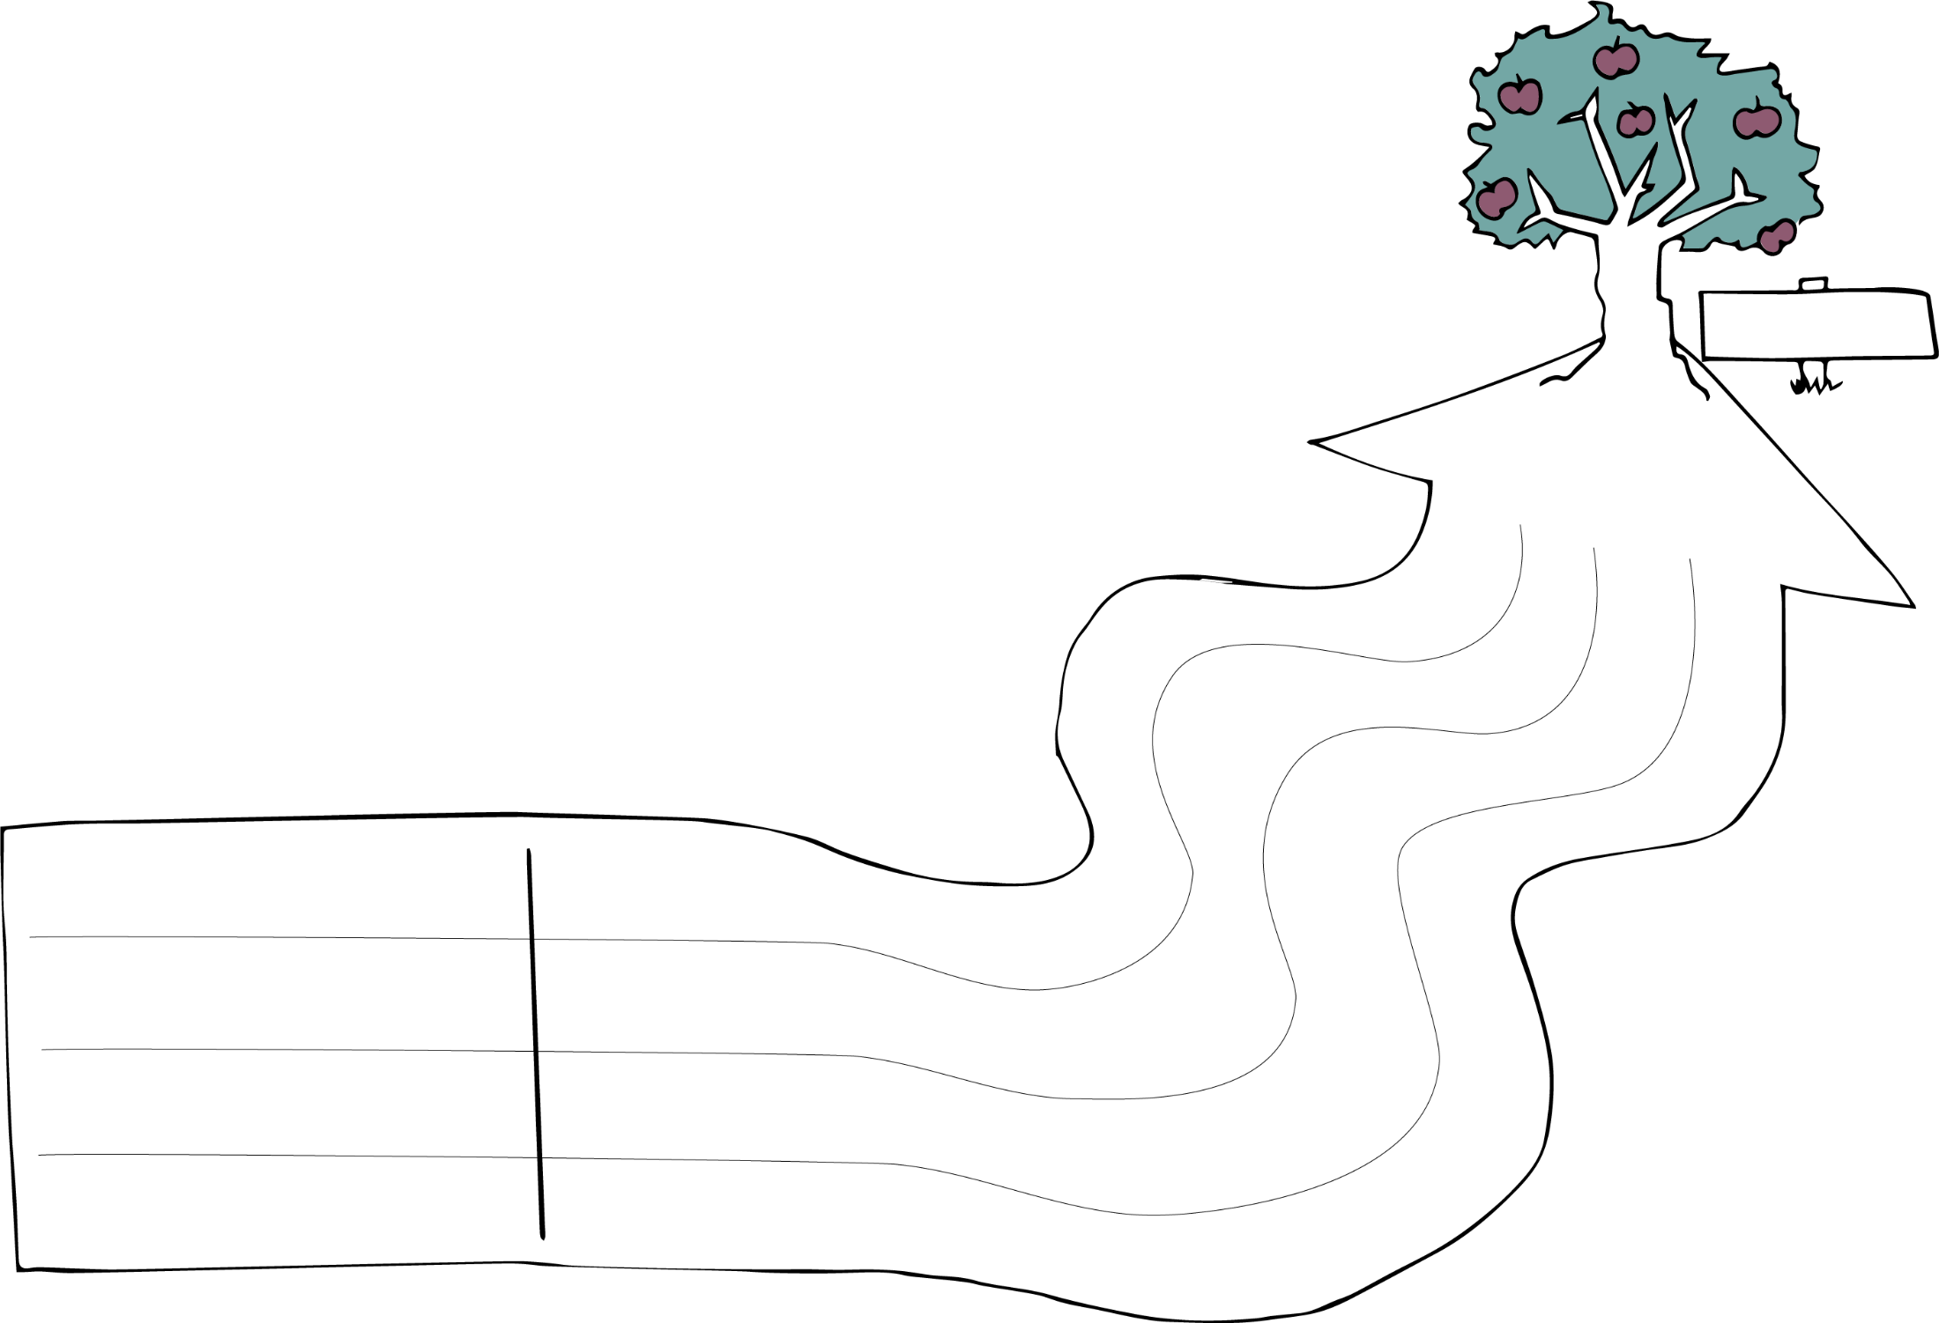
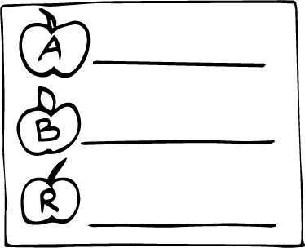
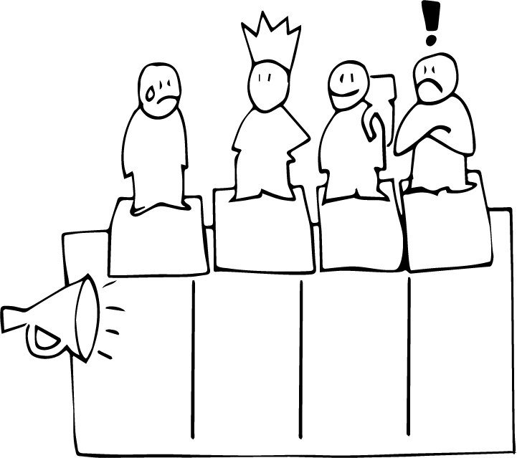
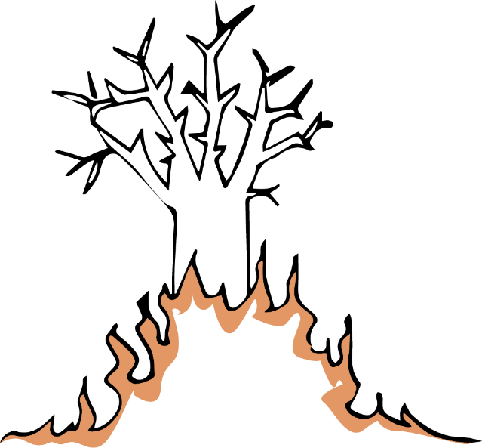
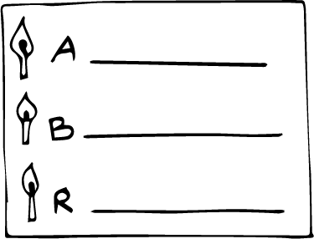
wmf.a mßj¾;k .uk
wm ljqo@
ld, rduqj
wruqK
mKsjqvh
Wml%u
mshjr
m%Yakh
wjodkï
Notes:
iyNd.sjkakkag Tjqkaf.a zmßj¾;k .ukZ ;jÿrg;a isÿlrf.k hdu i|yd fmr ieisfha Tjqka isá Tjqkaf.a l%shdldÍ ie,iqï lKavdhï fj; kej; hk f,i Tjqkaf.ka b,a,d isákak' lKavdhï fï jk úg Wml%u iy .kq ,nk l%shdud¾.j, mshjr ms<sn| idlÉPd lr fkdue;s kï oeka ta flfrys wjOdkh fhduq lsÍug Tjqkaj Èßu;a lrkak' lKavdhï j,g ;j;a fldmuK ld,hla b;sßj ;sfí oehs mjikak'

Slide 4
iqNme;=ïæ
Notes:
iqNme;Su
ieish wjidkfha iqNme;Sï isÿlrk w;r;=r fuu ia,hsvh m%o¾Ykh lr ;nkak'

