Slide 1
cs;@u; kl;l khw;wKz;lhf;Feu;fSf;fhd gapw;rp newp

Slide 2
mku;T 9:
khw;wj;jpw;fhd vkJ gazk;
Notes:
FO Ntiy: khw;wj;jpw;fhd vkJ gazk; (njhlu;r;rp)
,g;gapw;rpapid mwpKfg;gLj;Jtjw;F 2-3 tiuahd ];iyLfisg; gad;gLj;Jq;fs;.
ghlj;jpd; ,Wjp mku;Tf;F midtiuAk; kPz;Lk; tuNtw;fpNwhk;. mtu;fs; vt;tsT Kf;fpa Ntiy nra;fpwhu;fs; vd;W nrhy;yp mtu;fis Cf;Ftpf;fTk;.

Slide 3
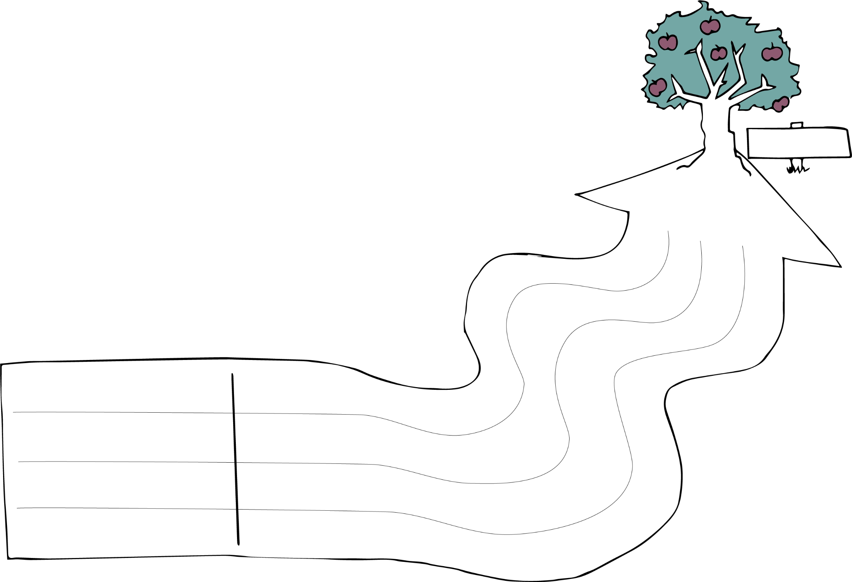
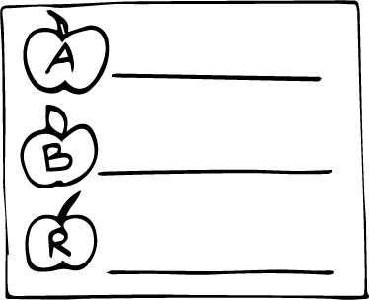
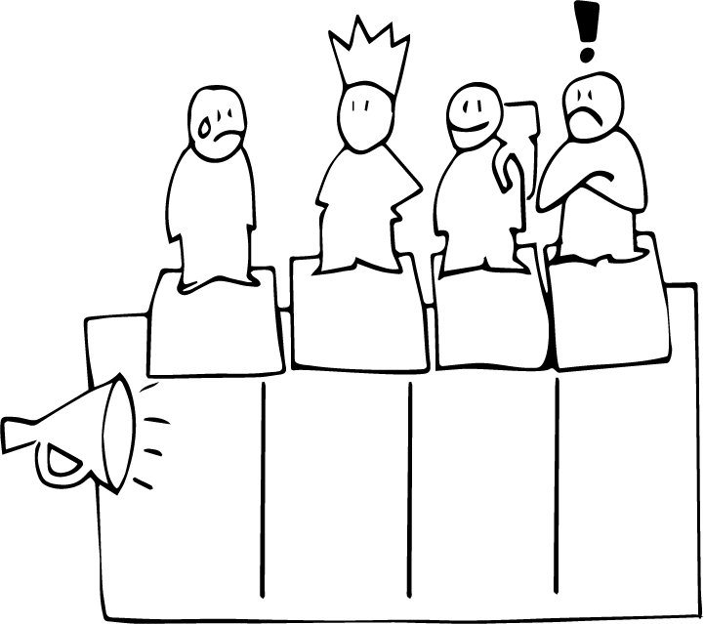
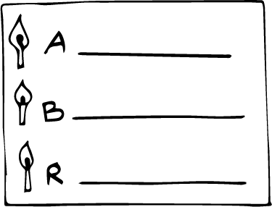
khw;wj;jpw;fhd vkJ gazk;
ehq;fs; ahu;?
mLj;j Mz;lstpy;
,yf;F
nra;jp
cj;jpfs;
gbKiwfs;
gpur;rid
mghaq;fs;
Notes:
gq;Nfw;ghsu;fis mtu;fspd; ‘khw;wg; gazj;jpy;’ njhlu;e;J gzpahw;w> Ke;ija mku;tpypUe;J mtu;fspd; nray; jpl;lkply; FOf;fSf;Fr; nry;y miof;fTk;. FOf;fs; ,ij Vw;fdNt njhlq;ftpy;iy vd;why;> ,g;NghJ cj;jpfs; kw;Wk; nray; gbfspy; ftdk; nrYj;j Cf;Ftpf;fTk;. FOf;fSf;F vt;tsT Neuk; ,Uf;fpwJ vd;W nrhy;Yq;fs;.

Slide 4
tho;j;Jf;fs;!
Notes:
nfhz;lhl;lk;
mku;tpd; ,Wjpapy; ,lk;ngWfpd;w nfhz;lhl;lj;jpd;NghJ ,e;j ];iybidf; fhl;rpg;gLj;Jq;fs;.

