Slide 1
Religious family/personal status laws in India

Slide 2
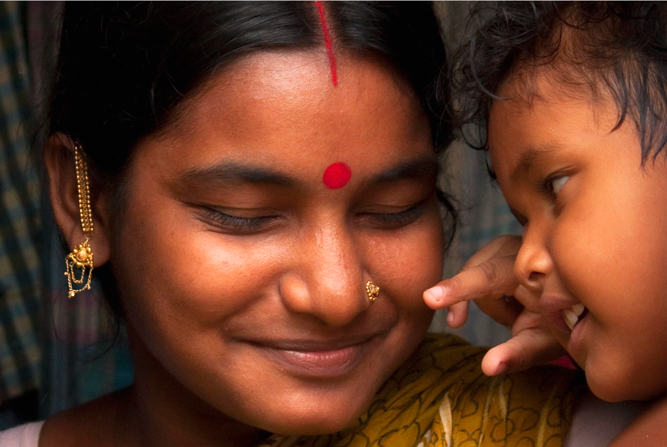
In India, Hindu family/personal status law has been extensively reformed, but there are still discriminatory provisions left in the legislation.
For example, according to the Hindu law, the father is the natural guardian of unmarried girls older than 5 years.
When daughters get married, the husband takes over the role as their guardians. Only if a child is born outside marriage, is the mother considered the guardian.

Slide 3
The family/personal status laws of the religious minorities have undergone fewer reforms than Hindu law. As a result, women in the minority communities continue to suffer from greater inequalities than Hindu women, increasing the discrimination based on both religion and gender.

Slide 4
There is however an optional civil law, the Special Marriage Act from 1954. This is for inter-religious or inter-caste marriages or for those who want a secular marriage. In this case, couples must give the district magistrate a 30-days' notice to give time for any legitimate objections to be raised. However, the information of the upcoming marriage is often leaked to extremist and right-wing groups who create unrest and threaten the couple.
Photo: R.M. Modi / Alamy Stock Photo

